Slide 1
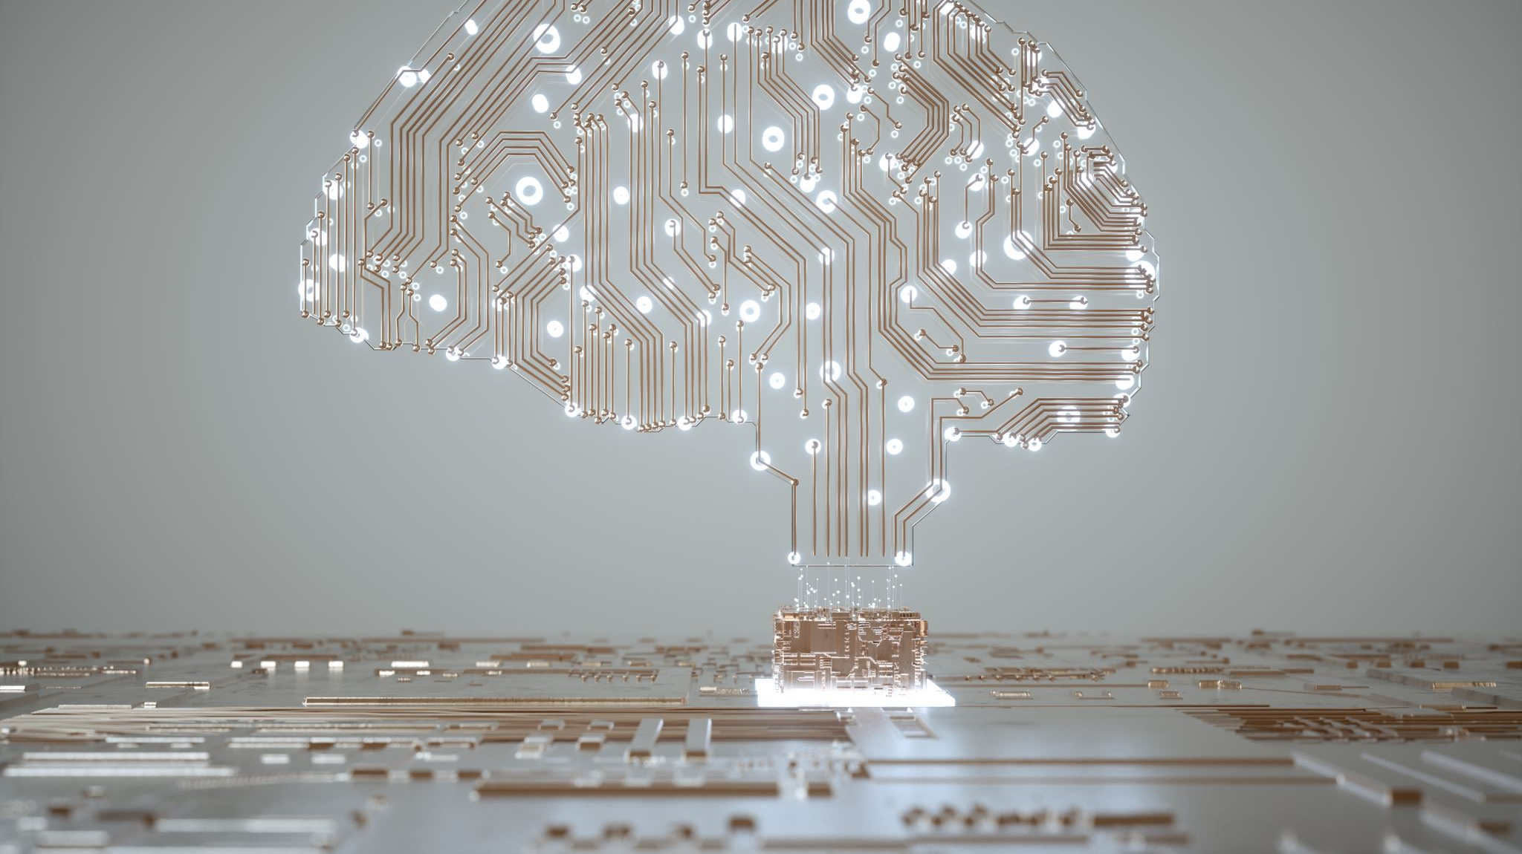
Artificial Intelligence

Slide 2
Artificial Intelligence
Artificial Intelligence is “behaviour of a machine which, if a human behaves in the same way, is considered intelligent”.
Simmons and Chappell (1988).
Notes:
Simmons, A.B. and Chappell, S.G., 1988. Artificial intelligence-definition and practice. IEEE journal of oceanic engineering, 13(2), pp.14-42.

Slide 3
Artificial Intelligence: Turing Test
What is the Turing Test?
The Turing Test is a concept introduced by computer scientist Alan Turing in 1950. It's a way to measure a machine's ability to exhibit intelligent behaviour indistinguishable from that of a human.
Notes:
Simmons, A.B. and Chappell, S.G., 1988. Artificial intelligence-definition and practice. IEEE journal of oceanic engineering, 13(2), pp.14-42.

Slide 4
Artificial Intelligence: Turing Test
Here's how it works:
A human judge has a conversation (usually through text) with two participants: one is a human, the other is a machine (like an AI).
The judge doesn't know which is which.
If the judge can't reliably tell which one is the machine and which one is the human based on their responses, the machine is said to have passed the Turing Test.
Notes:
Simmons, A.B. and Chappell, S.G., 1988. Artificial intelligence-definition and practice. IEEE journal of oceanic engineering, 13(2), pp.14-42.

Slide 5
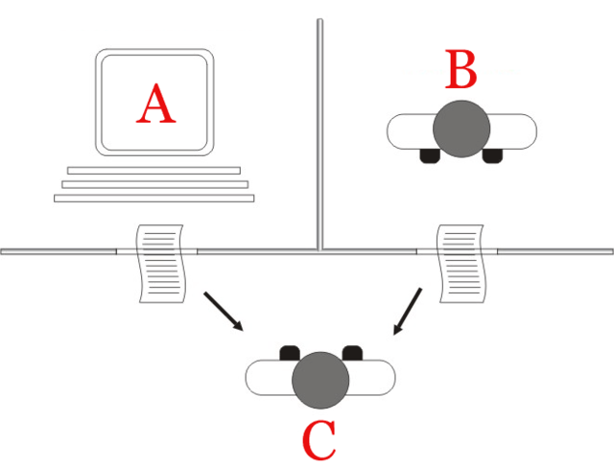
Artificial Intelligence: Turning Test

Slide 6
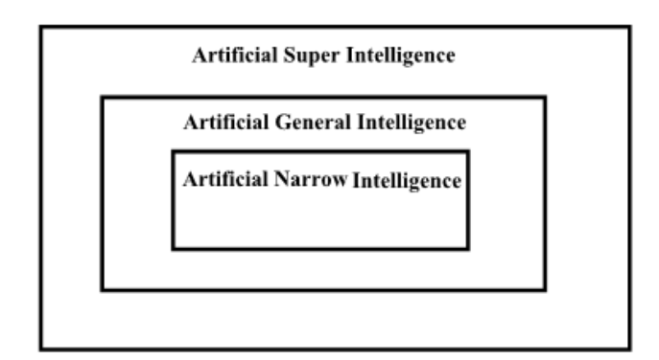
Artificial Intelligence

Slide 7
Artificial Intelligence
Two common approaches are:
Rule-Based Systems: Programs that make decisions or solves problems using a set of "if-then" rules. They were one of the earliest forms of artificial intelligence, especially popular in the 1970s and 80s.
Biologically-inspired Systems: Programs that are modelled after principles found in biology and nature. The idea is to mimic how natural systems solve complex problems—efficiently, adaptively, and often without central control.

Slide 8
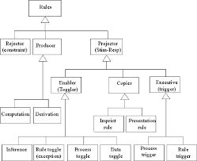
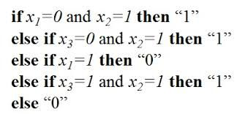
Artificial Intelligence
Rule-based Systems
e.g. Expert Systems

Slide 9
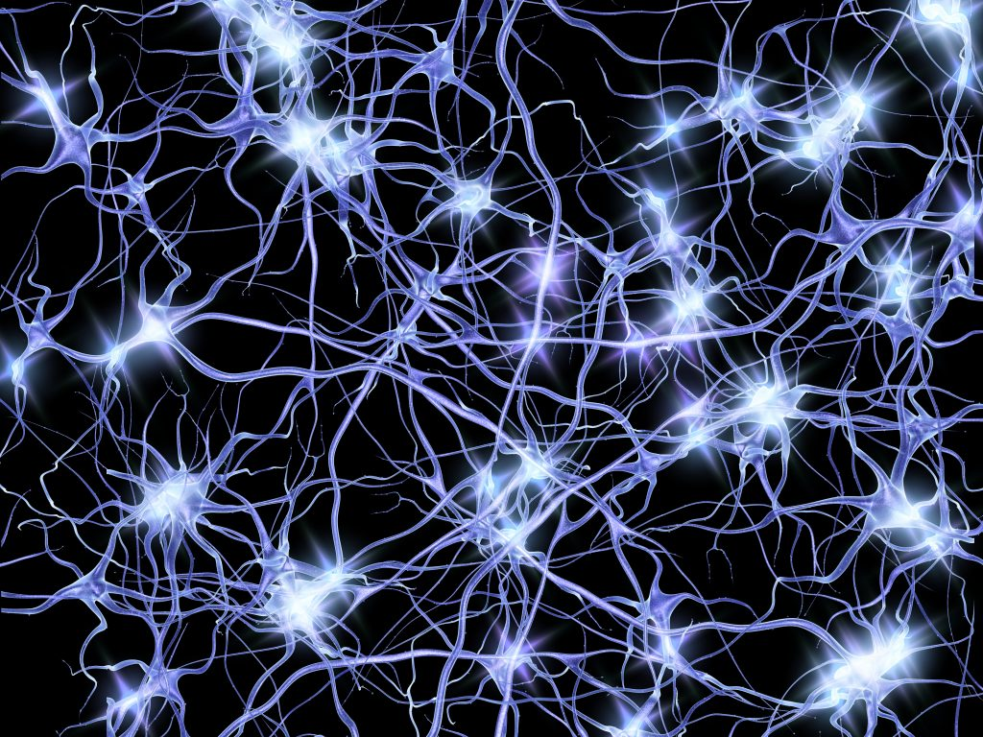
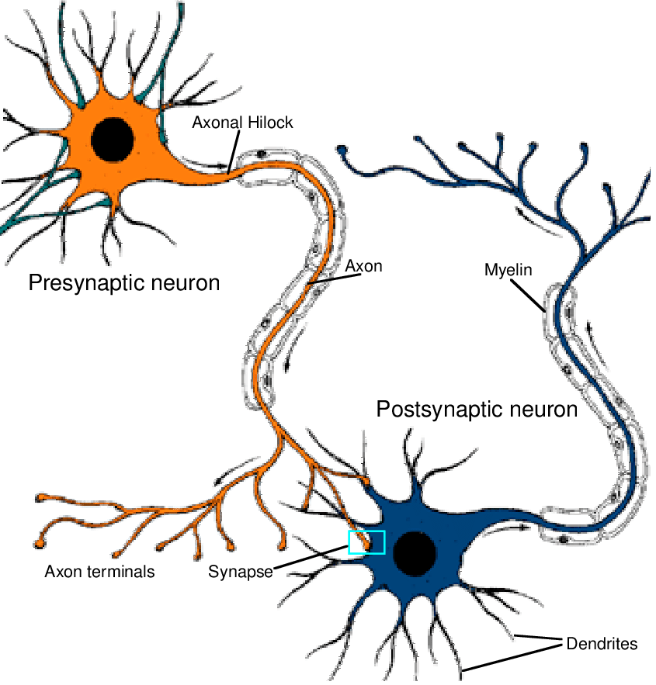
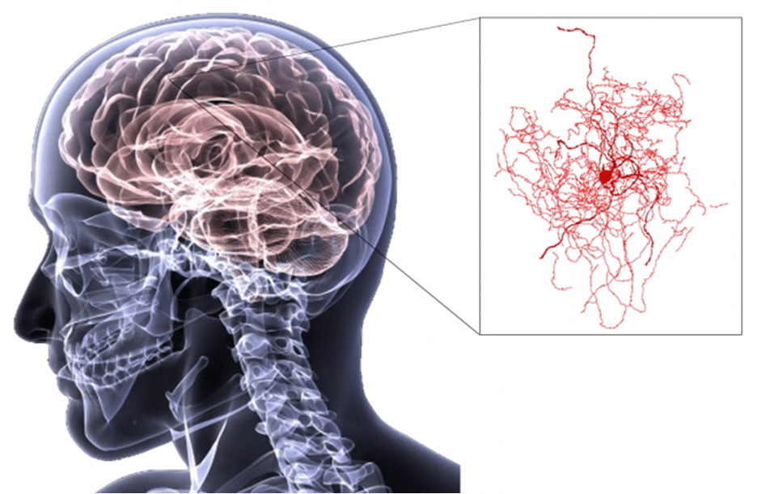
Artificial Intelligence
Biologically-inspired Systems

Slide 10
Artificial Intelligence
Biologically-inspired Systems
Neural Networks

Slide 11
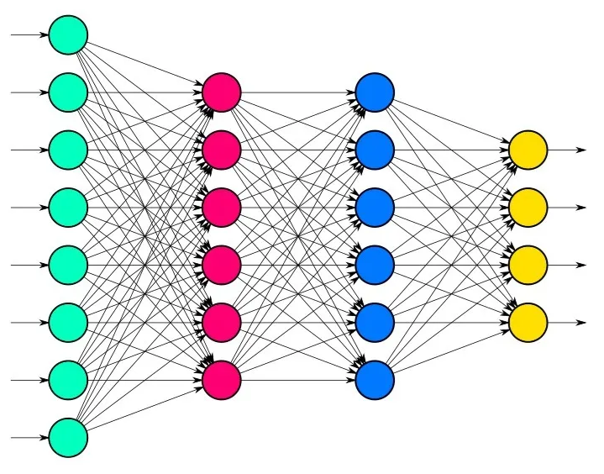
Artificial Intelligence
Artificial Neural Networks

Slide 12
Activity

Slide 13
Artificial Intelligence
ACTIVITY
In groups of 3-5 people
Consider how an AI system would classify fruits and vegetables.
What characteristics would it use, e.g. it could include colour (red, blue, yellow), size (small, medium, large), and weight (light, medium, heavy).
Pick three vegetables and three fruits, and classify them with characteristics that uniquely identify them.

Slide 14
Colour
Size
Weight

Slide 16
Artificial Intelligence
Machine
Learning
Natural
Language
Processing
Embodiment

Slide 17
Machine Learning

Slide 18
Artificial Intelligence: Machine Learning
Machine Learning is often defined as a “field of study that gives computers the ability to learn without being explicitly programmed”
Arthur Samuel (1959)
What this means is that it is AI techniques that focus on the use of data in learning.

Slide 19
Artificial Intelligence: Machine Learning
So what this means is that instead of defining all of the rules of a system, the machine learning approach just outlines the key rules to complete the overall goals of the system, and then the machine learning system uses suitable data to figure out its own set of rules.

Slide 20
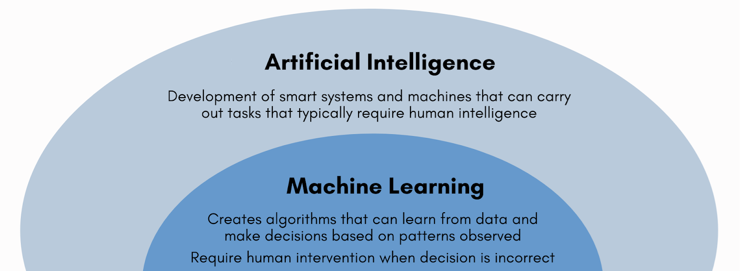

Slide 21
Labels

Slide 22
Artificial Intelligence: Machine Learning
The Datasets we use to train the machine learning system will be information about a specific topic.
We can add labels to each row in the data to make it easier for the machine learning system to understand what the system needs to learn.

Slide 23
Artificial Intelligence: Machine Learning
So, for example, if we had a dataset of credit card transactions, and some of the transactions are fraud, and the rest are legitimate transactions, it would be easier for the machine learning system to figure out which are bad, if we labelled them:

Slide 24
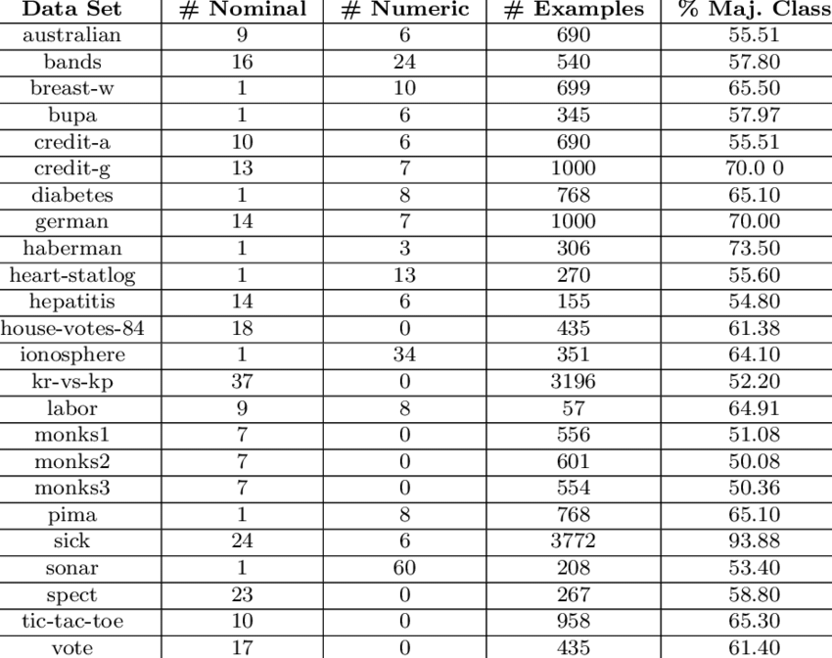
Artificial Intelligence: Machine Learning
Credit card transactions dataset:

Slide 25
Artificial Intelligence: Machine Learning
Credit card transactions dataset labelled:
NotFraud
NotFraud
Fraud
NotFraud
NotFraud
Fraud
Fraud
NotFraud
NotFraud

Slide 26
Artificial Intelligence: Machine Learning
When we have labelled data, we call it Supervised Learning, and if the data is unlabeled, it’s Unsupervised Learning.

Slide 27
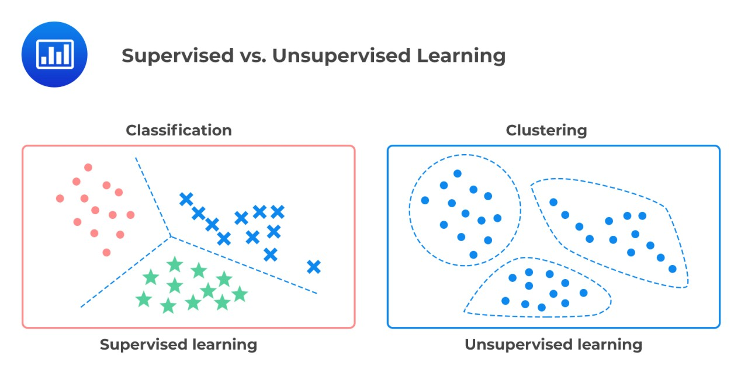
Artificial Intelligence: Machine Learning
If there are no labels we have to cluster the data
into the different relevant categories.

Slide 28
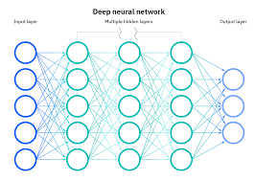
Artificial Intelligence: Machine Learning
Some Machine Learning models include:
Artificial Neural Nets
Deep Learning
Transformers

Slide 29
Timeline of Machine Learning
1957
1969
1982
1997
2017
Frank
Rosenblatt
invents
the
Perceptron
Minsky
And
Papert
Publish
"Perceptrons"
John Hopfield popularizes Hopfield networks
IBM's Deep Blue beats the world champion at chess
Google
invent the
Transformer
architecture

Slide 30
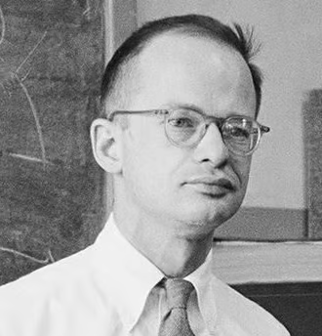
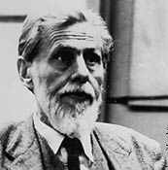
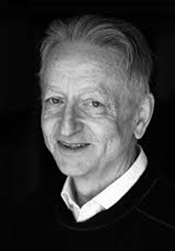
Some Famous Machine Learning Researchers
John J. Hopfield
Walter Pitts
Kate Crawford
Karen Hao
Warren McCulloch
Geoffrey E. Hinton

Slide 31
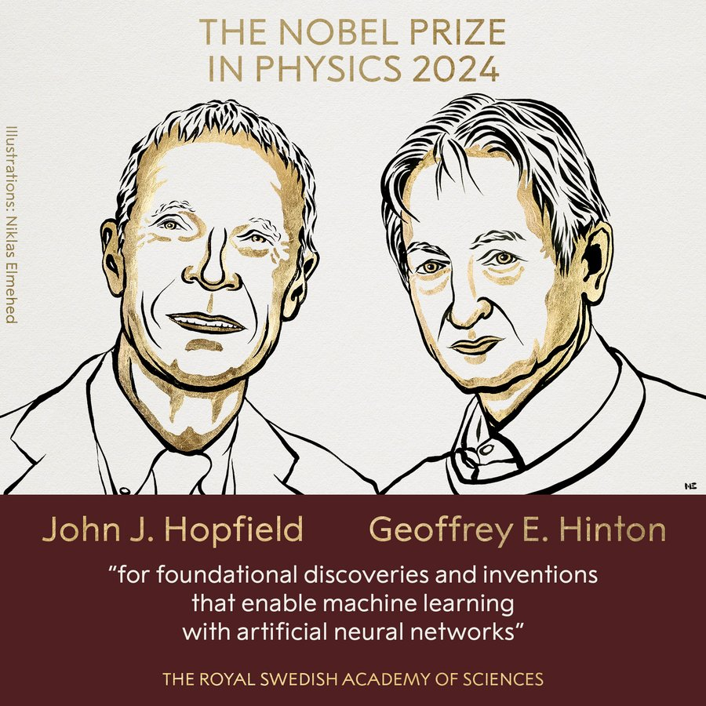

Slide 32
Natural Language Processing (NLP)

Slide 33
Artificial Intelligence: NLP
Natural Language Processing (NLP) is analyzing texts “for the purpose of achieving human-like language processing for a range of tasks or applications” - Liddy (2001)
Notes:
Liddy, E.D. 2001. Natural Language Processing. In Encyclopedia of Library and Information Science, 2nd Ed. NY. Marcel Decker, Inc.

Slide 34
Artificial Intelligence: NLP
Natural Language Processing (NLP) is used in things like:
Chat tools (like ChatGPT, Baird, etc.)
Computer-based Language Translation
Sentiment Analysis

Slide 35
Artificial Intelligence: NLP
Natural languages are the spoken and written languages that people use to communicate (e.g. English, French, Chinese, and Fijian), that have evolved, grown and changed over centuries.

Slide 36
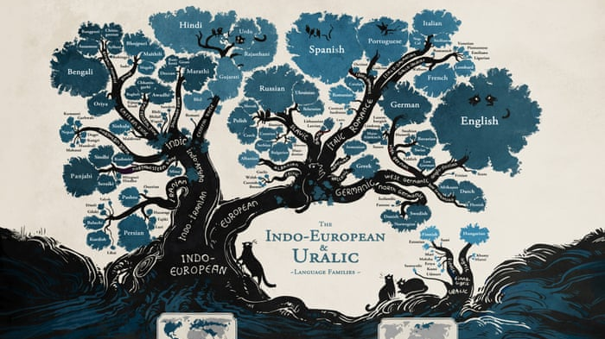
Notes:
https://www.youtube.com/watch?v=

Slide 37
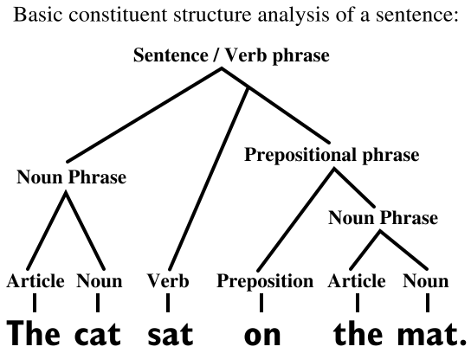
Artificial Intelligence: NLP

Slide 38
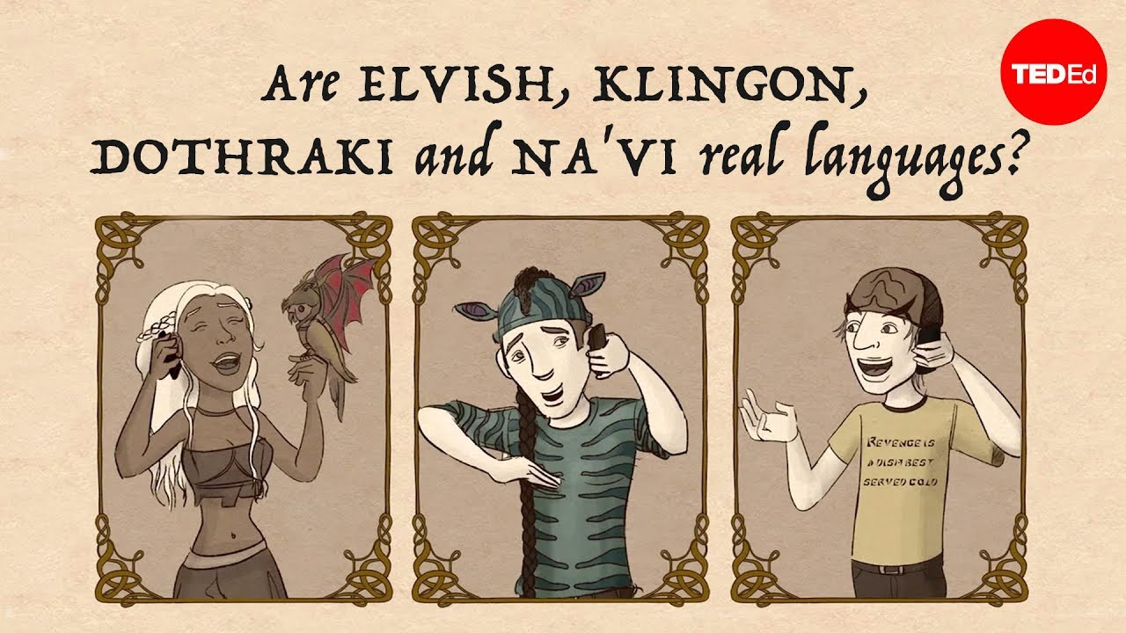
Notes:
https://www.youtube.com/watch?v=a5mZ0R3h8m0

Slide 39
Artificial Intelligence: NLP
Frequency of Letters:
E, T, A, O, I, N, S, H, R, D, L, C, U, M, W, F, G, Y, P, B, V, K, J, X, Q, Z

Slide 40
Artificial Intelligence: NLP

Slide 41
Artificial Intelligence: NLP

Slide 42
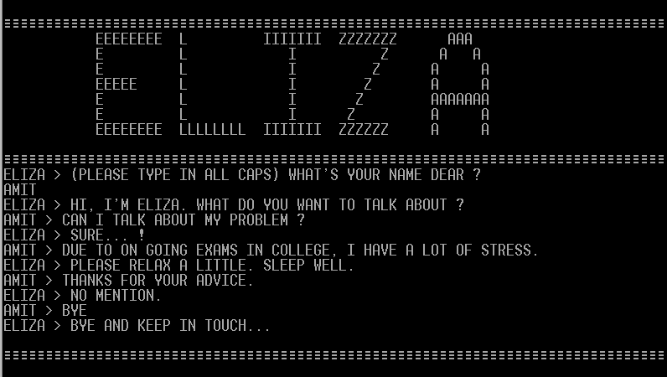

Slide 43
1966

Slide 44
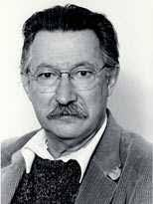
1966

Slide 46
Artificial Intelligence: NLP
Linguistic Relativity: Sapir–Whorf hypothesis and Whorf-Sapir hypothesis.
Linguistic relativity asserts that language influences worldview or cognition, and language determines thought and that linguistic categories limit and restrict cognitive categories.

Slide 47
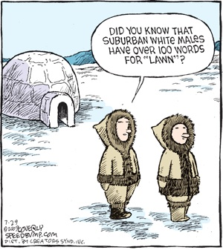

Slide 48
John Searle
American philosopher widely noted for contributions to the philosophy of language, philosophy of mind, and social philosophy
His notable concepts include the "Chinese room" argument against "strong" artificial intelligence.

Slide 49
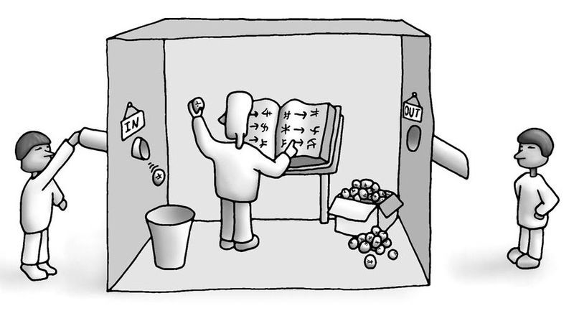

Slide 50
Rules and associations that ChatGPT has extracted from the millions of chats.

Slide 51
Rules and associations that ChatGPT has extracted from the millions of chats.
But it really doesn’t understand anything, it’s just pattern matching.

Slide 52
Artificial Intelligence
ACTIVITY
In groups of 3-5 people
Pick a theme for a chatbot (e.g. "Travel Assistant", "Movie Recommendation Bot", or "Fun Fact Bot“)
Spend 10 minutes writing pseudocode or a flowchart showing how your chatbot will respond based on different user inputs.

Slide 53
Timeline of NLP
1950
1957
1966
1966
2006
Automatic Language Processing Advisory Committee
Report
Creation
of the
Turing
Test
Noam
Chomsky
Publishes
“Syntactic
Structures”
Joseph Weizenbaum
develops
ELIZA
Google
launches the
Google
Translate
service

Slide 54
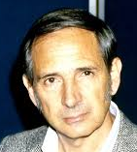
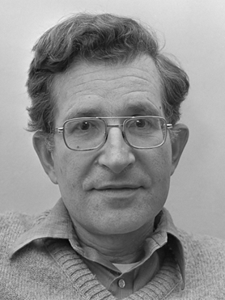
Some Famous NLP Researchers
John Searle
Emily M. Bender
Noam Chomsky
Joseph Weizenbaum
Andrew Ng
Fei-Fei Li

Slide 55
Embodiment

Slide 56
Artificial Intelligence: Embodiment
Embodiment is when AI systems are physically embodied in robots (or other physical systems), based on the idea that “cognition is constituted by body–world interactions” - Manzotti (2019)
In other words, true learning only occurs when an AI agent can interact with the world.
Notes:
Manzotti, R., 2019. Embodied AI beyond embodied cognition and enactivism. Philosophies, 4(3), p.39.

Slide 57
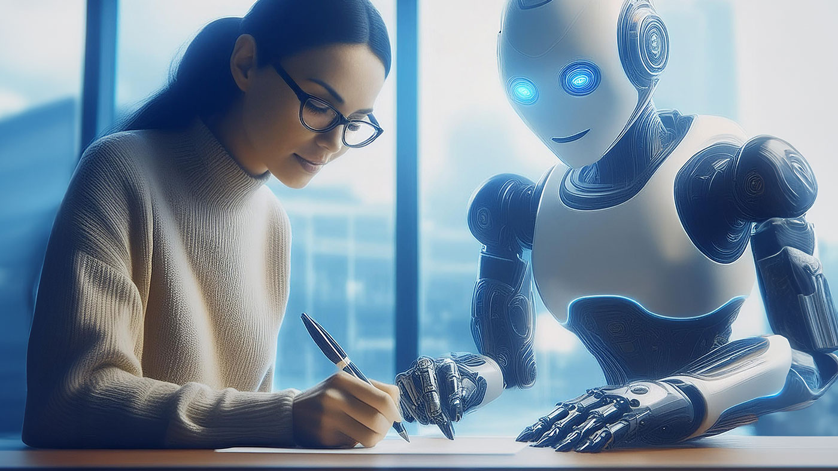

Slide 58
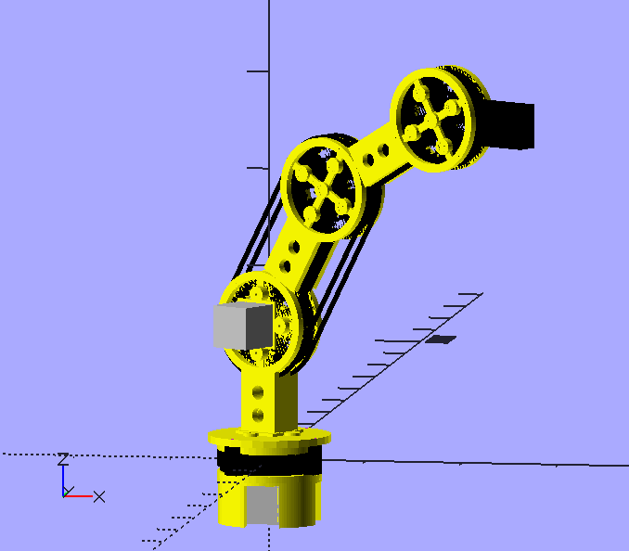
Artificial Intelligence: Embodiment
Teaching a robot to move an arm or a leg is surprisingly complicated and there is a whole branch of robotics devoted to it that uses 3D geometric equations to model movements, this is called Kinematics.

Slide 59
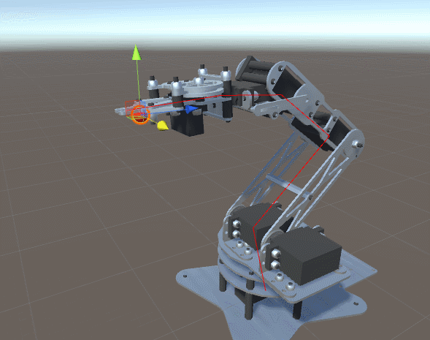
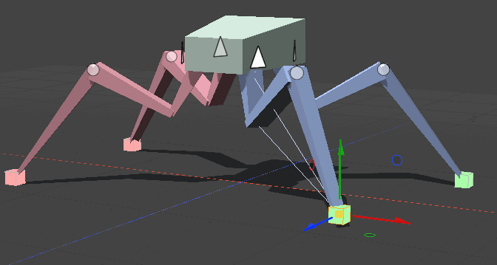
Artificial Intelligence: Embodiment
Kinematics

Slide 60
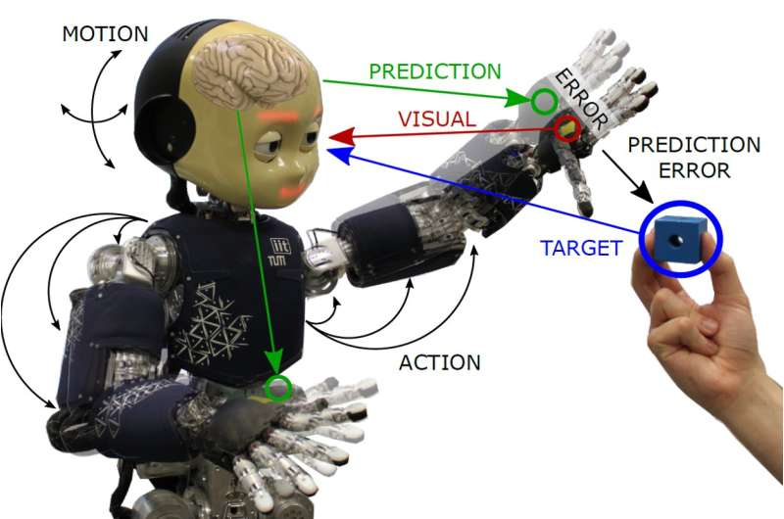
Artificial Intelligence: Embodiment
Robot perception is another exciting area in Embodiment, looking at giving robots human-like senses, including:
Vision
Hearing
Touch
Smell
Taste

Slide 61
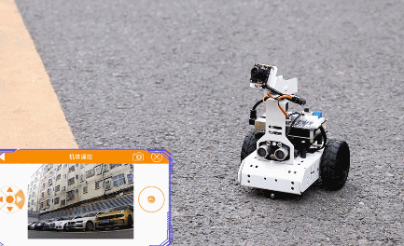
Artificial Intelligence: Embodiment
The most common sense to implement is vision which involves acquiring, processing, analyzing and understanding digital images, to help make decisions, like navigating.

Slide 62
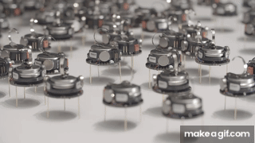
Artificial Intelligence: Embodiment
A different form of intelligence is through Swarm Robotics, where simple robotic agents interact locally with one another and with their environment, to lead to the emergence of intelligent global behaviour.

Slide 63
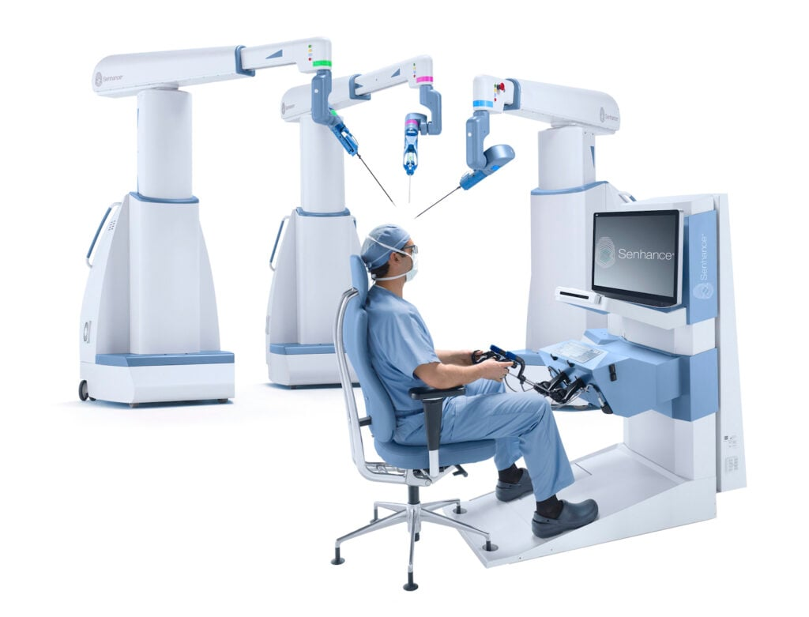
Artificial Intelligence: Embodiment
Robots can be combined with human intelligence using Teleoperation, which is remotely controlling robots, including applications in surgery, exploration, and hazardous environments.

Slide 64
Timeline of Embodiment
1921
1949
1972
2002
2005
Karel Čapek
coins the
term “Robot”
William
Grey Walter
builds a
navigating
robot
Introduction
of the
Robot vacuum
cleaner.
Introduction
of the
Self-driving
car
The First Robot to Use Artificial Intelligence

Slide 65
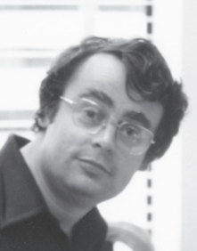
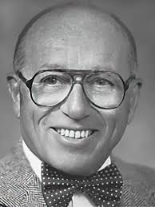
Some Famous Embodiment Researchers
Hao Zhang
David Marr
Cynthia Breazeal
John J. Leonard
Leslie P. Kaelbling
Joseph F. Engelberger

Slide 66
Artificial Intelligence

Slide 67
Artificial Intelligence
Knowledge Representation
Descriptive logic
Semantic networks
Probalistic reason
Fuzzy logic
Ontology engineering

Slide 68
Search Algorithms

Slide 69
Artificial Intelligence: Search Algorithms
If we were searching for one specific file in the heap of files here, where would we start? at the top? On the left side? On the right side?

Slide 70
Artificial Intelligence: Search Algorithms
What could we do to make the searching processing faster?

Slide 71
Artificial Intelligence: Search Algorithms
What could we do to make the searching processing faster?
SORT first, and
then SEARCH.

Slide 72
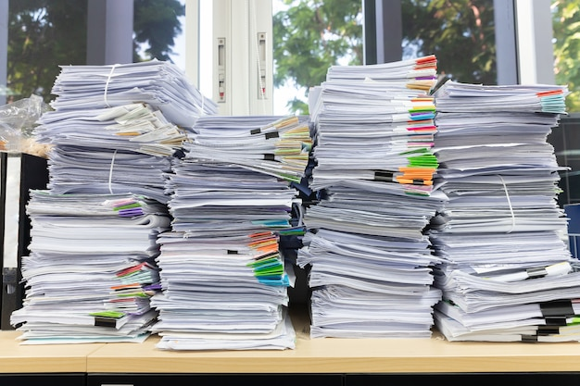
Artificial Intelligence: Search Algorithms
What could we do to make the searching processing faster?
SORT first, and
then SEARCH.

Slide 73
Artificial Intelligence: Search Algorithms
Is it worth taking the time to sort out the files first?
If you are going to be searching frequently in the heap it might be worth taking the time to sort it first.

Slide 74
Artificial Intelligence: Search Algorithms
Even if the files are sorted, there are still a number of ways to search the stacks. Start from the first column? Start at the last one? Start in the middle? etc.

Slide 75
Artificial Intelligence: Search Algorithms
The different possible approaches we can take to searching the heap can be called SEARCHING ALGORITHMS, and there are loads of them.

Slide 76
Artificial Intelligence
There are loads of Search Algorithms, including the following:
Depth-First Search
Breath-First Search
Uniform Cost Search
Greedy Search
A* Search
Graph Search

Slide 77
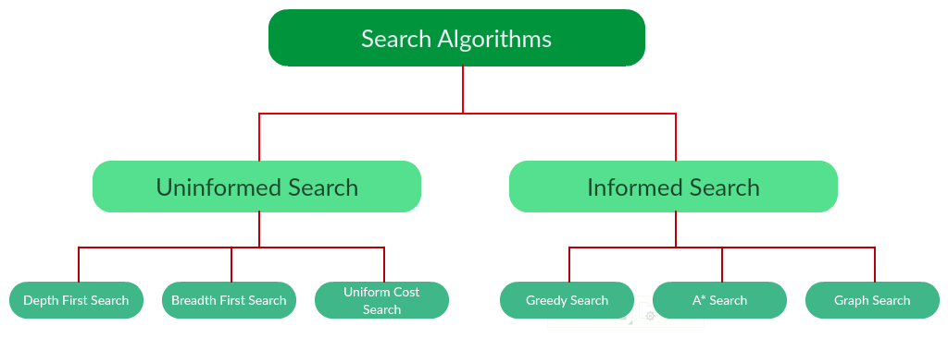
Artificial Intelligence
Notes:
https://www.geeksforgeeks.org/search-algorithms-in-ai/

Slide 78
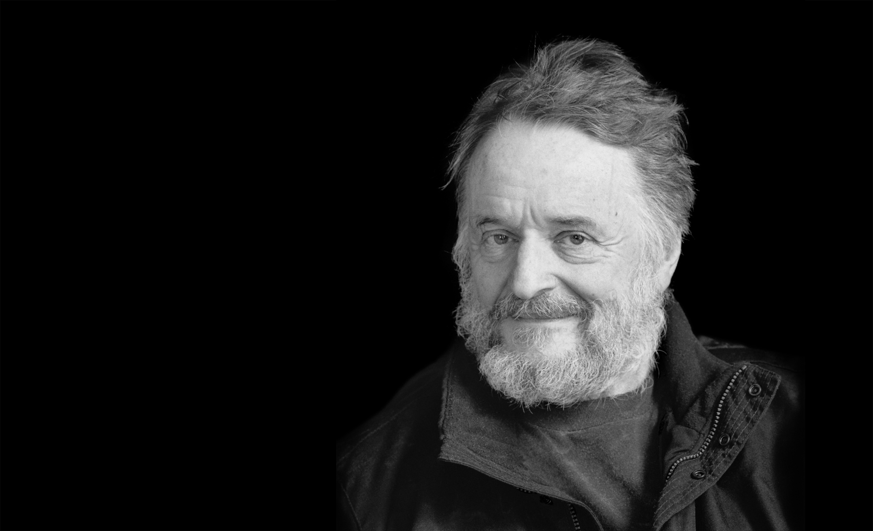
John Conway’s
Game of Life

Slide 79
Artificial Intelligence
Conway's Game of Life was devised by British mathematician John Conway in 1970. It's a zero-player game, meaning it evolves automatically based on its initial state without further input.
It simulates how cells (or units) in a grid live, die, or reproduce over time, following a set of simple rules.

Slide 80
Artificial Intelligence
The game evolves through "generations." For each generation, the following rules are applied to every cell in the grid:
Any live cell with fewer than two live neighbors dies (underpopulation).
Any live cell with two or three live neighbors survives to the next generation.
Any live cell with more than three live neighbors dies (overpopulation).
Any dead cell with exactly three live neighbors becomes a live cell (reproduction).
Neighbors refer to the eight cells surrounding any given cell (up, down, left, right, and diagonally).

Slide 82
Artificial Intelligence
Conway's Game of Life demonstrates how simple rules can lead to complex and emergent behavior.
The Game of Life explores concepts such as self-replication, emergence, and chaos vs. order, and has fascinated scientists, mathematicians, and computer enthusiasts for decades because even though it operates on simple rules, the patterns it generates can become very complex and unpredictable.

Slide 84
Artificial Intelligence
The AI Winters

Slide 85
Artificial Intelligence: The AI Winters
“AI Winters” refer to periods of time when there is a reduced interest and funding in AI research.
Part of the problem is that when new AI discoveries are made, they are sometimes over-hyped by the media and by investors, which can lead to unrealist expectations as to what these AI systems will actually be able to do.
This will ultimately lead to disappointment and criticism, followed by funding cuts.
Notes:
Crevier, Daniel (1993). AI: The Tumultuous Search for Artificial Intelligence. New York, NY: BasicBooks. ISBN 0-465-02997-3.

Slide 86
Timeline of AI Winters
1941
1956
1974
1980
1987
2000
Birth
of
Artificial
Intelligence
Dartmouth
Workshop
Start of
First
AI Winter
End of
First
AI Winter
Start of
Second
AI Winter
End of
Second
AI Winter

Slide 87
Artificial Intelligence: Setbacks
1960s
1966: USA - The ALPAC (Automatic Language Processing Advisory Committee) was established in 1964 by the United States government in order to evaluate the progress in computational linguistics, and in 1966 they issued a report that was very skeptical of research done in machine translation.
1969: USA - ALPAC chair, John Pierce from Dell, publishes an open letter called “Whither Speech Recognition?” that was critical of speech recognition research.
1969: USA - A famous book “Perceptrons” by Marvin Minsky and Seymour Papert showed that it was impossible for single-layer perceptrons to learn a simple logic function, an XOR function.

Slide 88
Artificial Intelligence: Setbacks
1970s
1973: UK - The Lighthill report is published. Written by James Lighthill for the British Science Research Council, it stated that “in no part of [AI] have the discoveries made so far produced the major impact that was then promised“.
1973-1974: USA - DARPA cut funding to academic AI research partially based on their frustration with the lack of progression from Carnegie Mellon University’s Speech Understanding Research program.

Slide 89
First AI Winter (1974 - 1980)

Slide 90
Artificial Intelligence: Setbacks
1980s
1987: USA - LISP Machines were developed by Richard Greenblatt and Thomas Knight in the 1970s, and they were computers that ran the programming language LISP, that was a favored programming language for artificial intelligence (AI) research. The market collapsed in 1987 due to lack of demand.
1987: USA – The US Department of Defense spent a total of $1 billion on a project Strategic Computing Initiative, whose goal was to fund research into advanced computer hardware and artificial intelligence, but by late 1987 it became clear that the project would not achieve many of its goals, so funding was halted.

Slide 91
Second AI Winter (1987 - 2000)

Slide 92
Artificial Intelligence: Setbacks
2000s
Rebranding “Artificial Intelligence”:
2005: John Markoff in the New York Times says: "At its low point, some computer scientists and software engineers avoided the term artificial intelligence for fear of being viewed as wild-eyed dreamers.“
2006: Patty Tascarella in the Pittsburgh Business Times: "Some believe the word 'robotics' actually carries a stigma that hurts a company's chances at funding."
2007: Alex Castro in The Economist: "[Investors] were put off by the term 'voice recognition' which, like 'artificial intelligence', is associated with systems that have all too often failed to live up to their promises."

Slide 93
Artificial Intelligence: Setbacks
2020s
The COVID-19 Virus:
The COVID-19 virus had a wide range of impacts, and in terms of AI research, a lot of researchers were locked down without access to there research machines and materials, so there was a significant fall in the number of publications of approximately 33% year on year from 2021 to 2023.
This was only the second instance in the history of AI research when publications fell by more than 20%, the first one occurring during the first AI winter. It wasn’t a full winter, but a snowstorm.

Slide 94
COVID-19 Snowstorm (2021 - 2023)

Slide 95
Artificial Intelligence: Setbacks
2020s
November 30th, 2022
The release of ChatGPT caused a reinvigoration in the interest of AI, not only in terms of research but also in terms of general interest by the public, as well as in terms of lots of investment.
ChatGPT and other generative AI systems easy to use by everyone, and therefore have ignited people’s interest and imagination in the use of AI.

Slide 96
… but remember …

Slide 97
* ALWAYS *

Slide 98
Timeline of Artificial Intelligence
1943
1949
1958
1969
1972
Warren
McCulloch
and Walter
Pitts publish
"A Logical
Calculus”
John
McCarthy
invents the
Lisp
programming
language
Alain
Colmerauer
invents the
Prolog programming language
Roger Schank defines the conceptual dependency model
Donald Hebb
develops an
algorithm
for ANNs

Slide 99
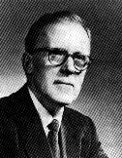
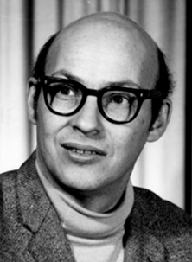
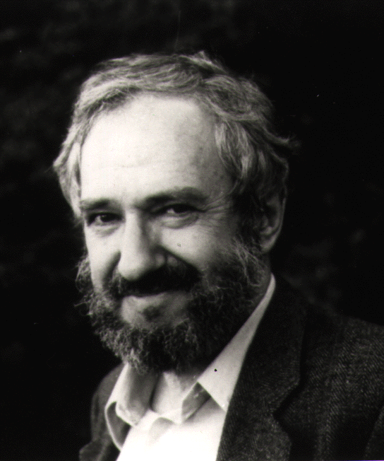
Some Famous Artificial Intelligence Researchers
Donald O. Hebb
Rodney Brooks
Candace Sidner
Marvin Minsky
Barbara J. Grosz
Seymour Papert

