Slide 1
History of Artificial Neural Networks
Damian Gordon

Slide 2
Contents
1943: McCulloch-Pitts Networks
1949: Hebbian Learning
1957: Perceptrons
1962: The Backpropagation Algorithm
1982: Hopfield Networks
1987: Adaptive Resonance Theory
1989: Convolutional Neural Network
1993: Recurrent Neural Networks
1997: Long Short-Term Memory Networks
2014: Generative Adversarial Networks

Slide 4
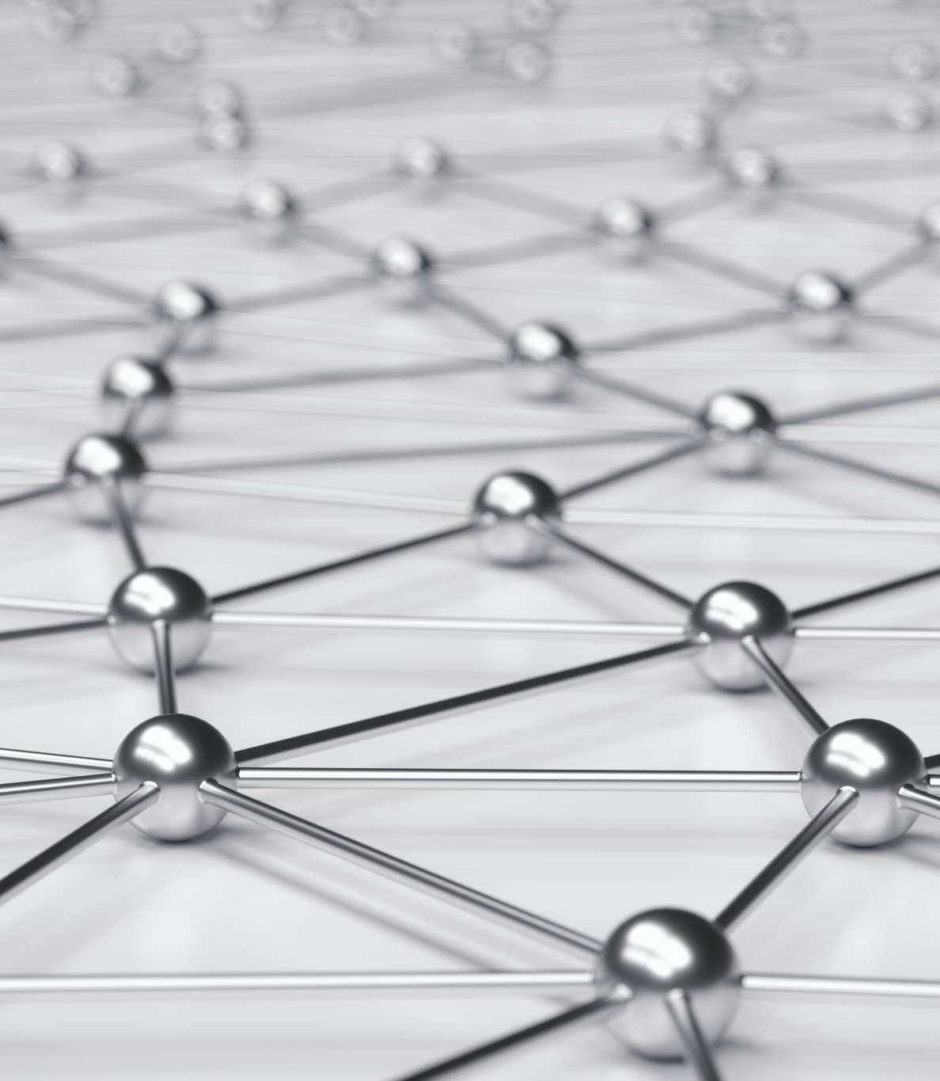
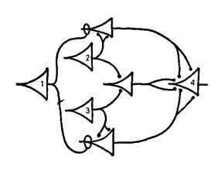
McCulloch-Pitts Networks

Slide 5
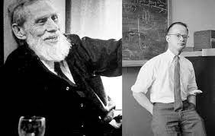
McCulloch-Pitts Networks
It all started off in 1943 when Warren McCulloch and Walter Pitts published a journal paper that studied several models of networks.

Slide 6
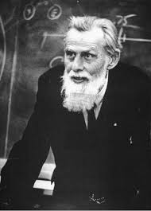
McCulloch-Pitts Networks
Warren McCulloch
Born: 16 November 1898
Orange, New Jersey, U.S.
Died: 24 September 1969
Cambridge, Mass., U.S.
An American neuropsychologist and cybernetician.

Slide 7
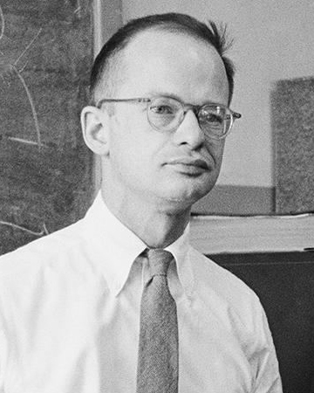
McCulloch-Pitts Networks
Walter Pitts
Born: April 23, 1923
Detroit, Michigan, U.S.
Died: May 14, 1969
Somewhere in the U.S.
An American logician who worked in the field of computational neuroscience

Slide 8
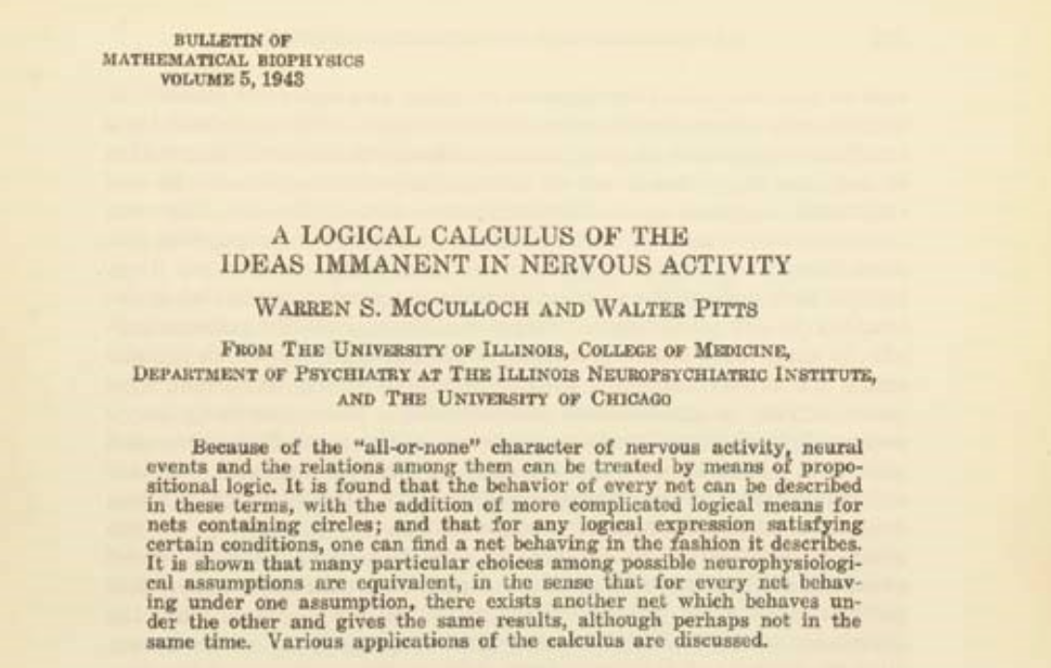

Slide 9
McCulloch-Pitts Networks
McCulloch, W.S., Pitts, W., 1943. “A Logical Calculus of the Ideas Immanent in Nervous Activity”. The Bulletin of Mathematical Biophysics, 5, pp.115-133.

Slide 10
McCulloch-Pitts Networks
In their paper they considered the question of whether the nervous system could be considered a kind of universal computing device.
Their work led to the development of two distinct fields of research:
Artificial neural networks
Computational neuroscience.

Slide 11
McCulloch-Pitts Networks
This paper presented the first mathematical model of a neural network, now referred to as the McCulloch-Pitts (M-P) neuron.
In it is described how networks of simple neurons could perform logical operations (AND, OR, NOT).
It also demonstrated that neural networks could, in theory, perform any computable function, making them Turing complete.

Slide 12
McCulloch-Pitts Networks
The paper also creates the foundations for Computational neuroscience. It argues that the brain can be modeled as a computational system, which is the basis of computational neuroscience.
This helped shape the connectionist view of cognition, which influenced cognitive science.

Slide 13
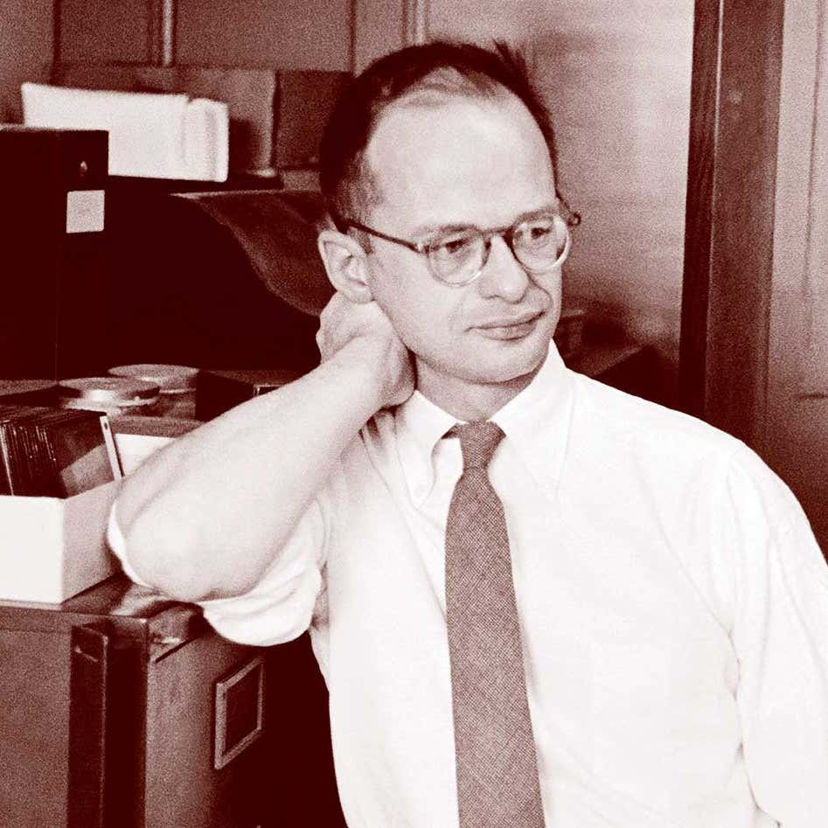
McCulloch-Pitts Networks
Before we move onto a new topic, I want to describe a little bit about the life of Walter Pitts.
He taught himself logic and mathematics as a child and became a proficient reader in several languages, including Greek and Latin.

Slide 14
McCulloch-Pitts Networks
At the age of 12 he sent a letter to Bertrand Russell pointing out what he considered serious problems in his works.
At age 15 he left home to study.

Slide 15
McCulloch-Pitts Networks
He was homeless and without income for several years, but during that time he was hanging around universities collaborating with some of the leading researchers in the US, who assumed he was a student.

Slide 16
McCulloch-Pitts Networks
In 1941 Warren McCulloch took a position as professor of psychiatry at the University of Illinois at Chicago, and in early 1942 he invited Pitts, who was still homeless, to live with his family.

Slide 17
McCulloch-Pitts Networks
In the evenings, McCulloch and Pitts considered the questions explored in their paper. After five years of unofficial studies, the University of Chicago awarded Pitts an Associate of Arts for his work on the paper.

Slide 18
McCulloch-Pitts Networks
In 1943, Pitts met Norbert Wiener at the Massachusetts Institute of Technology. At their first meeting, where they discussed Wiener's proof of the ergodic theorem, it went so well that Pitts moved to Greater Boston to work with Wiener.

Slide 19
Hebbian Learning

Slide 20
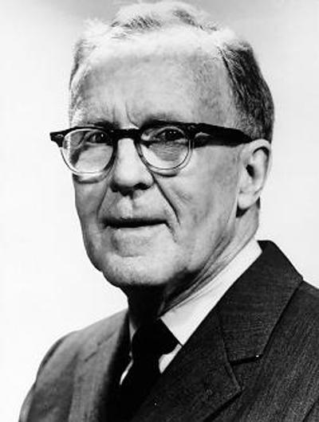
Hebbian Learning
Donald Hebb
Born: July 22, 1904 Chester, Nova Scotia, Canada
Died: August 20, 1985 Chester, Nova Scotia, Canada
A Canadian psychologist

Slide 21
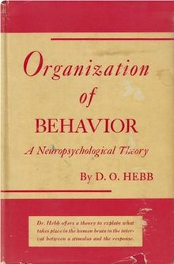
Hebbian Learning
In 1949 Donald Hebb published the book “Organization of Behavior” which discusses his findings after studying the brains of humans and animals.
Crucially his book attempts to explain how learning occurs based on a simple principle – the Hebb Rule.

Slide 22
Hebbian Learning
The Hebb Rule is stated in the book as follows:
“When an axon of cell A is near enough to excite cell B and repeatedly or persistently takes part in firing it, some growth process or metabolic change takes place in one or both cells such that A's efficiency, as one of the cells firing B, is increased.”
And is often summarized as follows:

Slide 23
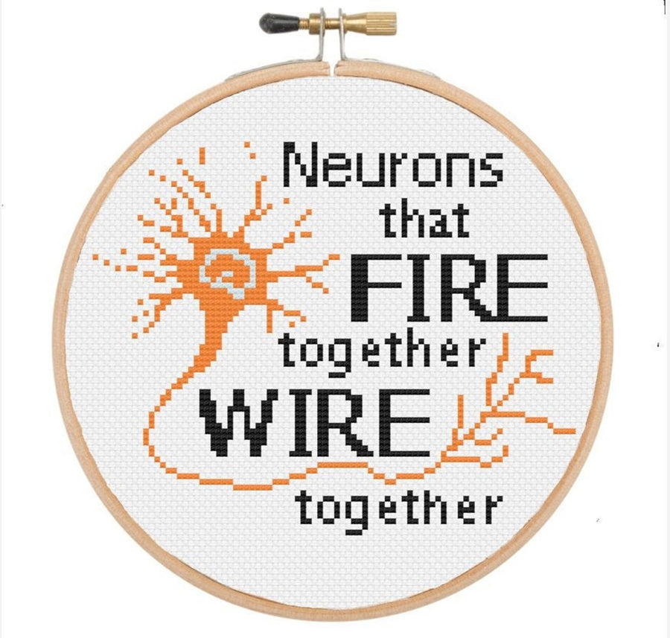
Hebbian Learning

Slide 24
Hebbian Learning
Hebb points out that the general idea was not new:
“The general idea is an old one, that any two cells or systems of cells that are repeatedly active at the same time will tend to become 'associated' so that activity in one facilitates activity in the other.”
However, he noted the importantly that his theory states:
“When one cell repeatedly assists in firing another, the axon of the first cell develops synaptic knobs (or enlarges them if they already exist) in contact with the soma of the second cell.”

Slide 25
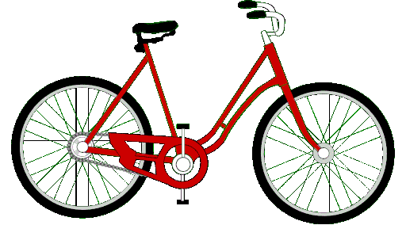
Hebbian Learning
Let’s consider the example of riding a bike:
1. At first, it’s tricky, you wobble, your legs struggle to pedal, and you might even fall a few times. Your brain is trying to control different factors, such as balancing, pedaling, and steering, all at the same time. Different groups of brain cells (neurons) are firing, but they’re not well connected yet.

Slide 26
Hebbian Learning
Let’s consider the example of riding a bike:
2. With practice you are getting better. Every time you try, the neurons controlling balance, pedaling, and steering will fire together. The connections between them get stronger, like a well-used path in a forest.

Slide 27
Hebbian Learning
Let’s consider the example of riding a bike:
3. After a while your brain will have built strong connections. Now, balancing, pedaling, and steering work together without you even thinking about it. You can just hop on a bike and go, and even if you don’t ride a bike for years, you never really forget.

Slide 28
Hebbian Learning
So, the key takeaway is:
Systems of cells that are repeatedly active at the same time will tend to become associated.

Slide 29
Perceptrons

Slide 30
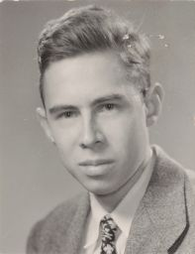
Perceptrons
Frank Rosenblatt
Born: July 11, 1928 New York, U.S.
Died: July 11, 1971 Chesapeake Bay
An American psychologist notable in the field of artificial intelligence.

Slide 31
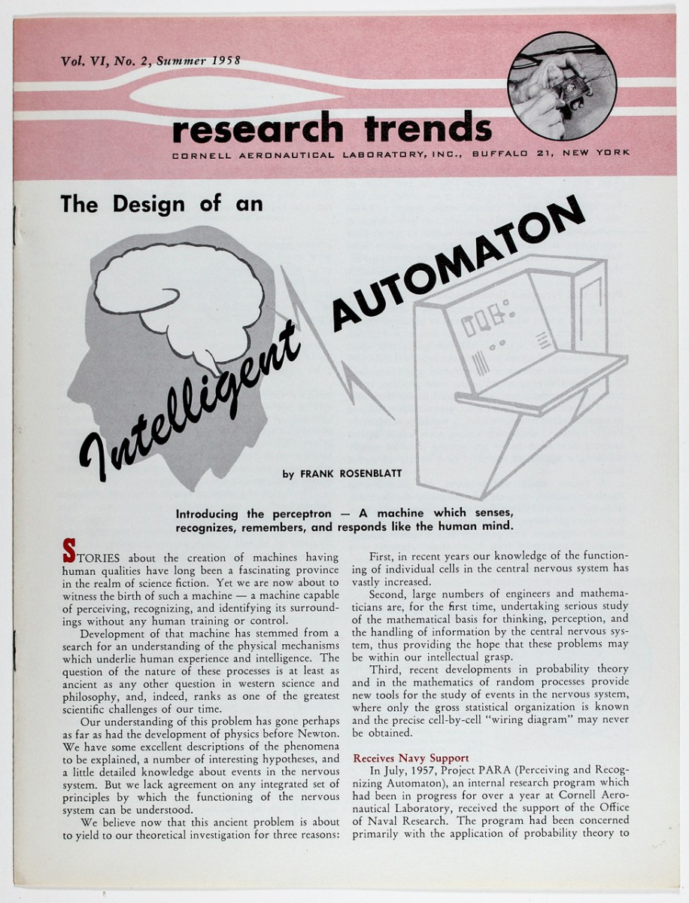
Perceptrons
In 1957 Frank Rosenblatt took the idea of the McCulloch-Pitts neuron, and expanded it into the idea of the perceptron. He made the following changes:

Slide 32
Perceptrons
Feature | McCulloch-Pitts Neuron | Perceptrons
Year | 1943 | 1957
Inputs | Only 1s and 0s | Any real number
Weights | Adds weights together | Multiplies them
Bias | No bias | Has a bias
Activation | Step-function | Step-function
Learning | Inflexible | Learning by adjusting weights
Can Solve | AND, OR, NOT | AND, OR, NOT

Slide 33
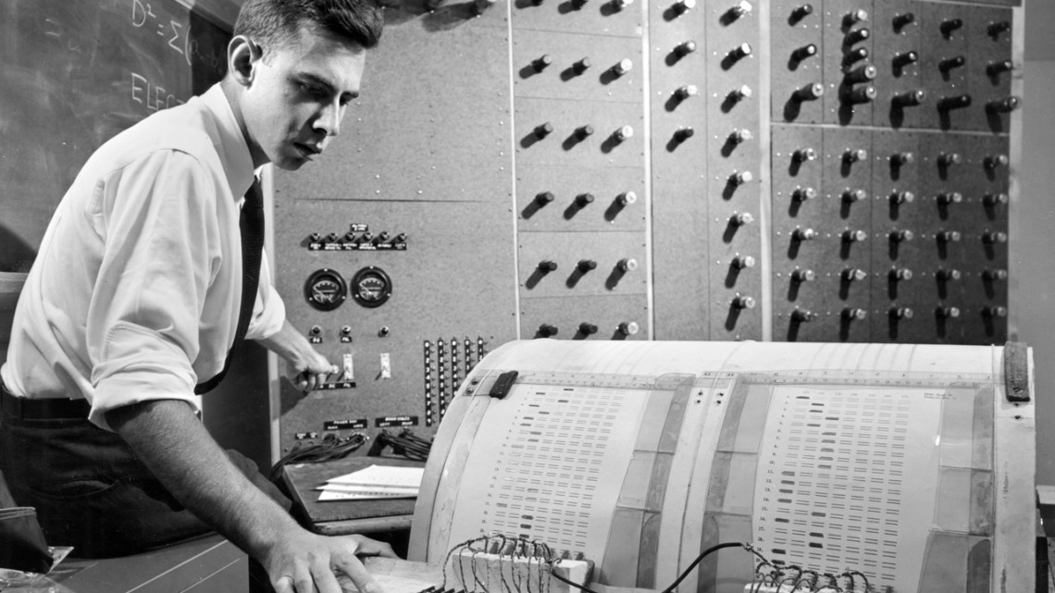

Slide 34
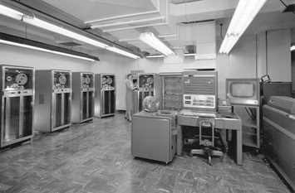
Perceptrons
Rosenblatt simulated the Perceptron on an IBM 704 computer at Cornell Aeronautical Laboratory in 1957.

Slide 35
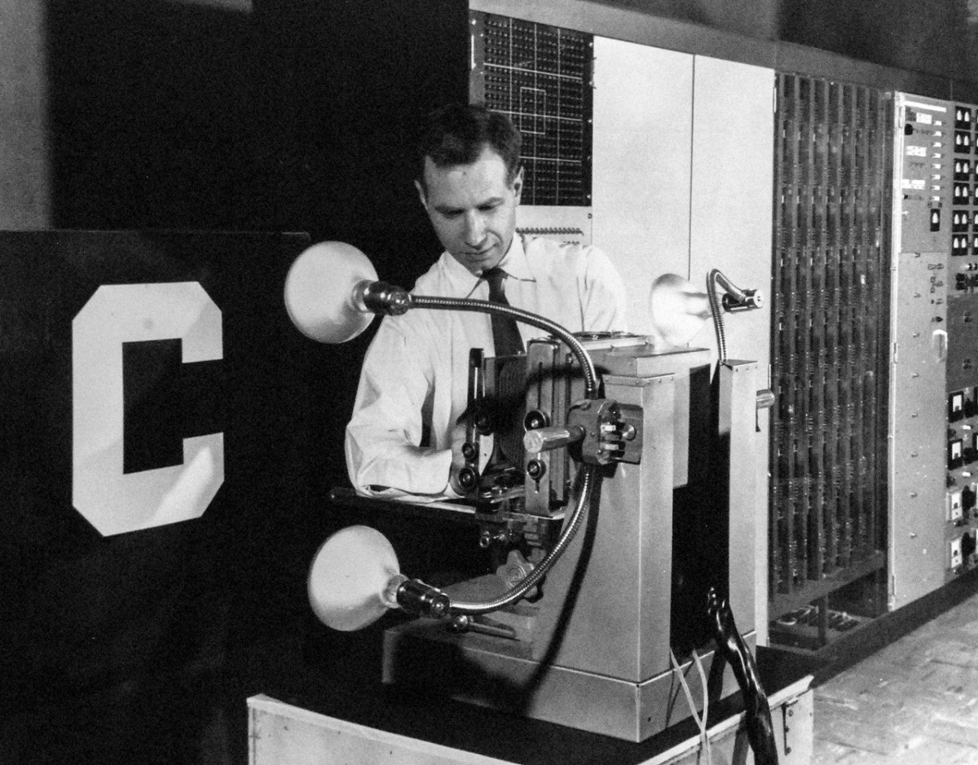
Perceptrons
When a triangle was held before the perceptron's eye, it would detect the image and convey it along a random succession of lines to the response units, where the image was registered.

Slide 36
Perceptrons
The results of the perceptron were promising, suggesting ways in which the human brain works, as well as how we might simulate that mechanism on a computer.
Rosenblatt was very optimistic about their potential, and claimed that neural nets would soon be able to see images, beat humans at chess, and reproduce.

Slide 37
Perceptrons
However, it was quickly recognized that perceptrons could not be trained to recognise several classes of patterns, including most famously, the XOR problem.
The key issue was that this design didn’t have any hidden layers (so it’s called a single-layer perceptron), and it would not be until the addition of hidden layers (a multilayer perceptron) that these issues could be addressed.

Slide 38
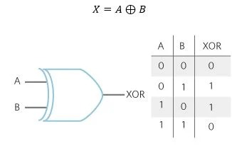
Perceptrons
XOR

Slide 39
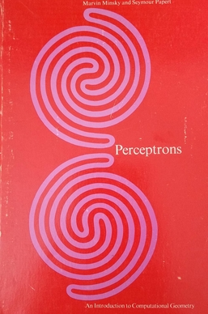
Perceptrons
In 1969, Marvin Minsky and Seymour Papert published a book, “Perceptrons”, wherein they showed the limitations of the perceptron architecture.
In it they proved that perceptrons could not be trained to recognise several classes of patterns.

Slide 40
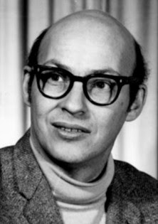
Perceptrons
Interestingly, Rosenblatt and Minsky knew each other since their youth, having studied with a one-year difference at the Bronx High School of Science. They became central figures of a debate inside the AI research community, and are known to have promoted loud discussions in conferences, yet remained friendly

Slide 41
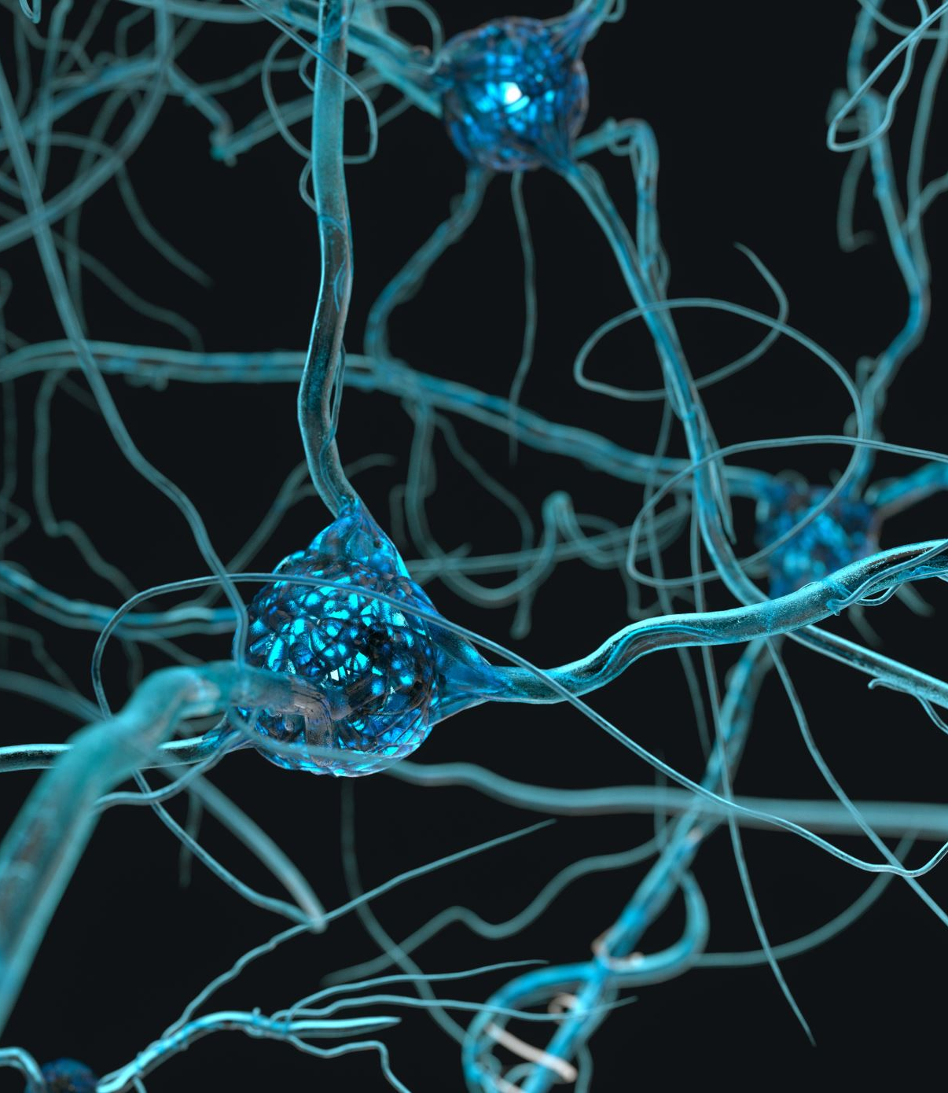
The Backpropagation Algorithm

Slide 42
The Backpropagation Algorithm
The Backpropagation algorithm is used in neural networks to help improve the accuracy of their results. There are three parts to the process:
The neural network guesses at the outputs
The difference between the guess and the expected output is calculated using a Mean Squared Error (or similar)
Backpropagation Step: The network calculates how much each neuron contributed to the error. The error is passed backward through the network. It finds which weights need to be adjusted and by how much.
The weights are adjusted using Gradient Descent. The network tries again, getting better each time.

Slide 43
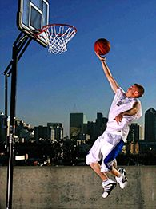
Backpropagation
Backpropagation is a lot like basketball:
You take a shot, so you guess how hard to throw the ball the first time.
You check if you made it, but if you missed, you figure out how wrong your shot was.
You adjust your next shot. If you threw too hard, next time you throw softer. If you threw too soft, next time you throw harder.
After many tries, you make fewer mistakes and hit the basket more often.

Slide 44
The Backpropagation Algorithm
Elements of Backpropagation have existed since at least 1676 when Gottfried Wilhelm Leibniz defined the chain rule (breaking down complicated problems into smaller, easier steps).
It wasn’t until 1962 that Stuart Dreyfus presented a clear mathematical description of backpropagation in the context of control theory.
Dreyfus, Stuart (1962). "The Numerical Solution of Variational Problems". Journal of Mathematical Analysis and Applications. 5 (1): 30–45.

Slide 45
The Backpropagation Algorithm
In 1970, Seppo Linnainmaa published a version of backprop as "reverse mode of automatic differentiation" for discrete connected networks of nested differentiable functions.
In 1982, Paul Werbos applied backpropagation to Multi-Layer Perceptrons in the way that has become standard.
Also in 1982, David E. Rumelhart independently developed an alternative version of backpropagation, but was unaware of previous work in the area. He published the algorithm first in a 1985 paper, then in a 1986 Nature paper an experimental analysis of the technique

Slide 46
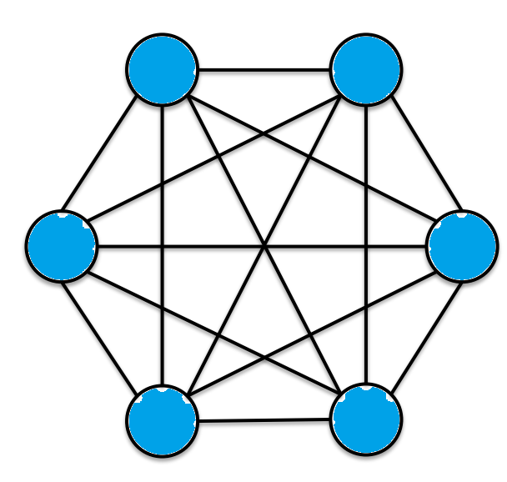
Hopfield Networks

Slide 47
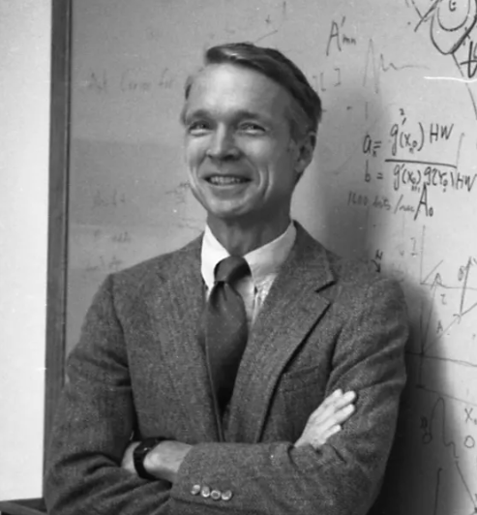
Hopfield Networks
John Hopfield
Born: July 15, 1933 Chicago, Illinois, U.S.
An American physicist and emeritus professor of Princeton University, most widely known for his study of associative neural networks in 1982

Slide 48
Hopfield Networks
The Hopfield network, named for John Hopfield, consists of a single layer of neurons, where each neuron is connected to every other neuron except itself. These connections are bidirectional and symmetric, meaning the weight of the connection from neuron In₁ to neuron In₂ is the same as the weight from neuron In₂ to neuron In₁. Patterns are associatively learned (or "stored") using Hebb’s Rule.

Slide 49
Hopfield Networks
One of the key features of Hopfield networks is their ability to recover complete patterns from partial or noisy inputs, making them robust in the face of incomplete or corrupted data.

Slide 50
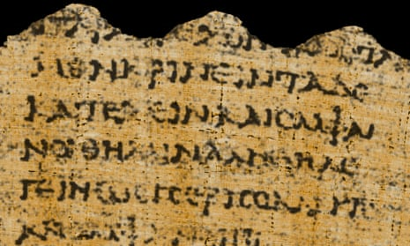
Hopfield Networks
So, we see them used to reconstruct corrupted or incomplete images, symbols, or text. As well as being used in Optical character recognition (OCR) systems.
original image (without noise), noisy image and the restored image

Slide 51
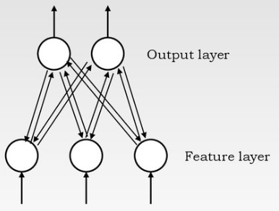
Adaptive Resonance Theory

Slide 52
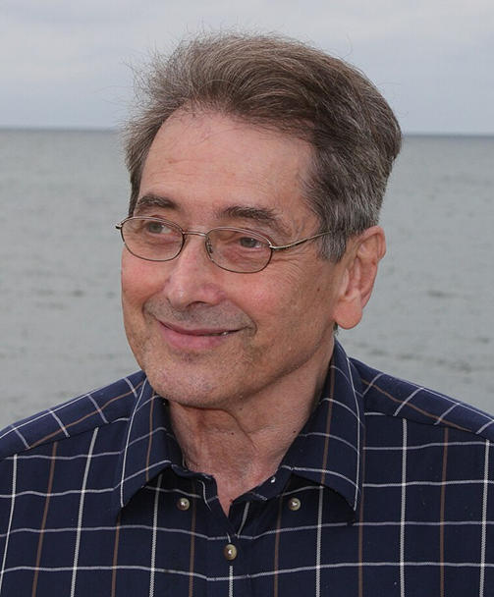
Adaptive Resonance Theory
Stephen Grossberg
Born: 31 December 1939 New York City, New York.
An American cognitive scientist, theoretical and computational psychologist, neuroscientist, and mathematician.

Slide 53
Adaptive Resonance Theory
Gail Carpenter
Born: 1948
New York City, New York.
An American cognitive scientist, neuroscientist and mathematician. She is now Professor Emerita of Mathematics and Statistics, Boston University.

Slide 54
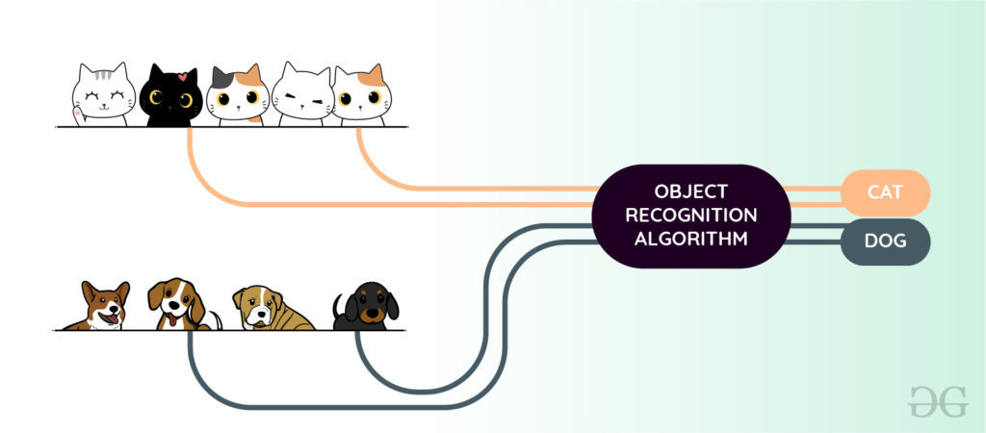
Adaptive Resonance Theory
Grossberg and Carpenter developed the adaptive resonance theory (ART). ART is a cognitive and neural theory of how the brain can quickly learn, and stably remember and recognize, objects and events.

Slide 55
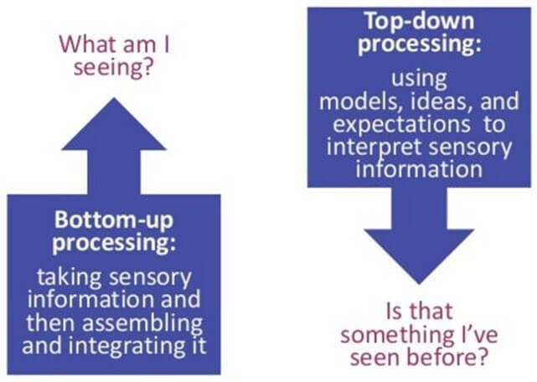
Adaptive Resonance Theory
The ART model is based on the notion that object identification and recognition generally occur as a result of the interaction of 'top-down' observer expectations with 'bottom-up' sensory information.

Slide 56
Adaptive Resonance Theory
The model proposes that 'top-down' expectations take the form of a memory template or prototype that is then compared with the actual features of an object as detected by the senses.
This comparison gives rise to a measure of category belongingness. As long as this difference between sensation and expectation does not exceed a set threshold called the 'vigilance parameter', the sensed object will be considered a member of the expected class.

Slide 57
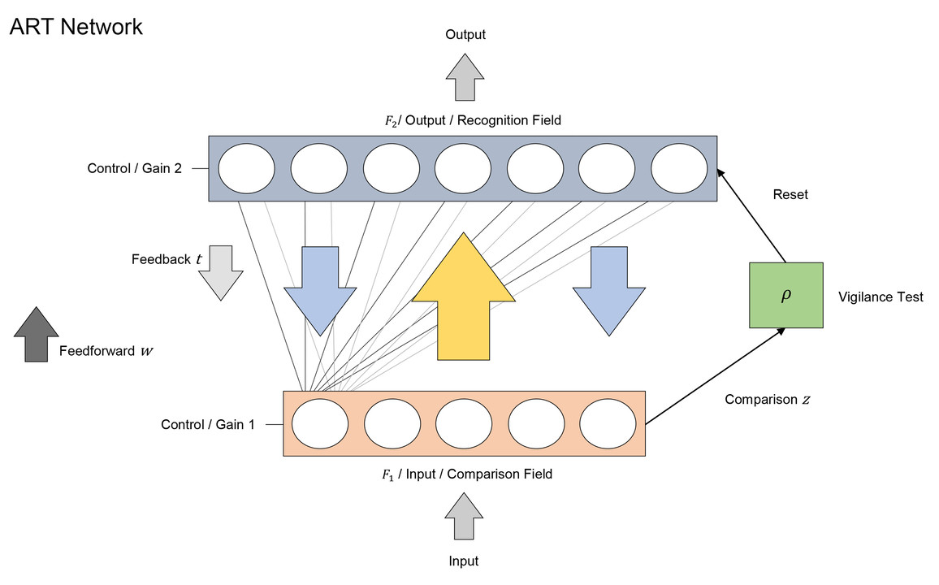

Slide 58
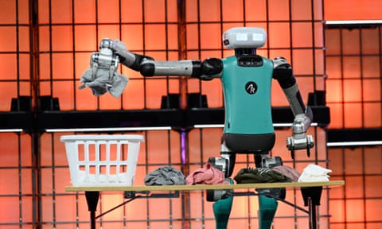

Slide 59
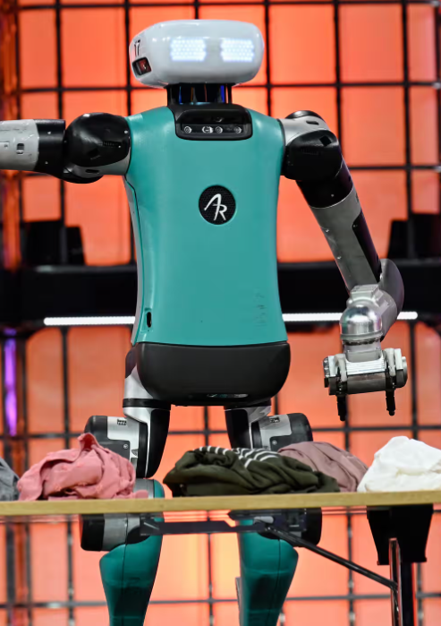
Adaptive Resonance Theory
ART is like having a sorting robot to sort clothes into different boxes. Every time you buy a new item of clothing, the robot checks if it looks like the clothing in any of the boxes. If it does, it puts it in the same box. If it looks very different, it creates a new box just for that item of clothing.

Slide 60
Adaptive Resonance Theory
The robot has the following features:
It remembers all the clothes it has seen before (it doesn't forget old ones).
It learns new clothes without messing up the old ones.
It doesn’t get confused easily if an item of clothing is slightly different (like a jacket with a different color).

Slide 61
Adaptive Resonance Theory
ART is used in applications such as:
Facial recognition
Optical Character Recognition
Detecting tumours or anomalies in X-rays and MRIs
Speech & Audio Processing Speech recognition
Genome sequencing
Fraud Detection
Cognitive & Neuroscience Research

Slide 62
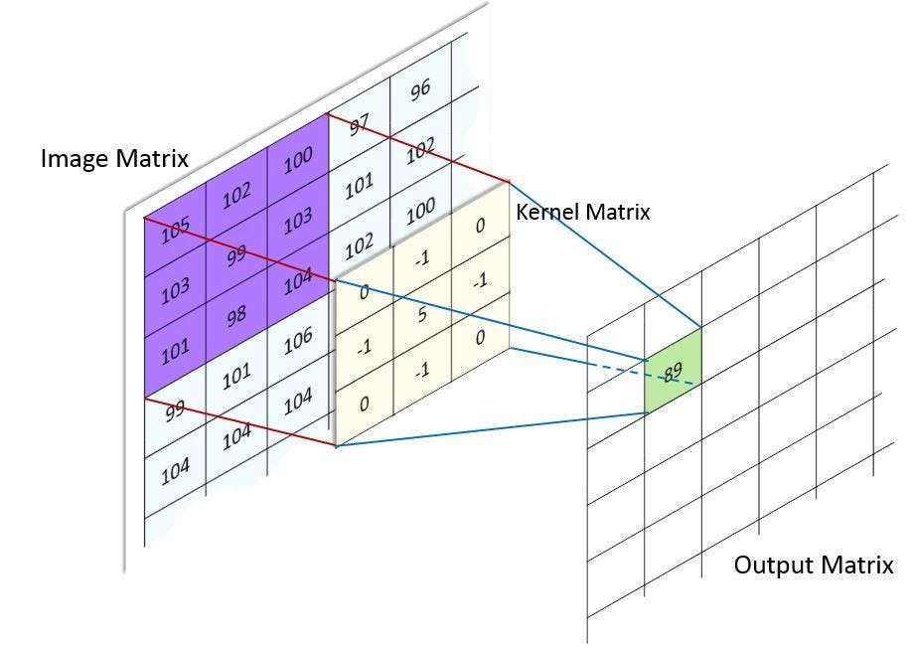
Convolutional Neural Networks

Slide 63
Convolutional Neural Networks
Convolution is a mathematical operation on two functions (let’s call them F₁and F₂) that produces a third function F₃
F₁ F₂ = F₃

Slide 64
Convolutional Neural Networks
For Convolutional Neural Networks, which focuses on image processing, it is often implemented as a matrix multiplication. Multiplying a large matrix (representing the image), by a smaller filter matrix (called the kernel) to enhance some of the features in the image.

Slide 66
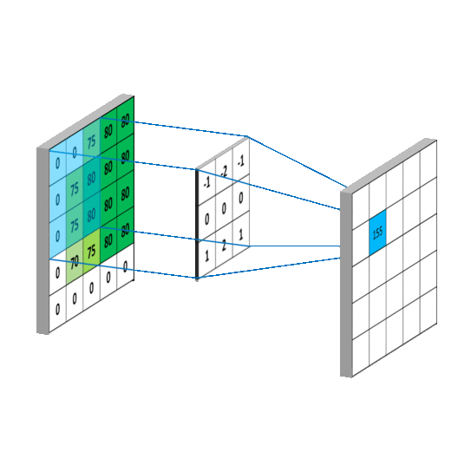

Slide 67
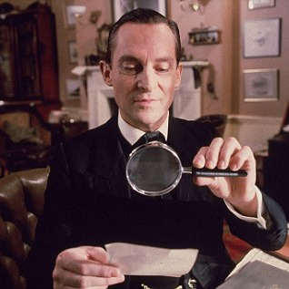
Convolutional Neural Networks
It’s like using a magnifying glass to examine small sections of the image instead of trying to understand the whole picture at once.

Slide 68
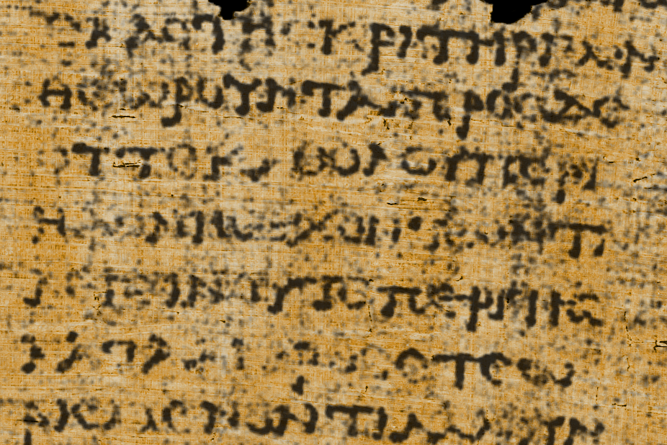

Slide 70
Convolutional Neural Networks
So the fours stages are:
Scanning Small Areas (Convolution Layer)
Finding Important Details (Feature Extraction)
Combining the Details (Pooling Layer)
Making a Decision (Fully Connected Layer)

Slide 71
Convolutional Neural Networks
Scanning Small Areas (Convolution Layer): Just like your magnifying glass moves over different parts of the image, a CNN slides a kernel over the image to detect patterns. At first, it might detect simple things like edges and corners.
Finding Important Details (Feature Extraction): As the CNN scans more areas, it starts to recognize shapes like circles, lines, or textures.
Combining the Details (Pooling Layer): You don’t need to remember every single tiny detail, just the important ones! A CNN does the same thing using Pooling, where it keeps the strongest signals and ignores unnecessary details (like shadows or background noise).
Making a Decision (Fully Connected Layer): After scanning the whole image, the CNN puts together everything it found.

Slide 72
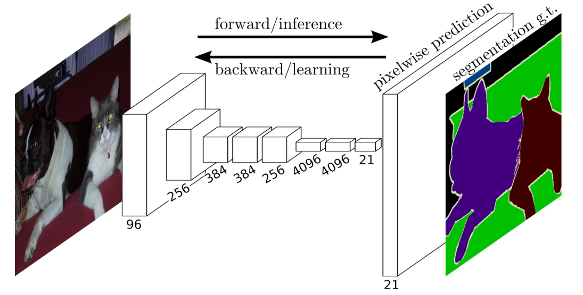

Slide 73
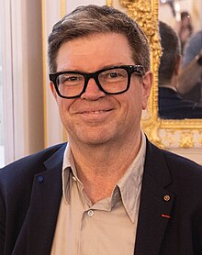
Convolutional Neural Networks
Yann LeCun
Born: 8 July 1960
Soisy-sous-Montmorency, France
A French-American computer scientist working primarily in the fields of machine learning, computer vision, mobile robotics and computational neuroscience. He is known for his work on CNNs.

Slide 74
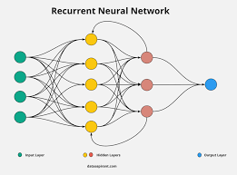
Recurrent Neural Networks

Slide 75
Recurrent Neural Networks
A Recurrent Neural Network (RNN) is a type of artificial neural network designed for sequential data.
Unlike traditional feedforward neural networks, RNNs have loops that allow information to persist, making them well-suited for tasks where previous inputs influence future outputs.

Slide 76
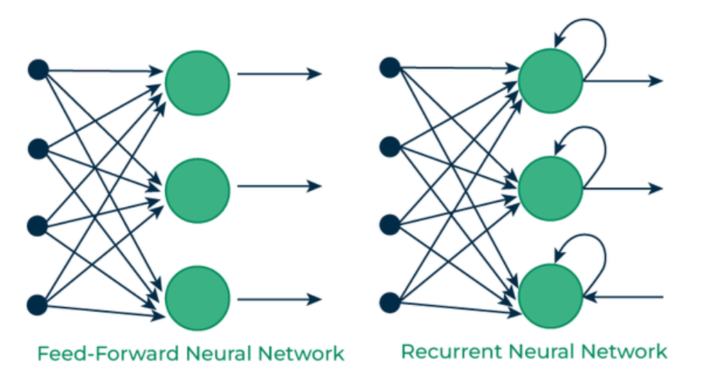

Slide 77
Recurrent Neural Networks
Key Features of RNNs:
Memory of Past Inputs: RNNs have connections that allow information from previous time steps to be used in the current time step.
Shared Weights: The same weights are used across different time steps, reducing the number of parameters compared to fully connected networks.
Sequential Processing: RNNs process input data step by step, making them ideal for time series, speech recognition, and natural language processing.

Slide 78
Recurrent Neural Networks
Applications of RNNs:
Natural Language Processing (NLP): Text generation, machine translation, sentiment analysis.
Speech Recognition: Transcribing spoken language into text.
Time Series Forecasting: Stock market prediction, weather forecasting.
Music Generation: Creating sequences of musical notes.

Slide 79
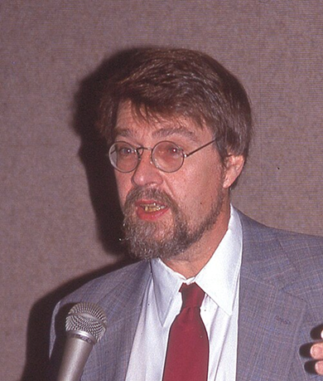
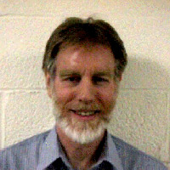
Recurrent Neural Networks
Recurrent Neural Networks (RNNs) were introduced by David Rumelhart and Ronald J. Williams in the 1980s. They developed the Backpropagation Through Time (BPTT) algorithm, which is used to train RNNs by adjusting weights based on past inputs.

Slide 80
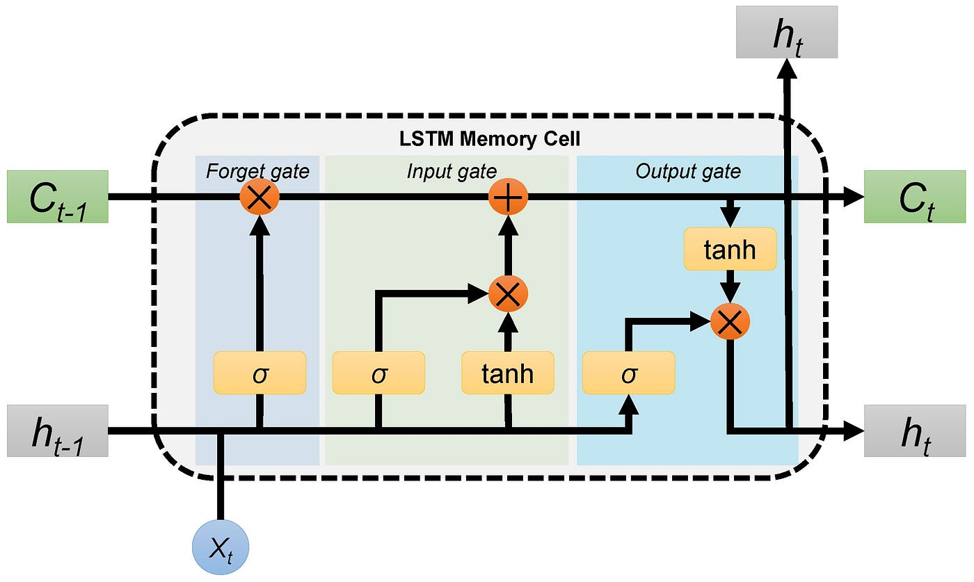
Long Short-Term Memory Networks

Slide 81
Long Short-Term Memory Networks
Long short-term memory (LSTM) is a specific type of recurrent neural network (RNN) aimed at mitigating the issue when a neural network forgets things from earlier steps because the learning signals become too weak.

Slide 82
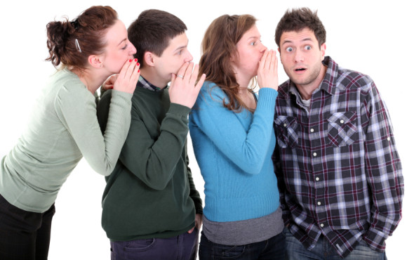
Long Short-Term Memory Networks
Think of it like passing a message through a long line of people. If each person whispers too softly, by the time the message reaches the last person, it’s almost gone or completely lost. In a neural network, this means the early layers stop learning because they don’t get enough updates.

Slide 83
Long Short-Term Memory Networks
Think of LSTM like a notepad:
It erases old notes that are no longer needed.
It adds new important notes when necessary.
It remembers useful notes from earlier.
LSTMs do this using three gates:
Forget Gate – Decides what information to erase.
Input Gate – Decides what new information to store.
Output Gate – Decides what part of the stored information to use for the output.

Slide 84
Long Short-Term Memory Networks
Candidate
The candidate is the potential new information that could be added to the memory (cell state). It is generated based on the current input and previous hidden state using a tanh activation.

Slide 85
Long Short-Term Memory Networks
New Cell State
The new cell state is the actual updated memory of the LSTM. It is formed by combining:
The old cell state (some parts are kept or forgotten via the forget gate).
The candidate (some parts are added via the input gate).

Slide 86
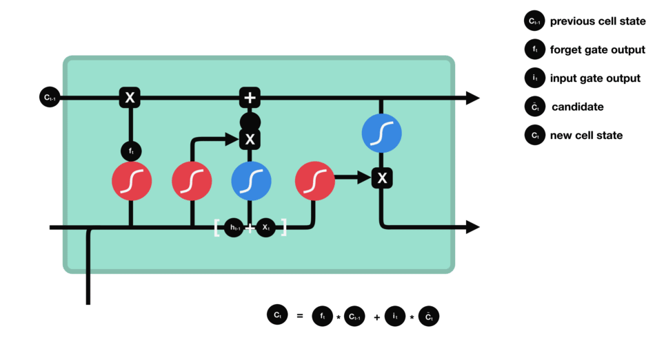

Slide 87
Long Short-Term Memory Networks
Example Use Cases
Predicting text (like autocomplete on your phone)
Speech recognition (turning speech into text)
Time-series forecasting (stock prices, weather predictions)

Slide 88
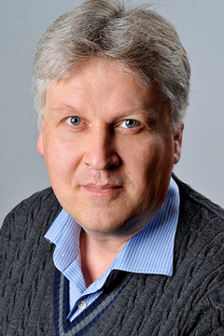
Long Short-Term Memory Networks
in 1997, Sepp Hochreiter and Jürgen Schmidhuber developed the Long Short-Term Memory (LSTM) network, which addressed the vanishing gradient problem in standard RNNs, making them more effective for long-sequence learning.

Slide 89
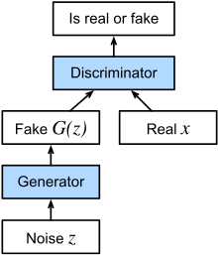
Generative Adversarial Networks

Slide 90
Generative Adversarial Networks
Generative Adversarial Networks (GANs) are a type of artificial intelligence model used to create new data that looks similar to real data.
They are widely used in image generation, deepfake creation, art generation, and data augmentation.

Slide 91
Generative Adversarial Networks
GANs have two parts that compete with each other:
Generator: Tries to create fake data (e.g., images that look like real photos). It learns to generate data that resembles real-world examples.
Discriminator: Tries to detect fake data and distinguish it from real data. This helps the generator improve by providing feedback.

Slide 92
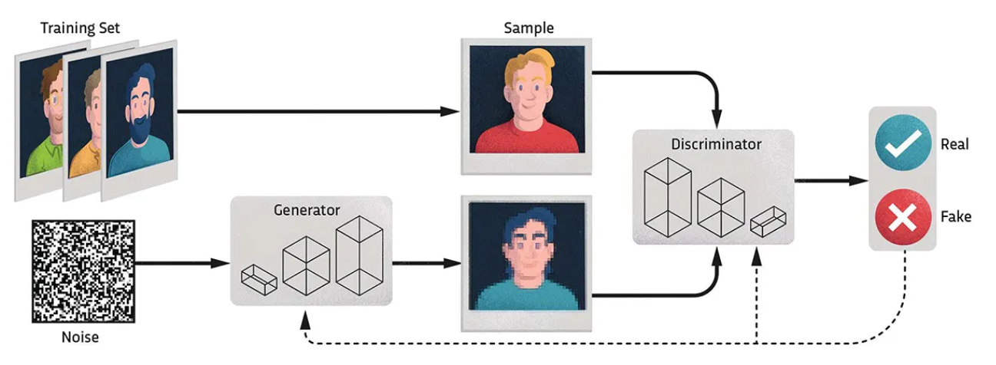

Slide 93
Generative Adversarial Networks
GANs have been used for transfer learning to enforce the alignment of the latent feature space, such as in deep reinforcement learning.
This works by feeding the embeddings of the source and target task to the discriminator which tries to guess the context.
The resulting loss is then (inversely) backpropagated through the encoder.

Slide 94
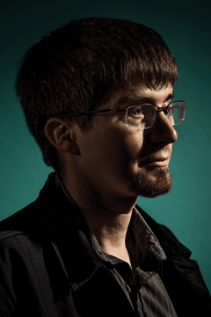
Generative Adversarial Networks
Ian Goodfellow
Born: 1987
An American computer scientist, most noted for his work on artificial neural networks. He is a research scientist at Google DeepMind. He is best known for inventing generative adversarial networks (GAN).

