Slide 1
Introduction to Generative AI
Damian Gordon

Slide 2
Contents
What is Generative AI?
Text Generation
Image, Video and Audio Generation
AI Business Models and Strategy
Governance, Policy, and Compliance

Slide 3
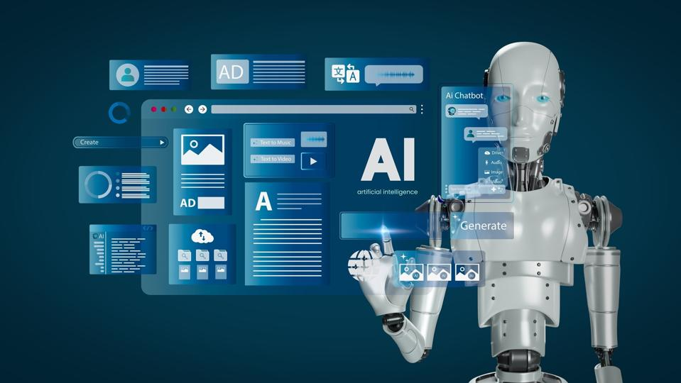
What is Generative AI?

Slide 4
What is Generative AI?
Generative AI are AI systems that can generate content, such as text, images, audio, video and code.
It includes models that produce new content based on patterns learned from training data.
Examples include image generators like DALL·E, music generators, and AI tools that generate 3D models.

Slide 5
Generative AI
Text
Generation
Code
Generation
Audio
Generation
Image
Generation
Video
Generation

Slide 6
What are LLMs?
Large Language Models (LLMs) are a subset of generative AI specifically designed to generate and understand human-like text.
They are trained on vast amounts of text data and can perform tasks like text completion, translation, summarization, and dialogue generation.
Examples include GPT-4, Claude, and LLaMA.

Slide 7
Examples of Generative AI Media

Slide 8
Examples of Generative AI Media
In the followings slides, we’ll review some of the tools you can use to produce different types of media. The tools that are listed just examples of the wide range of ones that are available:
Text
Images
Audio and Music
Video
Code

Slide 9
Examples of Text Generation
Chatbots and Virtual Assistants
Content Creation (Blog and Article Writing)
Summarization & Paraphrasing
Translation & Language Modelling
Creative Writing & Storytelling
Legal & Technical Document Generation
Email Drafting

Slide 10
Applications in text
Type | Applications
Chatbots | ChatGPT, Google Gemini, Claude
Content Creation | Jasper, Copy.ai, Writesonic
Summarization | Quillbot, Wordtune, TLDRThis
Translation | Google Translate, DeepL, SeamlessM4T
Storytelling | AI Dungeon, NovelAI
Legal Content | Casetext, HyperWrite
Email Drafting | Grammarly, Google Smart Compose, Microsoft Copilot

Slide 11
Applications in images
Art & Illustration
Graphic Design & Marketing
Photography & Photo Editing
3D Modeling & Game Design
Face Generation & Avatars
AI-Generated Fashion & Product Design
AI in Medical Imaging

Slide 12
Applications in images
Type | Applications
Art & Illustration | DALL·E (OpenAI) Deep Dream Generator (Google) Artbreeder
Graphic Design | Adobe Firefly, Canva Magic Studio, Runway ML
Photo Editing | Generative Fill (Adobe Photoshop), Luminar AI, Remove.bg
3D Modeling | NVIDIA GauGAN, DreamFusion
Face Generation | ZEPETO, Ready Player Me, Deep Nostalgia
Fashion & Products | FashionAI, Nike's AI-generated sneakers
Medical Imaging | DeepMind’s AI, Viz.ai

Slide 13
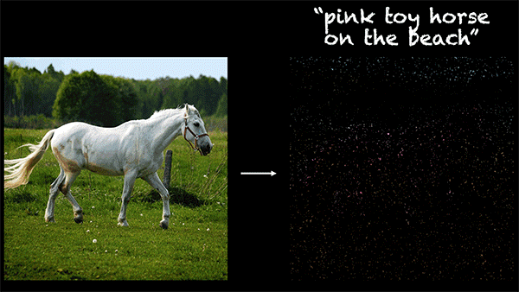
Applications in images

Slide 14
Applications in audio and music
Music Composition & Generation
AI-Generated Voice & Speech Synthesis
AI Voice Cloning & Deepfake Audio
AI-Powered Sound Effects & Foley
AI in Podcasting & Audiobooks
AI-Generated Rap & Singing

Slide 15
Applications in audio and music
Type | Applications
Music Composition | OpenAI's MuseNet, Amper Music, AIVA
AI-Generated Voice | OpenAI’s TTS, Google’s WaveNet, ElevenLabs, Amazon Polly
AI Voice Cloning | Resemble AI, Descript Overdub, iSpeech & Voicery
Sound Effects | Boom Library Soundweaver, Suno AI, Riffusion
AI in Podcasting | Adobe Podcast, Wondercraft AI, DeepZen
AI-Generated Rap | Uberduck AI, Voicemod AI, Holly+

Slide 16
Applications in video
AI-Powered Text-to-Video Generation
AI-Generated Animation & CGI
AI for Video Editing & Enhancement
AI for Deepfake & Face Swapping
AI-Generated Virtual Avatars & Digital Humans
AI-Driven Motion Capture & Video-to-Animation
AI for Film, TV & Gaming

Slide 17
Applications in video
Type | Applications
Text-to-Video | Runway Gen-2, Pika Labs, Synthesia, DeepBrain AI
Animation & CGI | Kaiber AI, Wonder Dynamics, Plask AI
Video Editing | Runway ML, Topaz Video Enhance AI, Descript Storyboard
Deepfakes | DeepFaceLab, FaceSwap AI, HeyGen
Virtual Avatars | Unreal Engine MetaHumans, D-ID, Rephrase AI
Motion Capture | DeepMotion, Kinetix AI, NVIDIA Vid2Vid Cameo
Film, TV & Gaming | Dreamix, RADiCAL AI, Wombo Dream

Slide 18
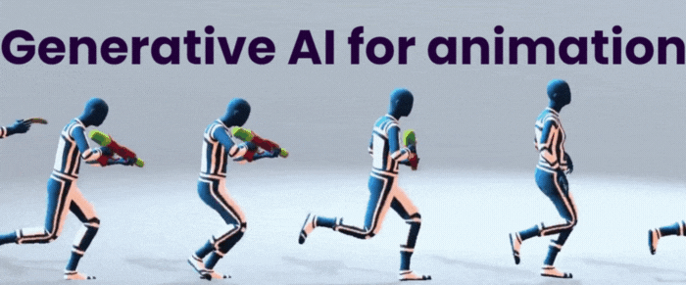
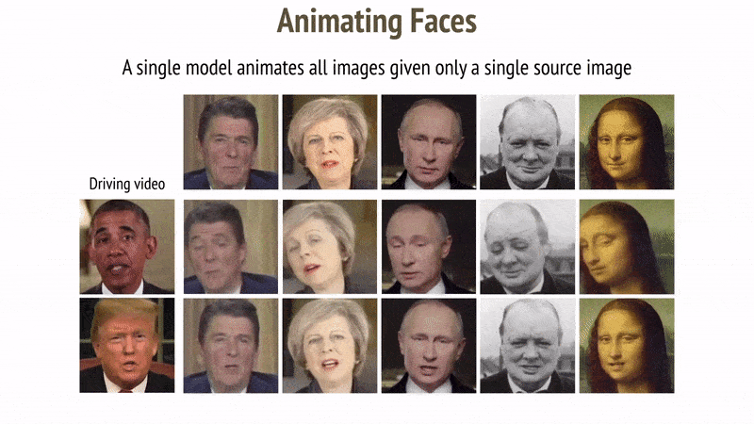
Applications in video

Slide 19
Applications in code
AI Code Assistants & Autocompletion
AI for Code Generation & Automation
AI-Powered Debugging & Code Review
AI for Documentation & Code Explanation
AI-Generated Test Cases & Automation
AI for SQL & Database Queries
AI for Game Development & 3D Coding
AI for Low-Code & No-Code Development

Slide 20
Applications in code
Type | Applications
Code Assistants | GitHub Copilot, Tabnine, Codeium
Code Generation | OpenAI Codex, ChatGPT, Mutable AI
Code Review | DeepCode, CodiumAI, SonarQube AI
Code Explanation | Mintlify, ExplainDev, DocuWriter.ai
Test Cases | Diffblue Cover, TestRigor, Functionize
SQL & Databases | Text-to-SQL, Kaggle AI SQL, DataRobot AI
Game Development | Unity AI, NVIDIA Omniverse Code AI
Low-Code & No-Code | Bubble AI, OutSystems AI, Retool AI

Slide 21
Tools and Frameworks

Slide 22
Tools and frameworks
Tool | Purpose | Best For | Developed By
🤗 Hugging Face | Pre-trained AI models | NLP, AI apps, sharing models | Hugging Face
🌍 OpenAI API | Access to OpenAI models | Chatbots, text/image generation | OpenAI
🔥 PyTorch | Deep learning framework | AI research, fast prototyping | Meta (Facebook)
🔷 TensorFlow | Deep learning framework | Large-scale AI, production models | Google

Slide 23
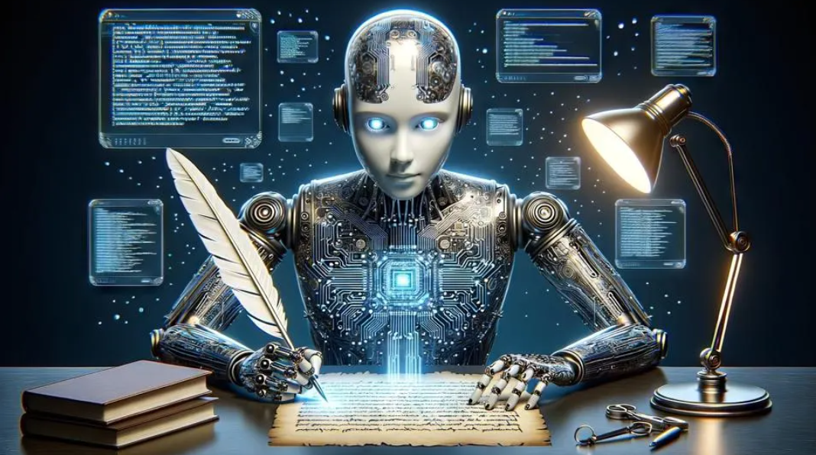
Text Generation

Slide 24
NLP Fundamentals
NLP is how computers understand and work with human language. Imagine talking to Siri, Alexa, or ChatGPT—they understand your words, answer questions, and even hold conversations. NLP helps machines read, understand, and generate text, just like humans do.
It combines linguistics (how language works) and machine learning (training computers to recognize patterns in data). NLP tasks include:

Slide 25
NLP Fundamentals
Tokenization:
This is the first step, it involves breaking a sentence into individual words or parts so a computer can understand them better.
For example:
Sentence: “I love NLP!”
Tokens: ["I", "love", "NLP", "!"]

Slide 26
NLP Fundamentals
Stemming:
This involves chopping off word endings to get the root form of a word.
For example:
“Running” → “Run”
“Walks” → “Walk”
“Studies” → “Studi”

Slide 27
NLP Fundamentals
Lemmatization:
This involves improving the outcomes of Stemming by finding the dictionary form of a word instead of just chopping off endings.
For example:
Stemming : “Caring” → “Car”
Lemmatization: “Caring” → “Care”

Slide 28
NLP Fundamentals
Embeddings:
This is like turning words into numbers so computers can understand them. Since computers don’t understand words, we convert words into mathematical representations (vectors). These vectors capture the meaning and relationships between words.
For example:
King – Man + Woman ≈ Queen
Paris – France + Italy ≈ Rome

Slide 29
NLP Fundamentals
Transformers:
A Transformer is an AI model that understands and generates human language. It does the following:
Reads an entire sentence all at once instead of one word at a time.
Finds relationships between words, even if they are far apart.
Understands context better using "self-attention“, where all words in the sentence are compared to all other words.
Continued →

Slide 30
NLP Fundamentals
Transformers:
For example:
"The cat chased the mouse because it was hungry."
Without self-attention, an AI might think "it" refers to "mouse", but self-attention helps it correctly connect "it" to "cat."

Slide 31
Large Language Models (LLMs)
GPT
LLaMA
Mistral
Claude

Slide 32
Large Language Models (LLMs)
GPT
GPT is a type of AI that can understand and generate human-like text. It works in three main steps:
Pre-training ("Learning from the Internet")
Fine-tuning ("Becoming Smarter")
Text Generation ("Answering & Writing")

Slide 33
Large Language Models (LLMs)
GPT
Pre-training ("Learning from the Internet"): GPT is trained on a massive amount of text data (books, articles, websites). It learns how words, sentences, and ideas are connected.
Fine-tuning ("Becoming Smarter"): After pre-training, it's fine-tuned to improve accuracy and avoid harmful responses. Human feedback is used to make sure it gives useful and safe answers.
Text Generation ("Answering & Writing"): When you ask GPT something, it predicts the next word based on patterns it learned. It keeps doing this quickly to form coherent sentences and paragraphs.

Slide 34
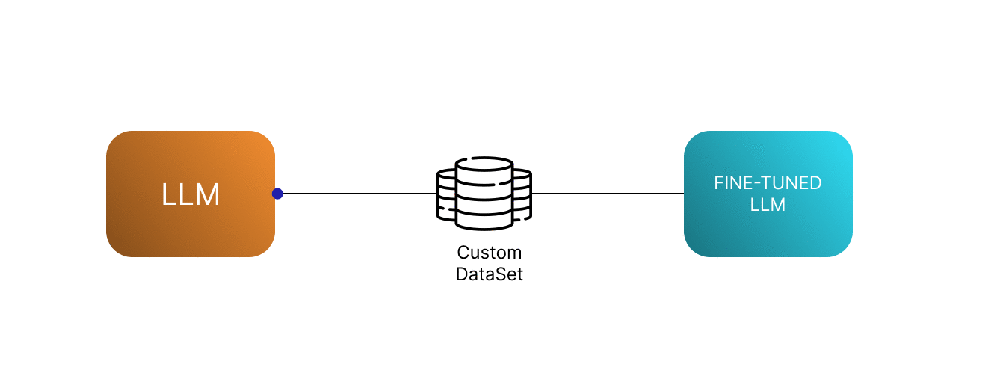
Fine-tuning models for domain-specific tasks
Fine-tuning is like teaching an AI model new tricks by training it on specific data after it has already learned general knowledge. Instead of starting from scratch, we take a pre-trained model and adjust it for a particular task.

Slide 35
Evaluation metrics for text generation
Metrics | Task
BLEU (Bilingual Evaluation Understudy) | Machine Translation
ROUGE (Recall-Oriented Understudy for Gisting Evaluation) | Summarization
METEOR (Metric for Evaluation of Translation with Explicit ORdering) | Chatbots
BERTScore | Open-Ended
Perplexity (for evaluating AI models) | Language Model Training

Slide 36
Image, Video and Audio Generation

Slide 37
Image, Video and Audio Generation
AI-powered generative models are revolutionizing media production, allowing users to create realistic images, videos, and audio from simple text prompts or existing content. These technologies are transforming entertainment, marketing, gaming, education, and content creation.

Slide 38
Image Generation
DALL·E 3
Stable
Diffusion
Midjourney
Imagen

Slide 39
Overview of key GenAI models
Stable
Diffusion
Stable Diffusion is an AI model that can generate images from text. Think of it as an AI-powered artist that paints whatever you describe, using the following 4 steps:
Understanding Your Text ("What do you want to see?")
Starting with Noise ("A Messy Canvas")
Gradual Refinement ("Bringing the Picture to Life")
Final Output ("Your AI-Generated Artwork!")

Slide 40
Overview of key GenAI models
Stable
Diffusion
Understanding Your Text ("What do you want to see?") You type a description, like "a futuristic city at sunset." The AI reads and understands your words.
Starting with Noise ("A Messy Canvas") Instead of drawing from scratch, the AI starts with a random noisy image (like TV static).
Gradual Refinement ("Bringing the Picture to Life") The AI removes noise step by step, shaping the image based on your text. It uses a process called diffusion, like sculpting a blurry image into something clear.
Final Output ("Your AI-Generated Artwork!") After many steps, the AI generates a detailed, high-quality image that matches your description.

Slide 41
Audio Generation
AudioLM
DeepSpeech
Google
WaveNet
iSpeech

Slide 42
Overview of key GenAI models
AudioLM
AudioLM is an AI model that can generate realistic audio, like speech, music, and sound effects, without needing transcripts., using the following 3 steps:
Learning from Real Audio ("Listening & Understanding")
Predicting What Comes Next ("Completing the Sound")
Generating Realistic Audio ("AI That Speaks & Sings")

Slide 43
Overview of key GenAI models
AudioLM
Learning from Real Audio ("Listening & Understanding"): The AI listens to real recordings of speech or music. It learns patterns like tone, rhythm, and structure (without needing text transcripts).
Predicting What Comes Next ("Completing the Sound"): If you give it a short audio clip, it predicts what should come next in the most natural way. Example: If it hears "Hello, how are…" it might complete it as "…you today?" in the same voice.
Generating Realistic Audio ("AI That Speaks & Sings"): It can generate human-like speech, realistic instrumental music, or even nature sounds. Unlike traditional text-to-speech (TTS), it captures emotion, style, and pauses for more natural results.

Slide 44
Key Neural Network Models

Slide 45
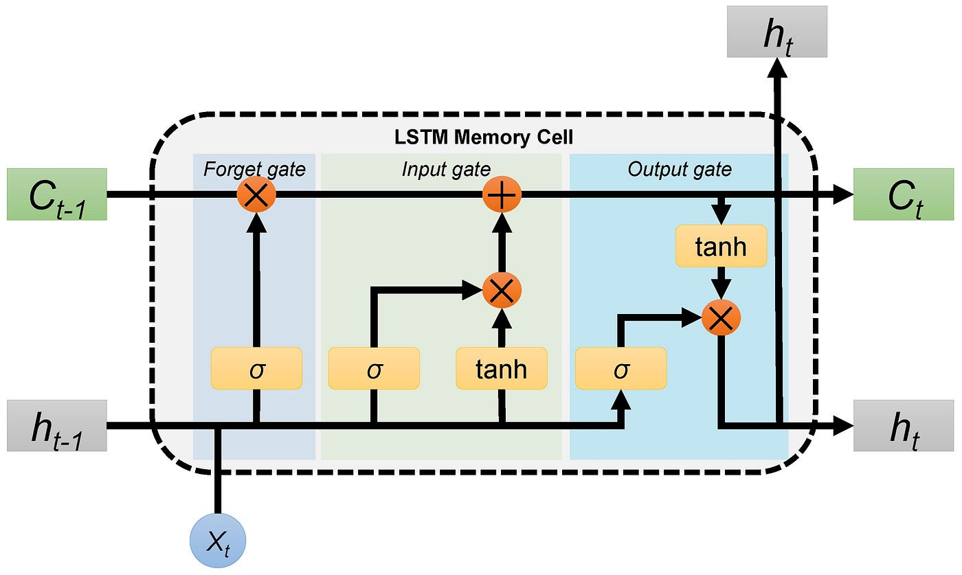
Long Short-Term Memory Networks

Slide 46
Long Short-Term Memory Networks
Long short-term memory (LSTM) is a specific type of recurrent neural network (RNN) aimed at mitigating the issue when a neural network forgets things from earlier steps because the learning signals become too weak.

Slide 47
Long Short-Term Memory Networks
Think of it like passing a message through a long line of people. If each person whispers too softly, by the time the message reaches the last person, it’s almost gone or completely lost. In a neural network, this means the early layers stop learning because they don’t get enough updates.

Slide 48
Long Short-Term Memory Networks
Think of LSTM like a notepad:
It erases old notes that are no longer needed.
It adds new important notes when necessary.
It remembers useful notes from earlier.
LSTMs do this using three gates:
Forget Gate – Decides what information to erase.
Input Gate – Decides what new information to store.
Output Gate – Decides what part of the stored information to use for the output.

Slide 49
Long Short-Term Memory Networks
Candidate
The candidate is the potential new information that could be added to the memory (cell state). It is generated based on the current input and previous hidden state using a tanh activation.

Slide 50
Long Short-Term Memory Networks
New Cell State
The new cell state is the actual updated memory of the LSTM. It is formed by combining:
The old cell state (some parts are kept or forgotten via the forget gate).
The candidate (some parts are added via the input gate).

Slide 51
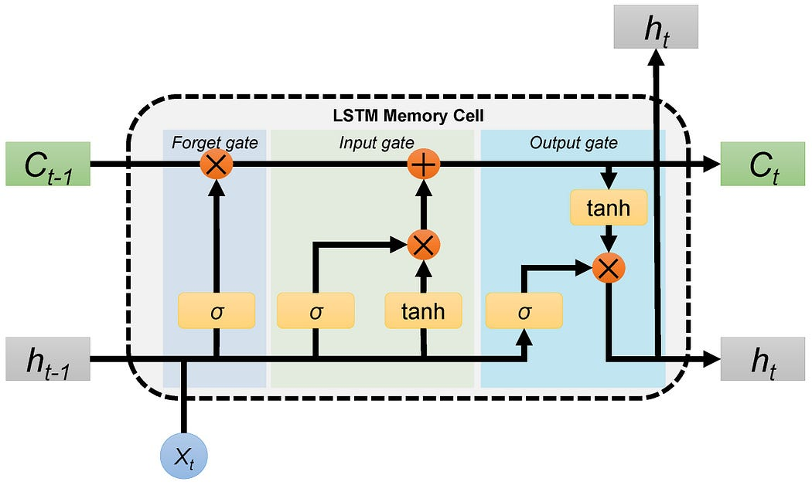

Slide 52
Long Short-Term Memory Networks
Example Use Cases
Predicting text (like autocomplete on your phone)
Speech recognition (turning speech into text)
Time-series forecasting (stock prices, weather predictions)

Slide 53
Long Short-Term Memory Networks
in 1997, Sepp Hochreiter and Jürgen Schmidhuber developed the Long Short-Term Memory (LSTM) network, which addressed the vanishing gradient problem in standard RNNs, making them more effective for long-sequence learning.

Slide 54
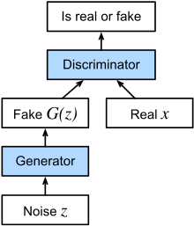
Generative Adversarial Networks

Slide 55
Generative Adversarial Networks
Generative Adversarial Networks (GANs) are a type of artificial intelligence model used to create new data that looks similar to real data.
They are widely used in image generation, deepfake creation, art generation, and data augmentation.

Slide 56
Generative Adversarial Networks
GANs have two parts that compete with each other:
Generator: Tries to create fake data (e.g., images that look like real photos). It learns to generate data that resembles real-world examples.
Discriminator: Tries to detect fake data and distinguish it from real data. This helps the generator improve by providing feedback.

Slide 57
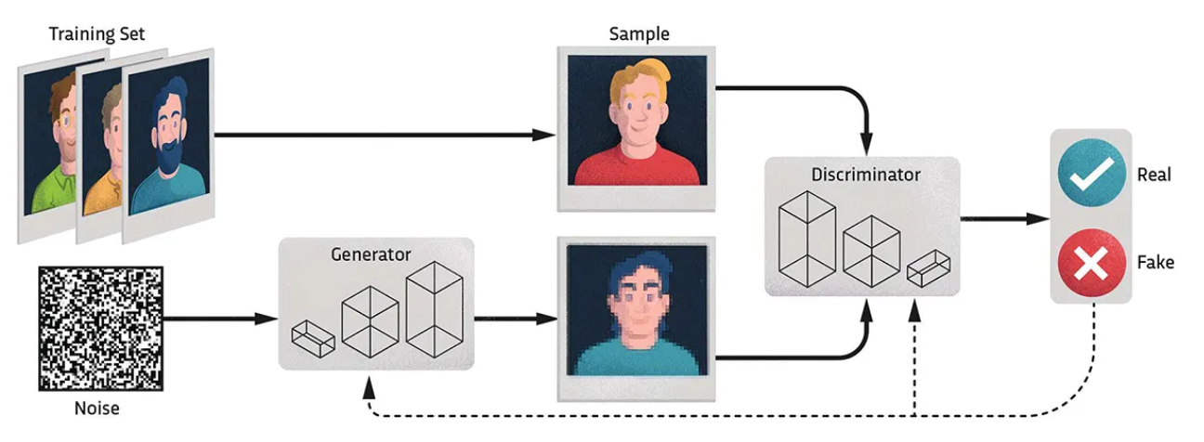

Slide 58
Generative Adversarial Networks
GANs have been used for transfer learning to enforce the alignment of the latent feature space, such as in deep reinforcement learning.
This works by feeding the embeddings of the source and target task to the discriminator which tries to guess the context.
The resulting loss is then (inversely) backpropagated through the encoder.

Slide 59
Generative Adversarial Networks
Ian Goodfellow
Born: 1987
An American computer scientist, most noted for his work on artificial neural networks. He is a research scientist at Google DeepMind. He is best known for inventing generative adversarial networks (GAN).

Slide 60
AI Business Models and Strategy

Slide 61
AI Business Models and Strategy
What is Business Process Re-engineering?
How Businesses leverage GenAI?
AI-driven Product Development
Case studies from startups and big tech
Cybersecurity risks in AI systems

Slide 62
What is Business Process Re-engineering?
Business Process Reengineering (BPR) is a strategic approach to improving business efficiency by redesigning workflows, optimizing processes, and leveraging technology. The goal is to achieve dramatic improvements in cost, quality, speed, and customer satisfaction.

Slide 63
What is Business Process Re-engineering?
BPR focuses on rethinking and radically redesigning core business processes to improve performance, efficiency, and competitiveness. Unlike incremental improvements, BPR involves fundamental changes to how a business operates.

Slide 64
What is Business Process Re-engineering?
Key Principles of BPR
1. Focus on Outcomes, Not Tasks – Redesign processes around business goals rather than individual tasks.
2. Use Technology to Enable Innovation – AI, automation, and cloud computing drive efficiency.
3. Eliminate Unnecessary Steps – Remove redundant approvals and streamline decision-making.

Slide 65
What is Business Process Re-engineering?
Key Principles of BPR
4. Organize Around Processes, Not Departments – Shift from functional silos to cross-functional teams.
5. Empower Employees – Give employees decision-making authority to improve responsiveness.
6. Customer-Centric Design – Align processes with customer needs to enhance satisfaction.

Slide 66
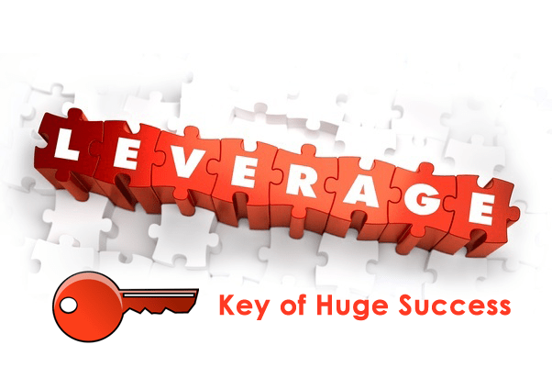
How Businesses leverage GenAI?
Businesses leverage Generative AI (GenAI) in multiple ways across cost reduction, innovation, and automation. Here’s a few example:

Slide 67
How Businesses leverage GenAI?
1. Cost Reduction
Operational Efficiency: Automates repetitive tasks (e.g., customer support, data entry), reducing labor costs.
Cloud-Based AI Models: Many businesses use pay-as-you-go AI services, cutting infrastructure and R&D expenses.
Marketing & Content Creation: AI-generated content (blogs, ads, product descriptions) reduces costs related to hiring copywriters and designers.
Predictive Maintenance: AI helps optimize supply chain management and reduce equipment downtime.
Fraud Detection & Risk Management: AI models identify fraudulent transactions, reducing financial losses.

Slide 68
How Businesses leverage GenAI?
2. Innovation
Product Design & Prototyping: AI assists in designing new products using generative models (e.g., AI-powered CAD tools).
AI-Generated Code: Developers use AI-assisted coding tools (e.g., GitHub Copilot, ChatGPT) to accelerate software development.
Drug Discovery & Healthcare: GenAI helps in designing new drugs, analyzing medical images, and personalizing treatment plans.
Creative Industries: AI-generated art, music, and video enhance creative workflows (e.g., deepfake technology, AI-powered movie scripts).
New Business Models: Companies explore AI-driven personalization (e.g., AI-powered recommendation systems in e-commerce).

Slide 69
How Businesses leverage GenAI?
3. Automation
Customer Support & Chatbots: AI-driven virtual assistants handle customer queries, reducing the need for human support staff.
AI-Powered Decision Making: Businesses automate decision-making in finance, HR, and operations using AI analytics.
Manufacturing & Robotics: AI optimizes production lines, improves quality control, and enables autonomous robotic systems.
Legal & Compliance Automation: AI reviews contracts, ensures regulatory compliance, and minimizes legal risks.
Personalization & Targeted Advertising: AI customizes user experiences on e-commerce platforms, streaming services, and social media.

Slide 70
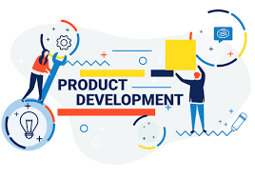
AI-driven Product Development
AI-driven product development is transforming industries by accelerating innovation, reducing costs, and enhancing customer-centric solutions. Companies leverage AI to ideate, prototype, and optimize products efficiently. Here’s how businesses integrate AI in product development:

Slide 71
AI-driven Product Development
1. AI in Ideation & Market Research
Before designing a product, companies use AI to analyze market trends, customer feedback, and competitor strategies.
Sentiment Analysis: AI tools like Brandwatch and MonkeyLearn analyze customer reviews and social media to identify gaps in the market.
AI-Generated Concepts: GPT-4, Midjourney, and DALL·E help generate new product ideas and designs based on consumer needs.
Predictive Analytics: AI-driven data modeling forecasts demand, guiding product decisions.
📌 Case Study: Nike uses AI-powered analytics to identify emerging fashion trends and personalize shoe designs.

Slide 72
AI-driven Product Development
2. AI-Enhanced Prototyping & Design
AI accelerates the design and prototyping phase by automating tasks that traditionally required human effort.
Generative Design: AI-driven tools like Autodesk Fusion 360, NVIDIA Omniverse, and Runway generate optimized product designs.
Digital Twins: Virtual models simulate how a product will perform in real-world conditions before physical production.
3D AI Modelling: AI-based CAD tools refine product models for faster iteration.
📌 Case Study: Airbus employs AI-powered generative design to create lighter aircraft components, improving fuel efficiency.

Slide 73
AI-driven Product Development
3. AI in Product Testing & Quality Control
AI enhances testing by automating defect detection and simulating real-world scenarios.
Computer Vision: AI-powered cameras identify defects in manufacturing, reducing quality control errors.
AI Simulation: Companies use digital twins and reinforcement learning to test product durability and efficiency.
Automated Bug Testing: AI tools like Testim and Applitools automate software testing, reducing development cycles.
📌 Case Study: Tesla uses AI-driven quality control to detect defects in car manufacturing, reducing recalls.

Slide 74
AI-driven Product Development
4. AI in Manufacturing & Production
AI optimizes manufacturing efficiency, minimizes waste, and automates assembly.
Predictive Maintenance: AI predicts equipment failures, reducing downtime and costs.
Supply Chain Optimization: AI analyzes demand patterns and logistics for efficient production.
Robotic Process Automation (RPA): AI-driven robots automate repetitive tasks, improving precision.
📌 Case Study: Siemens integrates AI in smart factories, using digital twins to optimize machine performance.

Slide 75
AI-driven Product Development
5. AI-Powered Product Personalization
AI enables businesses to create personalized products and experiences.
Custom AI Models: AI tailors recommendations and product configurations based on user data.
Dynamic Pricing: AI-driven pricing strategies adjust prices based on demand and competition.
Chatbots & Virtual Assistants: AI-powered assistants guide customers through product selection.
📌 Case Study: Spotify uses AI-driven algorithms to personalize playlists and music recommendations.

Slide 76
AI-driven Product Development
6. AI in Post-Launch Monitoring & Innovation
AI continuously refines products after launch through data-driven insights.
User Behaviour Analysis: AI monitors how customers interact with products and suggests improvements.
Automated Updates: AI updates software dynamically, fixing bugs and enhancing user experience.
Customer Feedback Analysis: AI extracts insights from reviews and support tickets.
📌 Case Study: Apple integrates AI-driven performance monitoring in iOS updates to enhance user experience.

Slide 77
Case studies from startups and big tech
Businesses, both startups and established tech giants, are increasingly integrating Generative AI (GenAI) to enhance operations, drive innovation, and automate processes. Here are some notable case studies:​

Slide 78
Case studies from startups and big tech
Startups Leveraging GenAI
1. OpusClip OpusClip, a Generative AI video editing startup, has developed a multimodal AI tool that enables users to create short social media videos from text prompts. The AI analyzes the input to select compelling clips, simplifying the video editing process to meet the growing demand for social media content. As of March 2025, OpusClip has over 10 million users and notable clients, including Univision, Billboard, and LinkedIn.

Slide 79
Case studies from startups and big tech
Startups Leveraging GenAI
2. Colossyan Colossyan offers an AI video platform that allows companies to create training videos without traditional filming equipment. Utilizing text-to-speech technology, the platform generates human-like AI avatars delivering content with realistic lip-syncing. Supporting over 70 languages, Colossyan's platform is used by major corporations such as Hewlett Packard, BASF, BMW, Novartis, Porsche, and Vodafone.

Slide 80
Case studies from startups and big tech
Startups Leveraging GenAI
3. Runway Runway specializes in Generative AI for video, media, and art. Notably, the company co-released Stable Diffusion, an open-source text-to-image model, and developed Gen-1 and Gen-2, models capable of video-to-video and text-to-video generation, respectively. Runway's tools have been utilized in films like "Everything Everywhere All At Once" and in music videos for artists such as A$AP Rocky and Kanye West.

Slide 81
Case studies from startups and big tech
Startups Leveraging GenAI
4. Headway Headway, a Ukrainian edtech startup, has significantly improved its advertising performance by leveraging AI tools like Midjourney and HeyGen. The integration of these tools led to a 40% increase in return on investment for video ads, achieving 3.3 billion impressions in the first half of 2024. AI has also helped reduce production costs and freed resources for more innovative tasks.

Slide 82
Case studies from startups and big tech
Big Tech Companies Implementing GenAI
1. Visa Visa has launched an innovative scam detection initiative that incorporates Generative AI and automation to protect customers and dismantle online scam networks. The initiative includes a dedicated intelligence team studying the dark web and social media to uncover scam activities, and a disruption team working with law enforcement to dismantle scam networks. In the previous year, Visa's efforts prevented over $350 million in fraud.

Slide 83
Case studies from startups and big tech
Big Tech Companies Implementing GenAI
2. Microsoft Microsoft has introduced an AI tool called Muse, aimed at revolutionizing the game development process. Muse creates AI-generated gameplay videos to help designers experiment efficiently, producing mock gameplay clips that can be tweaked with prompts. While Muse currently cannot create entirely new games or playable simulations, it represents a significant technical achievement in AI-assisted game design.

Slide 84
Case studies from startups and big tech
Big Tech Companies Implementing GenAI
3. Pegasystems Pegasystems has integrated Generative AI across its Pega Infinity portfolio, enhancing AI, low-code, and automation capabilities. This integration includes Pega GenAI, a set of 20 Generative AI boosters compatible with AWS and Google Cloud's large language models. These tools assist in optimizing application workflow designs, finding answers to user questions using enterprise knowledge bases, and teaching users how to use Pega software.

Slide 85
Case studies from startups and big tech
Big Tech Companies Implementing GenAI
4. Google Google is incorporating Generative AI to enhance user experiences, particularly in Google Search with AI Overviews. The company emphasizes responsible integration to avoid misinformation and is investing in AI to benefit users broadly, despite concerns about profitability and the economic impact on traditional content industries.

Slide 86
Cybersecurity risks in AI systems
AI systems introduce new cybersecurity challenges, including vulnerabilities to attacks, data privacy issues, and ethical concerns. Below are key cybersecurity risks in AI and how businesses can mitigate them.

Slide 87
Cybersecurity risks in AI systems
1. Adversarial Attacks
Attackers manipulate AI models by introducing carefully crafted data to mislead them.
Evasion Attacks: Slight modifications to input data (e.g., changing a few pixels in an image) can fool AI models into misclassifying objects.
Poisoning Attacks: Injecting malicious data into training datasets to alter model behavior.
Model Extraction: Attackers reverse-engineer AI models to steal intellectual property or find vulnerabilities.

Slide 88
Cybersecurity risks in AI systems
1. Adversarial Attacks
Example: In 2017, researchers tricked Google’s image recognition AI into misidentifying a panda as a gibbon by altering just a few pixels.
Mitigation Strategies:
Use adversarial training to harden AI models against attacks.
Regularly update and monitor AI models for anomalies.
Implement input validation techniques to detect suspicious inputs.

Slide 89
Cybersecurity risks in AI systems
2. Data Privacy & Model Inference Risks
AI models often process vast amounts of sensitive data, raising privacy concerns.
Membership Inference Attacks: Attackers determine whether a specific individual’s data was used to train an AI model.
Data Leakage: AI models may inadvertently reveal private training data through responses.
Unauthorized Access: AI-driven automation can expose confidential data if access controls are weak.

Slide 90
Cybersecurity risks in AI systems
2. Data Privacy & Model Inference Risks
Example: OpenAI’s GPT models have faced concerns about inadvertently memorizing and leaking user-provided data.
Mitigation Strategies:
Apply differential privacy techniques to limit data exposure.
Restrict access to AI training data and implement zero-trust security policies.
Regularly audit AI models for unintended data leakage.

Slide 91
Cybersecurity risks in AI systems
3. Bias & Ethical Risks
AI systems can inherit biases from training data, leading to unfair or discriminatory outcomes.
Algorithmic Bias: AI models may favor certain groups over others, leading to biased hiring, loan approvals, or policing.
Deepfake & Misinformation: AI-generated fake content (text, video, and audio) can be used maliciously.
Ethical AI Decision-Making: AI-driven decisions in healthcare, finance, and security may have life-altering consequences.

Slide 92
Cybersecurity risks in AI systems
3. Bias & Ethical Risks
Example: Amazon’s AI hiring tool was found to discriminate against female candidates because it was trained on past hiring data that favored male applicants.
Mitigation Strategies:
Use bias detection tools to audit AI decisions.
Implement diverse and representative training datasets.
Establish AI ethics policies and compliance frameworks.

Slide 93
Cybersecurity risks in AI systems
4. AI Supply Chain Attacks
AI models rely on third-party datasets, open-source software, and cloud environments, creating security risks.
Compromised AI Libraries: Attackers inject malicious code into widely used AI frameworks like TensorFlow or PyTorch.
Cloud AI Vulnerabilities: AI models hosted on cloud platforms can be targeted through API vulnerabilities.
Data Manipulation in Training: Attackers tamper with datasets sourced from external providers.

Slide 94
Cybersecurity risks in AI systems
4. AI Supply Chain Attacks
Example: Researchers demonstrated how poisoning open-source AI datasets could corrupt AI systems used by major companies.
Mitigation Strategies:
Vet and verify third-party AI tools before integration.
Use secure federated learning to train AI models without exposing raw data.
Monitor supply chain dependencies for vulnerabilities.

Slide 95
Cybersecurity risks in AI systems
5. Automated Malware & AI-Powered Cyber Threats
Cybercriminals are using AI to automate attacks and generate new forms of malware.
AI-Generated Phishing: AI can create highly convincing phishing emails and deepfake videos to manipulate users.
Malware Automation: AI-powered malware can adapt and evade traditional detection systems.
Autonomous Hacking: AI-driven bots can exploit system vulnerabilities without human intervention.

Slide 96
Cybersecurity risks in AI systems
5. Automated Malware & AI-Powered Cyber Threats
Example: In 2023, AI-generated deepfake scams resulted in millions in financial fraud by impersonating executives and employees.
Mitigation Strategies:
Deploy AI-powered cyber threat intelligence systems to detect AI-generated attacks.
Train employees to recognize deepfake and AI-generated phishing threats.
Implement behavioral analysis to detect unusual activity in AI systems.

Slide 97
Governance, Policy, and Compliance

Slide 98
Governance, Policy, and Compliance
Key AI regulations
Organizational compliance strategies
Frameworks for responsible AI

Slide 99
Key AI Regulations
Artificial intelligence (AI) regulation is evolving globally, with significant developments in the European Union (EU) and around the world:

Slide 100
Key AI Regulations
EU General Data Protection Regulation (GDPR):
Implemented in 2018, the GDPR addresses automated decision-making and profiling. Article 22 prohibits decisions based solely on automated processing that significantly affect individuals, unless explicitly authorized. It also provides data subjects with rights to obtain explanations about decisions made by automated systems.

Slide 101
Key AI Regulations
EU AI Act
The EU has introduced the Artificial Intelligence Act, aiming to regulate AI applications based on their potential risks. The Act prohibits certain harmful AI practices, mandates strict requirements for high-risk AI systems, and encourages voluntary codes of conduct for lower-risk applications. The regulation was approved by the European Parliament on March 13, 2024, and by the Council of the European Union on May 21, 2024.

Slide 102
Key AI Regulations
United Kingdom
The UK government has proposed changes to copyright laws to attract tech companies, allowing AI firms to use copyrighted works unless the owner opts out. However, experts argue this could breach international agreements like the Berne Convention, potentially leading to legal challenges. Critics emphasize that the issue lies in AI developers' non-compliance with existing laws rather than the laws themselves.

Slide 103
Key AI Regulations
China
China has implemented comprehensive AI regulations, emphasizing state control and alignment with national standards. In 2021, ethical guidelines were introduced, mandating that AI research upholds shared human values, remains under human oversight, and ensures public safety. Additionally, Beijing has made AI education mandatory across all schooling levels, starting from elementary, to maintain its competitive edge in the global AI landscape.

Slide 104
Organizational Compliance Strategies for AI Systems
AI compliance is crucial for businesses to mitigate legal, ethical, and security risks. Organizations must align AI governance with global regulations, industry standards, and ethical frameworks. Below are key compliance strategies:

Slide 105
Organizational Compliance Strategies for AI Systems
1. Establish an AI Governance Framework
Organizations should create an internal AI governance structure to oversee compliance.
Best Practices:
Appoint an AI Ethics & Compliance Officer.
Form a cross-functional AI governance committee (legal, IT, ethics, security).
Develop an AI risk assessment protocol to evaluate models before deployment.

Slide 106
Organizational Compliance Strategies for AI Systems
2. Align with AI Regulations & Industry Standards
AI regulations vary globally, and organizations must comply with relevant laws.
Key AI Regulations:
CCPA (California Consumer Privacy Act) – Grants users control over their AI-related data.
NIST AI Risk Management Framework – US standard for AI safety and trustworthiness.
Best Practices:
Conduct regulatory impact assessments before AI deployment.
Use explainable AI (XAI) techniques to ensure compliance with transparency requirements.
Regularly audit AI models to detect compliance gaps.

Slide 107
Organizational Compliance Strategies for AI Systems
3. Implement Ethical AI Policies
AI should be designed to prevent bias, discrimination, and unethical decision-making.
Best Practices:
Develop an AI ethics policy outlining fairness, transparency, and accountability.
Use bias detection algorithms to audit AI training data.
Ensure AI-generated decisions are explainable and interpretable.

Slide 108
Organizational Compliance Strategies for AI Systems
4. Strengthen AI Security & Data Protection
AI systems are vulnerable to cyber threats, adversarial attacks, and data breaches.
Best Practices:
Apply data anonymization and encryption to protect sensitive AI training data.
Implement differential privacy to prevent AI models from leaking user data.
Conduct regular security audits to identify vulnerabilities in AI pipelines.

Slide 109
Organizational Compliance Strategies for AI Systems
5. Ensure AI Transparency & Accountability
AI models must provide clear explanations for their decisions, especially in regulated industries like healthcare and finance.
Best Practices:
Maintain AI decision logs to track and audit AI predictions.
Use model interpretability tools (e.g., SHAP, LIME) to explain AI outputs.
Offer user opt-outs for AI-driven decisions affecting customers.

Slide 110
Organizational Compliance Strategies for AI Systems
6. Conduct AI Compliance Training & Awareness
AI governance is only effective if employees understand compliance requirements.
Best Practices:
Train employees on AI regulations, bias mitigation, and security risks.
Develop an AI compliance playbook with standardized policies.
Encourage whistleblower protections for AI misuse reporting.

Slide 111
Organizational Compliance Strategies for AI Systems
7. Establish Third-Party AI Compliance Checks
Many businesses use AI from third-party vendors (e.g., OpenAI, AWS, Google Cloud AI), requiring supplier compliance verification.
Best Practices:
Ensure AI vendors comply with GDPR, CCPA, and NIST AI standards.
Require third-party security certifications (e.g., ISO 27001, SOC 2).
Implement AI contractual clauses to enforce compliance.

Slide 112
Organizational Compliance Strategies for AI Systems
8. Monitor AI Systems for Continuous Compliance
AI compliance is not a one-time process—organizations must continuously audit AI models.
Best Practices:
Use AI compliance monitoring tools to detect violations in real-time.
Set up an AI audit review board to oversee ongoing compliance.
Update AI policies based on evolving legal standards.

Slide 113
Frameworks for Responsible AI
Responsible AI frameworks help organizations develop and deploy AI systems that are ethical, transparent, fair, and aligned with human values. These frameworks ensure compliance with global regulations while minimizing risks like bias, misinformation, and security threats.

Slide 114
Frameworks for Responsible AI
1. Core Principles of Responsible AI
Most AI governance frameworks follow these key principles:
Fairness – AI should not discriminate against any group.
Transparency – AI decisions should be explainable and understandable.
Accountability – Organizations must take responsibility for AI outputs.
Privacy & Security – AI should protect user data and comply with regulations.
Human-Centered AI – AI should augment human decision-making, not replace it.
Robustness & Safety – AI systems should be reliable and secure against adversarial attacks.

Slide 115
Frameworks for Responsible AI
2. Leading Responsible AI Frameworks
Several organizations and governments have developed Responsible AI frameworks.
Company | Framework Name | Focus Areas
Google | AI Principles | Fairness, privacy, social benefits
Microsoft | Responsible AI Standard | Transparency, inclusivity, accountability
IBM | AI Ethics Guidelines | Trustworthiness, bias mitigation
Meta (Facebook) | Responsible AI Practices | Content moderation, misinformation detection

Slide 116
Frameworks for Responsible AI
3. Implementing a Responsible AI Framework
Organizations can develop internal Responsible AI frameworks by following these steps:
Step 1: Define AI Ethics Policies
Draft an AI Ethics Charter with guiding principles.
Align policies with global AI regulations (EU AI Act, GDPR, CCPA).
Step 2: Establish AI Governance
Create an AI Ethics Committee (legal, tech, policy experts).
Assign AI Risk & Compliance Officers to oversee AI deployments.
Step 3: Integrate Fairness & Bias Audits
Use AI fairness toolkits (IBM AI Fairness 360, Google What-If Tool).
Conduct bias testing on training datasets and models.

Slide 117
Frameworks for Responsible AI
Step 4: Ensure Transparency & Explainability
Implement Explainable AI (XAI) techniques (e.g., SHAP, LIME).
Provide human-readable explanations for AI-driven decisions.

Slide 118
Frameworks for Responsible AI
Step 5: Enforce Security & Privacy Protections
Use differential privacy to protect user data.
Conduct AI adversarial testing to detect vulnerabilities.

Slide 119
Frameworks for Responsible AI
Step 6: Continuous Monitoring & Compliance
Perform AI impact assessments before deployment.
Use third-party AI audits to ensure compliance.

