Slide 1
Ethics of AI/GenAI
Damian Gordon

Slide 2
Contents
What is Ethics?
What is AI?
What is Ethical AI?
Ethical AI Frameworks
What is GenAI?
What is Ethical GenAI?

Slide 3
What is Ethics?

Slide 4
What is Ethics?
Ethics is the branch of philosophy that deals with morality—what’s right and wrong, good and bad, fair and unfair. It's about how we should act and why.

Slide 5
In the American TV show, “The Office”, in the season 5, episode 3, “Business Ethics” by Ryan Koh, the character, Oscar Martinez, says “Ethics is a real discussion of the competing conceptions of the good”.

Slide 6
So, what are some of those “competing conceptions of the good”?

Slide 7
Common Ethical Theories
The three dominant ethical theories are as follows:
Deontology
Utilitarianism
Virtue Ethics

Slide 8
Common Ethical Theories
The three dominant ethical theories are as follows:
Deontology: Always follow the rules or duties, even if the outcome isn't perfect.
Utilitarianism: Choose the action that creates the greatest good for the greatest number of people.
Virtue Ethics: Focus on becoming a good person by cultivating moral character and habits.

Slide 9
Common Ethical Theories
Let’s look at an AI example for each one:
Deontology Example: An AI doctor always tells patients the full truth about their diagnosis, even if it might cause distress—because honesty is a moral duty.
"The AI must tell the truth, because lying is always wrong."

Slide 10
Common Ethical Theories
Let’s look at an AI example for each one:
Utilitarianism Example: A city uses traffic prediction AI to reroute cars - even if some drivers are delayed - because it reduces congestion for the most people.
"Maximize total benefit, even if a few are inconvenienced."

Slide 11
Common Ethical Theories
Let’s look at an AI example for each one:
Virtue Ethics Example: Developers design a chatbot to show empathy and kindness, aiming to build systems that reflect human virtues.
"Build AI that helps people become better and act compassionately."

Slide 12
Now let’s look at one scenario from each of the three theories perspectives:

Slide 13
Common Ethical Theories

Slide 14
Common Ethical Theories
Scenario: You’re a developer working on an AI system that flags suspicious behaviour for airport security. One day, you realize the AI has a higher false positive rate for a specific racial group - meaning it disproportionately flags innocent people from that group. Fixing it will take weeks, during which time some real threats might go undetected.

Slide 15
Common Ethical Theories
DEONTOLOGY PERSPECTIVE: “Do the right thing - don’t violate people’s rights.”
Decision: Turn off the AI or stop using it until the bias is fixed.
Rational: Racial discrimination is inherently wrong, even if the system is effective in some ways. It treats people unfairly, violating the duty to respect each person equally.

Slide 16
Common Ethical Theories
UTILITARIANISM PERSPECTIVE: “Do whatever leads to the greatest good for the greatest number.”
Decision: Keep using the system for now, because it might prevent harm to many passengers, even if some are unfairly targeted.
Rational: The potential to save many lives outweighs the unjust treatment of a few - harsh, but pragmatic.

Slide 17
Common Ethical Theories
VIRTUE ETHICS PERSPECTIVE: “What would a just and compassionate person do?”
Decision: Pause and fix the system, or demand transparency while finding an immediate workaround.
Rational: A virtuous developer would care deeply about fairness and human dignity - character matters as much as results.

Slide 18
In Summary …
"Ethics is about asking good questions, not just giving the right answers."
It helps us think clearly when the right path isn’t obvious.
Ethics isn't just about rules - it’s about understanding impact, values, and who we want to be.

Slide 19
What is AI?

Slide 20
What is AI?
Artificial Intelligence (AI) is the field of computer science that focuses on creating systems that can perform tasks that normally require human intelligence, like learning, reasoning, problem-solving, understanding language, or recognizing patterns.

Slide 21
Artificial Intelligence
Artificial Intelligence could be seen as divided into two main fields:
Artificial Intelligence
Symbolic
AI
Machine Learning

Slide 22
Artificial Intelligence
Artificial Intelligence could be seen as divided into two main fields:
Artificial Intelligence
Symbolic
AI
Machine Learning
Uses
Rules
Uses
Data

Slide 23
Artificial Intelligence
Symbolic AI: It is a subfield of Artificial Intelligence that uses human-written rules and logic to represent knowledge and make decisions.
Machine Learning: It is a subfield of Artificial Intelligence where systems learn patterns from data instead of being explicitly programmed. It improves automatically through experience.

Slide 24
Artificial Intelligence
Scenario: How do teach an AI system to recognise birds in images.
Symbolic AI Example: We tell the system a rule: "If it has wings and feathers, then it's a bird."
Machine Learning Example: Show the system thousands of images of birds (data) and it learns to recognize them - without being told the rules.

Slide 25
Artificial Intelligence: Symbolic AI
Some subfields of Symbolic AI are:
Expert Systems
Automated Reasoning
Ontology Engineering
Symbolic Planning and Problem Solving

Slide 26
Artificial Intelligence: Machine Learning
Some subfields of Machine Learning are:
Supervised Learning
Unsupervised Learning
Deep Learning
Reinforcement Learning

Slide 27
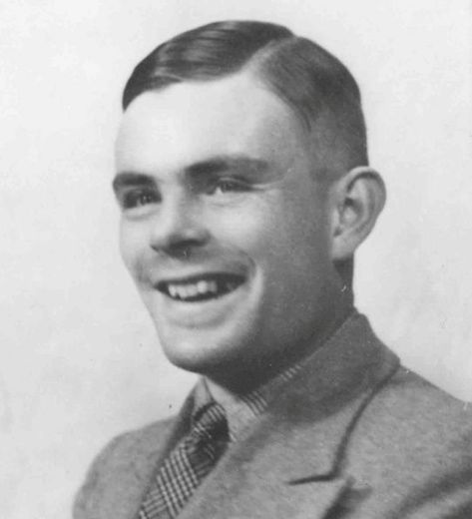
Artificial Intelligence: Turing Test
What is the Turing Test?
The Turing Test is a concept introduced by computer scientist Alan Turing in 1950. It's a way to measure a machine's ability to exhibit intelligent behaviour indistinguishable from that of a human.
Notes:
Simmons, A.B. and Chappell, S.G., 1988. Artificial intelligence-definition and practice. IEEE journal of oceanic engineering, 13(2), pp.14-42.

Slide 28
Artificial Intelligence: Turing Test
Here's how it works:
A human judge has a conversation (usually through text) with two participants: one is a human, the other is a machine (like an AI).
The judge doesn't know which is which.
If the judge can't reliably tell which one is the machine and which one is the human based on their responses, the machine is said to have passed the Turing Test.
Notes:
Simmons, A.B. and Chappell, S.G., 1988. Artificial intelligence-definition and practice. IEEE journal of oceanic engineering, 13(2), pp.14-42.

Slide 29
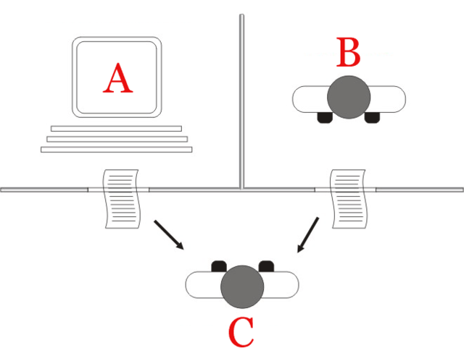
Artificial Intelligence: Turning Test

Slide 30
In Summary …
Artificial Intelligence (AI) is the field of computer science focused on building machines that can perform tasks that typically require human intelligence, like learning, problem-solving, or understanding language.
AI powers everyday technologies like voice assistants, recommendation systems, and self-driving cars.
Notes:
Simmons, A.B. and Chappell, S.G., 1988. Artificial intelligence-definition and practice. IEEE journal of oceanic engineering, 13(2), pp.14-42.

Slide 31
What is Ethical AI?

Slide 32
What is Ethical AI?
Ethical AI is the practice of designing and using artificial intelligence in ways that are fair, transparent, accountable, and respectful of human rights.
It ensures that AI systems do not cause harm, discriminate, or operate without oversight or explanation.
Notes:
Simmons, A.B. and Chappell, S.G., 1988. Artificial intelligence-definition and practice. IEEE journal of oceanic engineering, 13(2), pp.14-42.

Slide 33
What is Ethical AI?
To understand this topic better, in 2022 an international group of researchers came together to investigate the key Ethical AI principles, and published a paper called “Ethics of AI: A systematic literature review of principles and challenges”.
Notes:
Simmons, A.B. and Chappell, S.G., 1988. Artificial intelligence-definition and practice. IEEE journal of oceanic engineering, 13(2), pp.14-42.

Slide 34
What is Ethical AI?
The full citation is:
Khan, A.A., Badshah, S., Liang, P., Waseem, M., Khan, B., Ahmad, A., Fahmideh, M., Niazi, M. and Akbar, M.A., 2022, “Ethics of AI: A systematic literature review of principles and challenges”, Proceedings of the 26th international conference on evaluation and assessment in software engineering. (pp. 383-392).
Notes:
Simmons, A.B. and Chappell, S.G., 1988. Artificial intelligence-definition and practice. IEEE journal of oceanic engineering, 13(2), pp.14-42.

Slide 35
What is Ethical AI?
They found that some of the key Ethical AI principles are:
Transparency
Privacy
Accountability
Fairness
Autonomy

Slide 36
Ethical AI: Transparency
Make AI systems understandable and explainable to humans.
For example, users should know when they’re interacting with a bot, and why a decision was made.

Slide 37
Ethical AI: Privacy
Protect user data and respect individual privacy rights.
For example, avoid collecting unnecessary personal data or sharing it without consent.

Slide 38
Ethical AI: Accountability
There must be human responsibility for AI decisions.
For example, if an AI causes harm, someone (a person or organization) must be accountable.

Slide 39
Ethical AI: Fairness
Avoid bias and discrimination based on race, gender, age, or other factors.
For example, ensure AI doesn’t unfairly reject job or loan applications.

Slide 40
Ethical AI: Autonomy
AI should support - not replace - human decision-making.
For example, Doctors should make final decisions in healthcare decisions, not just follow an algorithm.

Slide 41
Ethical AI Frameworks

Slide 42
Ethical AI Frameworks
Asilomar AI Principles (Future of Life Institute, 2017)
Created by AI researchers and ethicists
23 Principles organized into:
Research issues
Ethics and values
Longer-term issues (like superintelligence safety)

Slide 43
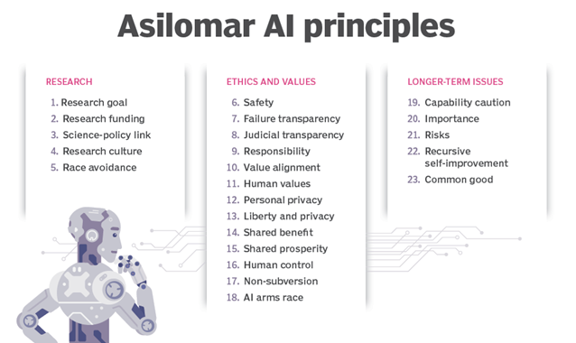

Slide 44
Ethical AI Frameworks
IEEE Ethically Aligned Design By: IEEE Global Initiative on Ethics of Autonomous and Intelligent Systems
Human well-being
Accountability
Data agency and privacy
Algorithmic bias
Governance and transparency

Slide 45
Ethical AI Frameworks
EU Guidelines for Trustworthy AI (2019) Created by: European Commission High-Level Expert Group on AI
Human agency and oversight
Technical robustness and safety
Privacy and data governance
Transparency
Diversity, non-discrimination, and fairness
Societal and environmental well-being
Accountability

Slide 46
What is Generative AI?

Slide 47
What is Generative AI?
Generative AI are AI systems that can generate content, such as text, images, audio, video and code.
It includes models that produce new content based on patterns learned from training data.

Slide 48
Generative AI
Text
Generation
Code
Generation
Audio
Generation
Image
Generation
Video
Generation

Slide 49
What are LLMs?
Large Language Models (LLMs) are a subset of generative AI specifically designed to generate and understand human-like text.
They are trained on vast amounts of text data and can perform tasks like text completion, translation, summarization, and dialogue generation.
Examples include GPT-4, Claude, and LLaMA.

Slide 50
What is Ethical GenAI?

Slide 51
Ethical GenAI Considerations
The key Ethical AI principles apply to GenAI:
Transparency
Privacy
Accountability
Fairness
Autonomy
But there are additional specific principles:

Slide 52
Ethical GenAI Considerations
Consent and Copyright Respect
Respect intellectual property and individual rights.
For example, don’t generate art “in the style of” living artists without permission; don’t train on private data without consent.

Slide 53
Ethical GenAI Considerations
Authenticity and Disclosure
Make it clear when content is AI-generated.
For example, watermarking images or flagging AI-written text.

Slide 54
Ethical GenAI Considerations
Misinformation Prevention
GenAI should not be used to generate or spread false or misleading information.
For example, blocking the generation of fake news, conspiracy theories, or deepfakes.

Slide 55
Ethical GenAI Considerations
Representation and Cultural Sensitivity
Be mindful of biases in how people, cultures, and identities are represented.
For example, avoid stereotypes or homogenized depictions of diverse groups.

Slide 56
Ethical GenAI Considerations
Human Oversight in Creative Use
AI should assist, not replace, human creators.
For example, writers or designers should guide and review GenAI outputs.

