Slide 1
Introduction to Python
Damian Gordon
e: Damian.Gordon@dit.ie
t: @damiantgordon

Slide 2
Introduction
This talk is aimed at people who are new to Python, to teach them basic operations and algorithms in Python.
We will look at SEQUENCE, SELECTION, and ITERATION.
We will look at some COMMON ALGORITHMS.

Slide 3
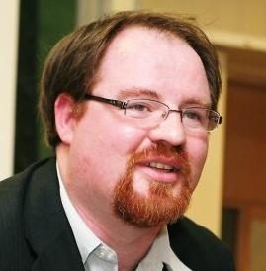
Your Speaker is…
Lecturer for 15 years in Dublin Institute of Technology
Educational Advisor on a number of EU projects
Research Interests
Education, Assistive Technology, Creativity, Hacking
previously Developer, Analyst, IT consultant
Programming for over 30 years
I absolutely love Python

Slide 4
http://www.damiantgordon.com/python/
Includes:
Videos
PowerPoints
Over 100 code samples
Exercises
External links

Slide 5
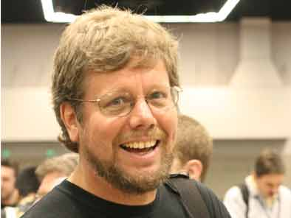
The Python Programming Language
Python was developed by Guido van Rossum in the Netherlands in 1989.
Van Rossum is Python's principal author, and his continuing central role in deciding the direction of Python is reflected in the title given to him by the Python community, Benevolent Dictator for Life (BDFL).

Slide 6
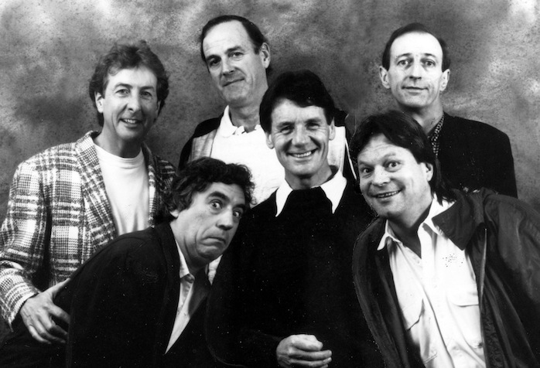
The Python Programming Language
Python is named for the British comedy group Monty Python.
The main members of the group are Eric Idle, Terry Jones, John Cleese, Michael Palin, Graham Chapman, and Terry Gilliam.

Slide 7
The Python Programming Language
Python is named for the British comedy group Monty Python.
The main members of the group are Eric Idle, Terry Jones, John Cleese, Michael Palin, Graham Chapman, and Terry Gilliam.

Slide 8
The Python Programming Language
1989
Ver 1
2008
Ver 3
2000
Ver 2

Slide 9
The Python Programming Language
Python is a multi-paradigm programming language:
structured programming
object-oriented programming
functional programming
aspect-oriented programming
design by contract
logic programming

Slide 10
The Python Programming Language
Python uses dynamic typing and a combination of reference counting and a cycle-detecting garbage collector for memory management. An important feature of Python is dynamic name resolution (late binding), which binds method and variable names during program execution.

Slide 11
The Python Programming Language
Rather than requiring all desired functionality to be built into the language's core, Python was designed to be highly extensible. Python can also be embedded in existing applications that need a programmable interface. This design of a small core language with a large standard library and an easily extensible interpreter was intended by Van Rossum from the very start

Slide 12
The Python Programming Language
Since 2003, Python has consistently ranked in the top ten most popular programming languages as measured by the TIOBE Programming Community Index. As of September 2015, it is in the fifth position. It was ranked as Programming Language of the Year for the year 2007 and 2010.

Slide 13
What does Python look like?

Slide 14
Part 1 of 3
# PROGRAM CheckPrime:
##################
# ERROR CHECKING #
##################
c = str(input("Do you want error checking on? (y/n)"))
if c == 'y':
# THEN
MyErrorCheck = True
else:
MyErrorCheck = False
# ENDIF;
##################
# PRIME CHECKING #
##################
a = int(input("Please input value:"))
b = a - 1
IsPrime = True

Slide 15
Part 2 of 3
while b != 1:
# DO
if a % b == 0:
# THEN
IsPrime = False
if MyErrorCheck == True:
# THEN
print("*** Division with no remainder found, with ", b, "*****”)
# ENDIF;
# ENDIF;
if MyErrorCheck == True:
# THEN
print(">> a is ",a,">> b is ",b, ">> IsPrime is ",IsPrime)
# ENDIF;
b = b - 1
# ENDWHILE;

Slide 16
Part 3 of 3
if IsPrime:
# THEN
print(a, "is a prime number")
else:
print(a, "is not a prime number")
# ENDIF;
# END.

Slide 17
The Python Programming Language
Organizations that use Python include Google, Yahoo!, CERN, and NASA.
Python can serve as a scripting language for web applications
Python has been embedded in a number of software products as a scripting language, including in finite element method software such as Abaqus, 3D parametric modeler like FreeCAD, 3D animation packages such as 3ds Max, Blender, Cinema 4D, Lightwave, Houdini, Maya, modo, MotionBuilder, Softimage, the visual effects compositor Nuke, 2D imaging programs like GIMP, Inkscape, Scribus and Paint Shop Pro, and musical notation program or scorewriter capella.

Slide 18
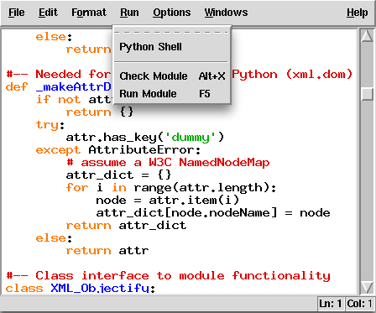
IDLE

Slide 19
etc.

Slide 20
PEP 20 – The Zen of Python
Tim Peters

Slide 21
Beautiful is better than ugly

Slide 22
Explicit is better than implicit

Slide 23
Simple is better than complex

Slide 24
Complex is better than complicated

Slide 25
Flat is better than nested

Slide 26
Sparse is better than dense

Slide 27
Readability counts

Slide 28
Special cases aren't special enough
to break the rules

Slide 29
Although practicality beats purity

Slide 30
Errors should never pass silently

Slide 31
Unless explicitly silenced

Slide 32
In the face of ambiguity,
refuse the temptation to guess

Slide 33
There should be one --
and preferably only one --
obvious way to do it

Slide 34
Although that way may not be obvious
at first
unless you're Dutch

Slide 35
Now is better than never

Slide 36
Although never is often
better than *right* now

Slide 37
If the implementation is hard to explain,
it's a bad idea

Slide 38
If the implementation is easy to explain,
It may be a good idea

Slide 39
Namespaces are one honking great idea --
let's do more of those!

Slide 41
Top-Down Design
Damian Gordon

Slide 42
Top-Down Design
Top-Down Design (also known as stepwise design) is breaking down a problem into steps.
In Top-down Design an overview of the problem is described first, specifying but not detailing any first-level sub-steps.
Each sub-step is then refined in yet greater detail, sometimes in many additional sub-steps, until the entire specification is reduced to basic elements.

Slide 43
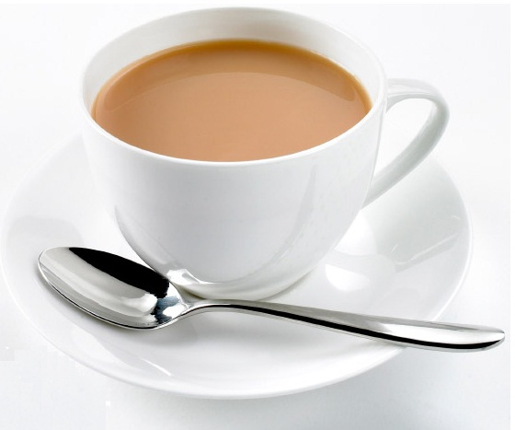
Example
Making a Cup of Tea

Slide 44
Example
Organise everything together
Plug in kettle
Put teabag in cup
Put water into kettle
Turn on kettle
Wait for kettle to boil
Add boiling water to cup
Remove teabag with spoon/fork
Add milk and/or sugar
Serve

Slide 45
Example
Organise everything together
Plug in kettle
Put teabag in cup
Put water into kettle
Turn on kettle
Wait for kettle to boil
Add boiling water to cup
Remove teabag with spoon/fork
Add milk and/or sugar
Serve

Slide 46
Example
Organise everything together
Plug in kettle
Put teabag in cup
Put water into kettle
Turn on kettle
Wait for kettle to boil
Add boiling water to cup
Remove teabag with spoon/fork
Add milk and/or sugar
Serve

Slide 47
Example
Organise everything together
Plug in kettle
Put teabag in cup
Put water into kettle
Turn on kettle
Wait for kettle to boil
Add boiling water to cup
Remove teabag with spoon/fork
Add milk and/or sugar
Serve

Slide 48
Example
Organise everything together
Plug in kettle
Put teabag in cup
Put water into kettle
Turn on kettle
Wait for kettle to boil
Add boiling water to cup
Remove teabag with spoon/fork
Add milk and/or sugar
Serve

Slide 49
Example
Organise everything together
Plug in kettle
Put teabag in cup
Put water into kettle
Turn on kettle
Wait for kettle to boil
Add boiling water to cup
Remove teabag with spoon/fork
Add milk and/or sugar
Serve

Slide 50
Example
Organise everything together
Plug in kettle
Put teabag in cup
Put water into kettle
Turn on kettle
Wait for kettle to boil
Add boiling water to cup
Remove teabag with spoon/fork
Add milk and/or sugar
Serve

Slide 51
Example
Organise everything together
Plug in kettle
Put teabag in cup
Put water into kettle
Turn on kettle
Wait for kettle to boil
Add boiling water to cup
Remove teabag with spoon/fork
Add milk and/or sugar
Serve

Slide 52
Example
Organise everything together
Plug in kettle
Put teabag in cup
Put water into kettle
Turn on kettle
Wait for kettle to boil
Add boiling water to cup
Remove teabag with spoon/fork
Add milk and/or sugar
Serve

Slide 53
Example
Organise everything together
Plug in kettle
Put teabag in cup
Put water into kettle
Turn on kettle
Wait for kettle to boil
Add boiling water to cup
Remove teabag with spoon/fork
Add milk and/or sugar
Serve

Slide 54
Example : Step-wise Refinement
Step-wise refinement of step 1 (Organise everything together)
1.1 Get a cup
1.2 Get tea bags
1.3 Get sugar
1.4 Get milk
1.5 Get spoon/fork.

Slide 55
Example : Step-wise Refinement
Step-wise refinement of step 2 (Plug in kettle)
2.1 Locate plug of kettle
2.2 Insert plug into electrical outlet

Slide 56
Example : Step-wise Refinement
Step-wise refinement of step 3 (Put teabag in cup)
3.1 Take teabag from box
3.2 Put it into cup

Slide 57
Example : Step-wise Refinement
Step-wise refinement of step 4 (Put water into kettle)
4.1 Bring kettle to tap
4.2 Put kettle under water
4.3 Turn on tap
4.4 Wait for kettle to be full
4.5 Turn off tap

Slide 58
Example : Step-wise Refinement
Step-wise refinement of step 5 (Turn on kettle)
5.1 Depress switch on kettle

Slide 59
Over to you…

Slide 60
etc.

Slide 61
Variables
Damian Gordon

Slide 62
Variables
We know what a variable is from maths.
We’ve all seen this sort of thing in algebra:
2x – 10 = 0
2x = 10
X = 5

Slide 63
Variables
We know what a variable is from maths.
We’ve all seen this sort of thing in algebra:
2x – 10 = 0
2x = 10
X = 5

Slide 64
Variables
We know what a variable is from maths.
We’ve all seen this sort of thing in algebra:
2x – 10 = 0
2x = 10
X = 5

Slide 65
Variables
We know what a variable is from maths.
We’ve all seen this sort of thing in algebra:
2x – 10 = 0
2x = 10
X = 5

Slide 66
Variables
We know what a variable is from maths.
We’ve all seen this sort of thing in algebra:
2x – 10 = 0
2x = 10
X = 5

Slide 67
Variables
…and in another problem we might have:
3x + 12 = 0
3x = -12
X = -4

Slide 68
Variables
So a variable contains a value, and that value changes over time.

Slide 69
Variables
…like your bank balance!

Slide 70
Variables
In programming, we tell the computer the value of a variable
So, for example,
x <- 5
means “X gets the value 5”
or “X is assigned 5”

Slide 71
Variables
In programming, we tell the computer the value of a variable
So, for example,
x = 5
means “X gets the value 5”
or “X is assigned 5”

Slide 72
Variables
In programming, we tell the computer the value of a variable
So, for example,
x = 5
means “X gets the value 5”
or “X is assigned 5”
X

Slide 73
Variables
In programming, we tell the computer the value of a variable
So, for example,
x = 5
means “X gets the value 5”
or “X is assigned 5”
5
X

Slide 74
Variables
And later we can say something like:
x = 8
means “X gets the value 8”
or “X is assigned 8”

Slide 75
Variables
If we want to add one to a variable:
x = x + 1
means “increment X”
or “X is incremented by 1”
4
X(old)
+1
5
X(new)

Slide 76
Variables
6
We can create a new variable Y
y = x
means “Y gets the value of X”
or “Y is assigned the value of X”
X
6
Y

Slide 77
Variables
6
X
+1
7
Y
We can also say:
y = x + 1
means “Y gets the value of x plus 1”
or “Y is assigned the value of x plus 1”

Slide 78
Variables
All of these variables are integers
They are all whole numbers

Slide 79
Variables
Let’s look at numbers with decimal points:
P = 3.14159
means “p gets the value of 3.14159”
or “p is assigned the value of 3.14159”

Slide 80
Variables
We should really give this a better name:
Pi = 3.14159
means “Pi gets the value of 3.14159”
or “Pi is assigned the value of 3.14159”

Slide 81
Variables
We can also have single character variables:
Vitamin = ‘B’
means “Vitamin gets the value of B”
or “Vitamin is assigned the value of B”

Slide 82
Variables
We can also have single character variables:
RoomNumber = ‘2’
means “RoomNumber gets the value of 2”
or “RoomNumber is assigned the value of 2”

Slide 83
Variables
We can also have a string of characters:
Pet = “Dog”
means “Pet gets the value of Dog”
or “Pet is assigned the value of Dog”

Slide 84
Variables
We also have a special type, called BOOLEAN
It has only two values, TRUE or FALSE
IsWeekend = False
means “IsWeekend gets the value of FALSE”
or “IsWeekend is assigned the value of FALSE”

Slide 85
etc.

Slide 86
Python: Print
Damian Gordon

Slide 87
Your first Python program
When learning a new computer programming language, the first thing typically taught is how to write a message to the screen saying “Hello, World”.
Let’s see how to do that:

Slide 88
print(“Hello, World”)

Slide 89
# PROGRAM HelloWorldProgram:
print(“Hello, World”)
# END.

Slide 90
# HelloWorldProgram – Version 1
# A program to print out “Hello, World”
# Written by: Damian Gordon
# Date: 10/09/2015
# PROGRAM HelloWorldProgram:
print(“Hello, World”)
# END.

Slide 91
The PRINT statement
If we want to add a blank line after our print statement:

Slide 92
# PROGRAM HelloWorldProgram:
print(“Hello, World”)
# END.

Slide 93
# PROGRAM HelloWorldProgram:
print(“Hello, World”)
# END.
# PROGRAM HelloWorldProgramNewLine:
print(“Hello, World\n”)
# END.

Slide 94
The PRINT statement
To print out two lines of text we do:

Slide 95
# PROGRAM HelloWorldProgramTwoLines:
print(“Hello, World”)
print(“I’m here”)
# END.

Slide 96
The PRINT statement
To join two strings together:

Slide 97
# PROGRAM HelloWorldProgramJoined:
print(“Hello, World” + “ I’m here”)
# END.

Slide 98
The PRINT statement
To print out the same message 10 times:

Slide 99
# PROGRAM HelloWorldProgram10Times:
print(“Hello, World” * 10)
# END.

Slide 100
The PRINT statement
To print out the same message 10 times, each one on a new line:

Slide 101
# PROGRAM HelloWorldProgramNewLine10Times:
print(“Hello, World\n” * 10)
# END.

Slide 102
Code | Description
\\ | Print a backslash
\’ | Print a single quote
\” | Print a double quote
\a | Play a beep
\n | Print a new line
\t | Print a tab

Slide 103
Python: Maths
Damian Gordon

Slide 104
Some Simple Maths
Let’s look at some simple maths first:

Slide 105
# PROGRAM AddingNumbers:
print(10 + 7)
# END.

Slide 106
Some Simple Maths
Let’s make that a bit more fancy

Slide 107
# PROGRAM AddingNumbers:
print(“10 + 7 = “, 10 + 7)
# END.

Slide 108
Some Simple Maths
Let’s try subtraction:

Slide 109
# PROGRAM SubtractingNumbers:
print(“10 - 7 = “, 10 - 7)
# END.

Slide 110
Some Simple Maths
Let’s try multiplication:

Slide 111
# PROGRAM MultiplyingNumbers:
print(“10 * 7 = “, 10 * 7)
# END.

Slide 112
Some Simple Maths
Division is a lot cooler, we can do three kinds of division,
Regular Division
Integer Division
Division Remainder

Slide 113
# PROGRAM RegularDivision:
print(“10 / 7 = “, 10 / 7)
# END.

Slide 114
# PROGRAM RegularDivision:
print(“10 / 7 = “, 10 / 7)
# END.
This should give us:
1.428571

Slide 115
# PROGRAM IntegerDivision:
print(“10 // 7 = “, 10 // 7)
# END.

Slide 116
# PROGRAM IntegerDivision:
print(“10 // 7 = “, 10 // 7)
# END.
This should give us:
1

Slide 117
# PROGRAM IntegerDivision:
print(“10 // 7 = “, 10 // 7)
# END.
which is how many times 7 divides evenly into 10
This should give us:
1

Slide 118
# PROGRAM DivisionRemainder:
print(“10 % 7 = “, 10 % 7)
# END.

Slide 119
# PROGRAM DivisionRemainder:
print(“10 % 7 = “, 10 % 7)
# END.
This should give us:
3

Slide 120
# PROGRAM DivisionRemainder:
print(“10 % 7 = “, 10 % 7)
# END.
which is what is left over when we divide 7 into 10
This should give us:
3

Slide 121
Some Simple Maths
Can you work this one out?

Slide 122
# PROGRAM DivisionProblem:
print(((10 / 7 – 10 // 7) * 7) + 7)
# END.

Slide 123
Python: Variables
Damian Gordon

Slide 124
Using Variables
Variables are easy to use in Python, there is no need to declare the type of the variable.
Python will work it out for you (mostly!).

Slide 125
# PROGRAM VariableAssignment:
x = 6
# END.

Slide 126
Using Variables
And if we want to check the value of the variable:

Slide 127
# PROGRAM VariablePrint:
x = 6
print(x)
# END.

Slide 128
Using Variables
Let’s add 1 to x:

Slide 129
# PROGRAM AddOneVariablePrint:
x = 6
print(x + 1)
# END.

Slide 130
Using Variables
Let’s try two variables:

Slide 131
# PROGRAM TwoVariablePrint:
x = 6
y = 5
print(x + y)
# END.

Slide 132
Using Variables
If we want to move from integers to real numbers

Slide 133
# PROGRAM RealVariablePrint:
x = 6.56
print(x)
# END.

Slide 134
# PROGRAM AnotherRealVariablePrint:
x = 6.0
print(x)
# END.

Slide 135
Using Variables
If we want to create character variables

Slide 136
# PROGRAM CharacterVariablePrint:
x = ‘@’
print(x)
# END.

Slide 137
# PROGRAM AnotherCharacterVariablePrint:
x = ‘5’
print(x)
# END.

Slide 138
Using Variables
Now we can see that we can’t do arithmetic with characters:

Slide 139
# PROGRAM ErrorProgram:
x = ‘5’
print(x + 1)
# END.

Slide 140
Using Variables
If we want to create String variables

Slide 141
# PROGRAM StringVariablePrint:
x = “This is a string”
print(x)
# END.

Slide 142
Using Variables
To get input from the screen, we can do the following:

Slide 143
# PROGRAM PrintMessage:
print(“Please input a message: ”)
NewMsg = input()
print(NewMsg)
# END.

Slide 144
Using Variables
Let’s do the converting temperature program:

Slide 145
# PROGRAM ConvertFromCelsiusToFahrenheit:
print(“Please input your temperature in C:”)
InputVal = int(input());
print(“That temperature in F is:”)
print((InputVal *2) + 30)
# END.

Slide 146
Convert | Description | Result
int(x) | Convert variable into an integer, e.g. x = “10” int(x) | 10
float(x) | Convert variable into a real e.g. x = “10.5” float(x) | 10.5
str(x) | Convert variable into an string, e.g. x = 10 str(x) | “10”

Slide 147
Using Variables
The following words cannot be used as variable names:
and | del | from | not | while
as | elif | global | or | with
assert | else | if | pass | yield
break | except | import | print
class | exec | in | raise
continue | finally | is | return
def | for | lambda | try

Slide 148
A Special Note On Boolean Variables

Slide 149
Boolean Variables
In the original version of Python (1989), there was no Boolean type, in Version 2.2.1 (2002) True and False constants were added to the built-ins (they were simply set to integer values of 1 and 0 and weren't a different type.

Slide 150
Boolean Variables
Finally in Version 2.3 (2003) True and False were added in as constants to the __builtin__ module, making them a core part of Python.

Slide 151
# PROGRAM BooleanVar:
x = True
print(x)
# END.

Slide 152
# PROGRAM BooleanVar:
x = False
print(x)
# END.

Slide 153
etc.

Slide 154
Selection: IF Statement
Damian Gordon

Slide 155
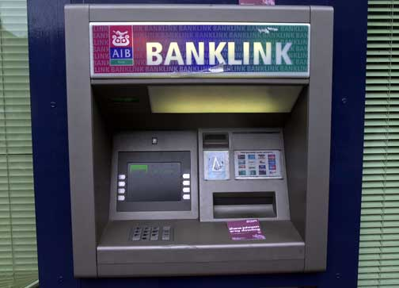
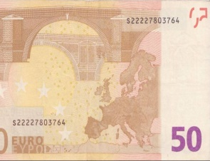
adsdfsdsdsfsdfsdsdlkmfsdfmsdlkfsdmkfsldfmskdddfsdsdfsd

Slide 156
Do you wish to print a receipt?
< YES NO >

Slide 157
Do you wish to print a receipt?
< YES NO >
In the interests of preserving the environment, we prefer not to print a receipt, but if you want to be a jerk, go ahead.
< PRINT RECEIPT CONTINUE >

Slide 158
Selection
What if we want to make a choice, for example, do we want to add sugar or not to the tea?

Slide 159
Selection
What if we want to make a choice, for example, do we want to add sugar or not to the tea?
We call this SELECTION.

Slide 160
IF Statement
So, we could state this as:
IF (sugar is required)
THEN add sugar;
ELSE don’t add sugar;
ENDIF;

Slide 161
IF Statement
Adding a selection statement in the program:
PROGRAM MakeACupOfTea:
Organise everything together;
Plug in kettle;
Put teabag in cup;
Put water into kettle;
Wait for kettle to boil;
Add water to cup;
Remove teabag with spoon/fork;
Add milk;
IF (sugar is required)
THEN add sugar;
ELSE do nothing;
ENDIF;
Serve;
END.

Slide 162
IF Statement
Adding a selection statement in the program:
PROGRAM MakeACupOfTea:
Organise everything together;
Plug in kettle;
Put teabag in cup;
Put water into kettle;
Wait for kettle to boil;
Add water to cup;
Remove teabag with spoon/fork;
Add milk;
IF (sugar is required)
THEN add sugar;
ELSE do nothing;
ENDIF;
Serve;
END.

Slide 163
etc.

Slide 164
Boolean Logic
Damian Gordon

Slide 165
Boolean Logic
You may have seen Boolean logic in another module already, for this module, we’ll look at three Boolean operations:
AND
OR
NOT

Slide 166
Boolean Logic
Boolean operators are used in the conditions of:
IF Statements
CASE Statements
WHILE Loops
FOR Loops
DO Loops
LOOP Loops

Slide 167
Boolean Logic
AND Operation
The AND operation means that both parts of the condition must be true for the condition to be satisfied.
A=TRUE, B=TRUE => A AND B = TRUE
A=FALSE, B=TRUE => A AND B = FALSE
A=TRUE, B=FALSE => A AND B = FALSE
A=FALSE, B=FALSE => A AND B = FALSE

Slide 168
Boolean Logic
OR Operation
The OR operation means that either (or both) parts of the condition must be true for the condition to be satisfied.
A=TRUE, B=TRUE => A OR B = TRUE
A=FALSE, B=TRUE => A OR B = TRUE
A=TRUE, B=FALSE => A OR B = TRUE
A=FALSE, B=FALSE => A OR B = FALSE

Slide 169
Boolean Logic
NOT Operation
The NOT operation means that the outcome of the condition is inverted.
A=TRUE => NOT(A) = FALSE
A=FALSE => NOT(A) = TRUE

Slide 170
etc.

Slide 171
Python: Selection
Damian Gordon

Slide 172
Python: Selection
We’ll consider two ways to do selection:
The IF statement
The CASE statement

Slide 173
Python: IF statement
Damian Gordon

Slide 174
Python: IF statement
In Python the general form of the IF statement is as follows:
if CONDITION:
STATEMENT(S)
else:
STATEMENT(S)

Slide 175
Python: IF statement
But we’ll do:
if CONDITION:
# THEN
STATEMENT(S)
else:
STATEMENT(S)
# ENDIF;

Slide 176
# PROGRAM SimpleIfStatement:
x = 6
y = 7
if x > y:
# THEN
print(“x is bigger”)
else:
print(“y is bigger”)
# ENDIF;
# END.

Slide 177
Python: IF statement
Let’s get the user to input the values of x and y:

Slide 178
# PROGRAM AnotherSimpleIfStatement:
x = int(input())
y = int(input())
if x > y:
# THEN
print(x, “is bigger than”, y)
else:
print(y, “is bigger than”, x)
# ENDIF;
# END.

Slide 179
Python: IF statement
Let’s add some PRINT statements to make this clearer:

Slide 180
# PROGRAM AnotherSimpleIfStatementPrints:
print(“Please input the first value”)
x = int(input())
print(“Please second the second value”)
y = int(input())
if x > y:
# THEN
print(x, “is bigger than”, y)
else:
print(y, “is bigger than”, x)
# ENDIF;
# END.

Slide 181
Python: IF statement
We can make this shorter:

Slide 182
# PROGRAM AnotherSimpleIfStatementPrintsShorter:
x = int(input(“Please input the first value\n”))
y = int(input(“Please second the second value\n”))
if x > y:
# THEN
print(x, “is bigger than”, y)
else:
print(y, “is bigger than”, x)
# ENDIF;
# END.

Slide 183
Python: IF statement
Lets try the Odd or Even program:

Slide 184
# PROGRAM IsOddOrEven:
x = int(input(“Please input the number\n”))
if (x % 2) != 0:
# THEN
print(x, “is odd”)
else:
print(x, “is even”)
# ENDIF;
# END.

Slide 185
Operator | Description
!= | is not equal to
== | is equal to
> | is greater than
< | is less than
>= | is greater than or equal to
<= | is less than or equal to

Slide 186
Python: IF statement
Let’s try the bigger of three numbers:

Slide 187
# PROGRAM BiggerOfThree:
a = int(input(“Please input the first value\n”))
b = int(input(“Please second the second value\n”))
c = int(input(“Please second the third value\n”))
if a > b:
# THEN
if a > c:
# THEN
print(a, “is bigger than”, b, “ and ”, c)
else:
print(c, “is bigger than”, a, “ and ”, c)
# ENDIF;
else:
if b > c:
# THEN
print(b, “is bigger than”, a, “ and ”, c)
else:
print(c, “is bigger than”, a, “ and ”, b)
# ENDIF;
# ENDIF;
# END.

Slide 188
Python: ELIF statement
Damian Gordon

Slide 189
# PROGRAM BiggerOfThree:
a = int(input(“Please input the first value\n”))
b = int(input(“Please second the second value\n”))
c = int(input(“Please second the third value\n”))
if a > b:
# THEN
if a > c:
# THEN
print(a, “is bigger than”, b, “ and ”, c)
else:
print(c, “is bigger than”, a, “ and ”, c)
# ENDIF;
else:
if b > c:
# THEN
print(b, “is bigger than”, a, “ and ”, c)
else:
print(c, “is bigger than”, a, “ and ”, b)
# ENDIF;
# ENDIF;
# END.

Slide 190
# PROGRAM BiggerOfThree:
a = int(input(“Please input the first value\n”))
b = int(input(“Please second the second value\n”))
c = int(input(“Please second the third value\n”))
if a > b:
# THEN
if a > c:
# THEN
print(a, “is bigger than”, b, “ and ”, c)
else:
print(c, “is bigger than”, a, “ and ”, c)
# ENDIF;
else:
if b > c:
# THEN
print(b, “is bigger than”, a, “ and ”, c)
else:
print(c, “is bigger than”, a, “ and ”, b)
# ENDIF;
# ENDIF;
# END.

Slide 191
# PROGRAM BiggerOfThreeElif:
a = int(input(“Please input the first value\n”))
b = int(input(“Please second the second value\n”))
c = int(input(“Please second the third value\n”))
if a > b:
# THEN
if a > c:
# THEN
print(a, “is bigger than”, b, “ and ”, c)
else:
print(c, “is bigger than”, a, “ and ”, c)
# ENDIF;
elif b > c:
# THEN
print(b, “is bigger than”, a, “ and ”, c)
else:
print(c, “is bigger than”, a, “ and ”, b)
# ENDIF;
# END.

Slide 192
Python: IF-ELIF statement
In Python the general form of the IF-ESIF statement is as follows:
if CONDITION:
STATEMENT(S)
elif CONDITION:
STATEMENT(S)
elif CONDITION:
STATEMENT(S)
else:
STATEMENT(S)

Slide 193
Python: IF-ELIF statement
But we’ll do:
if CONDITION:
# THEN
STATEMENT(S)
elif CONDITION:
# THEN
STATEMENT(S)
elif CONDITION:
# THEN
STATEMENT(S)
else:
STATEMENT(S)
# ENDIF;

Slide 194
Python: IF-ELIF statement
Let’s look at doing a multi-choice question program:

Slide 195
# PROGRAM MultiChoiceQuestion:
InputValue = input("Please input your answer:\n")
if InputValue == "a":
# THEN
print("Wrong Answer")
elif InputValue == "b":
# THEN
print("Wrong Answer")
elif InputValue == "c":
# THEN
print("Right Answer")
elif InputValue == "d":
# THEN
print("Wrong Answer")
else:
print("Bad Option")
# ENDIF;
# END.

Slide 196
Python: IF-ELIF statement
Here’s how to calculate a grade:

Slide 197
# PROGRAM GetGrade:
InputValue = int(input("Please input the first value\n"))
if InputValue >= 70:
# THEN
print("It's a first")
elif InputValue >= 60:
# THEN
print("It's a 2.1")
elif InputValue >= 50:
# THEN
print("It's a 2.2")
elif InputValue >= 40:
# THEN
print("It's a third")
else:
print("Dude, sorry, it's a fail")
# ENDIF;
# END.

Slide 198
etc.

Slide 199
Iteration: WHILE Loop
Damian Gordon

Slide 200
WHILE Loop
Consider the problem of searching for an entry in a phone book with only SELECTION:

Slide 201
WHILE Loop
Get first entry;
IF (this is the correct entry)
THEN write down phone number;
ELSE get next entry;
IF (this is the correct entry)
THEN write done entry;
ELSE get next entry;
IF (this is the correct entry)
……………

Slide 202
WHILE Loop
We may rewrite this using a WHILE Loop:

Slide 203
WHILE Loop
Get first entry;
Call this entry N;
WHILE (N is NOT the required entry)
DO Get next entry;
Call this entry N;
ENDWHILE;

Slide 204
WHILE Loop
START
A = 1
A = A + 1
Is A==6?
No
Print A
Yes
END

Slide 205
etc.

Slide 206
Python: Iteration
Damian Gordon

Slide 207
Python: Iteration
We’ll consider four ways to do iteration:
The WHILE loop
The FOR loop

Slide 208
Python: WHILE loop
Damian Gordon

Slide 209
Python: WHILE loop
The WHILE loop works as follows:
while CONDITION:
STATEMENTS

Slide 210
Python: WHILE loop
But we’ll do:
while CONDITION:
# DO
STATEMENTS
# ENDWHILE;

Slide 211
Python: WHILE loop
Let’s print out the numbers 1 to 5:

Slide 212
# PROGRAM Print1To5:
a = 1
while a != 6:
# DO
print(a)
a = a + 1
# ENDWHILE;
# END.

Slide 213
Python: WHILE loop
Let’s print the sum of the numbers 1 to 5:

Slide 214
# PROGRAM Sum1To5:
a = 1
total = 0
while a != 6:
# DO
total = total + a
a = a + 1
# ENDWHILE;
print(total)
# END.

Slide 215
Python: WHILE loop
Let’s do factorial:

Slide 216
Python: WHILE loop
Let’s do factorial:
Remember:
5! = 5*4*3*2*1
7! = 7*6 *5*4*3*2*1
N! = N*(N-1)*(N-2)*…*2*1

Slide 217
# PROGRAM Factorial:
value = int(input("Please input value:"))
total = 1
while value != 0:
# DO
total = total * value
value = value - 1
# ENDWHILE;
print(total)
# END.

Slide 218
Python: FOR loop
Damian Gordon

Slide 219
Python: WHILE loop
The FOR loop works as follows:
for RANGE:
STATEMENTS

Slide 220
Python: WHILE loop
But we’ll do:
for RANGE:
# DO
STATEMENTS
# ENDFOR;

Slide 221
Python: FOR loop
Let’s remember the program to print out the numbers 1 to 5:

Slide 222
# PROGRAM Print1To5:
a = 1
while a != 6:
# DO
print(a)
a = a + 1
# ENDWHILE;
# END.

Slide 223
Python: FOR loop
We can do it as follows as well:

Slide 224
# PROGRAM Print1To5For:
for a in range(1,6):
# DO
print(a)
# ENDFOR;
# END.

Slide 225
etc.

Slide 226
Prime Numbers
Damian Gordon

Slide 227
Prime Numbers
So let’s say we want to express the following algorithm:
Read in a number and check if it’s a prime number.

Slide 228
Prime Numbers
So let’s say we want to express the following algorithm:
Read in a number and check if it’s a prime number.
What’s a prime number?

Slide 229
Prime Numbers
So let’s say we want to express the following algorithm:
Read in a number and check if it’s a prime number.
What’s a prime number?
A number that’s only divisible by itself and 1, e.g. 7.

Slide 230
Prime Numbers
So let’s say we want to express the following algorithm:
Read in a number and check if it’s a prime number.
What’s a prime number?
A number that’s only divisible by itself and 1, e.g. 7.
Or to put it another way, every number other than itself and 1 gives a remainder, e.g. For 7, if 6, 5, 4, 3, and 2 give a remainder then 7 is prime.

Slide 231
Prime Numbers
So let’s say we want to express the following algorithm:
Read in a number and check if it’s a prime number.
What’s a prime number?
A number that’s only divisible by itself and 1, e.g. 7.
Or to put it another way, every number other than itself and 1 gives a remainder, e.g. For 7, if 6, 5, 4, 3, and 2 give a remainder then 7 is prime.
So all we need to do is divide 7 by all numbers less than it but greater than one, and if any of them have no remainder, we know it’s not prime.

Slide 232
Prime Numbers
So,
If the number is 7, as long as 6, 5, 4, 3, and 2 give a remainder, 7 is prime.
If the number is 9, we know that 8, 7, 6, 5, and 4, all give remainders, but 3 does not give a remainder, it goes evenly into 9 so we can say 9 is not prime

Slide 233
Prime Numbers
So remember,
if the number is 7, as long as 6, 5, 4, 3, and 2 give a remainder, 7 is prime.
So, in general,
if the number is A, as long as A-1, A-2, A-3, A-4, ... 2 give a remainder, A is prime.

Slide 234
etc.

Slide 235
Fibonacci Numbers
Damian Gordon

Slide 236
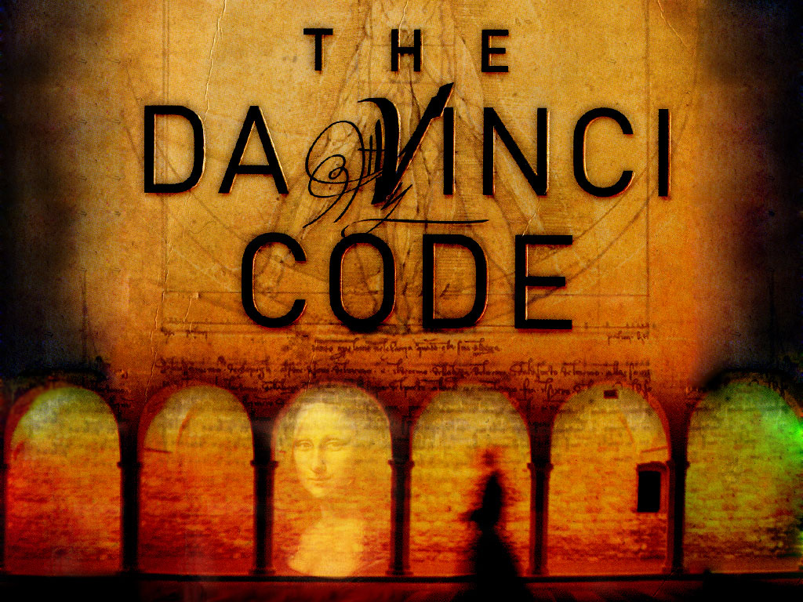

Slide 237
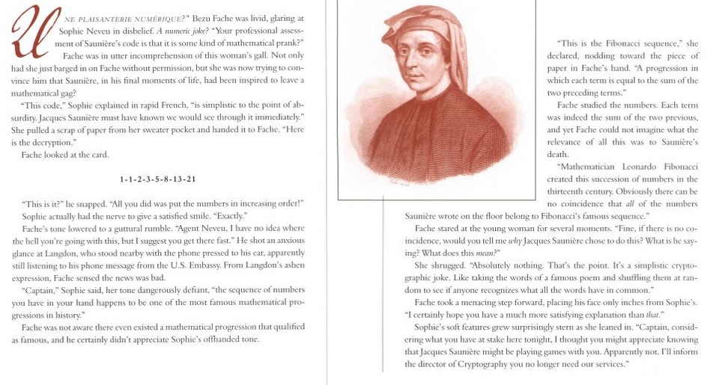
Fibonacci Numbers

Slide 238
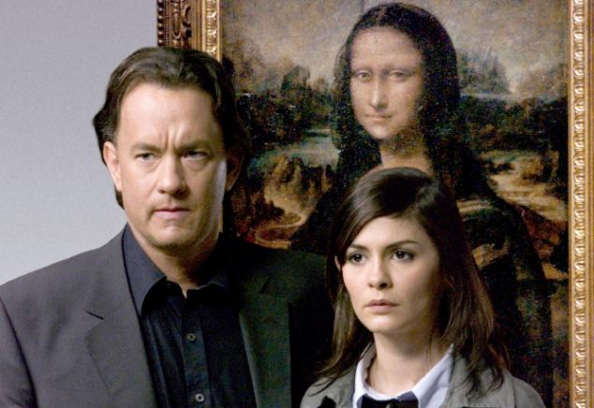
Fibonacci Numbers
As seen in the Da Vinci Code:

Slide 239
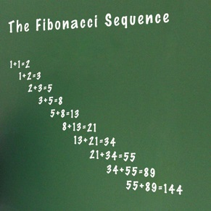
Fibonacci Numbers
The Fibonacci numbers are numbers where the next number in the sequence is the sum of the previous two.
The sequence starts with 1, 1,
And then it’s 2
Then 3
Then 5
Then 8
Then 13

Slide 240
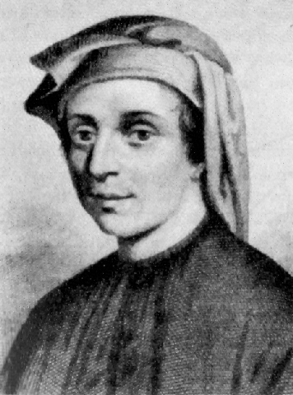
Leonardo Bonacci (aka Fibonacci)
Born 1170.
Born in Pisa, Italy
Died 1250.
An Italian mathematician, considered to be "the most talented Western mathematician of the Middle Ages".
Introduced the sequence of Fibonacci numbers which he used as an example in Liber Abaci.

Slide 241
etc.

Slide 242
Python: Algorithms
Damian Gordon

Slide 243
Prime Numbers
So let’s say we want to express the following algorithm:
Read in a number and check if it’s a prime number.
What’s a prime number?
A number that’s only divisible by itself and 1, e.g. 7.
Or to put it another way, every number other than itself and 1 gives a remainder, e.g. For 7, if 6, 5, 4, 3, and 2 give a remainder then 7 is prime.
So all we need to do is divide 7 by all numbers less than it but greater than one, and if any of them have no remainder, we know it’s not prime.

Slide 244
Prime Numbers
So,
If the number is 7, as long as 6, 5, 4, 3, and 2 give a remainder, 7 is prime.
If the number is 9, we know that 8, 7, 6, 5, and 4, all give remainders, but 3 does not give a remainder, it goes evenly into 9 so we can say 9 is not prime

Slide 245
Prime Numbers
So remember,
if the number is 7, as long as 6, 5, 4, 3, and 2 give a remainder, 7 is prime.
So, in general,
if the number is A, as long as A-1, A-2, A-3, A-4, ... 2 give a remainder, A is prime.

Slide 246
# PROGRAM CheckPrime:
a = int(input("Please input value:"))
b = a - 1
IsPrime = True
while b != 1:
# DO
if a % b == 0:
# THEN
IsPrime = False
# ENDIF;
b = b - 1
# ENDWHILE;
if IsPrime:
# THEN
print(a, "is a prime number")
else:
print(a, "is not a prime number")
# ENDIF;
# END.

Slide 247
Fibonacci Numbers
The Fibonacci numbers are numbers where the next number in the sequence is the sum of the previous two.
The sequence starts with 1, 1,
And then it’s 2
Then 3
Then 5
Then 8
Then 13

Slide 248
# PROGRAM FibonacciNumbers:
a = int(input("Please input value:"))
FirstNum = 1
SecondNum = 1
while a != 1:
# DO
total = SecondNum + FirstNum
FirstNum = SecondNum
SecondNum = total
a = a - 1
# ENDWHILE;
print(total)
# END.

Slide 249
etc.

Slide 250
Modularisation
Damian Gordon

Slide 251
Modularisation
Let’s imagine we had code as follows:

Slide 252
Modularisation
# Python program to mail merger
# Names are in the file names.txt
# Body of the mail is in body.txt
# open names.txt for reading
with open("names.txt",'r',encoding = 'utf-8') as names_file:
# open body.txt for reading
with open("body.txt",'r',encoding = 'utf-8') as body_file:
# read entire content of the body
body = body_file.read()
# iterate over names
for name in names_file:
mail = "Hello "+name+body
# write the mails to individual files
with open(name.strip()+".txt",'w',encoding = 'utf-8') as mail_file:
mail_file.write(mail)
# Python program to mail merger
# Names are in the file names.txt
# Body of the mail is in body.txt
# open names.txt for reading
with open("names.txt",'r',encoding = 'utf-8') as names_file:
# open body.txt for reading
with open("body.txt",'r',encoding = 'utf-8') as body_file:
# read entire content of the body
body = body_file.read()
# iterate over names
for name in names_file:
mail = "Hello "+name+body
# write the mails to individual files
with open(name.strip()+".txt",'w',encoding = 'utf-8') as mail_file:
mail_file.write(mail)

Slide 253
Modularisation
And some bits of the code are repeated a few times

Slide 254
Modularisation
# Python program to mail merger
# Names are in the file names.txt
# Body of the mail is in body.txt
# open names.txt for reading
with open("names.txt",'r',encoding = 'utf-8') as names_file:
# open body.txt for reading
with open("body.txt",'r',encoding = 'utf-8') as body_file:
# read entire content of the body
body = body_file.read()
# iterate over names
for name in names_file:
mail = "Hello "+name+body
# write the mails to individual files
with open(name.strip()+".txt",'w',encoding = 'utf-8') as mail_file:
mail_file.write(mail)
# Python program to mail merger
# Names are in the file names.txt
# Body of the mail is in body.txt
# open names.txt for reading
with open("names.txt",'r',encoding = 'utf-8') as names_file:
# open body.txt for reading
with open("body.txt",'r',encoding = 'utf-8') as body_file:
# read entire content of the body
body = body_file.read()
# iterate over names
for name in names_file:
mail = "Hello "+name+body
# write the mails to individual files
with open(name.strip()+".txt",'w',encoding = 'utf-8') as mail_file:
mail_file.write(mail)

Slide 255
Modularisation
# Python program to mail merger
# Names are in the file names.txt
# Body of the mail is in body.txt
# open names.txt for reading
with open("names.txt",'r',encoding = 'utf-8') as names_file:
# open body.txt for reading
with open("body.txt",'r',encoding = 'utf-8') as body_file:
# read entire content of the body
body = body_file.read()
# iterate over names
for name in names_file:
mail = "Hello "+name+body
# write the mails to individual files
with open(name.strip()+".txt",'w',encoding = 'utf-8') as mail_file:
mail_file.write(mail)
# Python program to mail merger
# Names are in the file names.txt
# Body of the mail is in body.txt
# open names.txt for reading
with open("names.txt",'r',encoding = 'utf-8') as names_file:
# open body.txt for reading
with open("body.txt",'r',encoding = 'utf-8') as body_file:
# read entire content of the body
body = body_file.read()
# iterate over names
for name in names_file:
mail = "Hello "+name+body
# write the mails to individual files
with open(name.strip()+".txt",'w',encoding = 'utf-8') as mail_file:
mail_file.write(mail)

Slide 256
Modularisation
It would be good if there was some way we could wrap up frequently used commands into a single package, and instead of having to rewrite the same code over and over again, we could just call the package name.
We can call these packages methods or functions
(or subroutines or procedures)

Slide 257
Modularisation
Let’s revisit our prime number algorithm again:

Slide 258
etc.

Slide 259
Python: Modularisation
Damian Gordon

Slide 260
Modularisation
Remember the prime checker program:

Slide 261
# PROGRAM CheckPrime:
a = int(input("Please input value:"))
b = a - 1
IsPrime = True
while b != 1:
# DO
if a % b == 0:
# THEN
IsPrime = False
# ENDIF;
b = b - 1
# ENDWHILE;
if IsPrime:
# THEN
print(a, "is a prime number")
else:
print(a, "is not a prime number")
# ENDIF;
# END.

Slide 262
# PROGRAM CheckPrime:
a = int(input("Please input value:"))
b = a - 1
IsPrime = True
while b != 1:
# DO
if a % b == 0:
# THEN
IsPrime = False
# ENDIF;
b = b - 1
# ENDWHILE;
if IsPrime:
# THEN
print(a, "is a prime number")
else:
print(a, "is not a prime number")
# ENDIF;
# END.

Slide 263
Modularisation
Let’s break this program into modules (functions).

Slide 264
#########################
# Prime Checking Module #
#########################
def IsItPrime():
a = int(input("Please input value: "))
b = a - 1
IsPrime = True
while b != 1:
# DO
if a % b == 0:
# THEN
IsPrime = False
# ENDIF;
b = b - 1
# ENDWHILE;
return IsPrime
# END IsItPrime.

Slide 265
#########################
# Prime Checking Module #
#########################
def IsItPrime():
a = int(input("Please input value: "))
b = a - 1
IsPrime = True
while b != 1:
# DO
if a % b == 0:
# THEN
IsPrime = False
# ENDIF;
b = b - 1
# ENDWHILE;
return IsPrime
# END IsItPrime.

Slide 266
################
# Main Program #
################
# PROGRAM CheckPrime:
if IsItPrime() == True:
# THEN
print("Prime number")
else:
print("Not a prime number")
# ENDIF;
# END.

Slide 267
Introduction to Python
Damian Gordon
e: Damian.Gordon@dit.ie
t: @damiantgordon

