Slide 1
Searching
Damian Gordon

Slide 2
Google PageRank
Damian Gordon

Slide 3
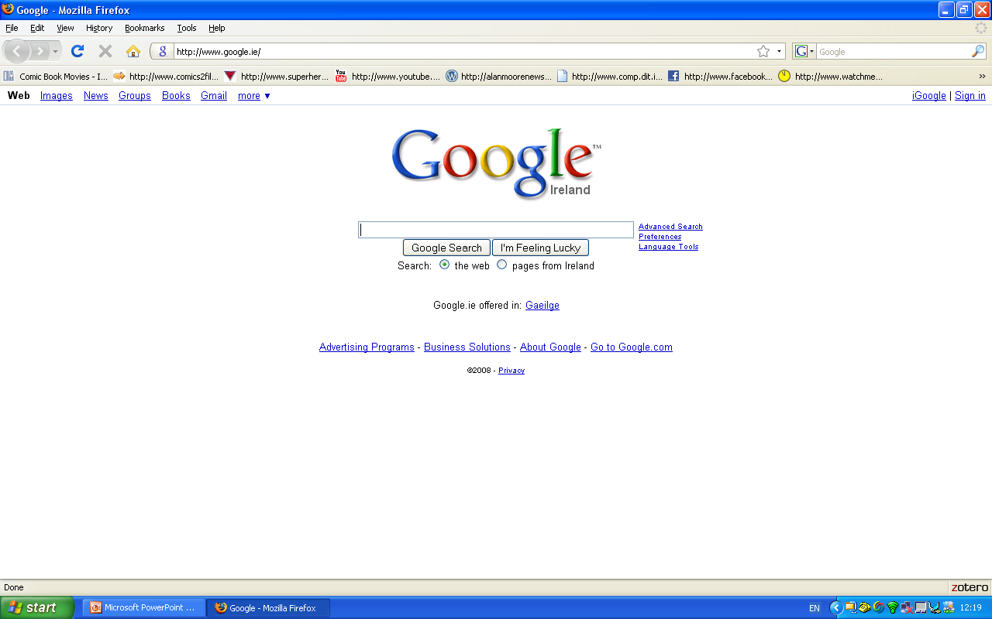

Slide 4
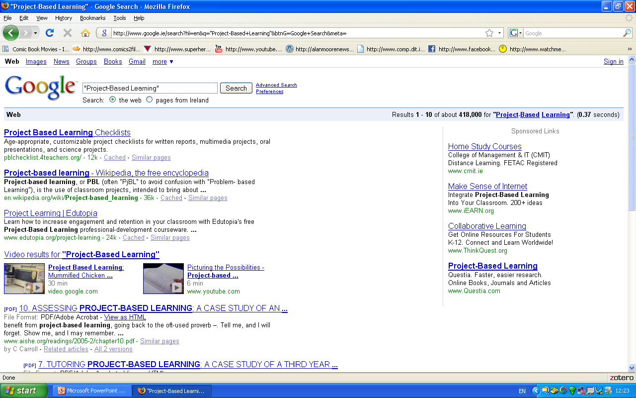

Slide 5
Google Search Algorithm
First Draft:
PROGRAM GoogleCollect:
NextLink <- random website;
WHILE (NextLink != NULL)
DO IF (No copy of this page in google collection)
THEN copy this page into google collection;
ENDIF;
NextLink <- Next link on this page;
ENDWHILE;
END.

Slide 6
Google Search Algorithm
First Draft:
PROGRAM GoogleSearch:
READ SearchString;
Get First Webpage from collection;
WHILE (Webpages Left to Search)
DO IF (SearchString IN Current-Web-Page)
THEN Put this page on the list;
ENDIF;
Get Next Webpage;
ENDWHILE;
Order the list according to PageRank;
END.

Slide 8
Database Searching
Damian Gordon

Slide 9
Searching
Oracle
DB2
MySQL
SQL Server
PostgreSQL

Slide 10
Searching

Slide 11
Array Searching
Damian Gordon

Slide 12
Searching
Let’s remember our integer array from before:

Slide 13
Searching
44
0
23
1
42
2
33
3
16
4
54
5
34
6
18
7
……..…
34
38
82
Age
39

Slide 14
Searching
Let’s say we want to find everyone who is aged 18:

Slide 15
Searching: Sequential Search

Slide 16
Searching: Sequential Search

Slide 17
Searching: Sequential Search

Slide 18
Searching: Sequential Search

Slide 19
Searching: Sequential Search

Slide 20
Searching: Sequential Search

Slide 21
Searching: Sequential Search

Slide 22
Searching: Sequential Search

Slide 23
Searching: Sequential Search

Slide 24
Searching: Sequential Search

Slide 25
Searching: Sequential Search

Slide 26
Searching: Sequential Search

Slide 27
Searching: Sequential Search

Slide 28
Searching: Sequential Search

Slide 29
Searching: Sequential Search

Slide 30
Searching: Sequential Search

Slide 31
Searching: Sequential Search

Slide 32
Searching: Sequential Search

Slide 33
Searching: Sequential Search

Slide 34
Searching: Sequential Search

Slide 35
Searching: Sequential Search

Slide 36
Searching: Sequential Search

Slide 37
Searching: Sequential Search

Slide 38
Searching: Sequential Search

Slide 39
Searching: Sequential Search

Slide 40
Searching: Sequential Search

Slide 41
Searching: Sequential Search

Slide 42
Searching: Sequential Search

Slide 43
Searching: Sequential Search

Slide 44
Searching: Sequential Search

Slide 45
Searching: Sequential Search

Slide 46
Searching: Sequential Search

Slide 47
Searching: Sequential Search

Slide 48
Searching: Sequential Search

Slide 49
Searching: Sequential Search

Slide 50
Searching: Sequential Search

Slide 51
Searching: Sequential Search

Slide 52
Searching: Sequential Search

Slide 53
Searching: Sequential Search

Slide 54
Searching: Sequential Search

Slide 55
Searching: Sequential Search

Slide 56
Searching: Sequential Search
This is a SEQUENTIAL SEARCH.
If the array is 40 characters long, it will take 40 checks to complete. If the array is 1000 characters long, it will take 1000 checks to complete.

Slide 57
Searching: Sequential Search
Here’s how we could do it:
PROGRAM SequentialSearch:
integer SearchValue <- 18;
integer ArraySize <- 40;
FOR N IN 0 TO ArraySize-1
DO IF Age[N] = SearchValue
THEN PRINT “User “ N “is 18”;
ENDIF;
ENDFOR;
END.

Slide 58
Searching: Binary Search
If the data is sorted, we can do a BINARY SEARCH

Slide 59
Searching: Binary Search
If the data is sorted, we can do a BINARY SEARCH
16
0
18
1
23
2
23
3
33
4
33
5
34
6
43
7
……..…
78
38
82
Age
39

Slide 60
Searching: Binary Search
If the data is sorted, we can do a BINARY SEARCH

Slide 61
Searching: Binary Search
If the data is sorted, we can do a BINARY SEARCH
This means we jump to the middle of the array, if the value being searched for is less than the middle value, all we have to do is search the first half of that array.

Slide 62
Searching: Binary Search
If the data is sorted, we can do a BINARY SEARCH
This means we jump to the middle of the array, if the value being searched for is less than the middle value, all we have to do is search the first half of that array.
We search the first half of the array in the same way, jumping to the middle of it, and repeat this.

Slide 63
Searching: Binary Search

Slide 64
Searching: Binary Search

Slide 65
Searching: Binary Search

Slide 66
Searching: Binary Search

Slide 67
Searching: Binary Search

Slide 68
Searching: Binary Search

Slide 69
Searching: Binary Search

Slide 70
Searching: Binary Search

Slide 71
Searching: Binary Search

Slide 72
Searching: Binary Search

Slide 73
Searching: Binary Search
The BINARY SEARCH just takes five checks to find the right value in an array of 40 elements. For an array of 1000 elements it will take 11 checks.
This is much faster than if we searched through all the values.

Slide 74
Searching: Binary Search
If the data is sorted, we can do a BINARY SEARCH
PROGRAM BinarySearch:
integer First <- 0;
integer Last <- 40;
boolean IsFound <- FALSE;
WHILE First <= Last AND IsFound = FALSE
DO Index = (First + Last)/2;
IF Age[Index] = SearchValue
THEN IsFound <- TRUE;
ELSE IF Age[Index] > SearchValue
THEN Last <- Index-1;
ELSE First <- Index+1;
ENDIF;
ENDIF;
ENDWHILE;
END.

Slide 75
etc.

