Slide 1
Let’s talk about DEBUGGING
Damian Gordon

Slide 2
DEBUGGING
Sometimes errors in programs are called “bugs”, so we have a special name for finding and fixing errors in computer programs, we call it “debugging” (in other words, taking the bugs out).
These terms are not exclusive to computers, as far back as the 1870s, Thomas Edison uses the term in a letter, where he says: “that "Bugs"—as such little faults and difficulties are called—show themselves”.

Slide 3
DEBUGGING
Programming is like every other skill we learn in life, the more we practice it, the better we will get at it.
When we start writing programs, we will build them wrong sometimes, so we need to check whether or not the code is doing what we want it to do, or not.

Slide 4
DEBUGGING
We can’t expect ourselves to be brilliant at programming immediately, and even once we become proficient, we should still treat it like writing an essay or an e-mail, we should expect that we will have to redraft a few times to get it working.
So, this is my golden rule:
At least 70% of the time will be spent debugging

Slide 5
DEBUGGING
We have to have the patience and persistence to review each part of the code to see if we can identify the problem. And often we have to stare at code for a few minutes before we will, in a flash, figure out what’s wrong.
This is not easy, and it requires a lot of determination, because often when we have figured out (and fixed) one bug, another one follows.

Slide 6
DEBUGGING
So, we have to type in our code very carefully, and review each part as we write it. And when we are finished writing code, and go to run it, we need to accept that it may not work correctly the first time, and when we fix the initial bug, there may be another, and another.

Slide 7
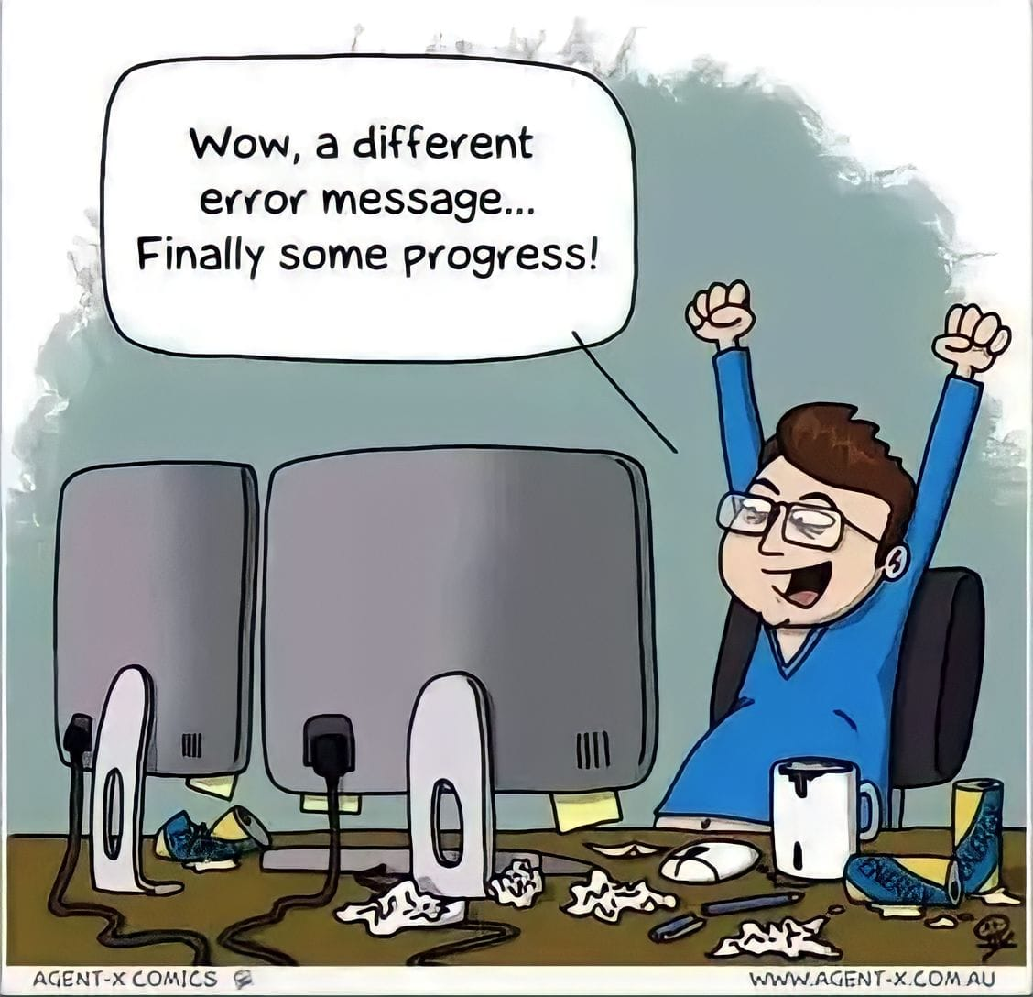
DEBUGGING

Slide 8
DEBUGGING: Breathing
Fixing code can be stressful, and the longer we are working on a bug, the more frustrated we can get. This can lead to short-term thinking, where we move parts of the code around at random in hopes that it will fix itself.
Try to avoid doing this, and try to avoid getting stressed, by breathing. There are a variety of breathing techniques that can be used to calm down, including the following:
Left Nostril Breathing: As the name suggests, just close your right nostril off, and breath in and out through your left nostril slowly, with your eyes closed. This creates a calming effect in your nervous systems within minutes.
7-2-11 Breathing: Breath in through your nose for 7 seconds, hold the breath for 2 seconds, and exhale through your mouth for 11 seconds. This takes a bit of practice, but after a few days of 4-8 sessions a day, you will master it.

Slide 9
DEBUGGING: Take a break
One important trick to know is when to take a break; so if I am staring at an bug and I can’t figure it out, my rule of thumb is after 7 minutes I walk away from the computer and get a glass of water and stop thinking about it for 2-3 minutes. More often than not as soon as I return to the computer, I know exactly the bug is, because I gave my unconscious mind time to work on it, and can fix it in no time.

Slide 10
DEBUGGING: Cardboard Helper
Sometimes the easiest way to fix a bug is to ask someone for help, and you will find that as soon as you say to someone “Excuse me, can you help me with this problem…”, even before you have even outlined the problem, you know what the solution is, because you got a chance to think about it in a different way. In fact, you don’t really need another person, just get a cardboard cutout and ask them for help.

Slide 11
DEBUGGING: Fixing
If the bug is producing an error message, that’s great, read it carefully. The error messages generally can give us a clue as to what the issue might be, or at least where to start looking from. It can also be incredibly useful for us to put the error message into Google, and search for it; we will often find that someone else has experienced this same bug and has found a solution.

Slide 12
DEBUGGING: Fixing
There are two parts to debugging, the locating and fixing of bugs. We’ll look at locating the bugs first, so if the program runs but doesn’t give us the results we are expecting, there is some error in the code that we need to find. The computer is only doing what it is told, so there must be a wrong instruction somewhere. There are a number of debugging approaches that can be taken to find that instruction:

Slide 13
DEBUGGING: Fixing
1. Brute Force Approach: The is probably the most common approach to debugging, and it typically involves adding a number of PRINT statements throughout the program to determine the values of variables in different parts of the program, to see if it possible to locate the cause of the error. There are also tools that can be used in this approach, these include both tracing tools and debugging tools.

Slide 14
DEBUGGING: Fixing
2. Backtracking Approach: The backtracking approach is exactly what it sounds like, you start at the end of the program where the results are being printed out from, and go backwards, manually reviewing each important line to see if it is correctly written, until the wrong instruction is found.

Slide 15
DEBUGGING: Fixing
3. Cause Elimination Approach: This approach involves creating a list of possible causes (or hypothesis) for the error, and initial tests are carried out to eliminate each hypothesis. Of the ones that cannot be eliminated in the initial testing, further tests are carried out to eliminate more and more hypotheses, until there is only one cause left. The error is then located.

Slide 16
One More Thing…
This may be just me, but when I’m trying to debug a program, and I don’t feel like I’m making progress; sometimes if I recite a verse of poetry, or part of a song, and I do that a couple of times, and it gives me the fortitude to continue and succeed.
The two verses below are the ones I most commonly use:

Slide 17
One More Thing…
There's nothing you can do that can't be done
Nothing you can sing that can't be sung
Nothing you can say, but you can learn how to play the game
It's easy
From the song “All You Need Is Love” by John Lennon and Paul McCartney (1967)
Great bugs have little bugs upon their backs to bite 'em,
And little bugs have lesser bugs, and so ad infinitum.
And the great bugs themselves, in turn, have greater bugs to go on;
While these again have greater still, and greater still, and so on.
“Siphonaptera” from Augustus De Morgan's A Budget of Paradoxes (1872)

Slide 18
etc.

