Slide 1
Fibonacci Numbers
Damian Gordon

Slide 2
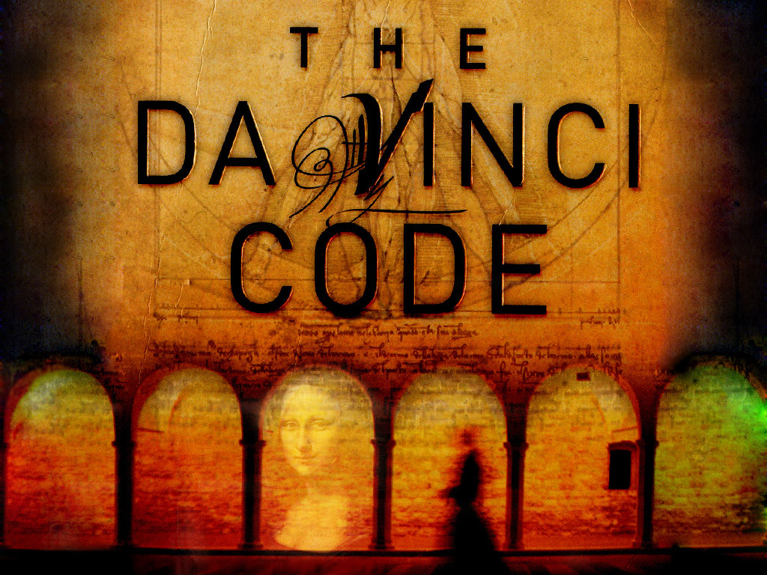

Slide 3
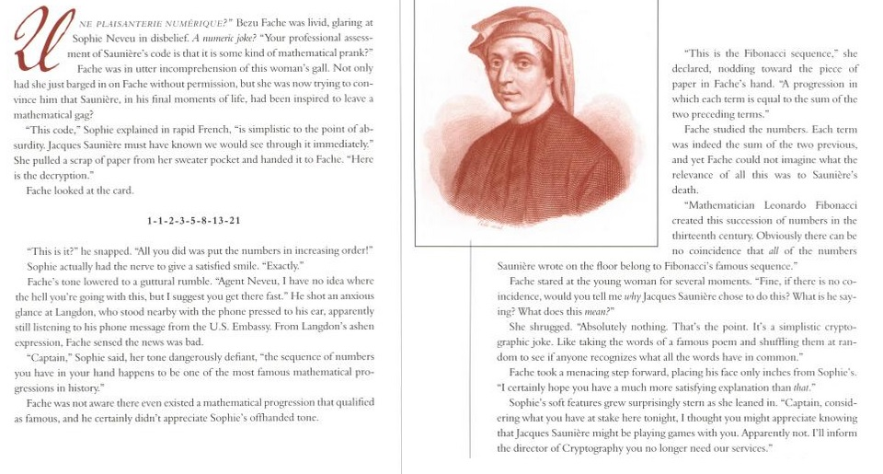
Fibonacci Numbers

Slide 4
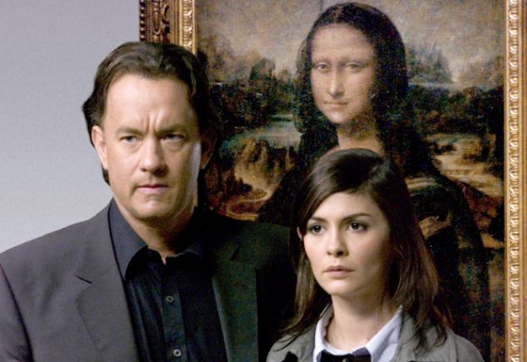
Fibonacci Numbers
As seen in the Da Vinci Code:

Slide 5
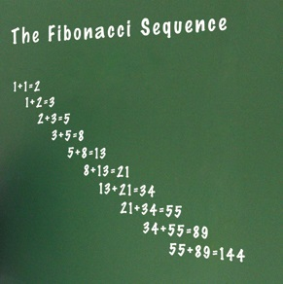
Fibonacci Numbers
The Fibonacci numbers are numbers where the next number in the sequence is the sum of the previous two.
The sequence starts with 1, 1,
And then it’s 2
Then 3
Then 5
Then 8
Then 13

Slide 6
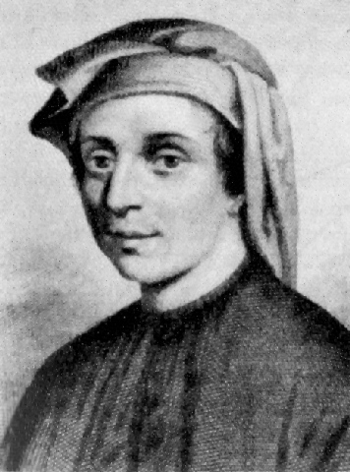
Leonardo Bonacci (aka Fibonacci)
Born 1170.
Born in Pisa, Italy
Died 1250.
An Italian mathematician, considered to be "the most talented Western mathematician of the Middle Ages".
Introduced the sequence of Fibonacci numbers which he used as an example in Liber Abaci.

Slide 7
Fibonacci Numbers
PROGRAM FibonacciNumbers:
READ A;
FirstNum <- 1;
SecondNum <- 1;
WHILE (A != 2)
DO Total <- SecondNum + FirstNum;
FirstNum <- SecondNum;
SecondNum <- Total;
A <- A – 1;
ENDWHILE;
Print Total;
END.

Slide 8
etc.

