Slide 1
Iteration:
FOR, DO, LOOP Loop
Damian Gordon

Slide 2
FOR Loop
The FOR loop does the same thing as a WHILE loop but is easier if you are using the loop to do a countdown (or countup).

Slide 3
FOR Loop
For example:

Slide 4
WHILE Loop
PROGRAM Print1to5:
A <- 1;
WHILE (A != 6)
DO Print A;
A <- A + 1;
ENDWHILE;
END.

Slide 5
FOR Loop
Can be expressed as:

Slide 6
FOR Loop
PROGRAM Print1to5:
FOR A IN 1 TO 5
DO Print A;
ENDFOR;
END.

Slide 7
FOR Loop
Or, in general:
FOR Variable IN Range
DO <Statements>;
ENDFOR;

Slide 8
DO Loop
The WHILE loop can execute any number of times, including zero times.
If we are writing a program, and we know that the loop we are using will be executed at least once, we could consider using a DO loop instead.

Slide 9
DO Loop
PROGRAM MenuOptions:
DO
Print “****** MENU OPTIONS ******”;
Print “1) Input Data”;
Print “2) Delete Data”;
Print “3) Print Report”;
Print “9) Exit”;
Get Value;
WHILE (Value != 9)
END.

Slide 10
DO Loop
Or, in general:
DO
<Statements>;
WHILE (<Condition>)

Slide 11
LOOP Loop
The LOOP loop is one that has no condition, so it is an infinite loop. But it does include an EXIT command to break out of the loop if needed.

Slide 12
LOOP Loop
PROGRAM Print1to5:
A <- 1;
LOOP
Print A;
IF (A = 6)
THEN EXIT;
ENDIF;
A <- A + 1;
ENDLOOP;
END.

Slide 13
LOOP Loop
Or, in general:
LOOP
<Statements>;
IF (<Condition>)
THEN EXIT;
ENDIF;
<Statements>;
ENDLOOP;

Slide 14
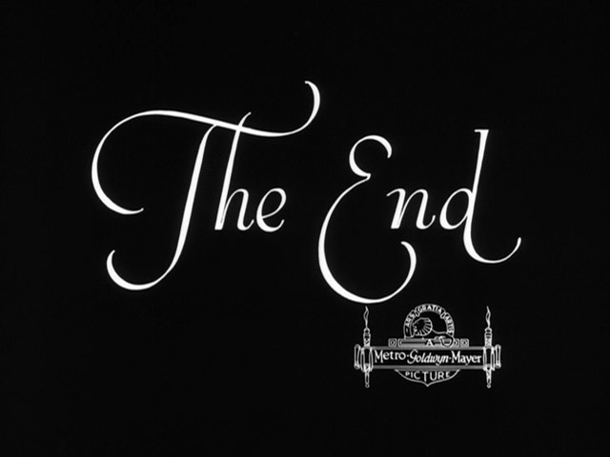
etc.

