Slide 1
Selection: IF Statement
Damian Gordon

Slide 2
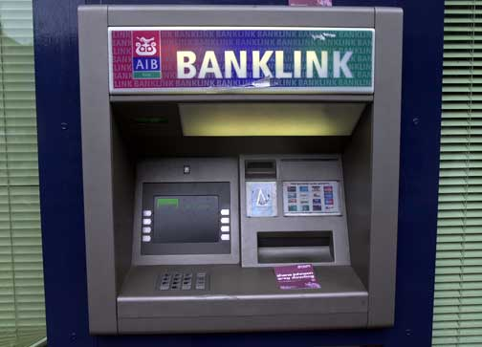
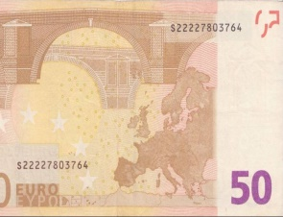
adsdfsdsdsfsdfsdsdlkmfsdfmsdlkfsdmkfsldfmskdddfsdsdfsd

Slide 3
Do you wish to print a receipt?
< YES NO >

Slide 4
Do you wish to print a receipt?
< YES NO >
In the interests of preserving the environment, we prefer not to print a receipt, but if you want to be a jerk, go ahead.
< PRINT RECEIPT CONTINUE >

Slide 5
Selection
What if we want to make a choice, for example, do we want to add sugar or not to the tea?

Slide 6
Selection
What if we want to make a choice, for example, do we want to add sugar or not to the tea?
We call this SELECTION.

Slide 7
IF Statement
So, we could state this as:
IF (sugar is required)
THEN add sugar;
ELSE don’t add sugar;
ENDIF;

Slide 8
IF Statement
Adding a selection statement in the program:
PROGRAM MakeACupOfTea:
Organise everything together;
Plug in kettle;
Put teabag in cup;
Put water into kettle;
Wait for kettle to boil;
Add water to cup;
Remove teabag with spoon/fork;
Add milk;
IF (sugar is required)
THEN add sugar;
ELSE do nothing;
ENDIF;
Serve;
END.

Slide 9
IF Statement
Adding a selection statement in the program:
PROGRAM MakeACupOfTea:
Organise everything together;
Plug in kettle;
Put teabag in cup;
Put water into kettle;
Wait for kettle to boil;
Add water to cup;
Remove teabag with spoon/fork;
Add milk;
IF (sugar is required)
THEN add sugar;
ELSE do nothing;
ENDIF;
Serve;
END.

Slide 10
IF Statement
Or, in general:
IF (<CONDITION>)
THEN <Statements>;
ELSE <Statements>;
ENDIF;

Slide 11
IF Statement
Or to check which number is biggest:
IF (A > B)
THEN Print A;
ELSE Print B;
ENDIF;

Slide 12
Pseudocode
So let’s say we want to express the following algorithm:
Read in a number, check if it is odd or even.

Slide 13
Pseudocode
PROGRAM IsOddOrEven:
Read A;
IF (A/2 gives a remainder)
THEN Print “It’s Odd”;
ELSE Print “It’s Even”;
ENDIF;
END.

Slide 14
Pseudocode
We can skip the ELSE part if there is nothing to do in the ELSE part.
So:
IF (sugar is required)
THEN add sugar;
ELSE don’t add sugar;
ENDIF;

Slide 15
Pseudocode
Becomes:
IF (sugar is required)
THEN add sugar;
ENDIF;

Slide 16
START

Slide 17
START
Read in A

Slide 18
START
Read in A
Does A/2 give a remainder?

Slide 19
START
Read in A
Does A/2 give a remainder?
Print “It’s Odd”
Yes

Slide 20
START
Read in A
Does A/2 give a remainder?
Print “It’s Odd”
Yes
No
Print “It’s Even”

Slide 21
START
Read in A
Does A/2 give a remainder?
Print “It’s Odd”
Yes
No
Print “It’s Even”
END

Slide 22
Pseudocode
So let’s say we want to express the following algorithm to print out the bigger of two numbers:
Read in two numbers, call them A and B. Is A is bigger than B, print out A, otherwise print out B.

Slide 23
Pseudocode
PROGRAM PrintBiggerOfTwo:
Read A;
Read B;
IF (A>B)
THEN Print A;
ELSE Print B;
ENDIF;
END.

Slide 24
START

Slide 25
START
Read in A and B

Slide 26
START
Read in A and B
A>B?

Slide 27
START
Read in A and B
A>B?
Print A
Yes

Slide 28
START
Read in A and B
A>B?
Print A
Yes
No
Print B

Slide 29
START
Read in A and B
A>B?
Print A
Yes
No
Print B
END

Slide 30
Pseudocode
So let’s say we want to express the following algorithm to print out the bigger of three numbers:
Read in three numbers, call them A, B and C.
If A is bigger than B, then if A is bigger than C, print out A, otherwise print out C.
If B is bigger than A, then if B is bigger than C, print out B, otherwise print out C.

Slide 31
Pseudocode
PROGRAM BiggerOfThree:
Read A;
Read B;
Read C;
IF (A>B)
THEN IF (A>C)
THEN Print A;
ELSE Print C;
ENDIF;
ELSE IF (B>C)
THEN Print B;
ELSE Print C;
ENDIF;
ENDIF;
END.

Slide 32
START

Slide 33
START
Read in A, B and C

Slide 34
START
Read in A, B and C
A>B?

Slide 35
START
Read in A, B and C
A>C?
A>B?
Yes

Slide 36
START
Read in A, B and C
A>C?
A>B?
B>C?
Yes
No

Slide 37
START
Read in A, B and C
A>C?
A>B?
B>C?
Yes
No
No
No
Print C

Slide 38
START
Read in A, B and C
A>C?
A>B?
B>C?
Yes
Yes
No
No
No
Print A
Print C

Slide 39
START
Read in A, B and C
A>C?
A>B?
B>C?
Yes
Yes
No
Yes
No
No
Print A
Print C
Print B

Slide 40
START
Read in A, B and C
A>C?
A>B?
B>C?
Yes
Yes
No
Yes
No
No
Print A
Print C
Print B
END

Slide 41
etc.

