Slide 1
Object-Orientated Design
(Summary)
Damian Gordon

Slide 2
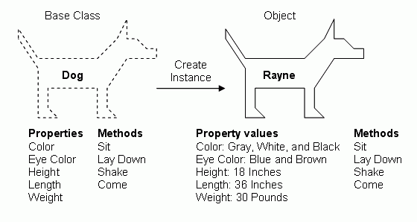

Class
Object
Instantiate
Class
Attributes
Tiny
Methods

Slide 3
Object Orientation
UML Class Diagram
go in >
go in >
*
1
*
1
Apple
Barrel
Orange
Basket
+colour: string
+weight: float
+barrel: Barrel
+size: int
+apples: list
+weight: float
+orchard: string
+date_picked: date
+basket: Basket
+location: string
+oranges: list
+pick(backet: Basket)
+squeeze( ): juice
+sell(cust: Customer)
+discard( )
+pick(backet: Basket)
+squeeze( ): juice
+sell(cust: Customer)
+discard( )

Slide 4
Information Hiding
Other
Classes
Encapsulation
Attrib1
Attributes
Attrib2
Methods
Method1
Public Interface:
Attrib1
Attrib2
Method1

Slide 5
Player
Composition
Car
Driver
drives >
+brakes
+accelerator
2
make_move >
Position
+steer( )
+change_gears( )
+apply_brakes( )
1
+chess_board: Board
Chess Set
1
Abstraction
64
+pieces: list
+board: Board
1
Car
Mechanic
1
+disc_brakes
+engine
+transmission
Board
fixes >
32
Piece
1
+chess_set: ChessSet
+positions: Position
+adjust_breaks( )
+change_oil( )
+chess_set: ChessSet

Slide 6
Inheritance
Piece
Castle
+chess_set: ChessSet
+colour: Sting
Pawn
+shape: String
+shape: String
+move(Board)
+move(Board)
Bishop
Queen
King
Knight
+shape: String
+shape: String
+shape: String
+shape: String
+move(Board)
+move(Board)
+move(Board)
+move(Board)

Slide 7
Objects in Python
(Summary)
Damian Gordon

Slide 8
class <ClassName>:
<Do stuff>
# END Class
def __init__(self,x,y):
self.move(x,y)
# END Init
Object. Attribute = Value
def __init__(self,x,y):
‘Initialise the point position’
self.move(x,y)
# END Init
DocStrings
class Point:
def reset(self):
self.x = 0
self.y = 0
# END Reset
# END Class
Adding Methods:
This is all you need

Slide 9
Modules and Packages
(Summary)
Damian Gordon

Slide 10
# PROGRAM Calling-Point-Docstrings:
import Pointdocstrings
p1 = Pointdocstrings.Point()
p2 = Pointdocstrings.Point()
# PROGRAM Calling-Point-Docstrings:
from Pointdocstrings import Point
p1 = Point()
p2 = Point()
# PROGRAM Calling-Point-Docstrings:
from Pointdocstrings import Point as Pt
p1 = Pt()
p2 = Pt()

Slide 11
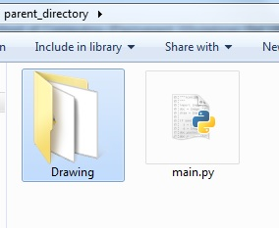
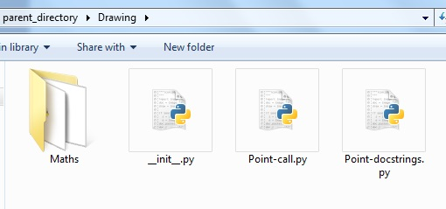
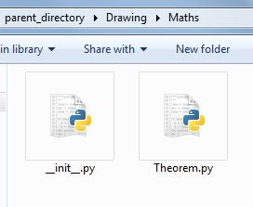
If Point-call.py
wants to call
Point-docstrings.py, you can say:
From .Point-docstrings import Point
If Theorem.py
wants to call
Point-docstrings.py, you can say:
From ..Point-docstrings import Point

Slide 12
Access Control
(Summary)
Damian Gordon

Slide 13
Access Control
By convention, if we prefix a method or attribute with a single underscore ( _ ) we are telling everyone that this method or attribute should not be used by other objects except in the most dire circumstances.
If we want to more strongly suggest that the methods or attributes are for internal use only we can use a double-underscore ( _ _ ) which means Python will try a little harder to make it private

Slide 14
class SecretString:
‘‘‘A not-at-all secure way to store a string.’’’
def __init__(self, plain_string, pass_phrase):
self.__plain_string = plain_string
self.__pass_phrase = pass_phrase
# End __init__
  def decrypt(self, pass_phrase):
  '''Only show the string if the pass_phrase.'''
  if pass_phrase == self.__pass_phrase:
  # THEN
  return self.__plain_string
  else:
  return ''
  # Endif;
  # End decrypt.
  # End Class.

Slide 15
>>> secret_string = SecretString("ACME: Top Secret", “secretpass")
>>> print(secret_string.decrypt("secretpass"))
ACME: Top Secret
>>> print(secret_string.__plain_string)
Traceback (most recent call last):
File "<pyshell#9>", line 1, in <module>
print(secret_string.__plain_string)
AttributeError: 'SecretString' object has no attribute '__plain_string‘
>>> print(secret_string.plain_string)
Traceback (most recent call last):
File "<pyshell#10>", line 1, in <module>
print(secret_string.plain_string)
AttributeError: 'SecretString' object has no attribute 'plain_string'
>>> print(secret_string._SecretString_ _plain_string)
ACME: Top Secret

Slide 16
Third-Party Libraries
(Summary)
Damian Gordon

Slide 17
Third-Party Libraries
If you want to find packages that might be of use to you, you can use the Python Package Index (PyPI):
  http://pypi.python.org

Slide 18
Basic Inheritance
(Summary)
Damian Gordon

Slide 19
class MySubClass(object):
  pass
# End Class.
class Supplier(Contact):
def order(self, order):
print(“The order will send ”
“’{}’ order to ‘{}’”.format(order,self.name))
# End order.
# End Class
Contact
Supplier
Inherit

Slide 20
class SupplierCheck(Supplier):
def order(self, order, balance):
if balance < 0:
# THEN
print("This customer is in debt.")
else:
print("The order will send our "
"'{}' order to '{}'".format(order,self.name))
# End order.
# End Class
This new class overrides the order method to now explore the new balance attribute.
Overriding
Super
class SupplierCheck(Supplier):
def order(self, order, balance):
if balance < 0:
# THEN
print("This customer is in debt.")
else:
super().order(order)
# End order.
# End Class
The super( ) class calls the superclass method from the subclass.

Slide 21
Multiple Inheritance
(Summary)
Damian Gordon

Slide 22
Multiple Inheritance
A subclass can inherit from multiple superclasses, and have the functionality of all of those superclasses available to it.
This is called Multiple Inheritance.
It sounds simple, and it is simple, but it is considered a very tricky to implement in a clear way.

Slide 23
class MailSender:
def send_mail(self, message)
print(“Sending mail to ” + self.email)
# e-mail logic here
# END send_mail.
# END class.
The simplest and most useful form of multiple inheritance is called a mixin.
A MIXIN is a class that is specifically created to be a superclass that other classes will inherit methods and attributes from.
  class EmailableContact(Contact,MailSender):
  # Do stuff
  # END class.

Slide 24
Polymorphism
(Summary)
Damian Gordon

Slide 25
Polymorphism
AudioFile
_ _init_ _( )
MP3File
WAVFile
OGGFile
play( )
play( )
play( )

Slide 26
  class AudioFile:
  def _ _init_ _(self, filename):
  if not filename.endswith(self.ext):
  # THEN
  raise Exception(“Invalid format”)
  # ENDIF;
  self.filename = filename
  # END init()
  # END CLASS.
class MP3File(AudioFile):
ext = “mp3”
def play(self):
print(self.filename)
# END play
# END CLASS.
class WAVFile(AudioFile):
ext = “wav”
def play(self):
print(self.filename)
# END play
# END CLASS.
class OGGFile(AudioFile):
ext = “ogg”
def play(self):
print(self.filename)
# END play
# END CLASS.

Slide 27
Migrating to
Object-Oriented Programs
(Summary)
Damian Gordon

Slide 28
class Polygon:
def _ _init_ _(self):
self.vertices = []
# END init
def add_point(self, point):
self.vertices.append((point))
# END add_point
    def perimeter(self):
    perimeter = 0
    points = self.vertices + [self.vertices[0]]
    for i in range(len(self.vertices)):
    perimeter += points[i].distance(points[i+1])
    # ENDFOR
    return perimeter
    # END perimeter
    # END class perimeter

Slide 29
class Colour:
def _ _init_ _(self, rgb_value, name):
self._rgb_value = rgb_value
self._name = name
# END _ _init_ _
def set_name(self, name):
self._name = name
# END set_name
def get_name(self):
return self._name
# END get_name
# END class.
The __init__ class is the same as before, except the internal variable names are now preceded by underscores to indicate that we don’t want to access them directly
The set_name class sets the name variable instead of doing it the old way:
x._name = “Red”
The get_name class gets the name variable instead of doing it the old way:
Print(x._name)

Slide 30
But that only works if we do this:
  print(redcolour.get_name())
What if we have a load of code written already that does this?
  print(redcolour._name)
Python provides us with a magic function that takes care of this, and it’s called property.
name = property(_get_name, _set_name)

Slide 31
Manager Objects
(Summary)
Damian Gordon

Slide 32

Manager Objects
The manager class and objects don’t really do much activity themselves, and instead they call other methods, and pass messages between those methods.
def zip_find_replace(self):
self.unzip_files()
self.find_replace()
self.zip_files()
# END zip_find_replace

