Slide 1
Top-Down Design
Damian Gordon

Slide 2
Top-Down Design
Top-Down Design (also known as stepwise design) is breaking down a problem into steps.
In Top-down Design an overview of the problem is described first, specifying but not detailing any first-level sub-steps.
Each sub-step is then refined in yet greater detail, sometimes in many additional sub-steps, until the entire specification is reduced to basic elements.

Slide 3
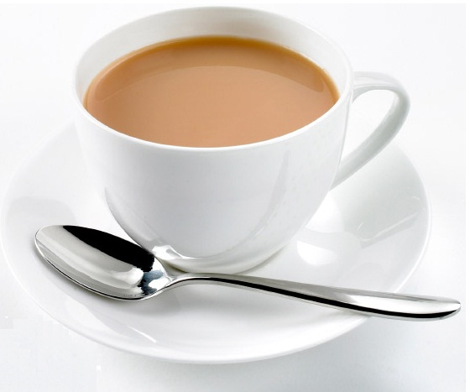
Example
Making a Cup of Tea

Slide 4
Example
Organise everything together
Plug in kettle
Put teabag in cup
Put water into kettle
Turn on kettle
Wait for kettle to boil
Add boiling water to cup
Remove teabag with spoon/fork
Add milk and/or sugar
Serve

Slide 5
Example
Organise everything together
Plug in kettle
Put teabag in cup
Put water into kettle
Turn on kettle
Wait for kettle to boil
Add boiling water to cup
Remove teabag with spoon/fork
Add milk and/or sugar
Serve

Slide 6
Example
Organise everything together
Plug in kettle
Put teabag in cup
Put water into kettle
Turn on kettle
Wait for kettle to boil
Add boiling water to cup
Remove teabag with spoon/fork
Add milk and/or sugar
Serve

Slide 7
Example
Organise everything together
Plug in kettle
Put teabag in cup
Put water into kettle
Turn on kettle
Wait for kettle to boil
Add boiling water to cup
Remove teabag with spoon/fork
Add milk and/or sugar
Serve

Slide 8
Example
Organise everything together
Plug in kettle
Put teabag in cup
Put water into kettle
Turn on kettle
Wait for kettle to boil
Add boiling water to cup
Remove teabag with spoon/fork
Add milk and/or sugar
Serve

Slide 9
Example
Organise everything together
Plug in kettle
Put teabag in cup
Put water into kettle
Turn on kettle
Wait for kettle to boil
Add boiling water to cup
Remove teabag with spoon/fork
Add milk and/or sugar
Serve

Slide 10
Example
Organise everything together
Plug in kettle
Put teabag in cup
Put water into kettle
Turn on kettle
Wait for kettle to boil
Add boiling water to cup
Remove teabag with spoon/fork
Add milk and/or sugar
Serve

Slide 11
Example
Organise everything together
Plug in kettle
Put teabag in cup
Put water into kettle
Turn on kettle
Wait for kettle to boil
Add boiling water to cup
Remove teabag with spoon/fork
Add milk and/or sugar
Serve

Slide 12
Example
Organise everything together
Plug in kettle
Put teabag in cup
Put water into kettle
Turn on kettle
Wait for kettle to boil
Add boiling water to cup
Remove teabag with spoon/fork
Add milk and/or sugar
Serve

Slide 13
Example
Organise everything together
Plug in kettle
Put teabag in cup
Put water into kettle
Turn on kettle
Wait for kettle to boil
Add boiling water to cup
Remove teabag with spoon/fork
Add milk and/or sugar
Serve

Slide 14
Example : Step-wise Refinement
Step-wise refinement of step 1 (Organise everything together)
1.1 Get a cup
1.2 Get tea bags
1.3 Get sugar
1.4 Get milk
1.5 Get spoon/fork.

Slide 15
Example : Step-wise Refinement
Step-wise refinement of step 2 (Plug in kettle)
2.1 Locate plug of kettle
2.2 Insert plug into electrical outlet

Slide 16
Example : Step-wise Refinement
Step-wise refinement of step 3 (Put teabag in cup)
3.1 Take teabag from box
3.2 Put it into cup

Slide 17
Example : Step-wise Refinement
Step-wise refinement of step 4 (Put water into kettle)
4.1 Bring kettle to tap
4.2 Put kettle under water
4.3 Turn on tap
4.4 Wait for kettle to be full
4.5 Turn off tap

Slide 18
Example : Step-wise Refinement
Step-wise refinement of step 5 (Turn on kettle)
5.1 Depress switch on kettle

Slide 19
Over to you…

Slide 20
etc.

