Slide 1
Third-Party Libraries
Damian Gordon

Slide 2
Third-Party Libraries
Python comes with a significant Standard Library with lots of features, but you will soon find out that there are features that aren’t available, so you have one of two options :
  Write a new package yourself
  Use somebody else’s code

Slide 3
Third-Party Libraries
If you want to find packages that might be of use to you, you can use the Python Package Index (PyPI):
  http://pypi.python.org

Slide 4
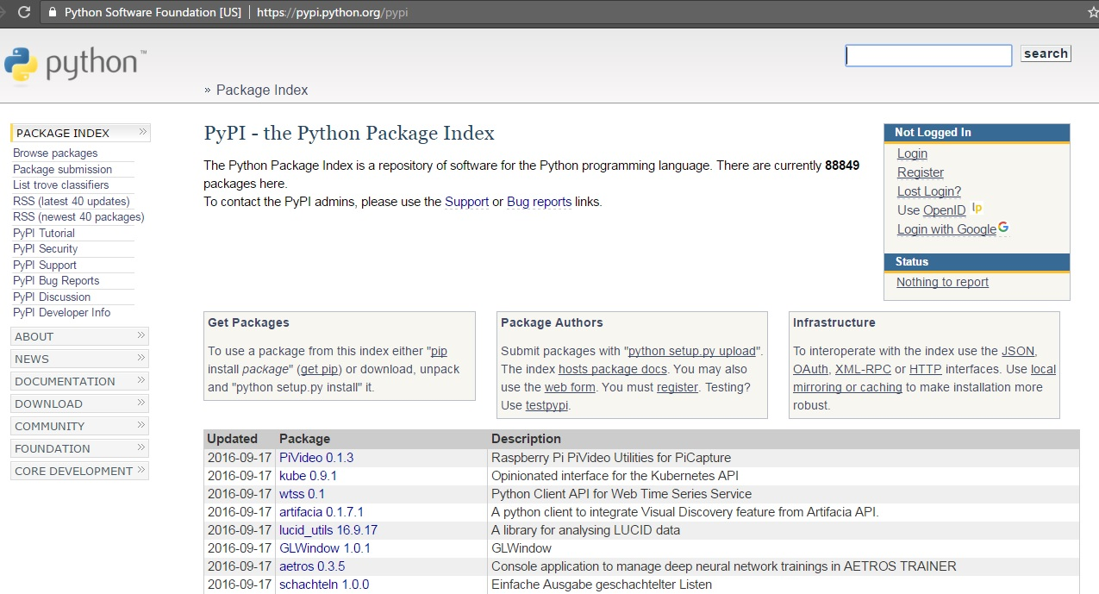
Third-Party Libraries

Slide 5
Third-Party Libraries
Once you’ve find a package you want to install, you can use the pip tool to install it.
Pip doesn’t come with the Python download, but you can download it from:
https://pypi.python.org/pypi/pip

Slide 6
Third-Party Libraries
Once pip has been installed you can install the software into your library using:
    pip install <package>

Slide 7

etc.

