Slide 1
Python: Programming the Google Search (Crawling)
Damian Gordon

Slide 2
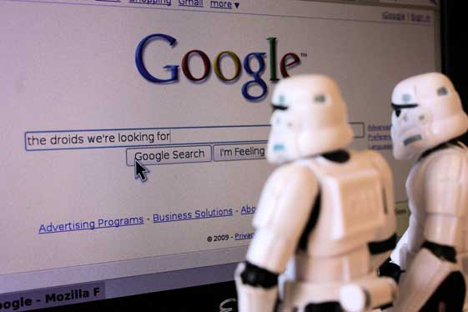
How Google works
How does Google search work?

Slide 3
How Google works
We’ll recall that we discussed the Google Search Engine before. Google Search sends programs called “spiders” to explore the web and find webpages, and take copies of those pages.

Slide 4
How Google works
Then it scans those pages and identifies words and phrases in each page, and stores a count of how many times each word appears in a page, this will help determine where each page is ranked in the search order.

Slide 5
How Google works
Another factor in the ranking of pages is the type of pages that link to each page, if a page is considered to be of good quality if well-know pages (like government websites, or newspaper sites) link to it:

Slide 6
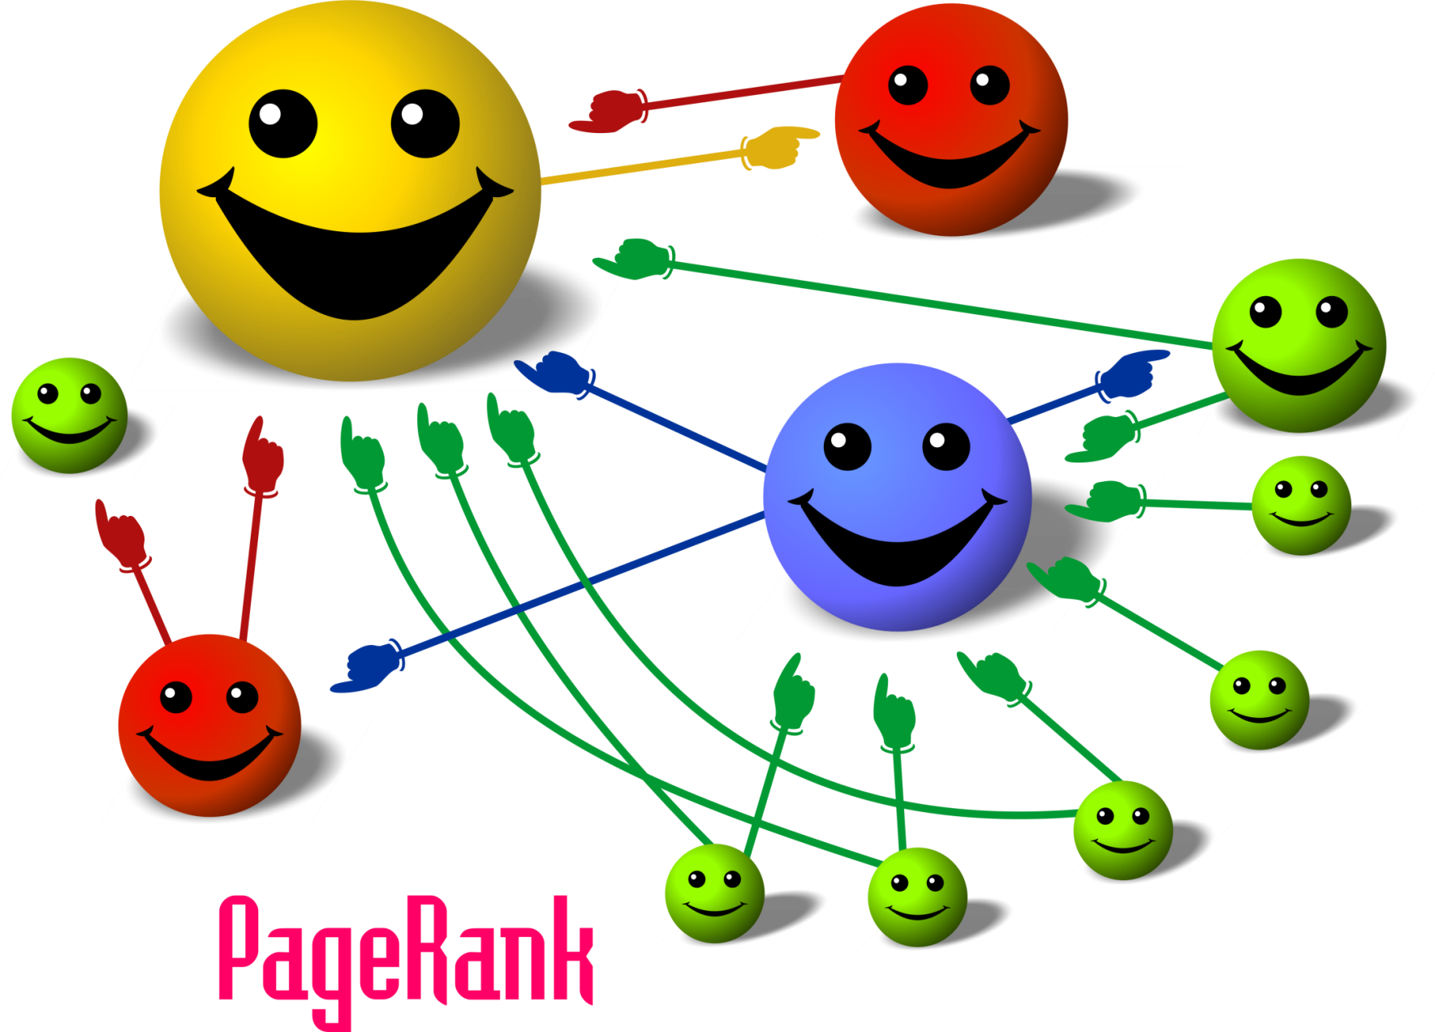
How Google works

Slide 7
Introduction to HTML

Slide 8
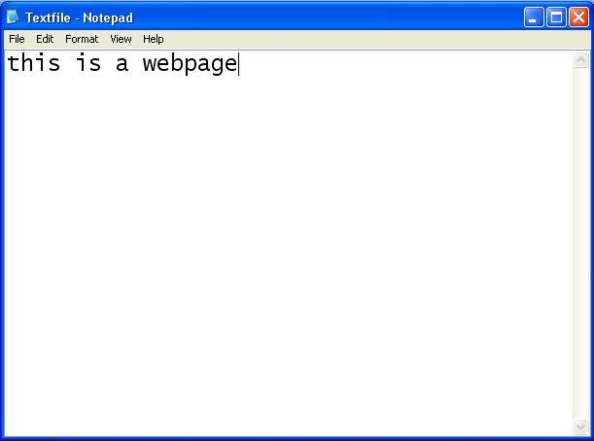
HTML Webpage

Slide 9
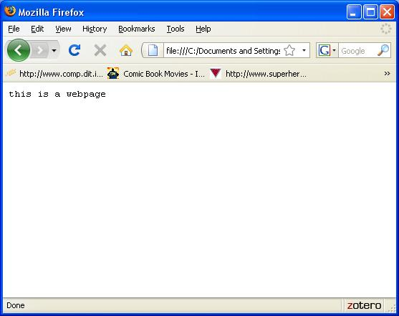
HTML Webpage

Slide 10
HTML Webpage
MyFirstPage.html

Slide 11
HTML Webpage
<HTML>
</HTML>

Slide 12
HTML Webpage
<HTML>
</HTML>

Slide 13
HTML Webpage
<HTML>
</HTML>

Slide 14
HTML Webpage
<HTML>
HEAD
</HTML>

Slide 15
HTML Webpage
<HTML>
HEAD
BODY
</HTML>

Slide 16
HTML Webpage
<HTML>
<HEAD>
</HEAD>
BODY
</HTML>

Slide 17
HTML Webpage
<HTML>
<HEAD>
</HEAD>
<BODY>
</BODY>
</HTML>

Slide 18
HTML Webpage
<HTML>
<HEAD>
</HEAD>
<BODY>
</BODY>
</HTML>

Slide 19

HTML Webpage
<HTML>
<HEAD>
</HEAD>
<BODY>
</BODY>
</HTML>

Slide 20
HTML Webpage
<HTML>
<HEAD>
</HEAD>
<BODY>
</BODY>
</HTML>

Slide 21
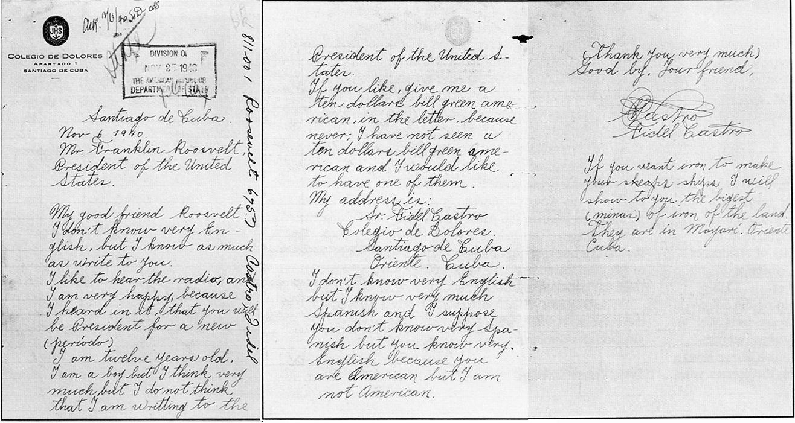
HTML Webpage
<HTML>
<HEAD>
</HEAD>
<BODY>
</BODY>
</HTML>

Slide 22
HTML Webpage
<HEAD>
</HEAD>

Slide 23
HTML Webpage
<HEAD>
<TITLE>
</TITLE>
</HEAD>

Slide 24
HTML Webpage
<HEAD>
<TITLE>
Anything you want in the blue bar
</TITLE>
</HEAD>

Slide 25
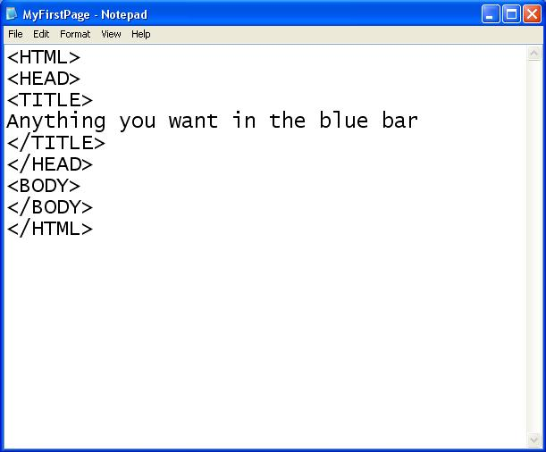
HTML Webpage

Slide 26
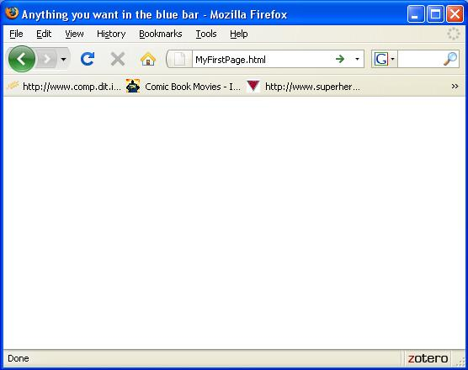
HTML Webpage

Slide 27
HTML Webpage
<HTML>
<HEAD>
</HEAD>
<BODY>
</BODY>
</HTML>

Slide 28
HTML Webpage
<BODY>
</BODY>

Slide 29
HTML Webpage
<BODY>
<H1>
Header of Page
</H1>
</BODY>

Slide 30
HTML Webpage
<BODY>
<H1>
Header of Page
</H1>
<H2>
Subtitle here
</H2>
</BODY>

Slide 31
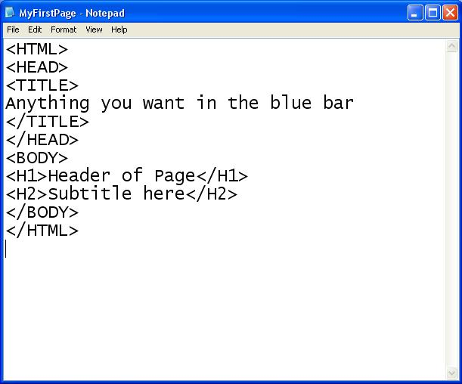
HTML Webpage

Slide 32
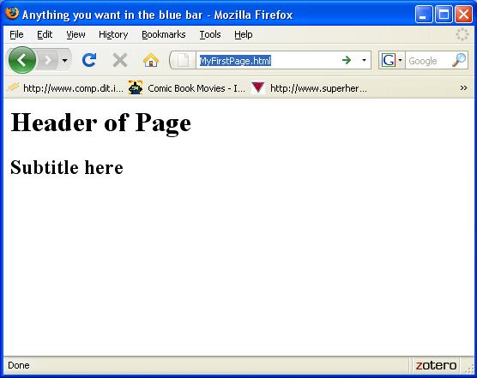
HTML Webpage

Slide 33
HTML Webpage
<BODY>
<H1>
Header of Page
</H1>
<H2>
Subtitle here
</H2>
<A HREF=“http://www.google.com">LINK HERE</A>
</BODY>

Slide 34
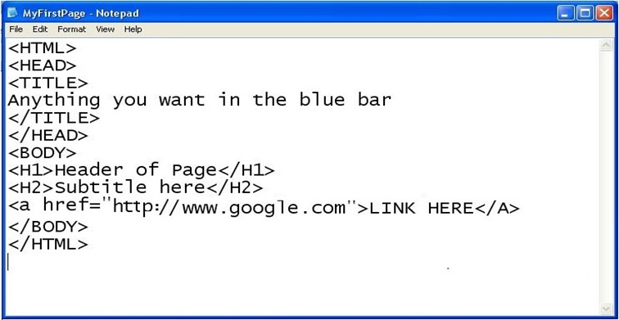
HTML Webpage

Slide 35
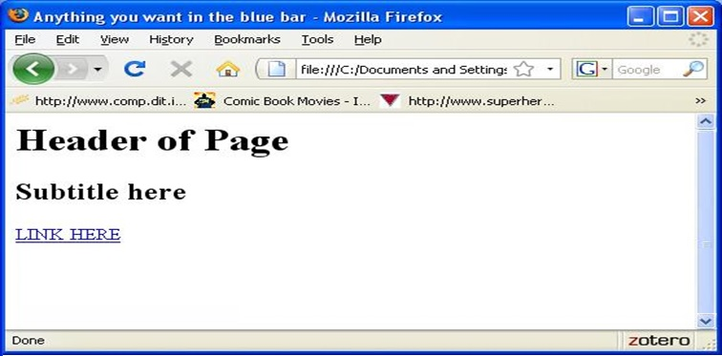
HTML Webpage

Slide 36
HTML Webpage
A note of the <A HREF> tag, it can either a specific completely new address:
<A HREF=“http://www.starwars.com/index.html”>
Or if the page being linked to is in the same directory (folder) as the current webpage, we can say:
<A HREF=“NewPage.html”>

Slide 37


Slide 38
Opening a URL

Slide 39
Opening a URL
A URL is a Uniform Resource Locator (URL), also called a web address. It specifies the location of a file in a computer network and a mechanism for retrieving it.
Most web browsers display the URL of a web page above the page in an address bar. A typical URL could have the form:
http://www.starwars.com/index.html
This indicates a protocol (http), a hostname (www.example.com), and a file name (index.html).

Slide 40
Opening a URL
Python has a number of built-in modules, for example print(), and it also provides a number of additional modules in The Standard Python Library.
Almost every instance of Python will have all of the Standard Library modules.

Slide 41
Opening a URL
One example of such a module is:
urlopen()
So, it’s module that you can use, but it’s in a collection called:
urllib.request

Slide 42
Opening a URL
To bring urlopen()into a Python program, we can say:
from urllib.request import urlopen
which means that we bring in urlopen()into a Python program.

Slide 43
Opening a URL
Alternatively we can say :
import urllib.request
Which means bring all the modules in urllib.request into a Python program, but this means the running program will be a lot bigger, because it will include a load of modules it doesn’t need.

Slide 44
Opening a URL
urlopen() allows us to open a webpage, and it also gives up a lot of descriptive information about the page, and the server it sits on. Here’s the header information about a webpage:
      Date: Mon, 11 Apr 2016 11:06:17 GMT
      Server: Apache
      X-SERVER: 2892
      Last-Modified: Sat, 12 Sep 2015 21:16:55 GMT
      ETag: "cf9-51f935a0df1f4"
      Accept-Ranges: bytes
      Content-Length: 3321
      Connection: close
      Content-Type: text/html

Slide 45
Opening a URL
urlopen() allows us to open a webpage, and it also gives up a lot of descriptive information about the page, and the server it sits on. Here’s the header information about a webpage:
      Date: Mon, 11 Apr 2016 11:06:17 GMT
      Server: Apache
      X-SERVER: 2892
      Last-Modified: Sat, 12 Sep 2015 21:16:55 GMT
      ETag: "cf9-51f935a0df1f4"
      Accept-Ranges: bytes
      Content-Length: 3321
      Connection: close
      Content-Type: text/html

Slide 46
Opening a URL
from urllib.request import urlopen
def URL_Opener(URL_input):
response = urlopen(URL_input)
if response.getheader('Content-Type')=='text/html':
#THEN
print("This is a webpage:", URL_input)
webpage1 = response.info()
print(webpage1)
else:
print("This is NOT a webpage:", URL_input)
# ENDIF
# END Check URL_Opener.

Slide 47


Slide 48
Creating a New URL

Slide 49
Creating a New URL
Another example of a module is:
urljoin()
So, it’s module that you can use, but it’s in a collection called:
parse in urllib

Slide 50
Creating a New URL
To bring urljoin()into a Python program, we can say:
from urllib import parse
Which means bring in parse and we can call parse.urljoin() in a Python program.

Slide 51
Creating a New URL
urljoin()constructs a full URL by combining a “base URL” with another URL.
This uses components of the base URL, in particular the addressing scheme, the network location and (part of) the path, to provide missing components in the relative URL.
>> urljoin('http://www.cwi.nl/guido/Py.html', 'FAQ.html')
'http://www.cwi.nl/guido/FAQ.html'

Slide 52
Creating a New URL
urljoin()constructs a full URL by combining a “base URL” with another URL.
This uses components of the base URL, in particular the addressing scheme, the network location and (part of) the path, to provide missing components in the relative URL.
>> urljoin('http://www.cwi.nl/guido/Py.html', 'FAQ.html')
'http://www.cwi.nl/guido/FAQ.html'

Slide 53
Creating a New URL
urljoin()is important because there are two types of hyperlinks we can find on a page:
<A HREF=“http://www.example.com/index.html”>
  An absolute address
<A HREF=“NewPage.html”>
  A relative address

Slide 54
Creating a New URL
If the page has a relative address:
<A HREF=“NewPage.html”>
  We need to create the full address by doing a urljoin() of the new page with the current site.
>> urljoin('http://www.dit.ie/home.html', ‘NewPage.html')
'http://www.dit.ie/NewPage.html'

Slide 55
Creating a New URL
If the page has a relative address:
<A HREF=“NewPage.html”>
  We need to create the full address by doing a urljoin() of the new page with the current site.
>> urljoin('http://www.dit.ie/home.html', ‘NewPage.html')
'http://www.dit.ie/NewPage.html'

Slide 56
Creating a New URL
  from urllib import parse
  webpages_found = ["ContactUs.html", "MainPage.html", "SignUp.html", "FAQ.html"]
  def URL_Joiner(URL_input):
  for PageIndex in webpages_found:
  # DO
  print(parse.urljoin(URL_input, PageIndex))
  # ENDFOR
  # END Check URL_Joiner.

Slide 57
The HTML Parser
The HTMLParser is a library module that is designed specifically to process HTML code.
A parser is a program that breaks files (or sentences) down into their component parts, and preserves the relationship of each part.
Our program is going to use the HTMLParser module.

Slide 58


Slide 59
Creating a Spider

Slide 60
Creating a Spider
Our spider (which is a program to crawl the web) will search for a specific term, and will take in the following parameters:
spider(Webpage, SearchTerm, MaxPages)
We need to specific a MaxPages, otherwise the spider might keep searching the web non-stop.

Slide 61
Creating a Spider
We will build up a list of URLs to visit, called pagesToVisit, and each time we encounter a new page, we will look for any links on the page (looking for “A HREF” and then use urljoin() to create the links) and add all those links to the pagesToVisit list.
Then we will visit each link and check if the SearchTerm is in that page or not.

Slide 62
Creating a Spider
The main part of the Spider is a loop which has to check three (3) things:
  Have we reached the maximum number of pages?
  Have we run out of pages to search?
  Have we found the SearchTerm?

Slide 63
Creating a Spider
The main part of the Spider is a loop which has to check three (3) things:
while
  numberVisited < maxPages and
  pagesToVisit != [] and
  not foundWord:

Slide 64
Creating a Spider
And inside the loop we are visiting each link in the list, and checking if there are other links on that page. We are going to use the library module HTMLParser to help us do find the links.
For each page we are also checking if the SearchTerm is in that page or not.

Slide 65
Creating a Spider
As mentioned our program is going to use the HTMLParser module, but the code adds new features to it using the Class command.
We don’t need to understand how the Class command work, other than to know that it allows us to modify other modules.

Slide 66
Creating a Spider
For this program as long as you understand the general principles I’ve explained, don’t worry about the specific detail of how it works.
As long as you know how to call the Spider module, that’s the important thing.

Slide 67

etc.

