Slide 1
Python: Programming the Google Search
Damian Gordon
Ref: Donaldson, 2013, Python: Visual QuickStart Guide, Chap.11

Slide 2
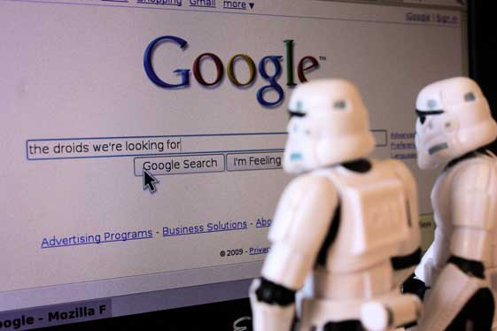
How Google works
How does Google search work?

Slide 3
How Google works
We’ll recall that we discussed the Google search engine before. Google search sends programs called “spiders” to explore the web and find webpages, and take copies of those pages.

Slide 4
How Google works
Then it scans those pages and identifies words and phrases in each page, and stores a count of how many times each word appears in a page, this will help determine where each page is ranked in the search order.

Slide 5
How Google works
Another factor in the ranking of pages is the type of pages that link to each page, if a page is considered to be of good quality if well-know pages (like government websites, or newspaper sites) link to it:

Slide 6
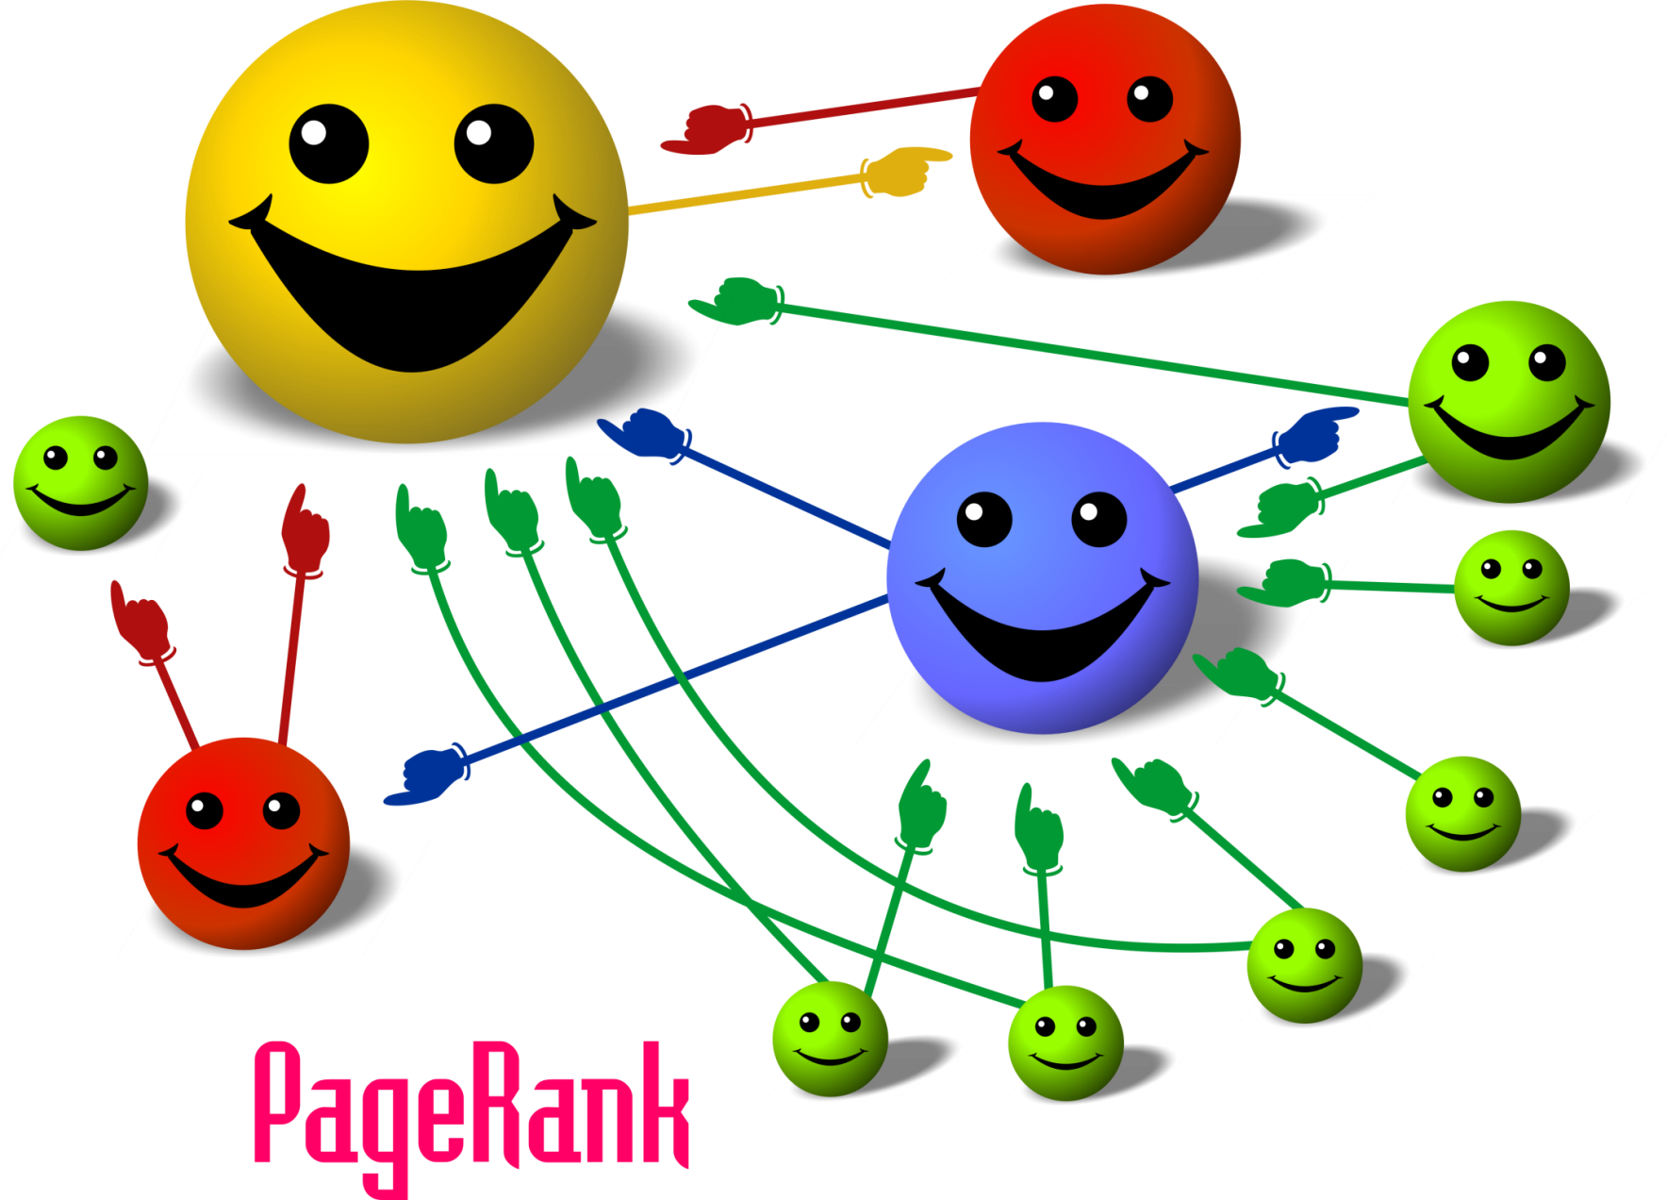
How Google works

Slide 7
Handling Strings

Slide 8
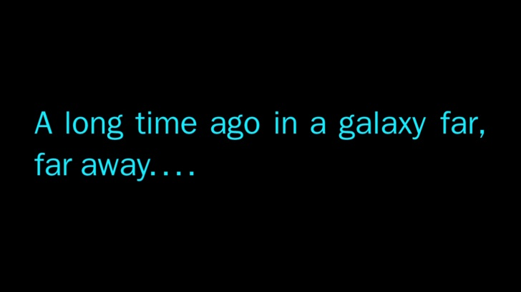

Slide 9
“
”

Slide 10
Handling Strings
s = “A long time ago in a galaxy far, far away ...”
s.split()
['a', 'long', 'time', 'ago', 'in', 'a', 'galaxy', 'far,', 'far', 'away', '...']

Slide 11
Handling Strings
s = “A long time ago in a galaxy far, far away ...”
s.split()
['a', 'long', 'time', 'ago', 'in', 'a', 'galaxy', 'far,', 'far', 'away', '...']

Slide 12
Handling Strings
s = “A long time ago in a galaxy far, far away ...”
s.split()
>>> [‘A', 'long', 'time', 'ago', 'in', 'a', 'galaxy', 'far,', 'far', 'away', '...']

Slide 13
Handling Strings
t = s.split()
print(t)
>>> [‘A', 'long', 'time', 'ago', 'in', 'a', 'galaxy', 'far,', 'far', 'away', '...']

Slide 14
Handling Strings
t = s.split()
print(t)
>>> [‘A', 'long', 'time', 'ago', 'in', 'a', 'galaxy', 'far,', 'far', 'away', '...']

Slide 15
Handling Strings
len(t)
>>> 11

Slide 16
Handling Strings
s = “A long time ago in a galaxy far, far away ...”
s2 = “a long time ago in a galaxy far far away”
Pre-processing

Slide 17
Handling Strings
s = “A long time ago in a galaxy far, far away ...”
s2 = “a long time ago in a galaxy far far away”
Pre-processing

Slide 18
What preprocessing features does Python provide?

Slide 19
Handling Strings
s3 =
"DARTH VADER: Obi-Wan never told you what happened to your father. LUKE: He told me enough. He told me you killed him. DARTH VADER: No. I am your father."

Slide 20
Handling Strings
s3.lower()
>>> 'darth vader: obi-wan never told you what happened to your father. luke: he told me enough. he told me you killed him. darth vader: no. i am your father.'

Slide 21
Handling Strings
s3 =
"DARTH VADER: Obi-Wan never told you what happened to your father. LUKE: He told me enough. He told me you killed him. DARTH VADER: No. I am your father."

Slide 22
Handling Strings
s3.replace('DARTH VADER', ‘Darth')
>>> ‘Darth: Obi-Wan never told you what happened to your father. LUKE: He told me enough. He told me you killed him. Darth: No. I am your father.'

Slide 23
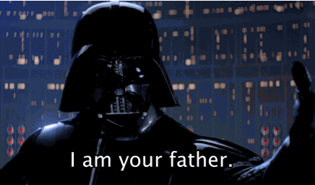

Slide 24
Handling Strings
s2 = “a long time ago in a galaxy far far away”
t2 = s.split()
print(t2)
>>> [‘a', 'long', 'time', 'ago', 'in', 'a', 'galaxy', 'far', 'far', 'away']

Slide 25
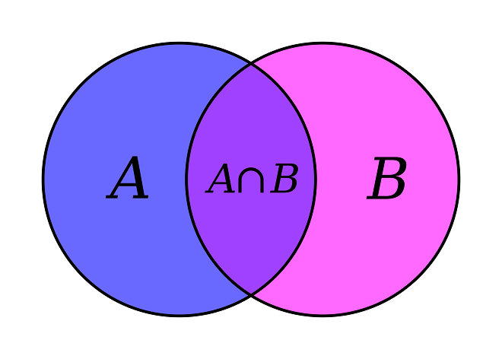
Handling Strings
Remember sets from school?

Slide 26
Handling Strings
Remember sets from school?
A key rule of a set is that there can be no repeated elements in a set (no value can be duplicated).

Slide 27
Handling Strings
Remember sets from school?
A key rule of a set is that there can be no repeated elements in a set (no value can be duplicated).
Python provides a set() function.

Slide 28
Handling Strings
print(t2)
>>> [‘a', 'long', 'time', 'ago', 'in', 'a', 'galaxy', 'far', 'far', 'away']
u2 =set(t2)
Print(u2)
{'away', 'long', 'far', 'ago', 'galaxy', 'in', 'a', 'time'}

Slide 29
Handling Strings
print(t2)
>>> [‘a', 'long', 'time', 'ago', 'in', 'a', 'galaxy', 'far', 'far', 'away']
u2 =set(t2)
Print(u2)
>>> {'away', 'long', 'far', 'ago', 'galaxy', 'in', 'a', 'time'}

Slide 30
Handling Strings
len(u2)
>>> 8

Slide 31
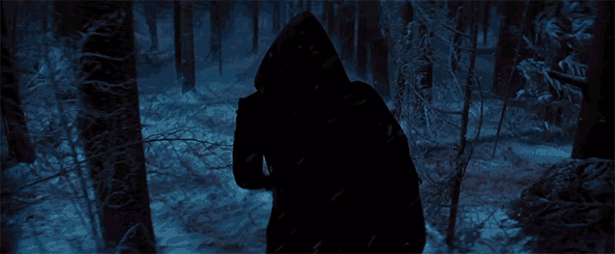

Slide 32
String Preprocessing
# PROGRAM String Preprocessing
keep = {'a', 'b', 'c', 'd', 'e',
'f', 'g', 'h', 'i', 'j', 'k', 'l',
'm', 'n', 'o', 'p', 'q', 'r', 's',
't', 'u', 'v', 'w', 'x', 'y', 'z',
' ', '-', "'"}
###################################
Continued →

Slide 33
String Preprocessing
← Continued
def Normalise(s):
result = ''
for x in s.lower():
# DO
if x in keep:
# THEN
result = result + x # Add current char to result
# ELSE
# Do not add current char to result
# ENDIF;
# ENDFOR;
return result
# END Normalise.
Continued →

Slide 34
String Preprocessing
← Continued
######### MAIN PRORGAM #########
Quote = "A long time ago in a galaxy far, far away ..."
NewQuote = Normalise(Quote)
print(Quote)
print(NewQuote)
# END.

Slide 35
String Preprocessing
← Continued
######### MAIN PRORGAM #########
Quote = "A long time ago in a galaxy far, far away ..."
NewQuote = Normalise(Quote)
print(Quote)
print(NewQuote)
# END.
A long time ago in a galaxy far, far away ...
a long time ago in a galaxy far far away

Slide 36


Slide 37
Handling Strings in Files
script = open('StarWarsscript.txt','r').read()
len(script)
326,359
script.count("\n")
8,150
len(script.split())
33,101

Slide 38
Handling Strings in Files
script = open('StarWarsscript.txt','r').read()
len(script)
>>> 326,359
script.count("\n")
8,150
len(script.split())
33,101

Slide 39
Handling Strings in Files
script = open('StarWarsscript.txt','r').read()
len(script)
>>> 326,359
script.count("\n")
8,150
len(script.split())
33,101
Characters

Slide 40
Handling Strings in Files
script = open('StarWarsscript.txt','r').read()
len(script)
>>> 326,359
script.count("\n")
>>> 8,150
len(script.split())
33,101
Characters

Slide 41
Handling Strings in Files
script = open('StarWarsscript.txt','r').read()
len(script)
>>> 326,359
script.count("\n")
>>> 8,150
len(script.split())
33,101
Characters
Lines

Slide 42
Handling Strings in Files
script = open('StarWarsscript.txt','r').read()
len(script)
>>> 326,359
script.count("\n")
>>> 8,150
len(script.split())
>>> 33,101
Characters
Lines

Slide 43
Handling Strings in Files
script = open('StarWarsscript.txt','r').read()
len(script)
>>> 326,359
script.count("\n")
>>> 8,150
len(script.split())
>>> 33,101
Characters
Lines
Words

Slide 44
The Dictionary Type

Slide 45
The Dictionary Type
Python has a built-in data structure called a “dictionary”.
It’s like an array, except instead of being indexed by numbers, it can be indexed by any type.

Slide 46
The Dictionary Type
31
0
41
1
59
2
26
3
53
4
59
5
66
6
Array
31
‘a’
41
‘b’
59
‘c’
26
‘d’
53
‘e’
59
‘f’
66
‘g’
Dictionary

Slide 47
The Dictionary Type
Title = {'the':1, 'force':2, 'awakens':3}
1
‘the’
2
‘force’
3
‘awakens’
Title

Slide 48
The Dictionary Type
Title.keys()
>>> dict_keys(['the', 'force', 'awakens'])
1
‘the’
2
‘force’
3
‘awakens’
Title

Slide 49
The Dictionary Type
Title['Star Wars'] = 0
print(Title)
>>> {'Star Wars': 0, 'the': 1, 'force': 2, 'awakens': 3}
0
‘Star Wars’
1
‘the’
2
‘force’
3
‘awakens’
Title

Slide 50
The Dictionary Type
Let’s write a program to count the frequency of each of the words in a string, using a dictionary.

Slide 51
The Dictionary Type
def FreqDict(s):
NewString = Normalise(s)
words = NewString.split()
Dict = {}
for wordindex in words:
if wordindex in Dict:
Dict[wordindex] = Dict[wordindex] + 1
else:
Dict[wordindex] = 1
# ENDIF;
# ENDFOR;
return Dict
# END FreqDict.

Slide 52
The Dictionary Type
Preprocessing
def FreqDict(s):
NewString = Normalise(s)
words = NewString.split()
Dict = {}
for wordindex in words:
if wordindex in Dict:
Dict[wordindex] = Dict[wordindex] + 1
else:
Dict[wordindex] = 1
# ENDIF;
# ENDFOR;
return Dict
# END FreqDict.

Slide 53
The Dictionary Type
Preprocessing
def FreqDict(s):
NewString = Normalise(s)
words = NewString.split()
Dict = {}
for wordindex in words:
if wordindex in Dict:
Dict[wordindex] = Dict[wordindex] + 1
else:
Dict[wordindex] = 1
# ENDIF;
# ENDFOR;
return Dict
# END FreqDict.
Create an empty dictionary

Slide 54
The Dictionary Type
Preprocessing
def FreqDict(s):
NewString = Normalise(s)
words = NewString.split()
Dict = {}
for wordindex in words:
if wordindex in Dict:
Dict[wordindex] = Dict[wordindex] + 1
else:
Dict[wordindex] = 1
# ENDIF;
# ENDFOR;
return Dict
# END FreqDict.
Create an empty dictionary
If that word is already found

Slide 55
The Dictionary Type
Preprocessing
def FreqDict(s):
NewString = Normalise(s)
words = NewString.split()
Dict = {}
for wordindex in words:
if wordindex in Dict:
Dict[wordindex] = Dict[wordindex] + 1
else:
Dict[wordindex] = 1
# ENDIF;
# ENDFOR;
return Dict
# END FreqDict.
Create an empty dictionary
If that word is already found
A long time ago in a galaxy far, far away ...
{'ago': 1, 'time': 1, 'galaxy': 1, 'away': 1, 'long': 1, 'a': 2, 'far': 2, 'in': 1}

Slide 56
The Dictionary Type
The only problem with the dictionary type is that it is indexed by words, not the values, so if we wanted to print out the top 20 most frequently occurring words in a string, that’d be a bit tricky.
But we have a simple way of fixing that.

Slide 57
The Dictionary Type
We can convert the dictionary into an array:
  DictArray = [ ]
  for k in Dict:
  # DO
  pair = (Dict[k], k)
  DictArray.append(pair)
  # ENDFOR;

Slide 58

etc.

