Slide 1
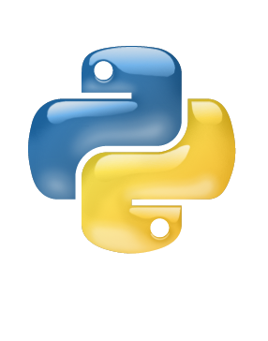
Introduction to Python
Damian Gordon

Slide 2
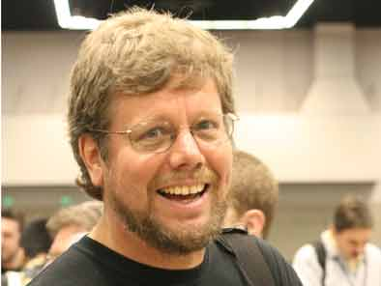
The Python Programming Language
Python was developed by Guido van Rossum in the Netherlands in 1989.
Van Rossum is Python's principal author, and his continuing central role in deciding the direction of Python is reflected in the title given to him by the Python community, Benevolent Dictator for Life (BDFL).

Slide 3
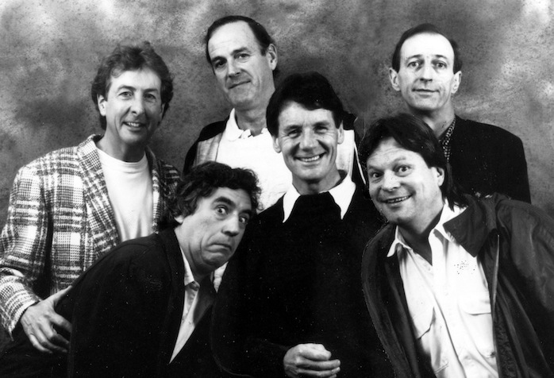
The Python Programming Language
Python is named for the British comedy group Monty Python.
The main members of the group are Eric Idle, Terry Jones, John Cleese, Michael Palin, Graham Chapman, and Terry Gilliam.

Slide 4
The Python Programming Language
1989
Ver 1
2008
Ver 3
2000
Ver 2

Slide 5
The Python Programming Language
Python is a multi-paradigm programming language:
structured programming
object-oriented programming
functional programming
aspect-oriented programming
design by contract
logic programming

Slide 6
The Python Programming Language
Python uses dynamic typing and a combination of reference counting and a cycle-detecting garbage collector for memory management. An important feature of Python is dynamic name resolution (late binding), which binds method and variable names during program execution.

Slide 7
The Python Programming Language
Rather than requiring all desired functionality to be built into the language's core, Python was designed to be highly extensible. Python can also be embedded in existing applications that need a programmable interface. This design of a small core language with a large standard library and an easily extensible interpreter was intended by Van Rossum from the very start

Slide 8
The Python Programming Language
Since 2003, Python has consistently ranked in the top ten most popular programming languages as measured by the TIOBE Programming Community Index. As of September 2015, it is in the fifth position. It was ranked as Programming Language of the Year for the year 2007 and 2010.

Slide 9
What does Python look like?

Slide 10
Part 1 of 3
# PROGRAM CheckPrime:
##################
# ERROR CHECKING #
##################
c = str(input("Do you want error checking on? (y/n)"))
if c == 'y':
# THEN
MyErrorCheck = True
else:
MyErrorCheck = False
# ENDIF;
##################
# PRIME CHECKING #
##################
a = int(input("Please input value:"))
b = a - 1
IsPrime = True

Slide 11
Part 2 of 3
while b != 1:
# DO
if a % b == 0:
# THEN
IsPrime = False
if MyErrorCheck == True:
# THEN
print("*** Division with no remainder found, with ", b, "*****”)
# ENDIF;
# ENDIF;
if MyErrorCheck == True:
# THEN
print(">> a is ",a,">> b is ",b, ">> IsPrime is ",IsPrime)
# ENDIF;
b = b - 1
# ENDWHILE;

Slide 12
Part 3 of 3
if IsPrime:
# THEN
print(a, "is a prime number")
else:
print(a, "is not a prime number")
# ENDIF;
# END.

Slide 13
The Python Programming Language
Organizations that use Python include Google, Yahoo!, CERN, and NASA.
Python can serve as a scripting language for web applications
Python has been embedded in a number of software products as a scripting language, including in finite element method software such as Abaqus, 3D parametric modeler like FreeCAD, 3D animation packages such as 3ds Max, Blender, Cinema 4D, Lightwave, Houdini, Maya, modo, MotionBuilder, Softimage, the visual effects compositor Nuke, 2D imaging programs like GIMP, Inkscape, Scribus and Paint Shop Pro, and musical notation program or scorewriter capella.

Slide 14
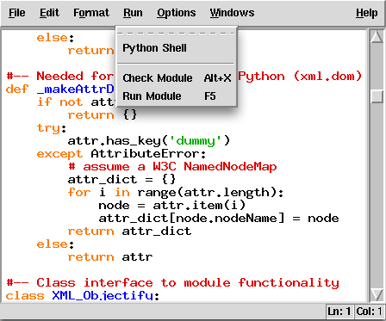
IDLE

Slide 15
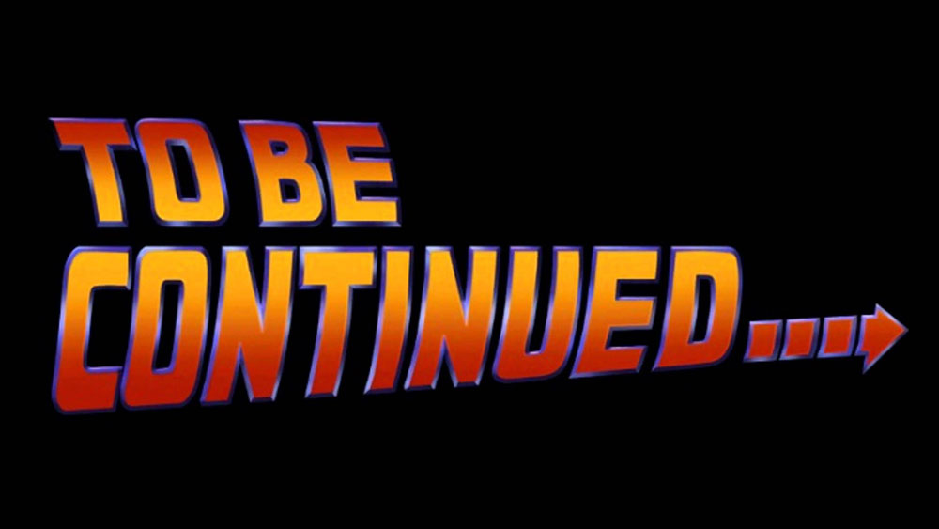
etc.

