Slide 1
Programming and Algorithms
Damian Gordon

Slide 2
Module Description
This module is an introduction to programming, program design and algorithms. Students are introduced to a structured procedural programming language and to commonly used algorithms and their implementation.
This module assumes no prior knowledge of programming or algorithms.
The aims of this module are to:
Teach the fundamentals of procedural programming
Teach the principles of good program design, implementation, documentation and testing.
Teach the theory and application of elementary algorithms and data structures.

Slide 3
Learning Outcomes
On Completion of this module, the learner will be able to
Design and write computer elementary programs in a structured procedural language.
Use a text editor with command line tools and simple Integrated Development Environment (IDE) to compile, link and execute program code.
Divide a computer program into modules.
Test computer programs to ensure compliance with requirements.
Implement elementary algorithms and data structures in a procedural language.

Slide 4
Indicative Syllabus
Introduction: What is a program? Source code. Machine code. Editing, Compiling, Linking Debugging. Use of an Integrated Development Environment (IDE).
Basic Data Types: integer, floating-point and character data and variables.
Basic Input-Output: Display data on a screen. Input data from the keyboard.
Programming Structures: Conditional statements: Boolean values and expressions, logical and relational operators, if-statement, case-statement, compound conditional statements.

Slide 5
Indicative Syllabus
Iterative constructs: while-statements, for-statements and nested control statements.
Structured Programming: functions, parameter passing, returning values.
Introduction to Data Structures: single-dimensional arrays, two-dimensional arrays, dynamically allocated arrays

Slide 6
Indicative Syllabus
Basic Algorithms: summation, counting, numeric operations, swapping, maximum and minimum, simple array manipulation.
Elementary Sorting Algorithms: Internal Sorting. Exchange sort. Interchange sort. Bubble sort. Shaker sort. Insertion sort.
Testing and debugging: Objectives and principles of testing. Choosing appropriate test data. Simple debugging using a program trace.
Documentation: Style guidelines.

Slide 7
Indicative Syllabus
Assessment Type | Weighting (%)
Written Assessment | 70
Continuous Assessment | 30

Slide 8
Introduction to Programming
Damian Gordon

Slide 9
Binary

Slide 10
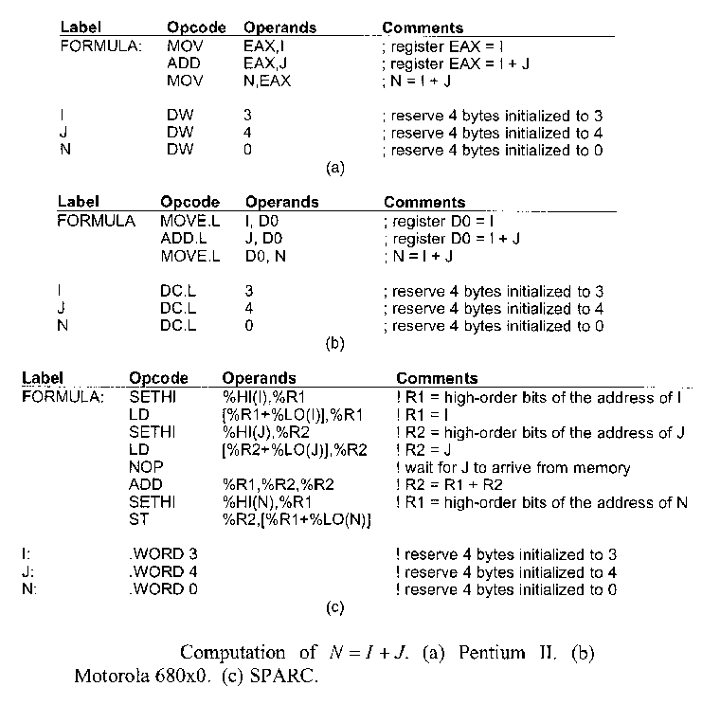
Assembly

Slide 11
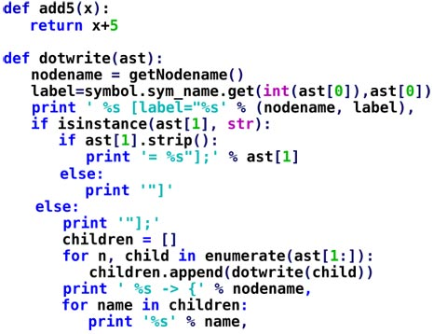
Python

Slide 12
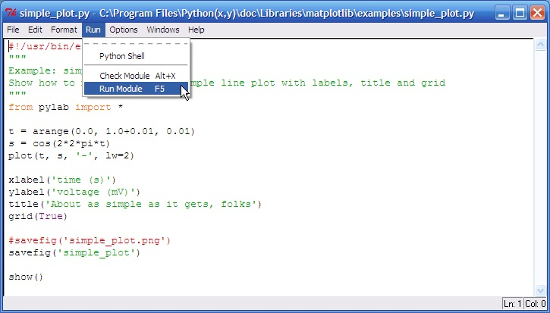
IDLE

Slide 13
Algorithms
An Algorithm is a series of instructions
Examples of algorithms include
Musical scores
Knitting patterns Row 1: SL 1, K8, K2 tog, K1, turn
Recipies

Slide 14
Algorithms
Problem Solving
Analyse Problem (Analysis)
Develop Algorithm (Design)
Convert into programming language (Development)

Slide 15
Blended Learning

Slide 16
Conversation
Interaction
Collaboration
Motivation
Mobility
Tracking
Globalisation
Flexibility
Traditional
On-Line
Blended Learning

Slide 17
Diana Laurillard’s Conversational Framework

Slide 18
Teacher’s
Conceptual
Model
Student’s
Conceptual
Model
Discussion
Reflection on student performance
Adaption of world
Adaption of actions
Reflection on Interaction
Teacher’s
Constructed
World
Student’s
Experiential
Knowledge
Interaction

Slide 19
Gilly Salmon’s 5-Stage Model of e-Learning

Slide 20
Tech Support
e-Moderating
Supporting
responding
Providing Links
Development
Knowledge
Construction
Facilitating
process
Conferencing
Information
Exchange
Facilitating
tasks
Searching,
personalizing software
On-Line
Socialization
Sending and
receiving messages
Providing
bridges
Access &
Motivation
Welcoming and
encouraging
Set-up
system and access

Slide 21
Pam Moule’s eLearning Ladder

Slide 22
I
N
C
R
E
A
S
I
N
G
On-line Communities of Practice
Chat rooms
E-mail Discussions
Group Work
Technical Support
Facilitation
Length of Engagement
ICT Access
ICT Skills
Video Conferencing
Interactive Media
Information Gathering

Slide 23
John Hattie’s Meta-Analysis

Slide 24
1. Feedback 2. Students’ Prior Cognitive Ability 3. Instructional Quality 4. Direct Instruction 5. Premeditation

Slide 25
1. Feedback 2. Students’ Prior Cognitive Ability 3. Instructional Quality 4. Direct Instruction 5. Premeditation

Slide 26
Robert Gagné's Nine Events of instructional Design

Slide 27
Gain
Attention
Inform Learner of Objectives
Stimulate recall of prior learning
Present
Information
Provide
Guidance
Elicit
Performance
Provide
Feedback
Assess
Performance
Enhance Retention and Transfer

Slide 28
Some Challenges of Blended Learning
Technical Issues
Motivation of the Students
Student Participation
Ensuring Interactive of lessons
Organisational Alignment

