Slide 1
Recursion
Damian Gordon

Slide 2
Recursion
Factorial
Fibonacci
Decimal to Binary conversion
Travelling Salesman Problem
Knight’s Tour

Slide 3
Recursion

Slide 4
Recursion

Slide 5
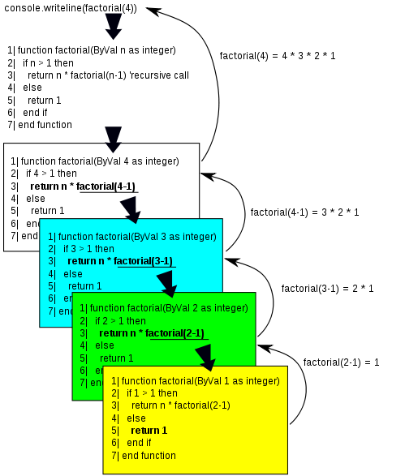
Recursion

Slide 6
Recursion
Recursion is a feature of modularisation, when a module can call itself to complete a solution.

Slide 7
Recursion
Recursion is a feature of modularisation, when a module can call itself to complete a solution.
Let’s remember factorial:
7! = 7 * 6 * 5 * 4 * 3 * 2 * 1

Slide 8
Recursion
Recursion is a feature of modularisation, when a module can call itself to complete a solution.
Let’s remember factorial:
7! = 7 * 6 * 5 * 4 * 3 * 2 * 1
and
6! = 6 * 5 * 4 * 3 * 2 * 1

Slide 9
Recursion
So
7! = 7 * (6 * 5 * 4 * 3 * 2 * 1)

Slide 10
Recursion
So
7! = 7 * (6 * 5 * 4 * 3 * 2 * 1)
is
7! = 7 * 6!

Slide 11
Recursion
So
7! = 7 * (6 * 5 * 4 * 3 * 2 * 1)
is
7! = 7 * 6!
and
9! = 9 * 8 * 7 * 6 * 5 * 4 * 3 * 2 * 1
9!= 9 * (8 * 7 * 6 * 5 * 4 * 3 * 2 * 1)
9! = 9 * 8!

Slide 12
Recursion
Or, in general:

Slide 13
Recursion
Or, in general:
N! = N * (N-1)!

Slide 14
Recursion
Or, in general:
N! = N * (N-1)!
or
Factorial(N) = N * Factorial(N-1)

Slide 15
Recursion
Let’s remember how we did Factorial iteratively:

Slide 16
Recursion
PROGRAM Factorial:
Get Value;
Total <- 1;
WHILE (Value != 0)
DO Total <- Value * Total;
Value <- Value - 1;
ENDWHILE;
Print Total;
END.

Slide 17
Recursion
Now this is how we implement the following:
Factorial(N) = N * Factorial(N-1)

Slide 18
Recursion
PROGRAM Factorial:
Get Value;
PRINT Fact(Value);
END.
MODULE Fact(N):
IF (N <= 0)
THEN RETURN 1;
ELSE RETURN N * Fact(N-1);
ENDIF;
END.

Slide 19
Recursion
PROGRAM Factorial:
Get Value;
PRINT Fact(Value);
END.
MODULE Fact(N):
IF (N <= 0)
THEN RETURN 1;
ELSE RETURN N * Fact(N-1);
ENDIF;
END.

Slide 20
Recursion
So if N is 5

Slide 21
Recursion
So if N is 5
MODULE Fact(5) returns
5 * Fact(4)

Slide 22
Recursion
So if N is 5
MODULE Fact(5) returns
5 * Fact(4)
5 * 4 * Fact(3)

Slide 23
Recursion
So if N is 5
MODULE Fact(5) returns
5 * Fact(4)
5 * 4 * Fact(3)
5 * 4 * 3 * Fact(2)

Slide 24
Recursion
So if N is 5
MODULE Fact(5) returns
5 * Fact(4)
5 * 4 * Fact(3)
5 * 4 * 3 * Fact(2)
5 * 4 * 3 * 2 * Fact(1)

Slide 25
Recursion
So if N is 5
MODULE Fact(5) returns
5 * Fact(4)
5 * 4 * Fact(3)
5 * 4 * 3 * Fact(2)
5 * 4 * 3 * 2 * Fact(1)
5 * 4 * 3 * 2 * 1 * Fact(0)

Slide 26
Recursion
So if N is 5
MODULE Fact(5) returns
5 * Fact(4)
5 * 4 * Fact(3)
5 * 4 * 3 * Fact(2)
5 * 4 * 3 * 2 * Fact(1)
5 * 4 * 3 * 2 * 1 * Fact(0)
5 * 4 * 3 * 2 * 1 * 1

Slide 27
Recursion
So if N is 5
MODULE Fact(5) returns
5 * Fact(4)
5 * 4 * Fact(3)
5 * 4 * 3 * Fact(2)
5 * 4 * 3 * 2 * Fact(1)
5 * 4 * 3 * 2 * 1 * Fact(0)
5 * 4 * 3 * 2 * 1 * 1
120

Slide 28
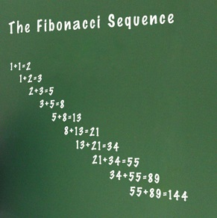
Recursion
The Fibonacci numbers are numbers where the next number in the sequence is the sum of the previous two.
The sequence starts with 1, 1,
And then it’s 2
Then 3
Then 5
Then 8
Then 13

Slide 29
Recursion
Let’s remember how we did Fibonacci iteratively:

Slide 30
Recursion
PROGRAM FibonacciNumbers:
READ A;
FirstNum <- 1;
SecondNum <- 1;
WHILE (A != 2)
DO Total <- SecondNum + FirstNum;
FirstNum <- SecondNum;
SecondNum <- Total;
A <- A – 1;
ENDWHILE;
Print Total;
END.

Slide 31
Recursion

Slide 32
etc.

