Slide 1
Python: Stacks and Queues
(as a Linked List)
Damian Gordon

Slide 2
Stacks

Slide 3
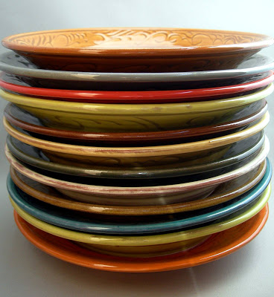
Stacks
A Stack is a pile of stuff:
It’s a structure that conforms to the principle of Last In, First Out (LIFO).
The last item to join the stack is the first item to be served.

Slide 4
Stacks
Values are added to the top:
67
59
53
26
59
41
31

Slide 5
Stacks
Values are removed from the top:
67
59
53
26
59
41
31

Slide 6
Stacks
We don’t need to give our Linked List a name
The Linked List has no maximum length
The current top of the stack is still called StackTop.

Slide 7
Stacks
Here is the stack as a Linked List
StackTop
23
62
37
31
NULL
Head

Slide 8
Stacks (IsEmpty)
def StackIsEmpty():
global StackTop
return StackTop == None
# END StackIsEmpty.

Slide 9
Stacks (PrintStack)
def PrintStack():
global StackTop
SPrint = StackTop
while(SPrint != None):
# DO
print(SPrint.value)
SPrint = SPrint.pointer
# ENDWHILE;
# END QueueIsEmpty.

Slide 10
Stacks (Push)
def StackPush(N):
global StackTop
nodeX = ListNode(N, None)
if StackIsEmpty():
# THEN
StackTop = nodeX
else:
nodeX.pointer = StackTop
StackTop = nodeX
# ENDIF;
# END StackPush.

Slide 11
Stacks (Pop)
def StackPop():
global StackTop
if StackIsEmpty():
# THEN
print("Stack is empty")
N = 0
else:
N = StackTop.value
StackTop = StackTop.pointer
# ENDIF;
return N
# END StackPop.

Slide 12
Stacks (Top)
def ShowStackTop():
global StackTop
if StackIsEmpty():
# THEN
print("Stack is empty")
N = 0
else:
N = StackTop.value
print("Top value:", StackTop.value)
# ENDIF;
return N
# END ShowStackTop.

Slide 13
Queues

Slide 14

Queues
We will remember queues:
It’s a structure that conforms to the principle of First In, First Out (FIFO).
The first item to join the queue is the first item to be served.

Slide 15
Queues
Values are added to the back:
59
53
26
59
41
31
86

Slide 16
Queues
Values are removed from the front:
86
59
53
26
59
41
31

Slide 17
Queues
We don’t need to give our Linked List a name
The Linked List has no maximum length
The current front of the queue is called QueueHead.
The current back of the queue is called QueueTail.

Slide 18
Queues (IsEmpty)
def QueueIsEmpty():
global QueueHead
global QueueTail
return QueueHead == QueueTail == None
# END QueueIsEmpty.

Slide 19
Queues (PrintQueue)
def PrintQueue():
global QueueHead
global QueueTail
QPrint = QueueHead
while(QPrint != None):
# DO
print(QPrint.value)
QPrint = QPrint.pointer
# ENDWHILE;
# END QueueIsEmpty.

Slide 20
Queues (AddToQ)
def AddToQ(N):
global QueueHead
global QueueTail
nodeX = ListNode(N, None)
Continued →

Slide 21
Queues (AddToQ)
← Continued
if QueueIsEmpty():
# THEN
QueueHead = nodeX;
QueueTail = nodeX;
else:
QueueTail.pointer = nodeX
QueueTail = nodeX
# ENDIF;
# END AddToQ.

Slide 22
Queues (DeleteFromQ)
def DeleteFromQ():
global QueueHead
global QueueTail
NewNode = QueueHead
Continued →

Slide 23
Queues (DeleteFromQ)
← Continued
if QueueIsEmpty():
# THEN
print("Queue is empty")
N = 0
else:
N = QueueHead.value
QueueHead = NewNode.pointer
# ENDIF;
return N
# END DeleteFromQ.

Slide 24

etc.

