Slide 1
Queues:
Implemented using Linked Lists
Damian Gordon

Slide 2

Queues
We can also have a queue:

Slide 3
Queues
Or:

Slide 4
Queues
We can also have a queue:
It’s a structure that conforms to the principle of First In, First Out (FIFO).
The first item to join the queue is the first item to be served.

Slide 5
Queues
59
53
26
59
41
31

Slide 6
Queues
59
53
26
59
41
31
Back
Front

Slide 7
Queues
Values are added to the back:
59
53
26
59
41
31
86

Slide 8
Queues
Values are added to the back:
59
53
26
59
41
31
86

Slide 9
Queues
Values are added to the back:
86
59
53
26
59
41
31

Slide 10
Queues
Values are removed from the front:
86
59
53
26
59
41
31

Slide 11
Queues
Values are removed from the front:
86
59
53
26
59
41
31

Slide 12
Queues
Values are removed from the front:
86
59
53
26
59
41
31

Slide 13
Queues
Values are removed from the front:
86
59
53
26
59
41

Slide 14
Queues
When we implemented this as an array:
  We will implement a queue as an array called Queue.
  The maximum length of the queue is called MaxSize.
  The current front of the queue is called Head.
  The current back of the queue is called Tail.
Using a Linked List:
  We don’t need to give our Linked List a name
  The Linked List has no maximum length
  The current front of the queue is called QueueHead.
  The current back of the queue is called QueueTail.

Slide 15
Queues
PROGRAM ImplementQueue:
TYPE Node:
INTEGER Value;
NODE Pointer;
ENDTYPE;
CreateList();
    Node QueueHead <- Head;
    Node QueueTail <- Head;
    END.
CreateList()
NULL
QueueHead
HEAD
QueueTail

Slide 16
Queues
We will implement a queue as a Linked List.
QueueHead
QueueTail
23
62
37
31
NULL
Head

Slide 17
Queues
We will look at implementing the following modules:
IsFull()
  Check if the queue is full
IsEmpty()
  Check if the queue is full
AddToQ(N)
  Add a new item (N) to the back of the queue
DeleteFromQ()
  Remove the front value from the queue
ClearQ()
  Empty the queue

Slide 18
Queues
IsFull() doesn’t apply for Linked Lists, you can always add a new node on to the end.
QueueHead
QueueTail
23
62
37
31
NULL

Slide 19
Queues
MODULE IsFull():
    PRINT “Queue is a Linked List”
    PRINT “and is never full”
    END.

Slide 20
Queues
IsEmpty()
  if QueueTail = QueueHead
QueueHead
QueueTail
23
62
37
31
NULL

Slide 21
Queues
MODULE IsEmpty():
    Boolean Empty;
    IF QueueHead = QueueTail
    THEN Empty <- True;
    ELSE Empty <- False;
    ENDIF;
    RETURN Empty;
    END.

Slide 22
Queues
Or
MODULE IsEmpty():
    RETURN QueueHead = QueueTail;
    END.

Slide 23
Queues
AddToQ(N)
  Add to the QueueTail, and move the QueueTail pointer.
QueueHead
QueueTail
23
62
37
31
NULL

Slide 24
Queues
MODULE AddToQ(N):
Node NewNode;
NewNode.Value <- N;
    QueueTail.Pointer <- NewNode;
    QueueTail <- NewNode;
    ENDIF;
    END.

Slide 25
Queues
DeleteFromQ()
  Write QueueHead value into N, and move QueueHead back.
QueueHead
QueueTail
23
62
37
31
NULL

Slide 26
Queues
MODULE DeleteFromQ():
Node NewNode;
NewNode <- QueueHead;
    IF IsEmpty() = True
    THEN Print “Queue is Empty”;
    ELSE N <- QueueHead.Value;
    QueueHead <- NewNode.Pointer;
    ENDIF;
    RETURN N;
    END.

Slide 27
Queues
ClearQ()
  Set QueueTail = QueueHead = Head
QueueHead
QueueTail
23
62
37
31
NULL

Slide 28
Queues
MODULE ClearQ():
    QueueTail <- Head;
    QueueHead <- QueueTail;
    END.

Slide 29
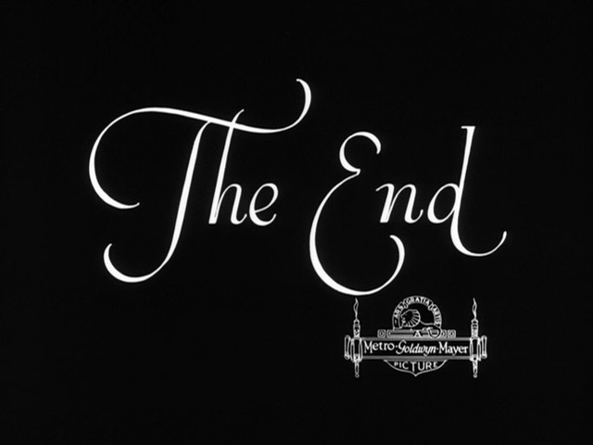
etc.

