Slide 1
Stacks:
Implemented using Linked Lists
Damian Gordon

Slide 2

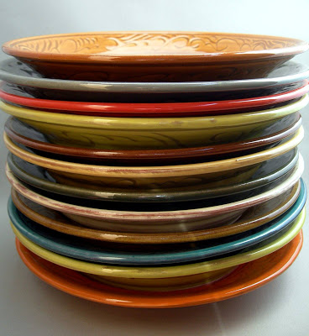
Stacks
A Stack is a pile of stuff:

Slide 3
Stacks
A Stack is a pile of stuff:
It’s a structure that conforms to the principle of Last In, First Out (LIFO).
The last item to join the stack is the first item to be served.

Slide 4
Stacks
59
53
26
59
41
31

Slide 5
Stacks
59
Top
53
26
59
41
31
Bottom

Slide 6
Stacks
Values are added to the top:

Slide 7
Stacks
Values are added to the top:
67
59
53
26
59
41
31

Slide 8
Stacks
Values are added to the top:
67
59
53
26
59
41
31

Slide 9
Stacks
Values are added to the top:
67
59
53
26
59
41
31

Slide 10
Stacks
Values are removed from the top:
67
59
53
26
59
41
31

Slide 11
Stacks
Values are removed from the top:
67
59
53
26
59
41
31

Slide 12
Stacks
Values are removed from the top:
59
53
26
59
41
31

Slide 13
Stacks
When we implemented this as an array:
  We had an array called Stack.
  The maximum length of the stack is called MaxSize.
  The current top of the stack is called StackTop.
Using a Linked List:
  We don’t need to give our Linked List a name
  The Linked List has no maximum length
  The current top of the stack is still called StackTop.

Slide 14
Stacks
Here is the stack as a Linked List
StackTop
23
62
37
31
NULL
Head

Slide 15
Stacks
PROGRAM ImplementStack:
TYPE Node:
INTEGER Value;
NODE Pointer;
ENDTYPE;
CreateList();
    Node StackTop <- Head;
    END.
CreateList()
NULL
HEAD
StackTop

Slide 16
Stacks
We will look at implementing the following modules:
IsFull()
  Check if the stack is full
IsEmpty()
  Check if the stack is full
Push(N)
  Add a new item (N) to the top of the stack
Pop()
  Remove the top value from the stack
Top()
  Tell us what the top value of the stack is (without removing it).

Slide 17
Stacks
IsFull() doesn’t apply for Linked Lists, you can always add a new node on to the end.
StackTop
23
62
37
31
NULL
Head

Slide 18
Stacks
MODULE IsFull():
    PRINT “Stack is a Linked List”
    PRINT “and is never full”
    END.

Slide 19
Stacks
IsEmpty()
  If StackTop = NULL
StackTop
23
62
37
31
NULL

Slide 20
Stacks
MODULE IsEmpty():
    Boolean Empty;
    IF StackTop = NULL
    THEN Empty <- True;
    ELSE Empty <- False;
    ENDIF;
    RETURN Empty;
    END.

Slide 21
Stacks
Or
MODULE IsEmpty():
    RETURN StackTop = NULL;
    END.

Slide 22
Stacks
Push(N)
  Add a new node at position 0, and write N into that node.
StackTop
23
62
37
31
NULL
Head

Slide 23
Stacks
MODULE Push(N):
Node NewNode;
NewNode.Value = N;
    IF IsEmpty() == True
    THEN StackTop <- NewNode;
    ELSE NewNode.pointer = StackTop
    StackTop <- NewNode
    ENDIF;
    END.

Slide 24
Stacks
Pop()
  Write out the value at StackTop, and move StackTop one node down.
StackTop
23
62
37
31
NULL
Head

Slide 25
Stacks
MODULE Pop():
Node TopNode <- Head;
    IF IsEmpty() = True
    THEN Print “Stack is Empty”;
    ELSE N <- TopNode.Value;
    StackTop <- StackTop.pointer;
    ENDIF;
    RETURN N;
    END.

Slide 26
Stacks
Top()
  Write out the value at StackTop.
StackTop
23
62
37
31
NULL

Slide 27
Stacks
MODULE Top():
    IF IsEmpty() = True
    THEN Print “Stack is Empty”;
    ELSE N <- StackTop.Value;
    ENDIF;
    RETURN N;
    END.

Slide 28

etc.

