Slide 1
Queues:
Implemented using Arrays
Damian Gordon

Slide 2

Queues
We will remember queues:

Slide 3
Queues
Or:

Slide 4
Queues
We will remember queues:
It’s a structure that conforms to the principle of First In, First Out (FIFO).
The first item to join the queue is the first item to be served.

Slide 5
Queues
59
53
26
59
41
31

Slide 6
Queues
59
53
26
59
41
31
Back
Front

Slide 7
Queues
Values are added to the back:
59
53
26
59
41
31
86

Slide 8
Queues
Values are added to the back:
59
53
26
59
41
31
86

Slide 9
Queues
Values are added to the back:
86
59
53
26
59
41
31

Slide 10
Queues
Values are removed from the front:
86
59
53
26
59
41
31

Slide 11
Queues
Values are removed from the front:
86
59
53
26
59
41
31

Slide 12
Queues
Values are removed from the front:
86
59
53
26
59
41
31

Slide 13
Queues
Values are removed from the front:
86
59
53
26
59
41

Slide 14
Queues
We will implement a queue as an array called Queue.
The maximum length of the queue is called MaxSize.
The current front of the queue is called Head.
The current back of the queue is called Tail.

Slide 15
Simple Simulation

Slide 16
Queues
We will implement a queue as an array called Queue.
Head
Tail
0
1
2
3
4
5
6
Queue
MaxSize

Slide 17
Queues
We will implement a queue as an array called Queue.
Head
Tail
0
1
2
3
4
5
6
Queue
MaxSize

Slide 18
Queues
We will implement a queue as an array called Queue.
Head
Tail
0
1
2
3
4
5
6
Queue
MaxSize

Slide 19
Queues
We will implement a queue as an array called Queue.
Head
Tail
0
1
2
3
4
5
6
Queue
MaxSize

Slide 20
Queues
We will implement a queue as an array called Queue.
Head
Tail
0
1
2
3
4
5
6
Queue
MaxSize

Slide 21
Queues
We will implement a queue as an array called Queue.
Head
Tail
0
1
2
3
4
5
6
Queue
MaxSize

Slide 22
End of Simulation

Slide 23
Queues
We will implement a queue as an array called Queue.
Head
Tail
31
0
41
1
59
2
26
3
53
4
5
6
Queue
MaxSize

Slide 24
Queues
PROGRAM ImplementQueue:
Integer Queue[7] <- {31,41,59,26,53,59,67};
    Integer MaxSize <- 7;
    Integer Head <- 0;
    Integer Tail <- 6;
    END.

Slide 25
Queues
We will look at implementing the following modules:
IsFull()
  Check if the queue is full
IsEmpty()
  Check if the queue is full
AddToQ(N)
  Add a new item (N) to the back of the queue
DeleteFromQ()
  Remove the front value from the queue
ClearQ()
  Empty the queue

Slide 26
Queues
IsFull()
  if Tail + 1 = MaxSize
Head
Tail
31
0
41
1
59
2
26
3
53
4
5
6
Queue
MaxSize (7)

Slide 27
Queues
MODULE IsFull():
    Boolean Full;
    IF Tail + 1 = MaxSize
    THEN Full <- True;
    ELSE Full <- False;
    ENDIF;
    RETURN Full;
    END.

Slide 28
Queues
Or
MODULE IsFull():
    RETURN Tail + 1 = MaxSize;
    END.

Slide 29
Queues
IsEmpty()
  if Tail = Head
Head
Tail
31
0
41
1
59
2
26
3
53
4
5
6
Queue
MaxSize

Slide 30
Queues
MODULE IsEmpty():
    Boolean Empty;
    IF Head = Tail
    THEN Empty <- True;
    ELSE Empty <- False;
    ENDIF;
    RETURN Empty;
    END.

Slide 31
Queues
Or
MODULE IsEmpty():
    RETURN Head = Tail;
    END.

Slide 32
Queues
AddToQ(N)
  Increment the Tail pointer, and add to the Tail.
Head
Tail
31
0
41
1
59
2
26
3
53
4
5
6
Queue
MaxSize

Slide 33
Queues
MODULE AddToQ(N):
    IF IsFull() = True
    THEN Print “Queue is Full”;
    ELSE Tail <- Tail + 1;
    Queue[Tail] <- N;
    ENDIF;
    END.

Slide 34
Queues
DeleteFromQ()
  Write Head value into N, and add one to Head
Head
Tail
31
0
41
1
59
2
26
3
53
4
5
6
Queue
MaxSize

Slide 35
Queues
MODULE DeleteFromQ():
N <- 0;
    IF IsEmpty() = True
    THEN Print “Queue is Empty”;
    ELSE N <- Queue[Head];
    Head <- Head + 1;
    ENDIF;
    RETURN N;
    END.

Slide 36
Queues
ClearQ()
  Set Tail = Head
Head
Tail
31
0
41
1
59
2
26
3
53
4
5
6
Queue
MaxSize

Slide 37
Queues
MODULE ClearQ():
    Tail <- -1;
    Head <- Tail;
    END.

Slide 38
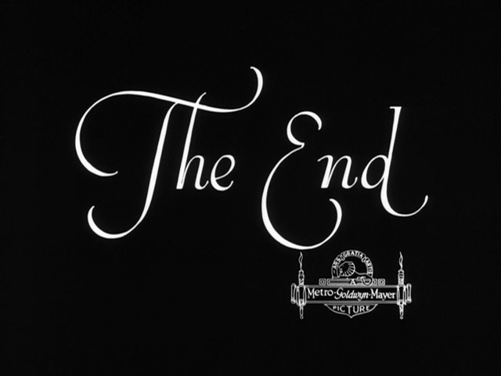
etc.

