Slide 1
Pseudocode (Revision)
Damian Gordon

Slide 2
Learning Outcomes
On Completion of this module, the learner will be able to
Design and write computer elementary programs in a structured procedural language.
Use a text editor with command line tools and simple Integrated Development Environment (IDE) to compile, link and execute program code.
Divide a computer program into modules.
Test computer programs to ensure compliance with requirements.
Implement elementary algorithms and data structures in a procedural language.

Slide 3
Algorithms
An Algorithm is a series of instructions
Examples of algorithms include
Musical scores
Knitting patterns
Row 1: SL 1, K8, K2 tog, K1, turn
Recipies

Slide 4
Pseudocode
The first thing we do when designing a program is to decide on a name for the program.
Let’s say we want to write a program to calculate interest, a good name for the program would be CalculateInterest.
Note the use of CamelCase.

Slide 5
Pseudocode
So the general structure of all programs is:
PROGRAM <ProgramName>:
<Do stuff>
END.

Slide 6
Variables
In programming, we tell the computer the value of a variable
So, for example,
x <- 5;
means “X gets the value 5”
or “X is assigned 5”
5
X

Slide 7
Variables
And later we can say something like:
x <- 8;
means “X gets the value 8”
or “X is assigned 8”

Slide 8
Variables
If we want to add one to a variable:
x <- x + 1;
means “increment X”
or “X is incremented by 1”
4
X(old)
+1
5
X(new)

Slide 9
Variables
6
We can create a new variable Y
y <- x;
means “Y gets the value of X”
or “Y is assigned the value of X”
X
6
Y

Slide 10
Variables
6
X
+1
7
Y
We can also say:
y <- x + 1;
means “Y gets the value of x plus 1”
or “Y is assigned the value of x plus 1”

Slide 11
Variables
All of these variables are integers
They are all whole numbers

Slide 12
Variables
Let’s look at numbers with decimal points:
P <- 3.14159;
means “p gets the value of 3.14159”
or “p is assigned the value of 3.14159”

Slide 13
Variables
We should really give this a better name:
Pi <- 3.14159;
means “Pi gets the value of 3.14159”
or “Pi is assigned the value of 3.14159”

Slide 14
Variables
We can also have single character variables:
Vitamin <- ‘B’;
means “Vitamin gets the value of B”
or “Vitamin is assigned the value of B”

Slide 15
Variables
We can also have single character variables:
RoomNumber <- ‘2’;
means “RoomNumber gets the value of 2”
or “RoomNumber is assigned the value of 2”

Slide 16
Variables
We can also have a string of characters:
Pet <- “Dog”;
means “Pet gets the value of Dog”
or “Pet is assigned the value of Dog”

Slide 17
Variables
We also have a special type, called BOOLEAN
It has only two values, TRUE or FALSE
IsWeekend <- FALSE;
means “IsWeekend gets the value of FALSE”
or “IsWeekend is assigned the value of FALSE”

Slide 18
Converting Temperatures
PROGRAM ConvertFromCelsiusToFahrenheit:
Print “Please Input Your Temperature in Celsius:”;
Read Temp;
Print “That Temperature in Fahrenheit:”;
Print (Temp*2) + 30;
END.

Slide 19
Pseudocode
PROGRAM PrintBiggerOfTwo:
Read A;
Read B;
IF (A>B)
THEN Print A;
ELSE Print B;
ENDIF;
END.

Slide 20
Pseudocode
PROGRAM BiggerOfThree:
Read A;
Read B;
Read C;
IF (A>B)
THEN IF (A>C)
THEN Print A;
ELSE Print C;
ENDIF;
ELSE IF (B>C)
THEN Print B;
ELSE Print C;
ENDIF;
ENDIF;
END.

Slide 21
Boolean Logic
Damian Gordon

Slide 22
Boolean Logic
You may have seen Boolean logic in another module already, for this module, we’ll look at three Boolean operations:
AND
OR
NOT

Slide 23
Boolean Logic
Boolean operators are used in the conditions of:
IF Statements
CASE Statements
WHILE Loops
FOR Loops
DO Loops
LOOP Loops

Slide 24
Boolean Logic
AND Operation
The AND operation means that both parts of the condition must be true for the condition to be satisfied.
A=TRUE, B=TRUE => A AND B = TRUE
A=FALSE, B=TRUE => A AND B = FALSE
A=TRUE, B=FALSE => A AND B = FALSE
A=FALSE, B=FALSE => A AND B = FALSE

Slide 25
Boolean Logic
PROGRAM GetGrade:
Read Result;
IF (A = 5 AND Age[Index] < Age[Index+1])
THEN PRINT “A is 5”;
ENDIF;
END.

Slide 26
Boolean Logic
PROGRAM GetGrade:
Read Result;
IF (A = 5 AND Age[Index] < Age[Index+1])
THEN PRINT “A is 5”;
ENDIF;
END.
Both A=5 and Age[Index] < Age[Index+1] must be TRUE to do the THEN part of the statement.

Slide 27
Boolean Logic
OR Operation
The OR operation means that either (or both) parts of the condition must be true for the condition to be satisfied.
A=TRUE, B=TRUE => A OR B = TRUE
A=FALSE, B=TRUE => A OR B = TRUE
A=TRUE, B=FALSE => A OR B = TRUE
A=FALSE, B=FALSE => A OR B = FALSE

Slide 28
Boolean Logic
PROGRAM GetGrade:
Read Result;
IF (A = 5 OR Age[Index] < Age[Index+1])
THEN PRINT “A is 5”;
ENDIF;
END.

Slide 29
Boolean Logic
PROGRAM GetGrade:
Read Result;
IF (A = 5 OR Age[Index] < Age[Index+1])
THEN PRINT “A is 5”;
ENDIF;
END.
Either or both of A=5 and Age[Index] < Age[Index+1] must be TRUE to do the THEN part of the statement.

Slide 30
Boolean Logic
NOT Operation
The NOT operation means that the outcome of the condition is inverted.
A=TRUE => NOT(A) = FALSE
A=FALSE => NOT(A) = TRUE

Slide 31
Boolean Logic
PROGRAM GetGrade:
Read Result;
IF (NOT (A = 5))
THEN PRINT “A is 5”;
ENDIF;
END.

Slide 32
Boolean Logic
PROGRAM GetGrade:
Read Result;
IF (NOT (A = 5))
THEN PRINT “A is 5”;
ENDIF;
END.
Only when A is not 5 the program will go into the THEN part of the IF statement, when A is 5 the THEN part is skipped.

Slide 33
CASE Statement
PROGRAM GetGrade:
Read Result;
CASE OF Result
Result => 70 :Print “You got a first”;
Result => 60 :Print “You got a 2.1”;
Result => 50 :Print “You got a 2.2”;
Result => 40 :Print “You got a 3”;
OTHER :Print “Dude, you failed”;
ENDCASE;
END.

Slide 34
WHILE Loop
WHILE (<CONDITION>)
DO <Statements>;
ENDWHILE;

Slide 35
WHILE Loop
PROGRAM Print1to5:
A <- 1;
WHILE (A != 6)
DO Print A;
A <- A + 1;
ENDWHILE;
END.

Slide 36
FOR Loop
PROGRAM Print1to5:
FOR A IN 1 TO 5
DO Print A;
ENDFOR;
END.

Slide 37
FOR Loop
Or, in general:
FOR Variable IN Range
DO <Statements>;
ENDFOR;

Slide 38
Prime Numbers
So let’s say we want to express the following algorithm:
Read in a number and check if it’s a prime number.
What’s a prime number?
A number that’s only divisible by itself and 1, e.g. 7.
Or to put it another way, every number other than itself and 1 gives a remainder, e.g. For 7, if 6, 5, 4, 3, and 2 give a remainder then 7 is prime.
So all we need to do is divide 7 by all numbers less than it but greater than one, and if any of them have no remainder, we know it’s not prime.

Slide 39
Prime Numbers
So,
If the number is 7, as long as 6, 5, 4, 3, and 2 give a remainder, 7 is prime.
If the number is 9, we know that 8, 7, 6, 5, and 4, all give remainders, but 3 does not give a remainder, it goes evenly into 9 so we can say 9 is not prime

Slide 40
Prime Numbers
So remember,
if the number is 7, as long as 6, 5, 4, 3, and 2 give a remainder, 7 is prime.
So, in general,
if the number is A, as long as A-1, A-2, A-3, A-4, ... 2 give a remainder, A is prime.

Slide 41
Prime Numbers
First Draft:
PROGRAM CheckPrime:
READ A;
B <- A-1;
WHILE (B != 1)
DO {KEEP CHECKING IF A/B DIVIDES EVENLY}
ENDWHILE;
IF (ANY TIME THE DIVISION WAS EVEN)
THEN Print “It is not prime”;
ELSE Print “It is prime”;
ENDIF;
END.

Slide 42
Prime Numbers
PROGRAM CheckPrime:
Read A;
B <- A - 1;
IsPrime <- TRUE;
WHILE (B != 1)
DO IF (A/B gives no remainder)
THEN IsPrime <- FALSE;
ENDIF;
B <- B – 1;
ENDWHILE;
IF (IsPrime = FALSE)
THEN Print “Not Prime”;
ELSE Print “Prime”;
ENDIF;
END.

Slide 43
Fibonacci Numbers
PROGRAM FibonacciNumbers:
READ A;
FirstNum <- 1;
SecondNum <- 1;
WHILE (A != 2)
DO Total <- SecondNum + FirstNum;
FirstNum <- SecondNum;
SecondNum <- Total;
A <- A – 1;
ENDWHILE;
Print Total;
END.

Slide 44
PROGRAM CompressExample:
Get Current Character;
WHILE (NOT End_of_Line)
DO Get Next Character;
IF (Current Character != Next Character)
THEN Get next char, and set current to next;
Write out Current Character;
ELSE
Keep looping while the characters match;
Keep counting;
Get next char, and set current to next;
When finished write out Counter;
Write out Current Character;
Reset Counter;
ENDIF;
ENDWHILE;
END.

Slide 45
PROGRAM CompressExample:
char Current_Char, Next_char;
Current_Char <- Get_char();
WHILE (NOT End_of_Line)
DO Next_Char <- Get_char();
IF (Current_Char != Next_char)
THEN Current_Char <- Next_Char;
Next_Char <- Get_char();
Write out Current_Char;
ELSE
WHILE (Current_Char = Next_char)
DO Counter <- Counter + 1;
Current_Char <- Next_Char;
Next_Char <- Get_char();
ENDWHILE;
Write out Counter, Current_Char;
Counter <- 0;
ENDIF;
ENDWHILE;
END.

Slide 46
Modularisation
PROGRAM CheckPrime:
Read A;
B <- A - 1;
IsPrime <- TRUE;
WHILE (B != 1)
DO IF (A/B gives no remainder)
THEN IsPrime <- FALSE;
ENDIF;
B <- B – 1;
ENDWHILE;
IF (IsPrime = FALSE)
THEN Print “Not Prime”;
ELSE Print “Prime”;
ENDIF;
END.

Slide 47
Modularisation
There’s two parts to the program:

Slide 48
Modularisation
PROGRAM CheckPrime:
Read A;
B <- A - 1;
IsPrime <- TRUE;
WHILE (B != 1)
DO IF (A/B gives no remainder)
THEN IsPrime <- FALSE;
ENDIF;
B <- B – 1;
ENDWHILE;
IF (IsPrime = FALSE)
THEN Print “Not Prime”;
ELSE Print “Prime”;
ENDIF;
END.

Slide 49
Modularisation
The first part checks if it’s prime…
The second part just prints out the result…

Slide 50
Modularisation
So we can create a module from the checking bit:

Slide 51
Modularisation
MODULE PrimeChecker:
Read A;
B <- A - 1;
IsPrime <- TRUE;
WHILE (B != 1)
DO IF (A/B gives no remainder)
THEN IsPrime <- FALSE;
ENDIF;
B <- B – 1;
ENDWHILE;
RETURN IsPrime;
END.

Slide 52
Modularisation
MODULE PrimeChecker:
Read A;
B <- A - 1;
IsPrime <- TRUE;
WHILE (B != 1)
DO IF (A/B gives no remainder)
THEN IsPrime <- FALSE;
ENDIF;
B <- B – 1;
ENDWHILE;
RETURN IsPrime;
END.

Slide 53
Modularisation
Let’s remind ourselves of what the algorithm was initially.

Slide 54
Modularisation
PROGRAM CheckPrime:
Read A;
B <- A - 1;
IsPrime <- TRUE;
WHILE (B != 1)
DO IF (A/B gives no remainder)
THEN IsPrime <- FALSE;
ENDIF;
B <- B – 1;
ENDWHILE;
IF (IsPrime = FALSE)
THEN Print “Not Prime”;
ELSE Print “Prime”;
ENDIF;
END.

Slide 55
Modularisation
Now that we have a module to do the check we can rewrite as follows:

Slide 56
Modularisation
PROGRAM CheckPrime:
IF (PrimeChecker = FALSE)
THEN Print “Not Prime”;
ELSE Print “Prime”;
ENDIF;
END.

Slide 57
Modularisation
MODULE PrimeChecker:
Read A;
B <- A - 1;
IsPrime <- TRUE;
WHILE (B != 1)
DO IF (A/B gives no remainder)
THEN IsPrime <- FALSE;
ENDIF;
B <- B – 1;
ENDWHILE;
RETURN IsPrime;
END.

Slide 58
Eras of Testing
Years | Era | Description
1945-1956 | Debugging orientated | In this era, there was no clear difference between testing and debugging.
1957-1978 | Demonstration orientated | In this era, debugging and testing are distinguished now - in this period it was shown, that software satisfies the requirements.
1979-1982 | Destruction orientated | In this era, the goal was to find errors.
1983-1987 | Evaluation orientated | In this era, the intention here is that during the software lifecycle a product evaluation is provided and measuring quality.
1988- | Prevention orientated | In the current era, tests are used to demonstrate that software satisfies its specification, to detect faults and to prevent faults.

Slide 59
Black Box Testing
Black box testing treats the software as a "black box"—without any knowledge of internal implementation.
Black box testing methods include:
equivalence partitioning,
boundary value analysis,
all-pairs testing,
fuzz testing,
model-based testing,
exploratory testing and
specification-based testing.
Black
Box

Slide 60
White Box Testing
White box testing is when the tester has access to the internal data structures and algorithms including the code that implement these.
White box testing methods include:
API testing (application programming interface) - testing of the application using public and private APIs
Code coverage - creating tests to satisfy some criteria of code coverage (e.g., the test designer can create tests to cause all statements in the program to be executed at least once)
Fault injection methods - improving the coverage of a test by introducing faults to test code paths
Mutation testing methods
Static testing - White box testing includes all static testing
White
Box

Slide 61
Grey Box Testing
Grey Box Testing involves having knowledge of internal data structures and algorithms for purposes of designing the test cases, but testing at the user, or black-box level.
The tester is not required to have a full access to the software's source code.
Grey box testing may also include reverse engineering to determine, for instance, boundary values or error messages.
Grey
Box

Slide 62
Testing Tools
Program testing and fault detection can be aided significantly by testing tools and debuggers. Testing/debug tools include features such as:
Program monitors, permitting full or partial monitoring of program code (more on the next slide).
Formatted dump or symbolic debugging, tools allowing inspection of program variables on error or at chosen points.
Automated functional GUI testing tools are used to repeat system-level tests through the GUI.
Benchmarks, allowing run-time performance comparisons to be made.
Performance analysis (or profiling tools) that can help to highlight hot spots and resource usage.

Slide 63
Testing Tools
Program monitors, permitting full or partial monitoring of program code including:
Instruction set simulator, permitting complete instruction level monitoring and trace facilities
Program animation, permitting step-by-step execution and conditional breakpoint at source level or in machine code
Code coverage reports

Slide 64
Arrays
We can think of an array as a series of pigeon-holes:

Slide 65
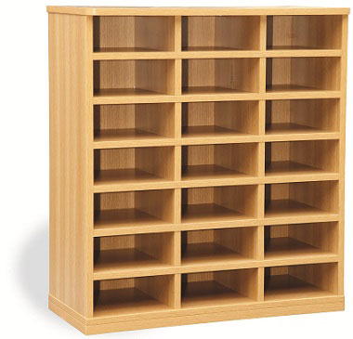
Array
0
1
2
3
4
5
6
7
8
10
11
9
13
14
12
16
17
15
19
20
18

Slide 66
Arrays
If we look at our array again:
44
0
23
1
42
2
33
3
16
4
54
5
34
6
18
7
……..…
34
38
82
Age
39

Slide 67
Arrays
If we wanted to add 1 to everyone’s age:
44
0
23
1
42
2
33
3
16
4
54
5
34
6
18
7
……..…
34
38
82
Age
39
+1
+1
+1
+1
+1
+1
+1
+1
+1
+1

Slide 68
Arrays
If we wanted to add 1 to everyone’s age:
45
0
24
1
43
2
34
3
17
4
55
5
35
6
19
7
……..…
35
38
83
Age
39

Slide 69
Arrays
We could do it like this:
PROGRAM Add1ToAge:
Age[0] <- Age[0] + 1;
Age[1] <- Age[1] + 1;
Age[2] <- Age[2] + 1;
Age[3] <- Age[3] + 1;
Age[4] <- Age[4] + 1;
Age[5] <- Age[5] + 1;
………………………………………………………
Age[38] <- Age[38] + 1;
Age[39] <- Age[39] + 1;
END.

Slide 70
Arrays
An easier way of doing it is:
PROGRAM Add1ToAge:
N <- 0;
WHILE (N != 40)
DO Age[N] <- Age[N] + 1;
N <- N + 1;
ENDWHILE;
END.

Slide 71
Arrays
Or:
PROGRAM Add1ToAge:
FOR N IN 0 TO 39
DO Age[N] <- Age[N] + 1;
ENDFOR;
END.

Slide 72
Arrays
We can also have an array of real numbers:
Bank
Balance
22.00
0
65.50
1
-2.20
2
78.80
3
54.00
4
-3.33
5
0.00
6
47.65
7

Slide 73
Arrays
What if we wanted to check who has a balance less than zero :
PROGRAM LessThanZeroBalance:
integer ArraySize <- 8;
FOR N IN 0 TO ArraySize-1
DO IF BankBalance[N] < 0
THEN PRINT “User” N “is in debt”;
ENDIF;
ENDFOR;
END.

Slide 74
Arrays
We can also have an array of characters:

Slide 75
Arrays
We can also have an array of characters:
G
0
A
1
T
2
T
3
C
4
C
5
A
6
G
7
……..…
A
38
A
Gene
39

Slide 76
Arrays
What if we wanted to count all the ‘G’ in the Gene Array:
G
0
A
1
T
2
T
3
C
4
C
5
A
6
G
7
……..…
A
38
A
Gene
39

Slide 77
Arrays
What if we wanted to count all the ‘G’ in the Gene Array:
PROGRAM AverageOfArray:
integer ArraySize <- 40;
integer G-Count <- 0;
FOR N IN 0 TO ArraySize-1
DO IF Gene[N] = ‘G’
THEN G-Count <- G-Count + 1;
ENDIF;
ENDFOR;
PRINT “The total G count is:” G-Count;
END.

Slide 78
Arrays
We can also have an array of strings:

Slide 79
Arrays
We can also have an array of strings:
Dog
0
Cat
1
Dog
2
Bird
3
Fish
4
Fish
5
Cat
6
Cat
7
Pets

Slide 80
Arrays
We can also have an array of booleans:

Slide 81
Arrays
We can also have an array of booleans:
In
School
TRUE
0
TRUE
1
FALSE
2
TRUE
3
FALSE
4
TRUE
5
FALSE
6
FALSE
7

Slide 82
Searching: Sequential Search
This is a SEQUENTIAL SEARCH.
If the array is 40 characters long, it will take 40 checks to complete. If the array is 1000 characters long, it will take 1000 checks to complete.

Slide 83
Searching: Sequential Search
Here’s how we could do it:
PROGRAM SequentialSearch:
integer SearchValue <- 18;
integer ArraySize <- 40;
FOR N IN 0 TO ArraySize-1
DO IF Age[N] = SearchValue
THEN PRINT “User “ N “is 18”;
ENDIF;
ENDFOR;
END.

Slide 84
Searching: Binary Search
If the data is sorted, we can do a BINARY SEARCH

Slide 85
Searching: Binary Search
If the data is sorted, we can do a BINARY SEARCH
16
0
18
1
23
2
23
3
33
4
33
5
34
6
43
7
……..…
78
38
82
Age
39

Slide 86
Searching: Binary Search
If the data is sorted, we can do a BINARY SEARCH
This means we jump to the middle of the array, if the value being searched for is less than the middle value, all we have to do is search the first half of that array.
We search the first half of the array in the same way, jumping to the middle of it, and repeat this.

Slide 87
Searching: Binary Search
The BINARY SEARCH just takes five checks to find the right value in an array of 40 elements. For an array of 1000 elements it will take 11 checks.
This is much faster than if we searched through all the values.

Slide 88
Searching: Binary Search
If the data is sorted, we can do a BINARY SEARCH
PROGRAM BinarySearch:
integer First <- 0;
integer Last <- 40;
boolean IsFound <- FALSE;
WHILE First <= Last AND IsFound = FALSE
DO Index = (First + Last)/2;
IF Age[Index] = SearchValue
THEN IsFound <- TRUE;
ELSE IF Age[Index] > SearchValue
THEN Last <- Index-1;
ELSE First <- Index+1;
ENDIF;
ENDIF;
ENDWHILE;
END.

Slide 89
Minimum Value in Array
Here’s how we could do it:
PROGRAM MinimumValue:
integer ArraySize <- 8;
MinValSoFar <- Age[0];
FOR N IN 1 TO ArraySize-1
DO IF MinValSoFar > Age[N]
THEN MinValSoFar <- Age[N];
ENDIF;
ENDFOR;
PRINT MinValSoFar;
END.

Slide 90
Maximum Value in Array
Here’s how we could do it:
PROGRAM MaximumValue:
integer ArraySize <- 8;
MaxValSoFar <- Age[0];
FOR N IN 1 TO ArraySize-1
DO IF MaxValSoFar < Age[N]
THEN MaxValSoFar <- Age[N];
ENDIF;
ENDFOR;
PRINT MaxValSoFar;
END.

Slide 91
Average Value in Array
Here’s how we could do it:
PROGRAM AverageValue:
integer ArraySize <- 8;
Integer Total <- 0;
FOR N IN 1 TO ArraySize-1
DO Total <- Total + Age[N];
ENDFOR;
PRINT Total/ArraySize;
END.

Slide 92
Standard Deviation of an Array
First Draft
PROGRAM StandardDeviationValue:
integer ArraySize <- 8;
GET AVERAGE OF ARRAY;
TotalSDNum <- 0;
FOR N IN 0 TO ArraySize-1
DO SDNum <-(Age[N]-ArrayAvg)*(Age[N]-ArrayAvg)
TotalSDNum <- TotalSDNum + SDNum;
ENDFOR;
Print SquareRoot(TotalSDNum/ArraySize-1);
END.

Slide 93
Standard Deviation of an Array
Here’s the final version:
PROGRAM StandardDeviationValue:
integer ArraySize <- 8;
Integer TotalAvg <- 0;
FOR N IN 1 TO ArraySize-1
DO TotalAvg <- TotalAvg + Age[N];
ENDFOR;
AverageValue <- TotalAvg/ArraySize;
TotalSDNum <- 0;
FOR N IN 0 TO ArraySize-1
DO SDNum <-(Age[N]-AverageValue)*(Age[N]- AverageValue)
TotalSDNum <- TotalSDNum + SDNum;
ENDFOR;
Print SquareRoot(TotalSDNum/ArraySize-1);
END.

Slide 94
Sorting: Bubble Sort
PROGRAM BubbleSort:
Integer Age[8] <- {44,23,42,33,16,54,34,18};
FOR Outer-Index IN 0 TO N-1
DO FOR Index IN 0 TO N-2
DO IF (Age[Index+1] < Age[Index])
THEN Temp_Value <- Age[Index+1];
Age[Index+1] <- Age[Index];
Age[Index] <- Temp_Value;
ENDIF;
ENDFOR;
ENDFOR;
END.

Slide 95
Sorting: Selection Sort
PROGRAM SelectionSort:
Integer Age[8] <- {44,23,42,33,16,54,34,18};
FOR Outer-Index IN 0 TO N-1
MinValueLocation <- Outer-Index;
FOR Index IN Outer-Index+1 TO N-1
DO IF (Age[Index] < Age[MinValueLocation])
THEN MinValueLocation <- Index;
ENDIF;
ENDFOR;
IF (MinValueLocation != Outer-Index)
THEN Swap(Age[Outer-Index], Age[MinValueLocation]);
ENDIF;
ENDFOR;
END.

Slide 96
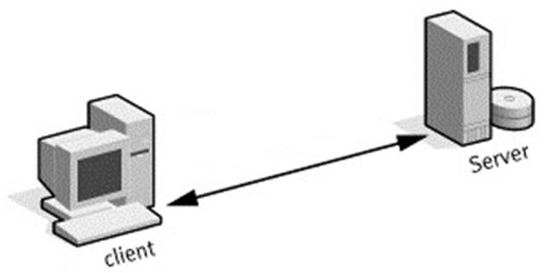

Slide 97
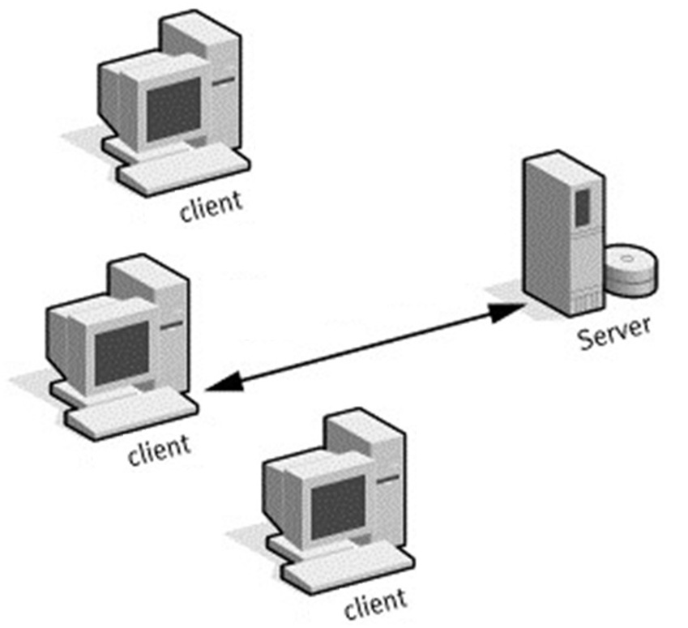

Slide 98
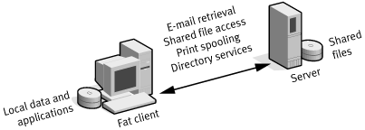

Slide 99
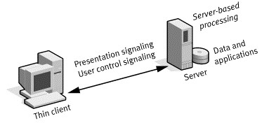

Slide 102
Most Processing happens here!

Slide 103
Most Processing happens here!
Most Processing happens here!

Slide 104
3-Tier Architecture

Slide 105
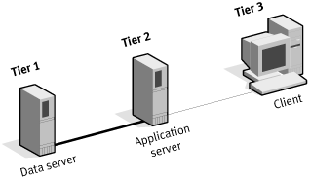

Slide 106
N-Tier Architecture

Slide 107
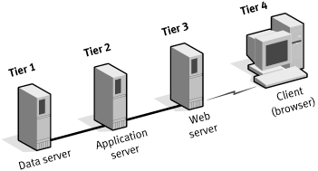

Slide 108
N-Tier Architecture with Server Load Balancing

Slide 109
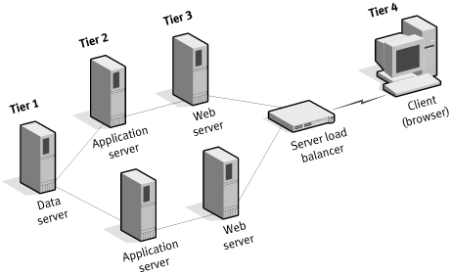

Slide 110
etc.

Slide 111
Universal Design
Universal Design means…
Design Once
Include All
It is not (just) about disability
It is about usability for all

Slide 112
Universal Design
Inclusive Design
Design for All
User Needs Design
User-Centred Design
Human-Centred Design
Barrier-Free Design
Accessible Design
Adaptable Design
Transgenerational design
Design for a Broader Average

Slide 113
The Principles of Universal Design
Equitable Use
Flexibility in Use
Simple and Intuitive
Perceptible Information
Tolerance for Error
Low Physical Effort
Size and Space for Approach and Use

Slide 114
Timeline of Methodologies
1950s Code & Fix
1960s Design-Code-Test-Maintain
1970s Waterfall Model
1980s Spiral Model
1990s V-Model/Rapid Application Development
2000s Agile Methods

