Slide 1
Computer Networks
Damian Gordon

Slide 2
Computer Networks
When we hook up computers together using data communication facilities, we call this a computer network.

Slide 3
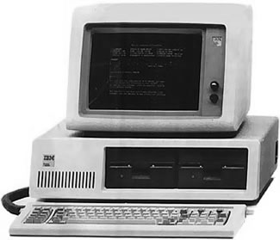
Computer Networks
When we hook up computers together using data communication facilities, we call this a computer network.

Slide 4
Computer Networks
When we hook up computers together using data communication facilities, we call this a computer network.

Slide 5
Computer Networks
When we hook up computers together using data communication facilities, we call this a computer network.

Slide 6
Computer Networks
When we hook up computers together using data communication facilities, we call this a computer network.

Slide 7
Network Types
We can classify networks by the geographical distance they cover:
Local Area Network (LAN)
Metropolitan Area Network (MAN)
Wide Area Network (WAN)
Wireless Local Area Network (WLAN)

Slide 8
Network Types
LAN
MAN
WAN

Slide 9
Network Types
A Local Area Network (LAN) is a network within a single building or campus, e.g. an office, a college, or a warehouse. It is typically owned and used by a single organisation. Typically it’s a cluster of PCs or workstations. A LAN can be linked to larger networks via a bridge or gateway.

Slide 10
Network Types
A Metropolitan Area Network (MAN) is a network that covers a full street, a neighbourhood, or even a city, as long as it doesn’t exceed a circumference of 100 kilometres. The MAN is often owned and run as a public utility, and are typically configured as a Ring Topology.

Slide 11
Network Types
A Wide Area Network (WAN) is a network that a country, or connects countries. The WAN is often owned and run as a public utility, but telephone companies have WANs also. WANs can use anything for satellites to microwaves transmissions. The most common example of a WAN is the Internet, but there are other commercial WANs.

Slide 12
Network Types
A Wireless Local Area Network (WLAN) is a wireless LAN. It works exactly the same as a normal LAN, but the technology means that the network uses a wireless protocol such as IEEE 802.11a, IEEE 802.11b, IEEE 802.11g, or IEEE 802.11n. Additionally 802.16 (the mobile WiMAX standard) is available.

Slide 13
etc.

