Slide 1
Software Development Methodologies
(1980s – To Date)
Damian Gordon

Slide 2
Timeline of Methodologies
1950s Code & Fix
1960s Design-Code-Test-Maintain
1970s Waterfall Model
1980s Spiral Model
1990s V-Model/Rapid Application Development
2000s Agile Methods

Slide 3
Timeline of Methodologies
1950s Code & Fix
1960s Design-Code-Test-Maintain
1970s Waterfall Model
1980s Spiral Model
1990s V-Model/Rapid Application Development
2000s Agile Methods

Slide 4
1980s: Spiral Model

Slide 5
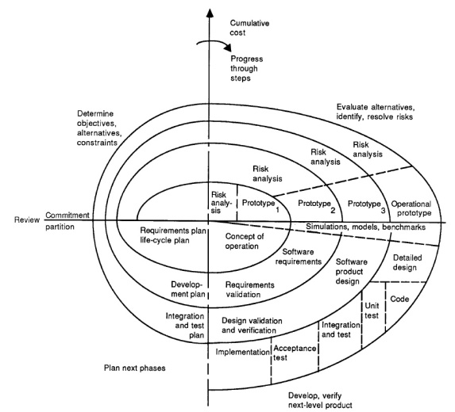
A Spiral Model of Software Development and Enhancement by
Barry Boehm

Slide 6
Reference
Boehm, B., 1986, "A Spiral Model of Software Development and Enhancement", ACM SIGSOFT Software Engineering Notes, 11(4) (August), pp.14-24.

Slide 7

Barry Boehm
Born in 1935.
An American software engineer, TRW Emeritus Professor of Software Engineering at the Computer Science Department of the University of Southern California.
Known for his many contributions to software engineering.

Slide 8
Introduction
“Stop the life cycle—I want to get off!”
“Life-cycle Concept Considered Harmful.”
“ The waterfall model is dead.”
“No, it isn’t, but it should be.”
“These statements exemplify the current debate about software life-cycle process models. The topic has recently received a great deal of attention.
The Defense Science Board Task Force Report on Military Software issued in 1987 highlighted the concern that traditional software process models were discouraging more effective approaches to software development such as prototyping and software reuse. The Computer Society has sponsored tutorials and workshops on software process models that have helped clarify many of the issues and stimulated advances in the field (see “Further Reading”).
The spiral model presented in this article is one candidate for improving the software process model situation. The major distinguishing feature of the spiral model is that it creates a risk-driven approach to the software process rather than a primarily document-driven or code-driven process. It incorporates many of the strengths of other models and resolves many of their difficulties.
This article opens with a short description of software process models and the issues they address. Subsequent sections outline the process steps involved in the spiral model; illustrate the application of the spiral model to a software project, using the TRW Software Productivity Project as an example; summarize the primary advantages and implications involved in using the spiral model and the primary difficulties in using it at its current incomplete level of elaboration; and present resulting conclusions.”

Slide 9
Background
The primary functions of a software process model are to determine the order of the stages involved in software development and evolution and to establish the transition criteria for progressing from one stage to the next.

Slide 10
Background
Thus the key questions that a process model must consider are:
  What shall we do next?
  How long shall we continue to do it?

Slide 11
Background
Problems with the Waterfall Model
It emphasises fully elaborated documents as a completion criteria for the stages. This may not be always desirable, for example, for end-user applications a large amount of documentation is not necessarily desirable or needed.

Slide 12
The Spiral Model
The spiral model of the software process has been evolving for several years, based on experience with various refinements of the waterfall model as applied to large government software projects.

Slide 13


Slide 14
The Spiral Model
The radial dimension represents the cumulative cost incurred in accomplishing the steps to date; the angular dimension represents the progress made in completing each cycle of the spiral.
The model reflects the underlying concept that each cycle involves a progression that addresses the same sequence of steps, for each portion of the product and for each of its levels of elaboration, from an overall concept of operation document down to the coding of each individual program.

Slide 17
1

Slide 18
The Spiral Model
A typical cycle of the spiral. Each cycle of the spiral begins with the identification of
  the objectives of the portion of the product being elaborated (performance, functionality, ability to accommodate change, etc.);
  the alternative means of implementing this portion of the product (design A , design B, reuse, buy, etc.); and
  the constraints imposed on the application of the alternatives (cost, schedule, inter-face, etc.).

Slide 21
2

Slide 22
The Spiral Model
The next step is to evaluate the alternatives relative to the objectives and constraints.
Frequently, this process will identify areas of uncertainty that are significant sources of project risk.
If so, the next step should involve the formulation of a cost-effective strategy for resolving the sources of risk.
This may involve prototyping, simulation, benchmarking, reference checking, administering user questionnaires, analytic modelling, or combinations of these and other risk resolution techniques.

Slide 25
3

Slide 26
The Spiral Model
Once the risks are evaluated, the next step is determined by the relative remaining risks.
If performance or user-interface risks strongly dominate program development or internal interface-control risks, the next step may be an evolutionary development one: a minimal effort to specify the overall nature of the product, a plan for the next level of prototyping, and the development of a more detailed prototype to continue to resolve the major risk issues.

Slide 29
4

Slide 30
The Spiral Model
If this prototype is operationally useful and robust enough to serve as a low-risk base for future product evolution, the subsequent risk-driven steps would be the evolving series of evolutionary prototypes going toward the right of the figure.
In this case, the option of writing specifications would be addressed but not exercised. Thus, risk considerations can lead to a project implementing only a subset of all the potential steps in the model.
On the other hand, if previous prototyping efforts have already resolved all of the performance or user-interface risks, and program development or interface-control risks dominate, the next step follows the basic waterfall approach (concept of operation, soft-ware requirements, preliminary design, etc.), modified as appropriate to incorporate incremental development.
Each level of software specification in the figure is then followed by a validation step and the preparation of plans for the succeeding cycle.

Slide 31
A prioritized top-ten list of software risk items

Slide 32
 | Risk Item | Risk Management Techniques
1. | Personnel shortfalls | Staffing with top talent, job matching; teambuilding; morale building; cross-training; pre-scheduling key people
2. | Unrealistic schedules and budgets | Detailed, multisource cost and schedule estimation; design to cost; incremental development; software reuse; requirements scrubbing
3. | Developing the wrong software functions | Organization analysis; mission analysis; ops-concept formulation; user surveys; prototyping; early users’ manuals
4. | Developing the wrong user interface | Task analysis; prototyping; scenarios; user characterization (functionality, style, workload)
5. | Gold plating | Requirements scrubbing; prototyping; cost-benefit analysis; design to cost
6. | Continuing stream of requirement changes | High change threshold; information hiding; incremental development (defer changes to later increments)
7. | Shortfalls in externally furnished components | Benchmarking; inspections; reference checking; compatibility analysis
8. | Shortfalls in externally performed tasks | Reference checking; pre-award audits; award-fee contracts; competitive design or prototyping; teambuilding
9. | Real-time performance shortfalls | Simulation; benchmarking; modelling; prototyping; instrumentation; tuning
10. | Straining computer-science capabilities | Technical analysis; cost—benefit analysis; prototyping; reference checking

Slide 33
1990s: The V-Model and
Rapid Application Development

Slide 34
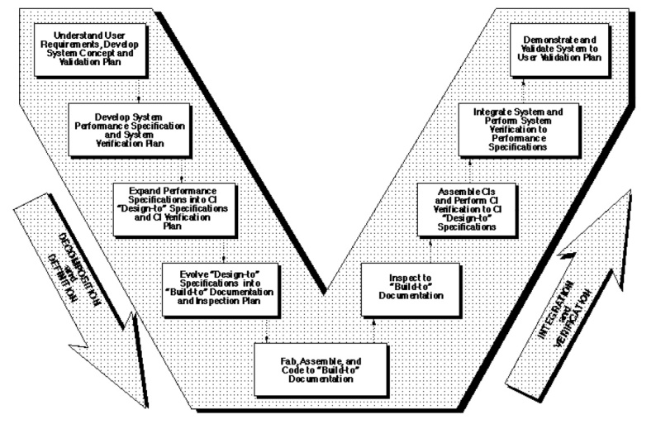
The Relationship of System Engineering to the Project Cycle by
Kevin Forsberg and Harold Mooz

Slide 35
Reference
Forsberg, K., Mooz, H., 1991, "The Relationship of System Engineering to the Project Cycle", Chattanooga, Tennessee: Proceedings of the National Council for Systems Engineering (NCOSE) Conference, pp. 57–65.

Slide 36
Abstract
“A new way of portraying the technical aspect of the project cycle clarifies the role and responsibility of system engineering to a project. This new three dimensional graphic illustrates the end-to-end involvement of system engineering in the project cycle, clarifies the relationship of system engineering and design engineering, and encourages the implementation of concurrent engineering.”

Slide 37
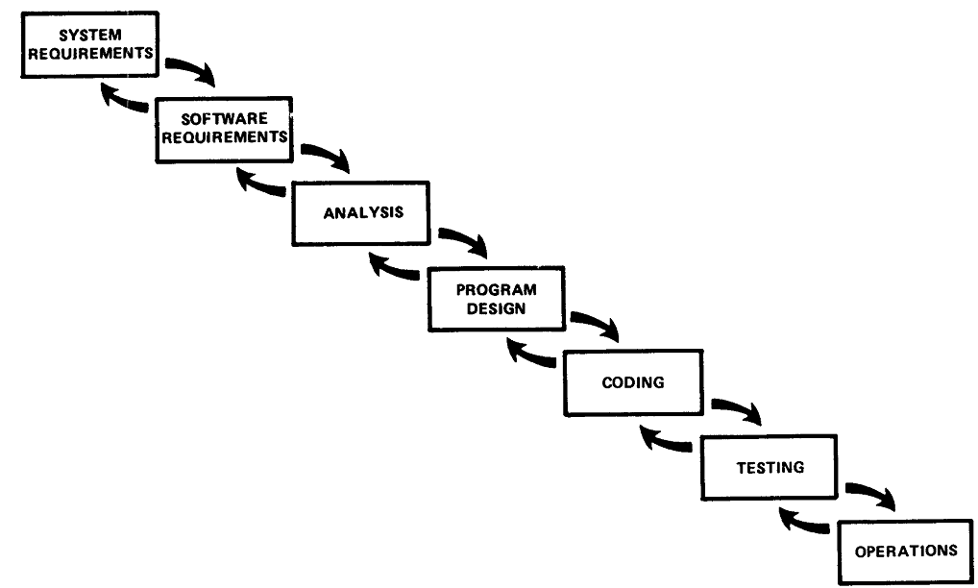
Introduction
The Waterfall Model has a deficiency in that it implies that the work downstream cannot begin until the upstream major reviews have occurred.

Slide 38
Introduction
The Spiral Model is better since it ensures prototyping occurs earlier, but the role of software engineering in the overall process is unclear.

Slide 39
The “Vee” Model
Start with the user needs on the upper right, and ending with a user-validated system on the upper right.

Slide 40


Slide 41
Detailed Discussion of the “Vee” Model
Start with the user needs on the upper right, and ending with a user-validated system on the upper right.

Slide 42
Detailed Discussion of the “Vee” Model
As project development progresses, a series of six baselines are established to systematically manage cohesive system development:
  The first is the “User Requirements Baseline” established by the System Requirement Document approved and put under Configuration Management prior to the System Requirements Review.
  The second is the “Concept Baseline” established by the Concept Definition section of the Integrated Program Summary document at the System Requirements Review.
  The third is the “System Performance Baseline” (or Development Baseline) established by the System Performance Specification at the System Design Review.
  The fourth is the “‘Design-To’ Baseline” (or Allocated Baseline) established at the series of Preliminary Design Reviews.
  The fifth is the “‘Build-To’ Baseline” (or preliminary Product Baseline) established at the series of Critical Design Reviews.
  The sixth is the “‘As-Built’ Baseline” (or Production Baseline) established at the series of Formal Qualification Reviews (FQRs). Each of the baselines is put under formal Configuration Management at the time they are approved.

Slide 43
Detailed Discussion of the “Vee” Model
Incremental Development
If the User Requirements are too vague to permit final definition at Preliminary Design Review, one approach is to develop the project in predetermined incremental releases.
The first release is focused on meeting a minimum set of User Requirements, with subsequent releases providing added functionality and performance. This is a common approach in software development.

Slide 44
Detailed Discussion of the “Vee” Model
Concurrent Engineering
If high iteration with User Requirements is required after the System Design Review (SDR), it is probable that the project has passed early Control Gates prematurely, and it is not sufficiently defined.
One cause of premature advance is that the appropriate technical experts were not involved at early stages, resulting in acceptance of requirements and design concepts which cannot be built, inspected, and/or maintained.

Slide 45
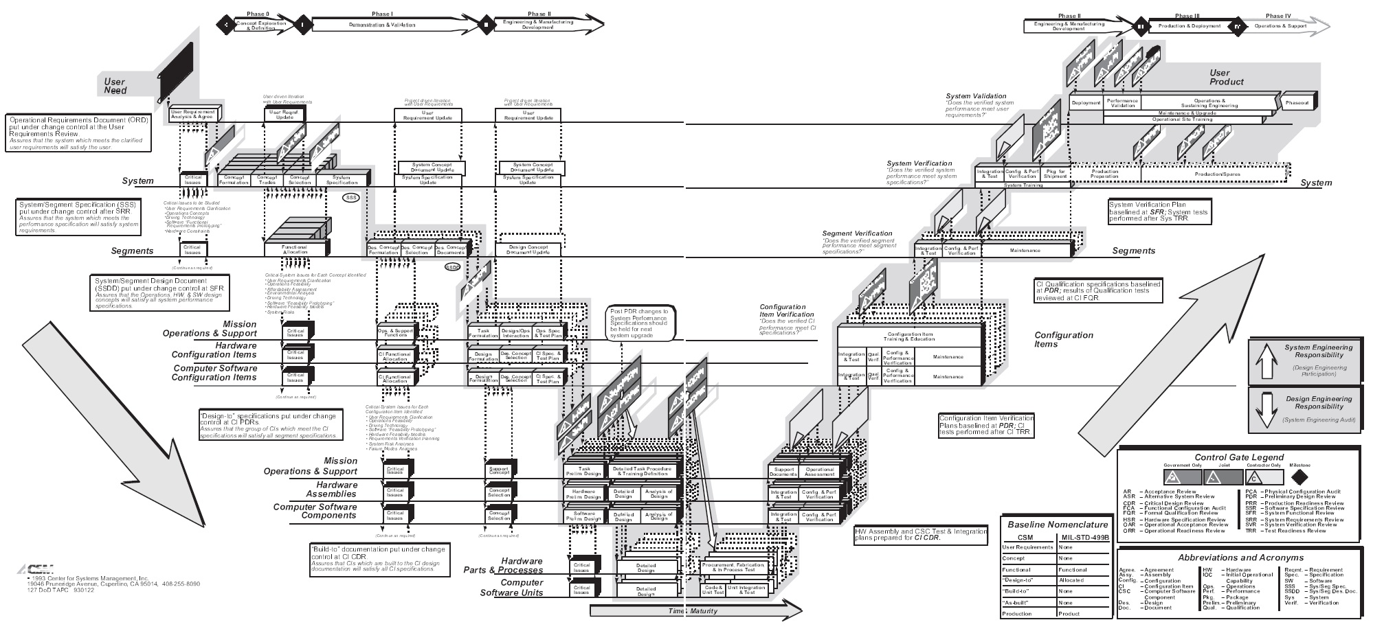

Slide 46
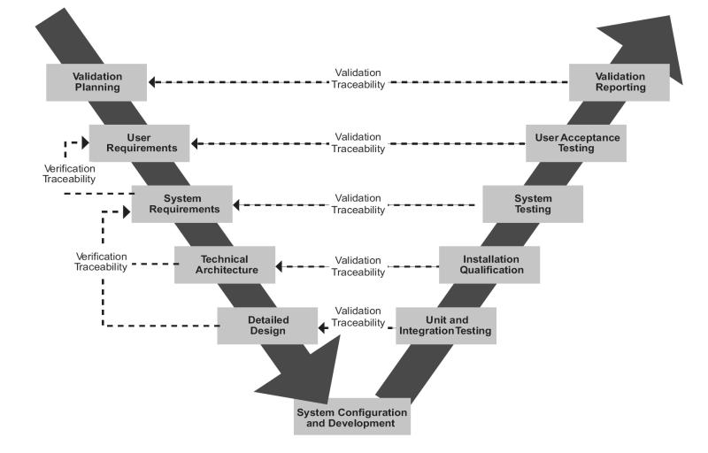

Slide 47
RAD: Rapid Application Development by
James Martin

Slide 48
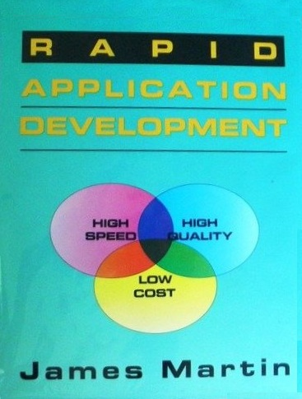
Reference
Martin, J., RAD: Rapid Application Development, 1991, MacMillan Publishing Co., New York.

Slide 49

James Martin
Born in 1933.
Born in Ashby, Leicestershire
a British Information Technology consultant and author, who was nominated for a Pulitzer prize for his book, The Wired Society: A Challenge for Tomorrow (1977).

Slide 50
Rapid Application Development
Rapid Application Development
  1. Joint Requirements Planning (JRP)
  2. Joint Application Design (JAD)
  3. Construction
    Heavy use of tools: code generators
    Time-boxed; many prototypes
  4. Cutover
Good for systems with extensive user input available

Slide 51
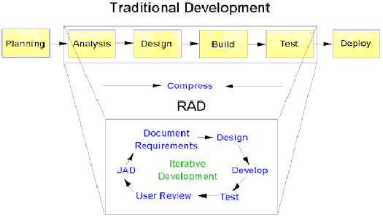
Rapid Application Development

Slide 52
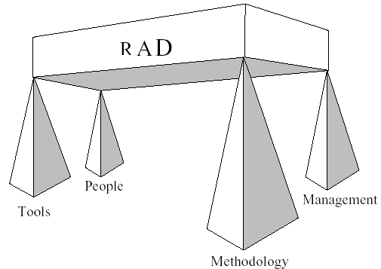
Rapid Application Development

Slide 53
Rapid Application Development
RAD is a way to deliver systems very fast
  The longer a project, the greater its likelihood of failure
It is a lightweight approach
Uses proven technology effectively
Make the solution fit within the capabilities of the tools (hammer?)
RAD is not Quick and Dirty with a thin veneer of discipline
RAD operates where the 80 / 20 rule applies
RAD can’t be used in all situations

Slide 54
2000s: Agile Development

Slide 55
Manifesto for Agile Software Development by
Kent Beck
Mike Beedle
Arie van Bennekum
Alistair Cockburn
Ward Cunningham
Martin Fowler
James Grenning
Jim Highsmith
Andrew Hunt
Ron Jeffries
Jon Kern
Brian Marick
Robert C. Martin
Steve Mellor
Ken Schwaber
Jeff Sutherland
Dave Thomas

Slide 56
Reference
Beck, K. et al., 2001, "Manifesto for Agile Software Development“, Agile Alliance.

Slide 57
Background
In February 2001, 17 software developers met at the Snowbird, Utah resort, to discuss lightweight development methods.
They published the Manifesto for Agile Software Development to define the approach now known as agile software development.
Some of the manifesto's authors formed the Agile Alliance, a non-profit organization that promotes software development according to the manifesto's principles.

Slide 58
Manifesto for Agile Software Development
We are uncovering better ways of developing
software by doing it and helping others do it.
Through this work we have come to value:
Individuals and interactions over processes and tools
Working software over comprehensive documentation
Customer collaboration over contract negotiation
Responding to change over following a plan
That is, while there is value in the items on
the right, we value the items on the left more.

Slide 59
Agile Methods
Well-known agile software development methods include:
  Agile Modelling
  Agile Unified Process (AUP)
  Dynamic Systems Development Method (DSDM)
  Essential Unified Process (EssUP)
  Extreme Programming (XP)
  Feature Driven Development (FDD)
  Open Unified Process (OpenUP)
  Scrum
  Velocity tracking

Slide 60

etc.

