Slide 1
Software Development Methodologies
Damian Gordon

Slide 2
Timeline of Methodologies
1950s Code & Fix
1960s Design-Code-Test-Maintain
1970s Waterfall Model
1980s Spiral Model
1990s V-Model/Rapid Application Development
2000s Agile Methods

Slide 3
1950s: Code & Fix

Slide 4
Code-and-Fix
Aka “Code-like-Hell”
Specification (maybe),
Code (yes),
Release (maybe)
Suitable for prototypes or throwaways

Slide 5
Code-and-Fix
Advantages
No overhead
Requires little expertise
Disadvantages
No process, quality control, etc.
Highly risky

Slide 6
1960s: Design-Code-Test-Maintain

Slide 7
Design-Code-Test-Maintain
Design:
Specify requirement diagrammatically
Code:
Write the code
Test:
Check if it is working
Maintain:
Keep it up-to-date

Slide 8
Design-Code-Test-Maintain
Advantages
More process control
Less risky
Disadvantages
More Overhead
Requires more expretise

Slide 9
1970s: Waterfall Model

Slide 10
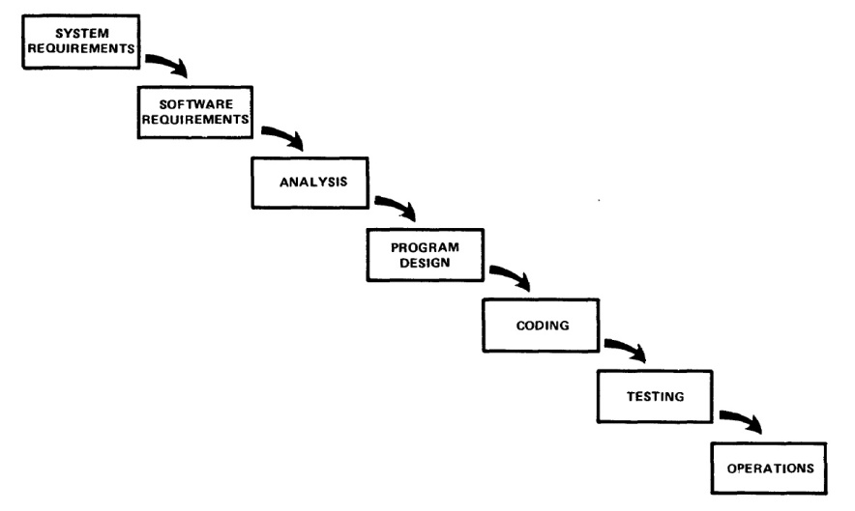
Managing the Development of Large Software Systems by W.W. Royce

Slide 11
Reference
Royce, W.W., 1970, "Managing the Development of Large Software Systems", Proceedings of IEEE WESCON 26 (August), pp.1–9.

Slide 12
Winston W. Royce
Born in 1929.
Died in 1995.
An American computer scientist, director at Lockheed Software Technology Center in Austin, Texas, and one of the leaders in software development in the second half of the 20th century.
He was the first person to describe the “Waterfall model” for software development, although Royce did not use the term "waterfall" in that article, nor advocated the waterfall model as a working methodology.

Slide 13
Introduction
“I am going to describe my personal views about managing large software developments.
I have had various assignments during the past nine years, mostly concerned with the development of software packages for spacecraft mission planning, commanding and post-flight analysis.
In these assignments I have experienced different degrees of success with respect to arriving at an operational state, on-time, and within costs.
I have become prejudiced by my experiences and I am going to relate some of these prejudices in this presentation.”

Slide 14
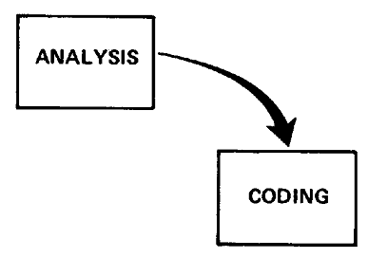
Small Developments
For a small development, you only need the following steps
Typically done for programs for internal use

Slide 15
Large Developments

Slide 16
Large Developments
System Requirements: Identify, select and document functional, scheduling and financial requirements.

Slide 17
Large Developments
Software Requirements: Identify, select and document the software features necessary to satisfy the system requirements.

Slide 18
Large Developments
Analysis: Methodically work through the details of each requirement.

Slide 19
Large Developments
Program Design: Use programming techniques to design software and hardware within the constraints and objectives set in the earlier stages.

Slide 20
Large Developments
Coding: Implement the program as designed in the earlier stages.

Slide 21
Large Developments
Testing: Test the software and record the results.

Slide 22
Large Developments
Operations: Deliver, install and configure the completed software.

Slide 23
Large Developments

Slide 24
Large Developments
"I believe in this concept,
but the implementation
described above is risky
and invites failure."

Slide 25
Iterative Relationship between Successive Development Phases

Slide 26
Iterative Relationship between Successive Development Phases
Each step progresses and the design is further detailed, there is an iteration with the preceding and succeeding steps but rarely with the more remote steps in the sequence.
The virtue of all of this is that as the design proceeds the change process is scoped down to manageable limits.

Slide 27
Unfortunately the design iterations are never confined to the successive steps

Slide 28
Unfortunately the design iterations are never confined to the successive steps
The testing phase which occurs at the end of the development cycle is the first event for which timing, storage, input/output transfers, etc., are experienced as distinguished from analyzed.
These phenomena are not precisely analyzable.
Yet if these phenomena fail to satisfy the various external constraints, then invariably a major redesign is required.

Slide 29
How do we fix this?

Slide 30
Five Steps
Program Design comes first
Document the Design
Do it twice
Plan, Control and Monitor Testing
Involve the Customer

Slide 31
1. Program Design comes first
A preliminary program design phase has been inserted between the Software Requirements Generation phase and the Analysis phase.

Slide 32
1. Program Design comes first

Slide 33
1. Program Design comes first
The following steps are required:
1) Begin the design process with program designers, not analysts or programmers.
2) Design, define and allocate the data processing modes.
3) Write an overview document that is understandable, informative and current.

Slide 34
2. Document the Design
“How much documentation?"
“Quite a lot"
More than most programmers, analysts, or program designers are willing to do if left to their own devices.
The first rule of managing software development is ruthless enforcement of documentation requirements.

Slide 35
2. Document the Design

Slide 36
3. Do It Twice
Create a pilot study
If the computer program in question is being developed for the first time, arrange matters so that the version finally delivered to the customer for operational deployment is actually the second version insofar as critical design/operations areas are concerned.

Slide 37
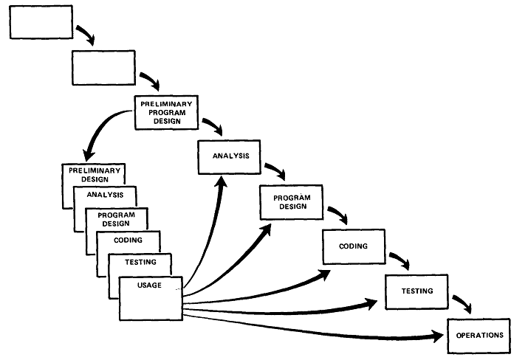
3. Do It Twice

Slide 38
4. Plan, Control and Monitor Testing
Without question the biggest user of project resources, whether it be manpower, computer time, or management judgment, is the test phase. It is the phase of greatest risk in terms of dollars and schedule.

Slide 39
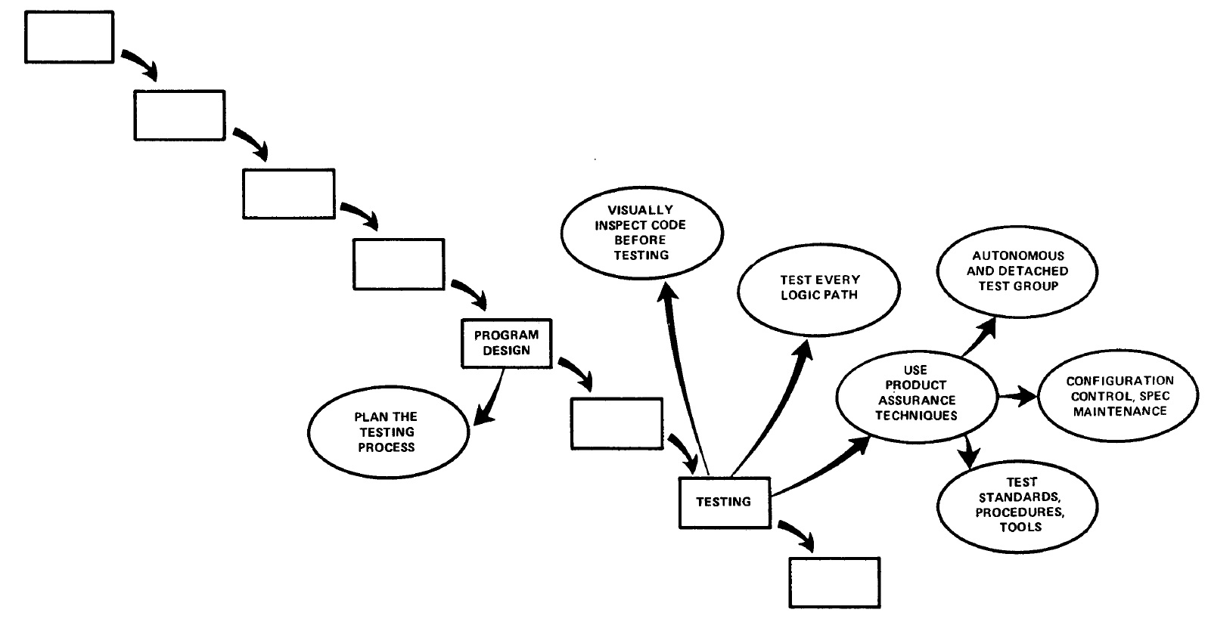
4. Plan, Control and Monitor Testing

Slide 40
4. Plan, Control and Monitor Testing
1) Many parts of the test process are best handled by test specialists who did not necessarily contribute to the original design.
2) Most errors are of an obvious nature that can be easily spotted by visual inspection.
3) Test every logic path in the computer program at least once with some kind of numerical check.
4) After the simple errors (which are in the majority, and which obscure the big mistakes) are removed, then it is time to turn over the software to the test area for checkout purposes.

Slide 41
5. Involve the Customer
For some reason what a software design is going to do is subject to wide interpretation even after previous agreement.
It is important to involve the customer in a formal way so that he has committed himself at earlier points before final delivery.
To give the contractor free rein between requirement definition and operation is inviting trouble.

Slide 42
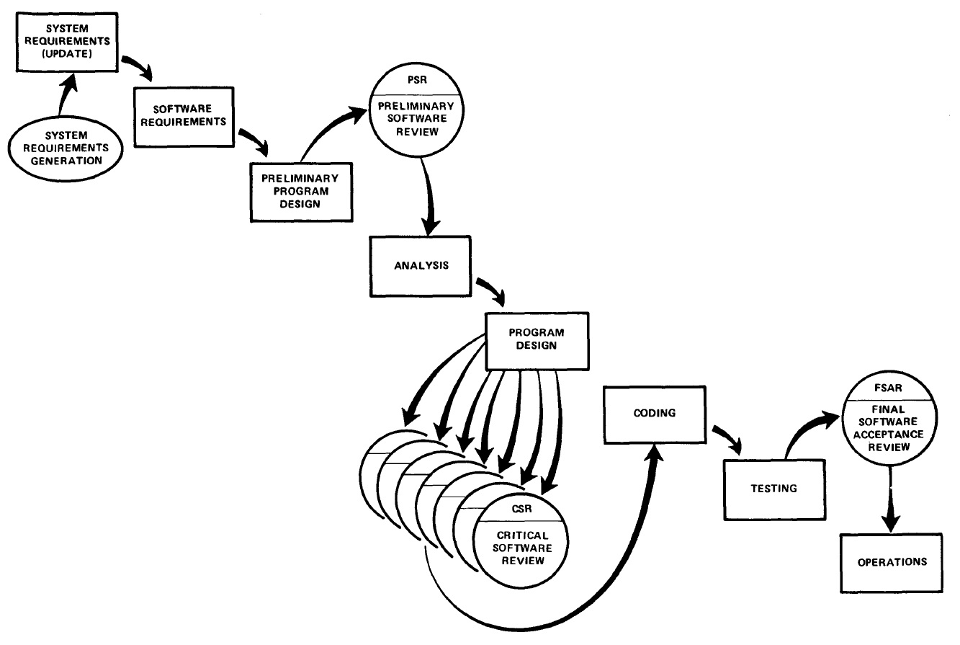
5. Involve the Customer

Slide 43
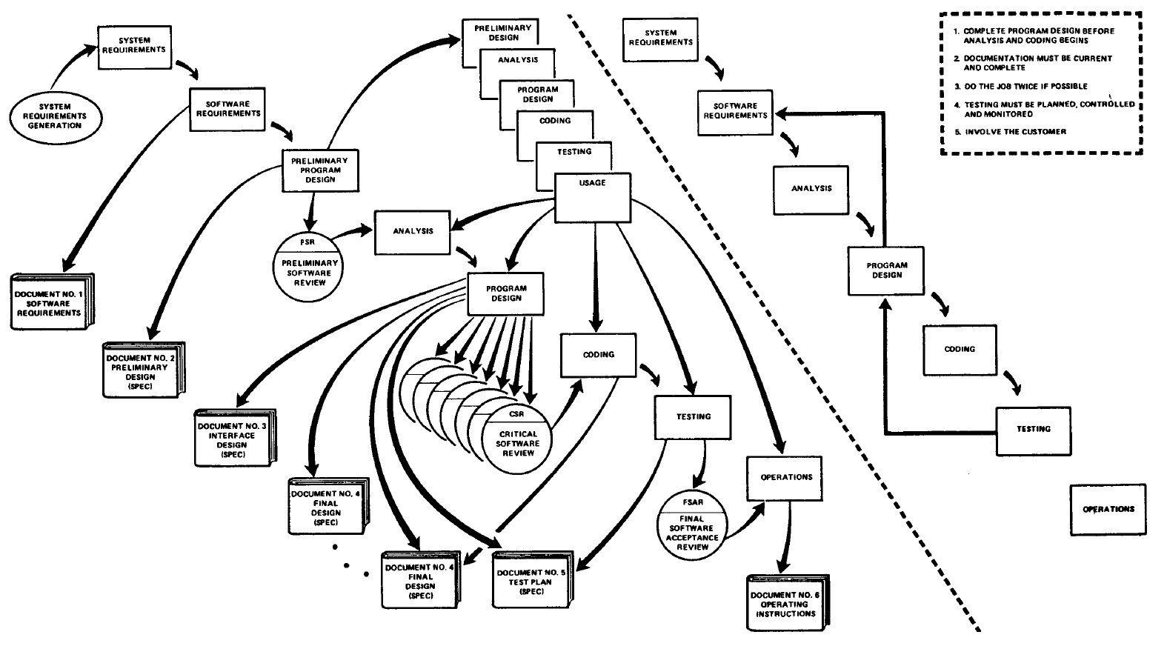
Summary

Slide 44
1980s: Spiral Model

Slide 45
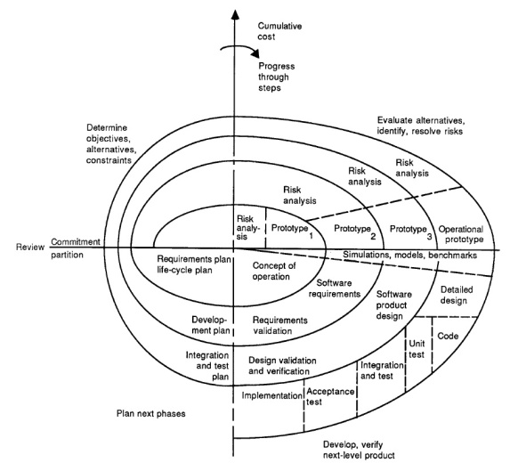
A Spiral Model of Software Development and Enhancement by Barry Boehm

Slide 46
Reference
Boehm, B., 1986, "A Spiral Model of Software Development and Enhancement", ACM SIGSOFT Software Engineering Notes, 11(4) (August), pp.14-24.

Slide 47
Barry Boehm
Born in 1935.
An American software engineer, TRW Emeritus Professor of Software Engineering at the Computer Science Department of the University of Southern California.
Known for his many contributions to software engineering.

Slide 48
Introduction
“Stop the life cycle—I want to get off!”
“Life-cycle Concept Considered Harmful.”
“ The waterfall model is dead.”
“No, it isn’t, but it should be.”
“These statements exemplify the current debate about software life-cycle process models. The topic has recently received a great deal of attention.
The Defense Science Board Task Force Report on Military Software issued in 1987 highlighted the concern that traditional software process models were discouraging more effective approaches to software development such as prototyping and software reuse. The Computer Society has sponsored tutorials and workshops on software process models that have helped clarify many of the issues and stimulated advances in the field (see “Further Reading”).
The spiral model presented in this article is one candidate for improving the software process model situation. The major distinguishing feature of the spiral model is that it creates a risk-driven approach to the software process rather than a primarily document-driven or code-driven process. It incorporates many of the strengths of other models and resolves many of their difficulties.
This article opens with a short description of software process models and the issues they address. Subsequent sections outline the process steps involved in the spiral model; illustrate the application of the spiral model to a software project, using the TRW Software Productivity Project as an example; summarize the primary advantages and implications involved in using the spiral model and the primary difficulties in using it at its current incomplete level of elaboration; and present resulting conclusions.”

Slide 49
Background
The primary functions of a software process model are to determine the order of the stages involved in software development and evolution and to establish the transition criteria for progressing from one stage to the next.

Slide 50
Background
Thus the key questions that a process model must consider are:
What shall we do next?
How long shall we continue to do it?

Slide 51
Background
Problems with the Waterfall Model
It emphasises fully elaborated documents as a completion criteria for the stages. This may not be always desirable, for example, for end-user applications a large amount of documentation is not necessarily desirable or needed.

Slide 52
The Spiral Model
The spiral model of the software process has been evolving for several years, based on experience with various refinements of the waterfall model as applied to large government software projects.

Slide 54
The Spiral Model
The radial dimension represents the cumulative cost incurred in accomplishing the steps to date; the angular dimension represents the progress made in completing each cycle of the spiral.
The model reflects the underlying concept that each cycle involves a progression that addresses the same sequence of steps, for each portion of the product and for each of its levels of elaboration, from an overall concept of operation document down to the coding of each individual program.

Slide 57
1

Slide 58
The Spiral Model
A typical cycle of the spiral. Each cycle of the spiral begins with the identification of
the objectives of the portion of the product being elaborated (performance, functionality, ability to accommodate change, etc.);
the alternative means of implementing this portion of the product (design A , design B, reuse, buy, etc.); and
the constraints imposed on the application of the alternatives (cost, schedule, inter-face, etc.).

Slide 61
2

Slide 62
The Spiral Model
The next step is to evaluate the alternatives relative to the objectives and constraints.
Frequently, this process will identify areas of uncertainty that are significant sources of project risk.
If so, the next step should involve the formulation of a cost-effective strategy for resolving the sources of risk.
This may involve prototyping, simulation, benchmarking, reference checking, administering user questionnaires, analytic modelling, or combinations of these and other risk resolution techniques.

Slide 65
3

Slide 66
The Spiral Model
Once the risks are evaluated, the next step is determined by the relative remaining risks.
If performance or user-interface risks strongly dominate program development or internal interface-control risks, the next step may be an evolutionary development one: a minimal effort to specify the overall nature of the product, a plan for the next level of prototyping, and the development of a more detailed prototype to continue to resolve the major risk issues.

Slide 69
4

Slide 70
The Spiral Model
If this prototype is operationally useful and robust enough to serve as a low-risk base for future product evolution, the subsequent risk-driven steps would be the evolving series of evolutionary prototypes going toward the right of the figure.
In this case, the option of writing specifications would be addressed but not exercised. Thus, risk considerations can lead to a project implementing only a subset of all the potential steps in the model.
On the other hand, if previous prototyping efforts have already resolved all of the performance or user-interface risks, and program development or interface-control risks dominate, the next step follows the basic waterfall approach (concept of operation, soft-ware requirements, preliminary design, etc.), modified as appropriate to incorporate incremental development.
Each level of software specification in the figure is then followed by a validation step and the preparation of plans for the succeeding cycle.

Slide 71
A prioritized top-ten list of software risk items

Slide 72
 | Risk Item | Risk Management Techniques
1. | Personnel shortfalls | Staffing with top talent, job matching; teambuilding; morale building; cross-training; pre-scheduling key people
2. | Unrealistic schedules and budgets | Detailed, multisource cost and schedule estimation; design to cost; incremental development; software reuse; requirements scrubbing
3. | Developing the wrong software functions | Organization analysis; mission analysis; ops-concept formulation; user surveys; prototyping; early users’ manuals
4. | Developing the wrong user interface | Task analysis; prototyping; scenarios; user characterization (functionality, style, workload)
5. | Gold plating | Requirements scrubbing; prototyping; cost-benefit analysis; design to cost
6. | Continuing stream of requirement changes | High change threshold; information hiding; incremental development (defer changes to later increments)
7. | Shortfalls in externally furnished components | Benchmarking; inspections; reference checking; compatibility analysis
8. | Shortfalls in externally performed tasks | Reference checking; pre-award audits; award-fee contracts; competitive design or prototyping; teambuilding
9. | Real-time performance shortfalls | Simulation; benchmarking; modelling; prototyping; instrumentation; tuning
10. | Straining computer-science capabilities | Technical analysis; cost—benefit analysis; prototyping; reference checking

Slide 73
1990s: The V-Model and Rapid Application Development

Slide 74
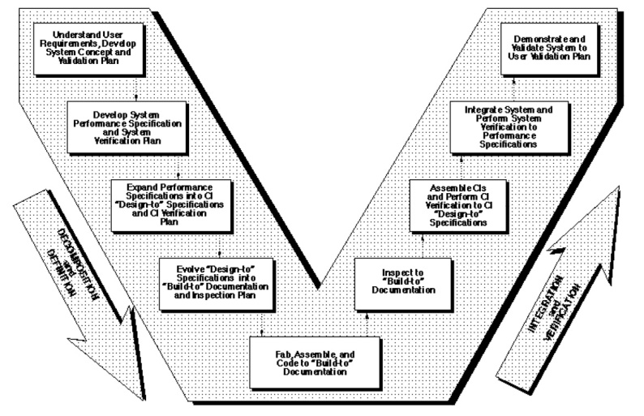
The Relationship of System Engineering to the Project Cycle by Kevin Forsberg and Harold Mooz

Slide 75
Reference
Forsberg, K., Mooz, H., 1991, "The Relationship of System Engineering to the Project Cycle", Chattanooga, Tennessee: Proceedings of the National Council for Systems Engineering (NCOSE) Conference, pp. 57–65.

Slide 76
Abstract
“A new way of portraying the technical aspect of the project cycle clarifies the role and responsibility of system engineering to a project. This new three dimensional graphic illustrates the end-to-end involvement of system engineering in the project cycle, clarifies the relationship of system engineering and design engineering, and encourages the implementation of concurrent engineering.”

Slide 77
Introduction
The Waterfall Model has a deficiency in that it implies that the work downstream cannot begin until the upstream major reviews have occurred.

Slide 78
Introduction
The Spiral Model is better since it ensures prototyping occurs earlier, but the role of software engineering in the overall process is unclear.

Slide 79
The “Vee” Model
Start with the user needs on the upper right, and ending with a user-validated system on the upper right.

Slide 81
Detailed Discussion of the “Vee” Model
Start with the user needs on the upper right, and ending with a user-validated system on the upper right.

Slide 82
Detailed Discussion of the “Vee” Model
As project development progresses, a series of six baselines are established to systematically manage cohesive system development:
The first is the “User Requirements Baseline” established by the System Requirement Document approved and put under Configuration Management prior to the System Requirements Review.
The second is the “Concept Baseline” established by the Concept Definition section of the Integrated Program Summary document at the System Requirements Review.
The third is the “System Performance Baseline” (or Development Baseline) established by the System Performance Specification at the System Design Review.
The fourth is the “‘Design-To’ Baseline” (or Allocated Baseline) established at the series of Preliminary Design Reviews.
The fifth is the “‘Build-To’ Baseline” (or preliminary Product Baseline) established at the series of Critical Design Reviews.
The sixth is the “‘As-Built’ Baseline” (or Production Baseline) established at the series of Formal Qualification Reviews (FQRs). Each of the baselines is put under formal Configuration Management at the time they are approved.

Slide 83
Detailed Discussion of the “Vee” Model
Incremental Development
If the User Requirements are too vague to permit final definition at Preliminary Design Review, one approach is to develop the project in predetermined incremental releases.
The first release is focused on meeting a minimum set of User Requirements, with subsequent releases providing added functionality and performance. This is a common approach in software development.

Slide 84
Detailed Discussion of the “Vee” Model
Concurrent Engineering
If high iteration with User Requirements is required after the System Design Review (SDR), it is probable that the project has passed early Control Gates prematurely, and it is not sufficiently defined.
One cause of premature advance is that the appropriate technical experts were not involved at early stages, resulting in acceptance of requirements and design concepts which cannot be built, inspected, and/or maintained.

Slide 85
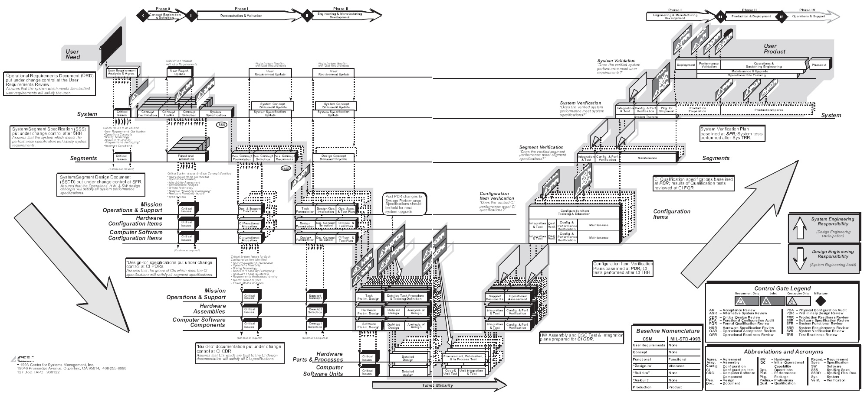

Slide 86
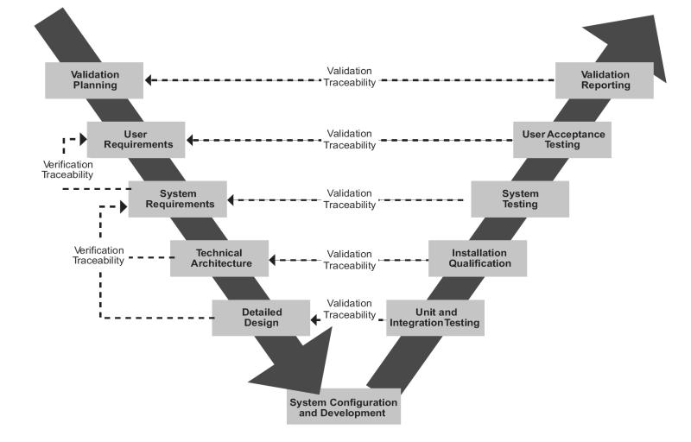

Slide 87
RAD: Rapid Application Development by James Martin

Slide 88
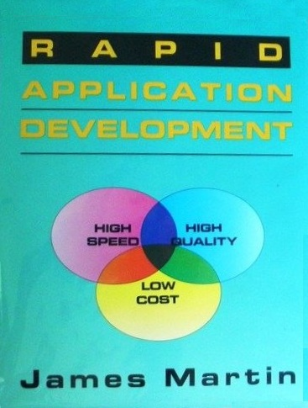
Reference
Martin, J., RAD: Rapid Application Development, 1991, MacMillan Publishing Co., New York.

Slide 89
James Martin
Born in 1933.
Born in Ashby, Leicestershire
a British Information Technology consultant and author, who was nominated for a Pulitzer prize for his book, The Wired Society: A Challenge for Tomorrow (1977).

Slide 90
Rapid Application Development
Rapid Application Development
1. Joint Requirements Planning (JRP)
2. Joint Application Design (JAD)
3. Construction
Heavy use of tools: code generators
Time-boxed; many prototypes
4. Cutover
Good for systems with extensive user input available

Slide 91
Rapid Application Development

Slide 92
Rapid Application Development

Slide 93
Rapid Application Development
RAD is a way to deliver systems very fast
The longer a project, the greater its likelihood of failure
It is a lightweight approach
Uses proven technology effectively
Make the solution fit within the capabilities of the tools (hammer?)
RAD is not Quick and Dirty with a thin veneer of discipline
RAD operates where the 80 / 20 rule applies
RAD can’t be used in all situations

Slide 94
2000s: Agile Development

Slide 95
Manifesto for Agile Software Development by
Kent Beck Mike Beedle Arie van Bennekum Alistair Cockburn Ward Cunningham Martin Fowler
James Grenning Jim Highsmith Andrew Hunt Ron Jeffries Jon Kern Brian Marick
Robert C. Martin Steve Mellor Ken Schwaber Jeff Sutherland Dave Thomas

Slide 96
Reference
Beck, K. et al., 2001, "Manifesto for Agile Software Development“, Agile Alliance.

Slide 97
Background
In February 2001, 17 software developers met at the Snowbird, Utah resort, to discuss lightweight development methods.
They published the Manifesto for Agile Software Development to define the approach now known as agile software development.
Some of the manifesto's authors formed the Agile Alliance, a non-profit organization that promotes software development according to the manifesto's principles.

Slide 98
Manifesto for Agile Software Development
We are uncovering better ways of developing software by doing it and helping others do it. Through this work we have come to value:
Individuals and interactions over processes and tools Working software over comprehensive documentation Customer collaboration over contract negotiation Responding to change over following a plan
That is, while there is value in the items on the right, we value the items on the left more.

Slide 99
Agile Methods
Well-known agile software development methods include:
Agile Modelling
Agile Unified Process (AUP)
Dynamic Systems Development Method (DSDM)
Essential Unified Process (EssUP)
Extreme Programming (XP)
Feature Driven Development (FDD)
Open Unified Process (OpenUP)
Scrum
Velocity tracking

Slide 100
etc.

