Slide 1
Technical Architectures
Damian Gordon

Slide 2
Contents
2-Tier Architecture (Client/Server)
3-Tier Architecture
N-Tier Architecture
N-Tier Architecture (with Server Load Balancing)
http://cis.cuyamaca.net/draney/214/web_server/client.htm

Slide 3
2-Tier Architecture (Client/Server)

Slide 4
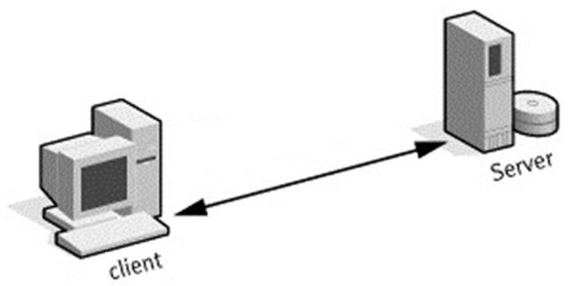

Slide 5
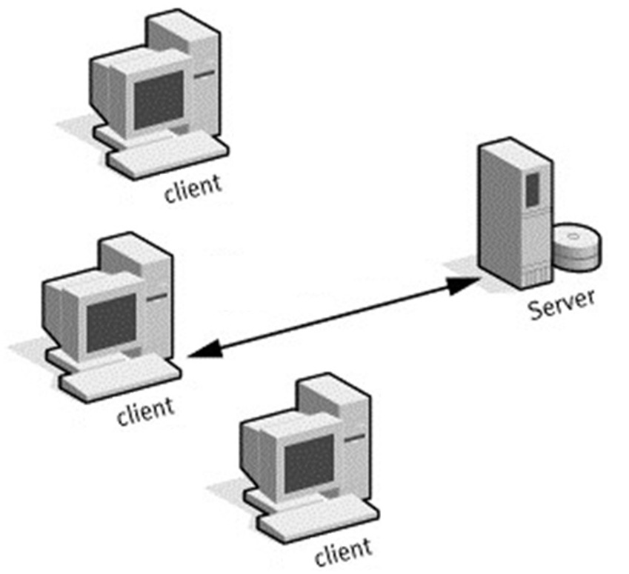

Slide 6
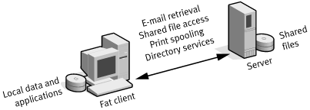

Slide 7
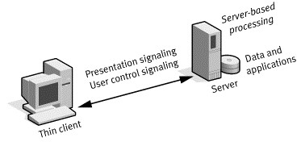

Slide 10
Most Processing happens here!

Slide 11
Most Processing happens here!
Most Processing happens here!

Slide 12
3-Tier Architecture

Slide 13
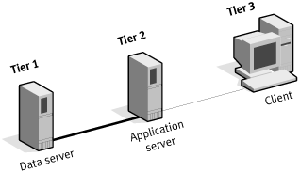

Slide 14
N-Tier Architecture

Slide 15
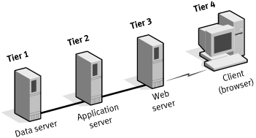

Slide 16
N-Tier Architecture with Server Load Balancing

Slide 17
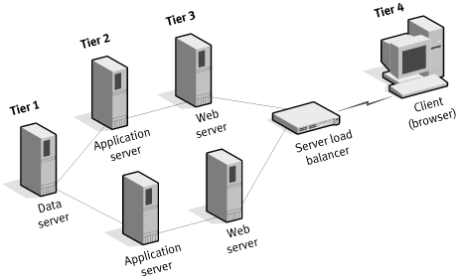

Slide 18
etc.

