Slide 1
Data Structures: Advanced
Damian Gordon

Slide 2
Advanced Data Structure
We’ll look at:
Linked Lists
Trees
Stacks
Queues

Slide 3
Linked Lists
Imagine we wanted to have an array where we can dynamically add elements into it, and take them away.
We can do this with a linked list.

Slide 4
Linked Lists
A linked list is made up of nodes.

Slide 5
Linked Lists
A linked list is made up of nodes.
Each node has two parts to it:

Slide 6
Linked Lists
A linked list is made up of nodes.
Each node has two parts to it:
Value
Pointer

Slide 7
Linked Lists
For example

Slide 8
Linked Lists
For example
23

Slide 9
Linked Lists
For example
23
62

Slide 10
Linked Lists
For example
23
62
37

Slide 11
Linked Lists
For example
23
62
37
31

Slide 12
Linked Lists
For example
23
62
37
31
NULL

Slide 13
Linked Lists
For example
23
62
37
31
NULL
Start
of List
End
of List

Slide 14
Linked Lists
To add a value in:
23
62
37
31
NULL

Slide 15
Linked Lists
To add a value in:
23
62
37
31
NULL
26

Slide 16
Linked Lists
To add a value in:
23
62
37
31
NULL
26

Slide 17
Linked Lists
To add a value in:
23
62
37
31
NULL
26

Slide 18
Linked Lists
To add a value in:
23
62
26
37
31
NULL

Slide 19
Linked Lists
To delete a value:
23
62
26
37
31
NULL

Slide 20
Linked Lists
To delete a value:
23
62
26
37
31
NULL

Slide 21
Linked Lists
To delete a value:
23
62
37
31
NULL

Slide 22
Trees
We can also have a tree:

Slide 23
Trees
We can also have a tree:
A tree is made up of nodes.
Each node has three parts.

Slide 24
Trees
We can also have a tree:
A tree is made up of nodes.
Each node has three parts.
A value and two pointers, a left and a right one.
Value
Left
Right

Slide 25
Trees
23
This is what it looks like:
68
14
33
53
11
83
77
27

Slide 26
Trees
23
Root
This is what it looks like:
Parent
68
14
33
53
11
83
Child
77
27
Leaf

Slide 27
Stacks
We can also have a stack:

Slide 28
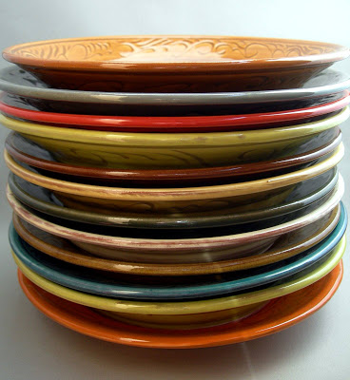
Stacks
We can also have a stack:

Slide 29
Stacks
We can also have a stack:
It’s a structure that conforms to the principle of Last In, First Out (LIFO).
The last item to join the stack is the first item to be served.

Slide 30
Stacks
59
53
26
59
41
31

Slide 31
Stacks
59
Top
53
26
59
41
31
Bottom

Slide 32
Stacks
Values are added to the top:

Slide 33
Stacks
Values are added to the top:
67
59
53
26
59
41
31

Slide 34
Stacks
Values are added to the top:
67
59
53
26
59
41
31

Slide 35
Stacks
Values are added to the top:
67
59
53
26
59
41
31

Slide 36
Stacks
Values are removed from the top:
67
59
53
26
59
41
31

Slide 37
Stacks
Values are removed from the top:
67
59
53
26
59
41
31

Slide 38
Stacks
Values are removed from the top:
59
53
26
59
41
31

Slide 39
Queues
We can also have a queue:

Slide 40
Queues
We can also have a queue:

Slide 41
Queues
We can also have a queue:
It’s a structure that conforms to the principle of First In, First Out (FIFO).
The first item to join the queue is the first item to be served.

Slide 42
Queues
59
53
26
59
41
31

Slide 43
Queues
59
53
26
59
41
31
Back
Front

Slide 44
Queues
Values are added to the back:
59
53
26
59
41
31
86

Slide 45
Queues
Values are added to the back:
59
53
26
59
41
31
86

Slide 46
Queues
Values are added to the back:
86
59
53
26
59
41
31

Slide 47
Queues
Values are removed from the front:
86
59
53
26
59
41
31

Slide 48
Queues
Values are removed from the front:
86
59
53
26
59
41
31

Slide 49
Queues
Values are removed from the front:
86
59
53
26
59
41
31

Slide 50
Queues
Values are removed from the front:
86
59
53
26
59
41

Slide 51
etc.

