Slide 1

Thinking Outside of the Box
Damian Gordon

Slide 2

Thinking Outside of the Box

Slide 3
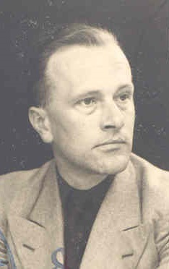
Thinking Outside of the Box
Karl Duncker

Slide 4
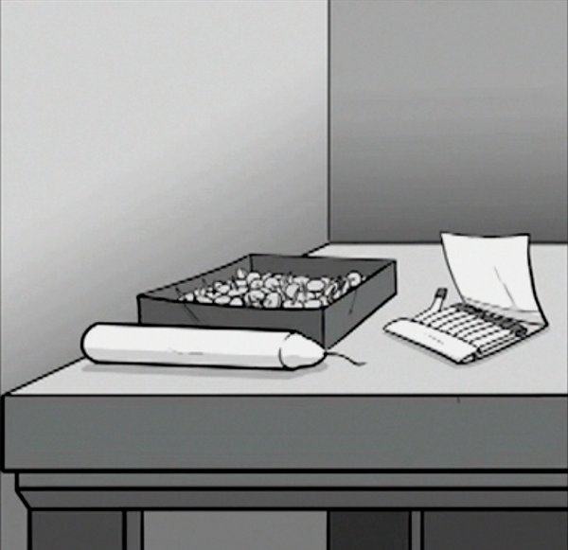
Thinking Outside of the Box

Slide 5
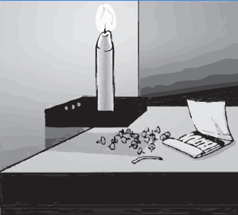
Thinking Outside of the Box

Slide 6

Thinking Outside of the Box

