Slide 1
Flow Charting

Slide 2
Flow Charting
Students are given a text on an unfamiliar topic. They are asked to study the text in pairs and then to produce a flowchart/diagram that summarises the process described in the text.
Now get them to assess what parts need to be changed to make it work for a different scenario.

Slide 3
Diagrams of the 2009 Claremont Report on Database Research

Slide 4
Introduction
Agrawal et al. (2009) "The Claremont Report on Database Research", Communications of the ACM, 52(6).

Slide 5
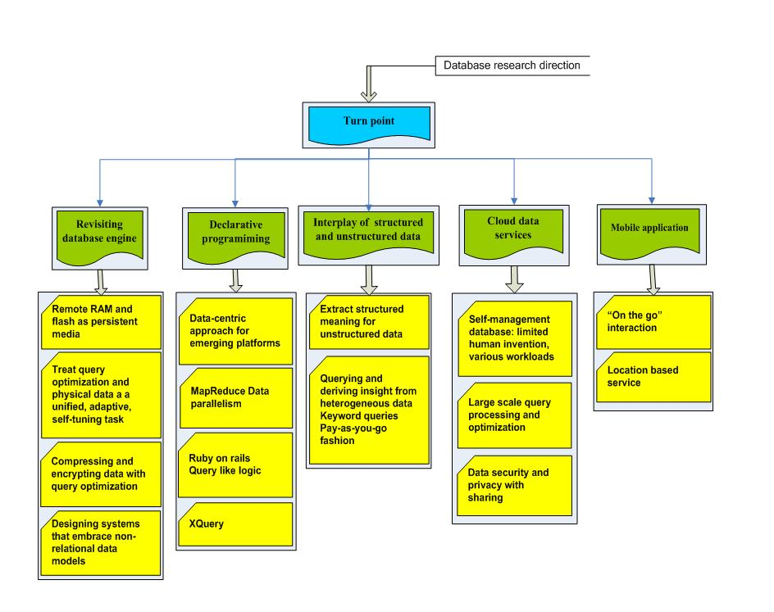

Slide 6
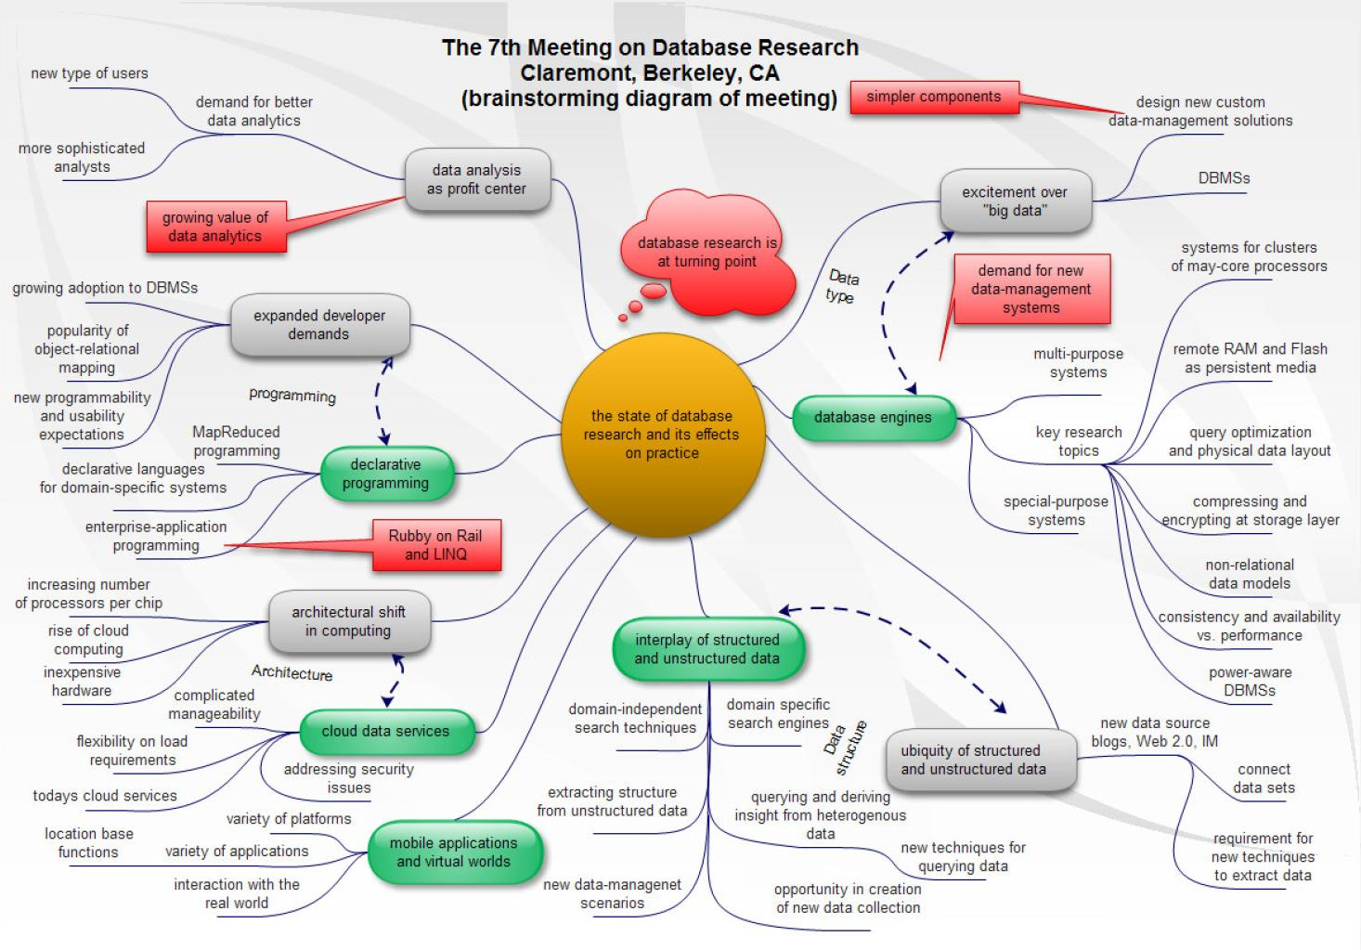

Slide 8
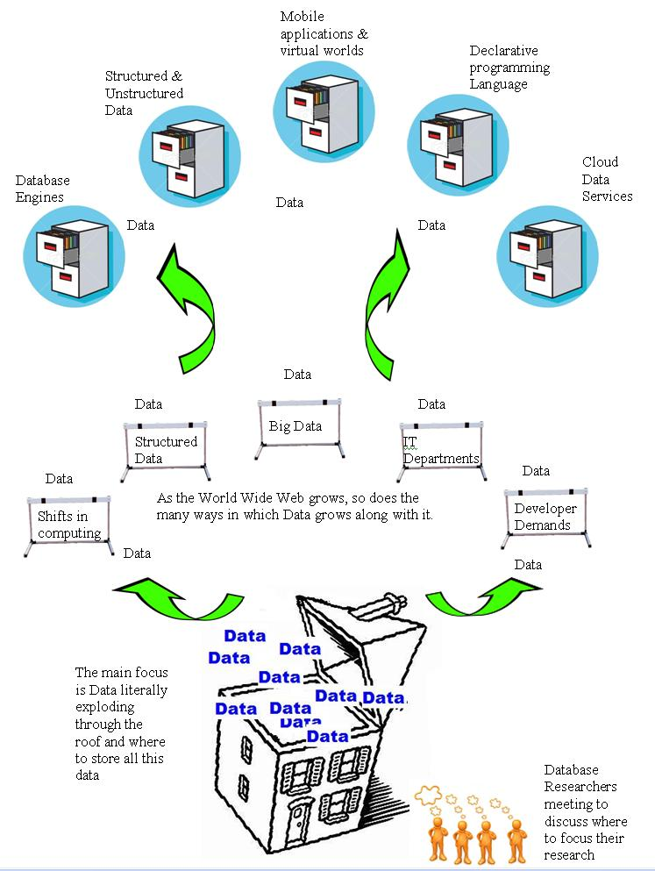

Slide 13
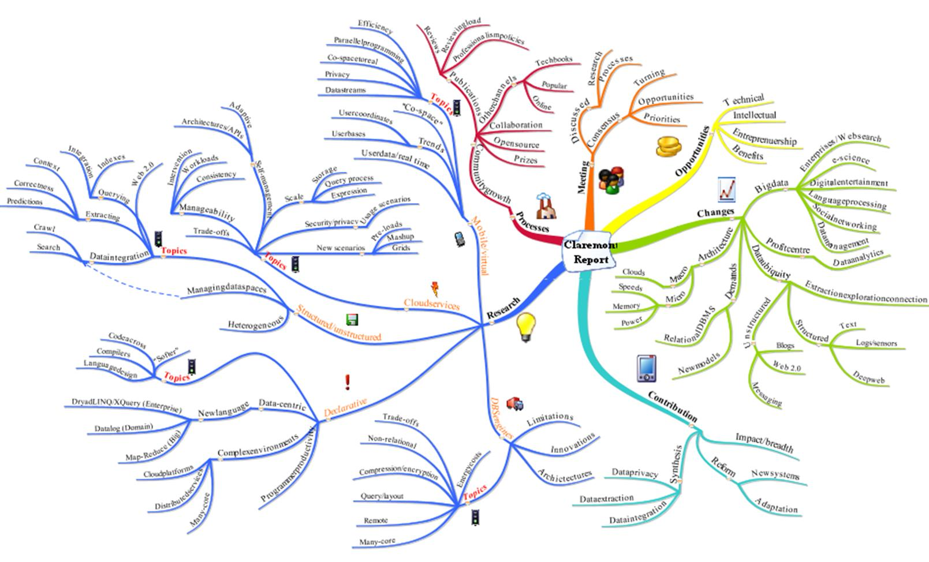

Slide 14
