Slide 1
Evaluation of Content
Damian Gordon

Slide 2
Financial Evaluation

Slide 3
Financial Evaluation
Cost-Benefit Analysis
Cost-Benefit Analysis should really be called Benefit-Cost Analysis, as it describes the ratio between Benefits and Costs.
Cost-Benefit Analysis = Ratio (Benefits : Costs)

Slide 4
Financial Evaluation
Return on Investment
Return on Investment is calculated by first determining the Net Profit (with is Benefits minus Costs), dividing that by the costs, and multiplying the result by 100.
Return on Investment = (Benefits – Costs) * 100
------------
Costs

Slide 5
SWOT Analysis

Slide 6
SWOT
Developed originally as strategic planning tool for organisations to determine the internal and external factors that might be advantageous and detrimental to their business.
Although the origins of SWOT are elusive, generally it is credited to Albert S. Humphrey working at the Stanford Research Institute in the 1960s and 1970s.

Slide 7
SWOT
SWOT stands for:
S: Strengths - what is going well in this organisation?
W: Weaknesses - what is not going well in this organisation?
O: Opportunities - what external elements are present to improve success?
T: Threats - what external elements are present that might be an impediment?

Slide 8
SWOT
SWOT
SWOT can be used for any decision making scenario where a clear end goal has been established.
The Strengths and Weaknesses tend to look at the present whereas the Opportunities and Threats focus on the future.
Helpful
Harmful
Internal
S
W
External
O
T

Slide 9
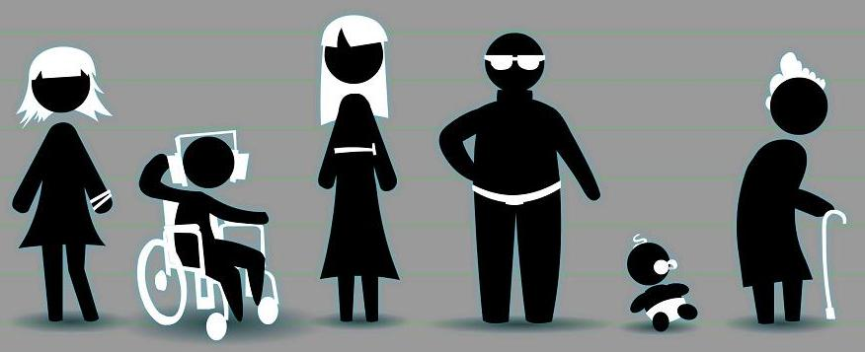
The Normals

Slide 10
LORI from eLera
eLera is a distributed group that researches and evaluates e-learning. Their specific interests include learning objects, e-portfolios, and learning design specifications, and related topics.
eLera provides tools and information for learning object evaluation and research, maintains a database of learning object reviews, and supports communication and collaboration among researchers, evaluators and users of online learning resources.

Slide 11
LORI from eLera
The goals of eLera are to:
improve the quality of online learning resources through better design and evaluation
develop effective pedagogical models that incorporate learning objects
help students, teachers, professors, instructional designers and others to select pedagogical models and digital resources that meet their requirements

Slide 12
LORI from eLera
The Learning Object Review Instrument (LORI) is used to evaluate the quality of e-learning resources. LORI is an online form consisting of rubrics, rating scales and comment fields. The current version of LORI available from eLera is version 1.5.
http://www.elera.net/eLera/Home/Articles/LORI%201.5.pdf

Slide 13
LORI from eLera
Nine Dimensions of LORI
Content Quality
Learning Goal Alignment
Feedback and Adaptation
Motivation
Presentation Design
Interaction Usability
Accessibility
Reusability
Standards Compliance

Slide 14
LORI from eLera
Nine Dimensions of LORI
1. Content Quality: Veracity, accuracy, balanced presentation of ideas, and appropriate level of detail

Slide 15
LORI from eLera
Nine Dimensions of LORI
2. Learning Goal Alignment: Alignment among learning goals, activities, assessments, and learner characteristics

Slide 16
LORI from eLera
Nine Dimensions of LORI
3. Feedback and Adaptation: Adaptive content or feedback driven by differential learner input or learner modelling

Slide 17
LORI from eLera
Nine Dimensions of LORI
4. Motivation: Ability to motivate and interest an identified population of learners

Slide 18
LORI from eLera
Nine Dimensions of LORI
5. Presentation Design: Design of visual and auditory information for enhanced learning and efficient mental processing

Slide 19
LORI from eLera
Nine Dimensions of LORI
6. Interaction Usability: Ease of navigation, predictability of the user interface, and quality of the interface help features

Slide 20
LORI from eLera
Nine Dimensions of LORI
7. Accessibility: Design of controls and presentation formats to accommodate disabled and mobile learners

Slide 21
LORI from eLera
Nine Dimensions of LORI
8. Reusability: Ability to use in varying learning contexts and with learners from differing backgrounds

Slide 22
LORI from eLera
Nine Dimensions of LORI
9. Standards Compliance: Adherence to international standards and specifications

Slide 23
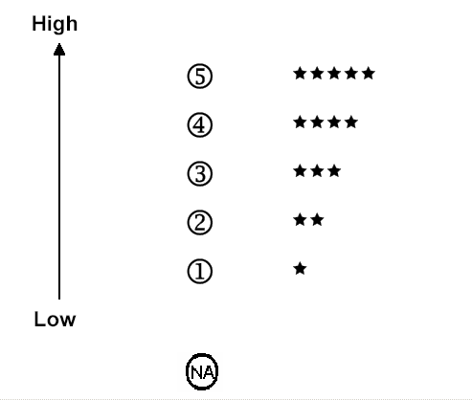
9 items rated on a 5-point scale

Slide 24
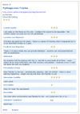
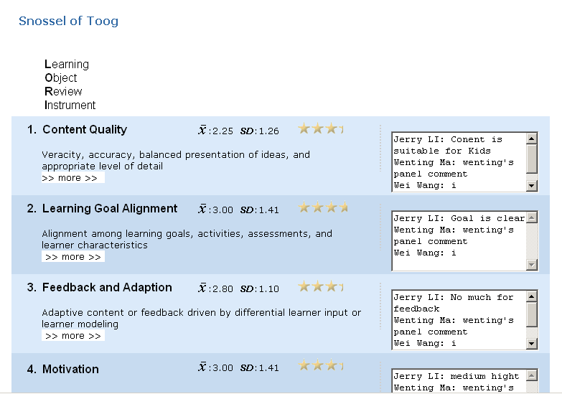
LORI Review process
diagram here is showing individual reviews merging to a panel review and then published on web.

