Slide 1
UDL – Week3 Recap
Damian Gordon

Slide 2
Module Contents
On Brightspace
Also here:
www.damiantgordon.com

Slide 3
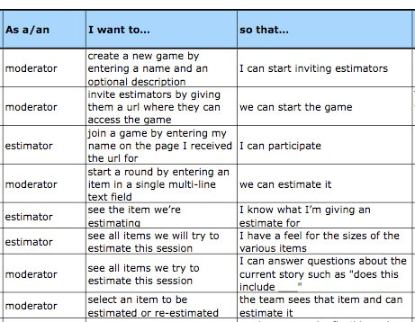
User Stories
User Story template:

Slide 4
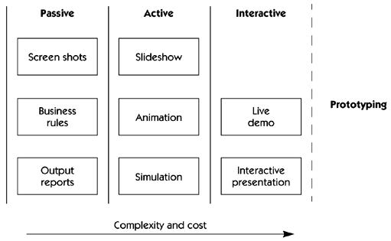
Storyboarding

Slide 5
UDL 3.0
ENGAGEMENT
Welcoming Interests & Identities
Sustaining Effort & Persistence
Emotional Capacity
The
“WHY”

Slide 6
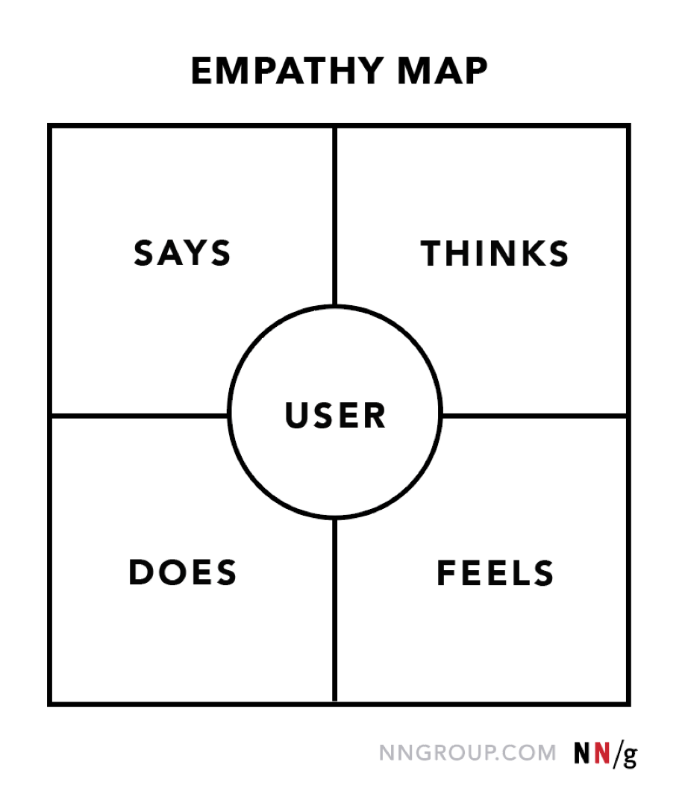
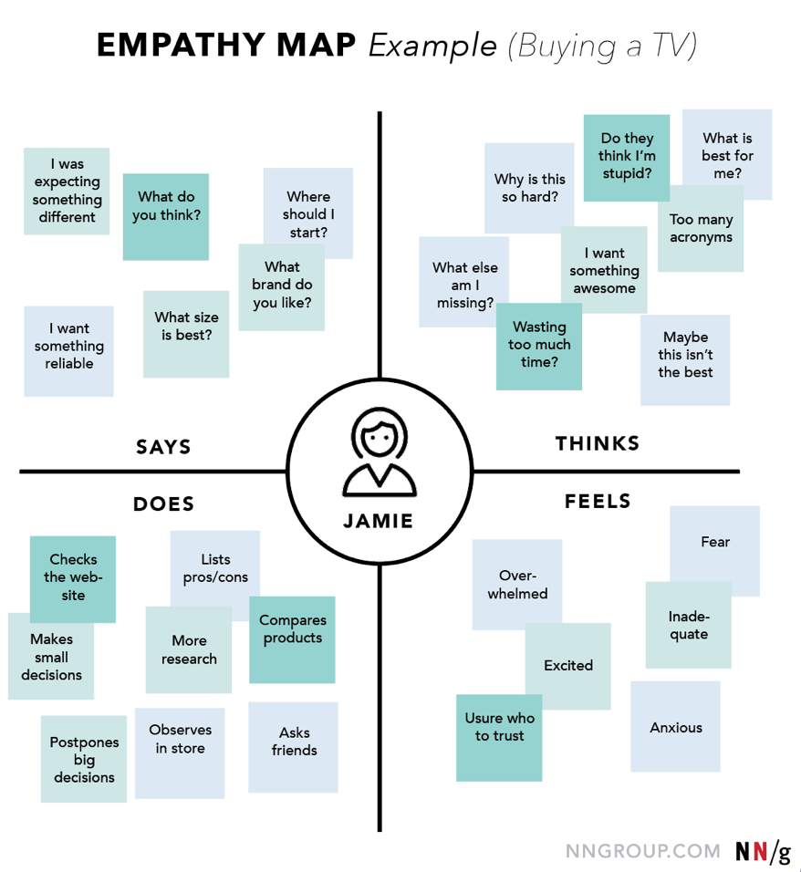
EMPATHY MAPPING
Notes:
Summary: Visualising user attitudes and behaviours in an empathy map helps UX teams align on a deep understanding of end users.
Says: Direct or paraphrased representative quotes from users
Thinks: Users’ thoughts, motivations, and needs framed in first-person statements
Does: Typical or observed user behaviours and actions
Feels: Users’ emotional states during the process

Slide 7
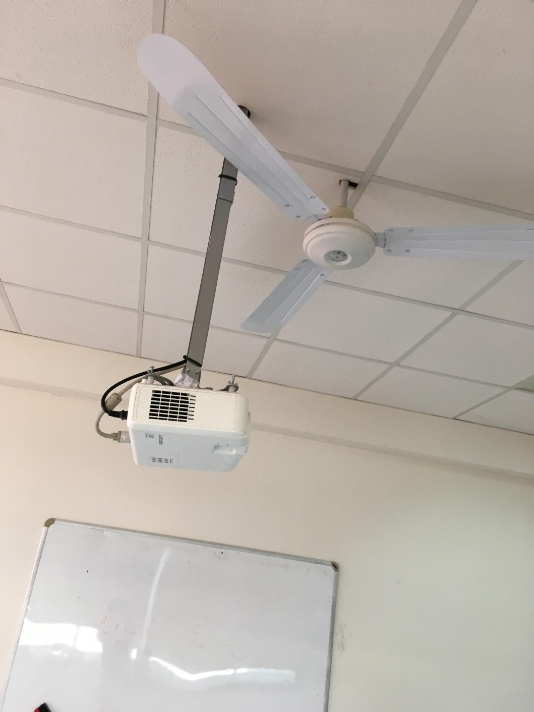
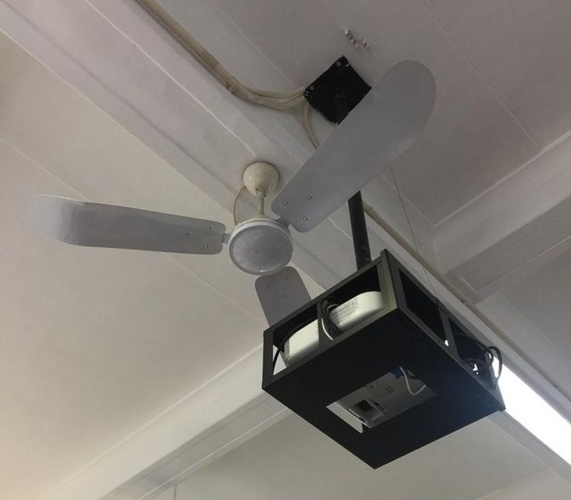

Slide 8
Learning Activity
Redesign some aspect of an educational activity you are currently delivering in line with the principles of Universal Design for Learning
https://www.damiantgordon.com/Courses/UniversalDesignforLearning/Assessment.html

