Slide 1
Thinking and Learning Styles
Damian Gordon
To Design, Develop, and Evaluate Quality Blended Learning

Slide 2
Learning Styles
Learning depends on a large number of factors, many of which are specific to the individual person.
The individual learning style represents the particular set of strengths and preferences that an individual or group of people have in how they take in and process information
To Design, Develop, and Evaluate Quality Blended Learning

Slide 3
Learning Styles
The most commonly accepted definition is by Keefe (1979) who defines it as "the composite of characteristic cognitive, affective, and physiological factors that serve as relatively stable indicators of how a learner perceives, interacts with, and responds to the learning environment.“
Keefe, J.W. (1979) “Learning Style: An Overview" in NASSP's Student Learning Styles: Diagonosing and Prescribing Programs” (pp. 1-17), Reston, VA: National Association of Secondary Schools.
To Design, Develop, and Evaluate Quality Blended Learning

Slide 4
The VARK Model

Slide 5
The VARK Model
VARK stands for:
  VISUAL – Likes pictures and imagery
  AUDITORY – Likes to listen and speak
  READ/WRITE – Likes to read, and to write
  KINESTHETIC – Likes hands-on activities

Slide 6
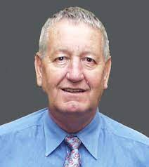
The VARK Model
Neil Fleming
Born: 1940
Born in New Zealand
Died: June 16 2022
Creator of VAK/VARK

Slide 7
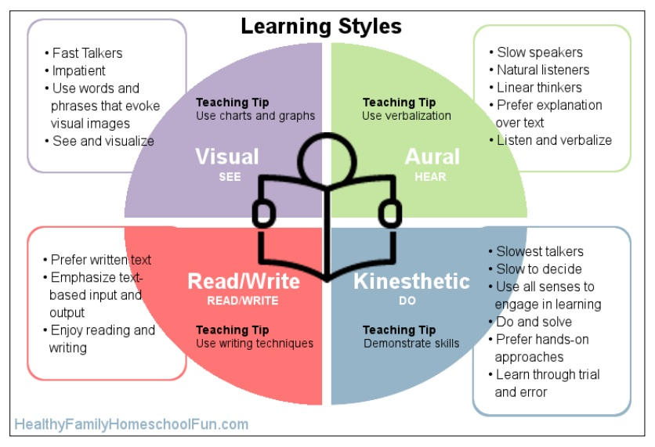

Slide 8
The VARK Model
Take the test here:
https://vark-learn.com/the-vark-questionnaire/
To Design, Develop, and Evaluate Quality Blended Learning

Slide 9
History of Learning Styles

Slide 10
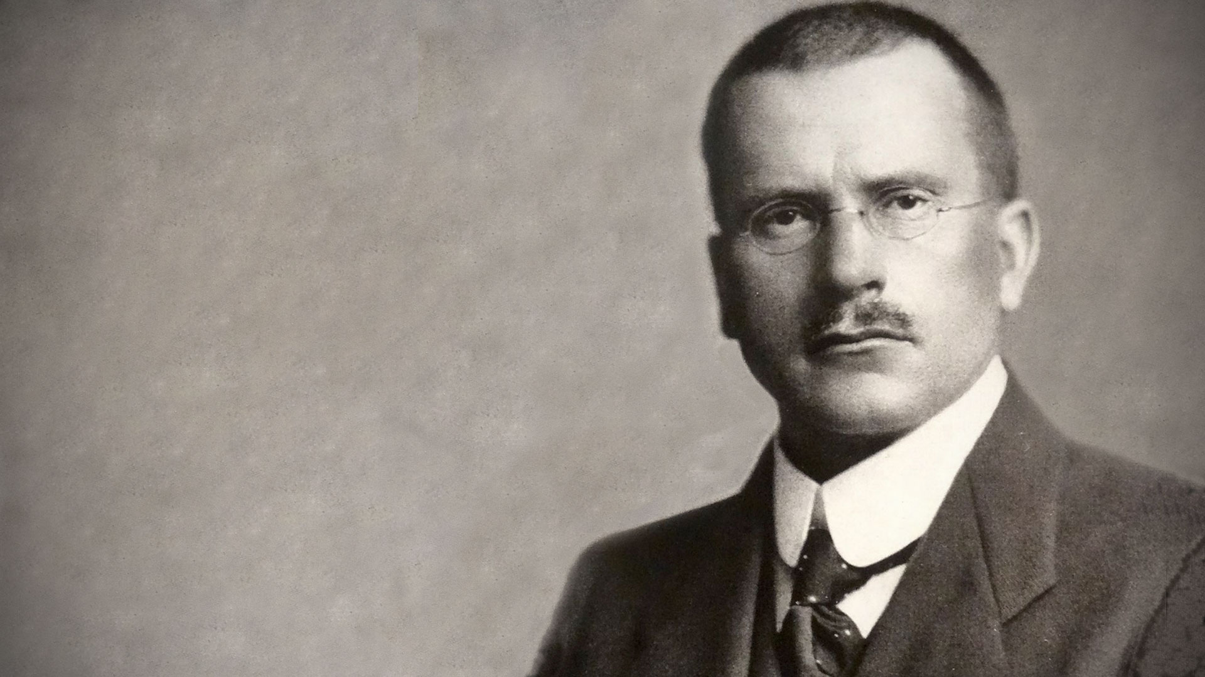
Carl Jung
Born: July 26, 1875,
Born in Kesswil, Switzerland
Died: June 6, 1961
A psychiatrist and psychoanalyst who founded analytical psychology.

Slide 11
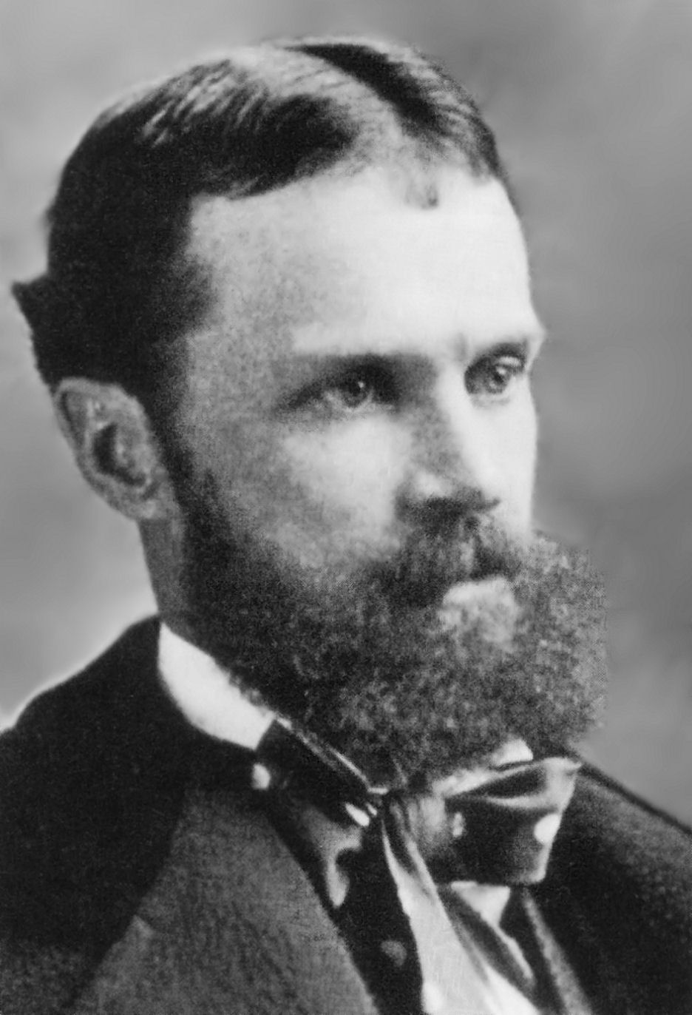
William James
Born: January 11, 1842
Born in New York City
Died: August 26, 1910
A philosopher, historian, psychologist, and educator.

Slide 12

Learning Styles
Based on letters exchanged with William James, Carl Jung developed a theory early in the 20th century to describe basic individual preferences and explain similarities and differences between people.
To Design, Develop, and Evaluate Quality Blended Learning

Slide 13
Learning Styles
Main postulate of the theory is that people have inborn behavioral tendencies and preferences:
  Your natural response in daily situations
  Used when we are generally not stressed and feel competent, and energetic
  Could be defined as those behaviors you often don’t notice
To Design, Develop, and Evaluate Quality Blended Learning

Slide 14

Learning Styles
Environment
Cognitive
Senses
To Design, Develop, and Evaluate Quality Blended Learning

Slide 15
Learning Styles
Environment
Cognitive
Senses
To Design, Develop, and Evaluate Quality Blended Learning

Slide 16
Learning Styles
Environment
Sensing
Cognitive
Senses
Intuiting
To Design, Develop, and Evaluate Quality Blended Learning

Slide 17

Learning Styles
Environment
Sensing
Cognitive
Senses
Intuiting
To Design, Develop, and Evaluate Quality Blended Learning

Slide 18
Learning Styles
Feeling
Environment
Sensing
Cognitive
Senses
Thinking
Intuiting
To Design, Develop, and Evaluate Quality Blended Learning

Slide 19
The Myers–Briggs Type Indicator

Slide 20
The Myers–Briggs Type Indicator
Isabel Myers and Katherine Briggs (mother-daughter team) expanded on Jung’s work by developing an instrument to help people identify their preferences
To Design, Develop, and Evaluate Quality Blended Learning

Slide 21
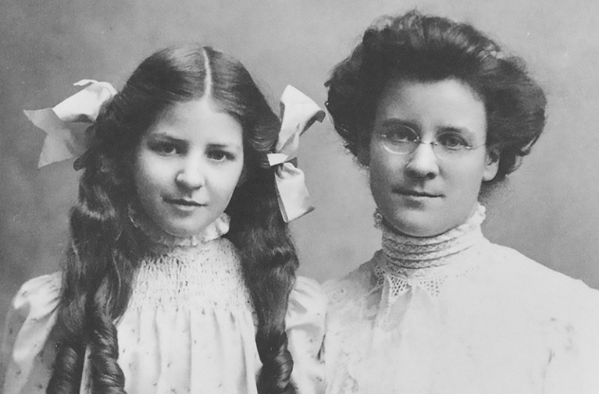

Slide 22
Isabel Briggs Myers
Born: October 18, 1897
Born in Washington
Died: May 5, 1980
Katharine Cook Briggs
Born: January 3, 1875
Born in Pennsylvania
Died: July 10, 1968

Slide 23
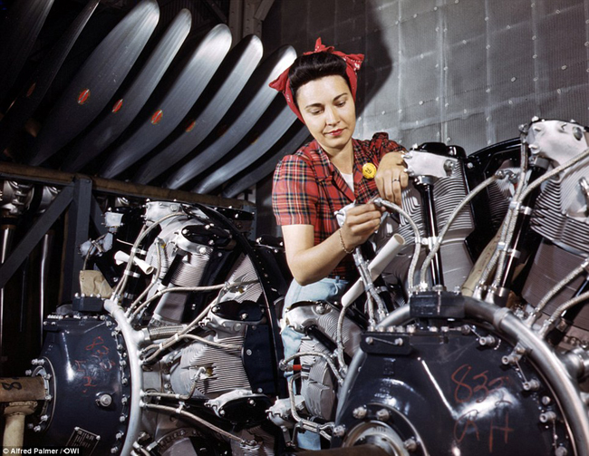


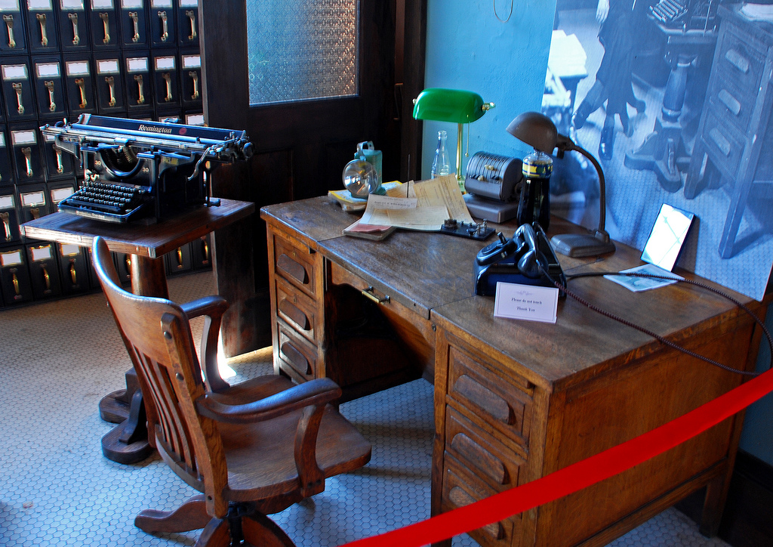

Learning Styles
To Design, Develop, and Evaluate Quality Blended Learning

Slide 24
Learning Styles
JUNG
Feeling
Environment
Sensing
Cognitive
Senses
Thinking
Intuiting
To Design, Develop, and Evaluate Quality Blended Learning

Slide 25
Learning Styles
MBTI
Feeling
Introvert
Judger
Environment
Sensing
Cognitive
Senses
Thinking
Extrovert
Perceiver
Intuiting
To Design, Develop, and Evaluate Quality Blended Learning

Slide 26
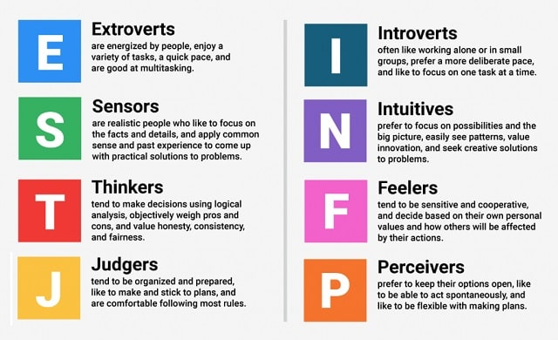
The Myers–Briggs Type Indicator
How we are
energized
How we
gather data
How we make
decisions
How we
approach life

Slide 27
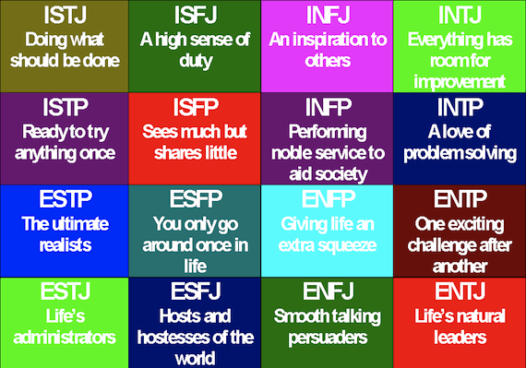
The Myers–Briggs Type Indicator

Slide 28
I
E

Slide 29
S
N
I
E

Slide 30
S
N
J
I
P
E
J

Slide 31
S
N
J
I
P
E
J
T
F
T

Slide 32
ISTJ
Management
Administration
Law enforcement
Accounting
ISFJ
Education
Health care
Religious settings
INFJ
Religion
Counseling
Teaching
Arts
INTJ
Scientific or technical fields
Computers
Law
ISTP
Skilled trades
Technical fields
Agriculture
Law Enforcement
Military
ISFP
Health care
Business
Law enforcement
INFP
Counseling
Writing
Arts
INTP
Scientific or technical fields
ESTP
Marketing
Skilled trades
Business
Law enforcement
Applied technology
ESFP
Health care
Teaching
Coaching
Childcare worker
Skilled trades
ENFP
Counseling
Teaching
Religion
Arts
ENTP
Science
Management
Technology
Arts
ESTJ
Management
Administration
Law enforcement
ESFJ
Education
Health care
Religion
ENFJ
Religion
Arts
Teaching
ENTJ
Management
Leadership

Slide 33
The Myers–Briggs Type Indicator
So what does this tell us about training:
Some people like working in groups and others don’t
Some people like quiet time to reflect and others spontaneous
Some people like facts and some like to connect emotionally
Some people like creative problems and others practical ones
To Design, Develop, and Evaluate Quality Blended Learning

Slide 34
The Myers–Briggs Type Indicator
Take the test here:
https://www.humanmetrics.com/personality/test
To Design, Develop, and Evaluate Quality Blended Learning

Slide 35
The Keirsey Temperament Sorter

Slide 36
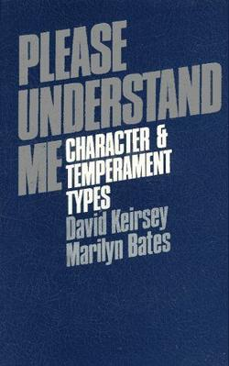
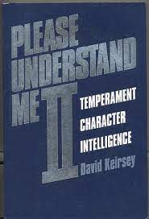
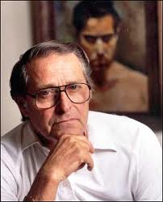
The Keirsey Temperament Sorter

Slide 37
The Keirsey Temperament Sorter

Slide 38
The Keirsey Temperament Sorter
NT

Slide 39
The Keirsey Temperament Sorter
NF
NT

Slide 40
The Keirsey Temperament Sorter
NF
NT
SP

Slide 41
The Keirsey Temperament Sorter
NF
NT
SJ
SP
SJ

Slide 42
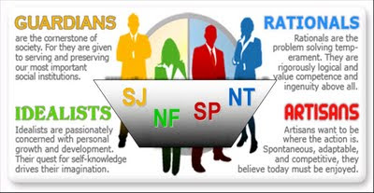
The Keirsey Temperament Sorter

Slide 43
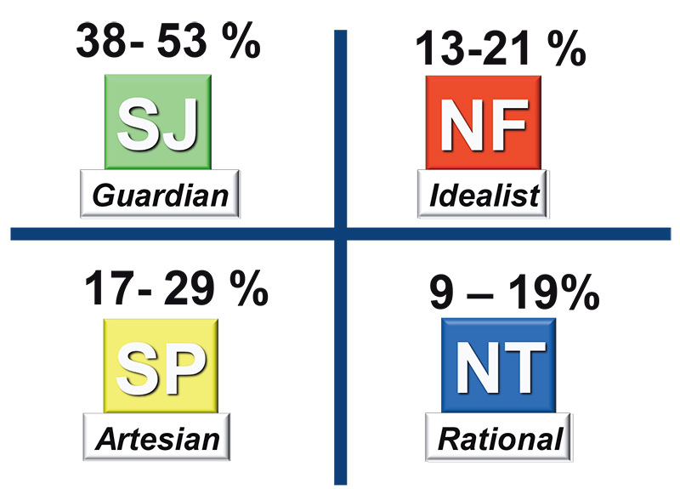
The Keirsey Temperament Sorter

Slide 44
Dunn and Dunn Learning Styles Inventory

Slide 45
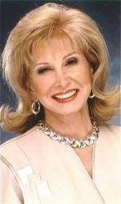

Dunn and Dunn Learning Styles Inventory
Rita Dunn
&
Kenneth Dunn

Slide 47
Other Models of Learning Styles

Slide 48
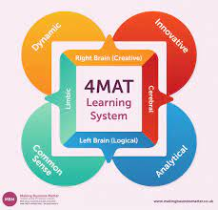
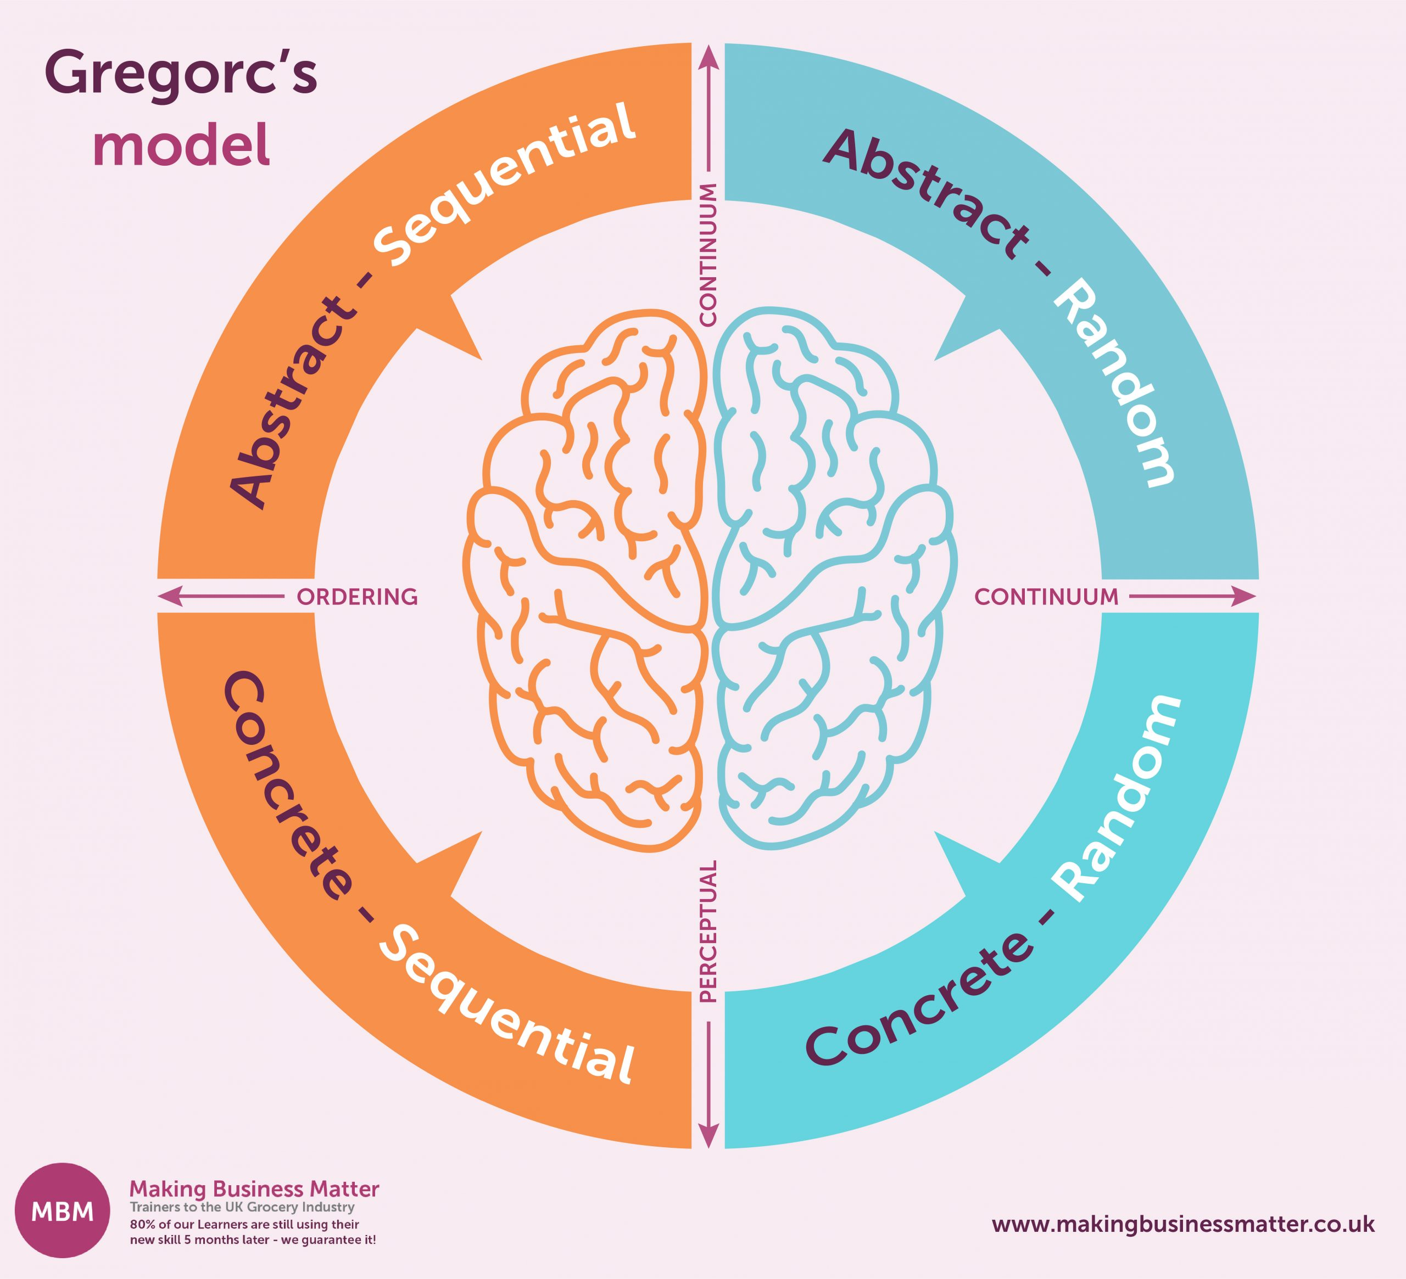
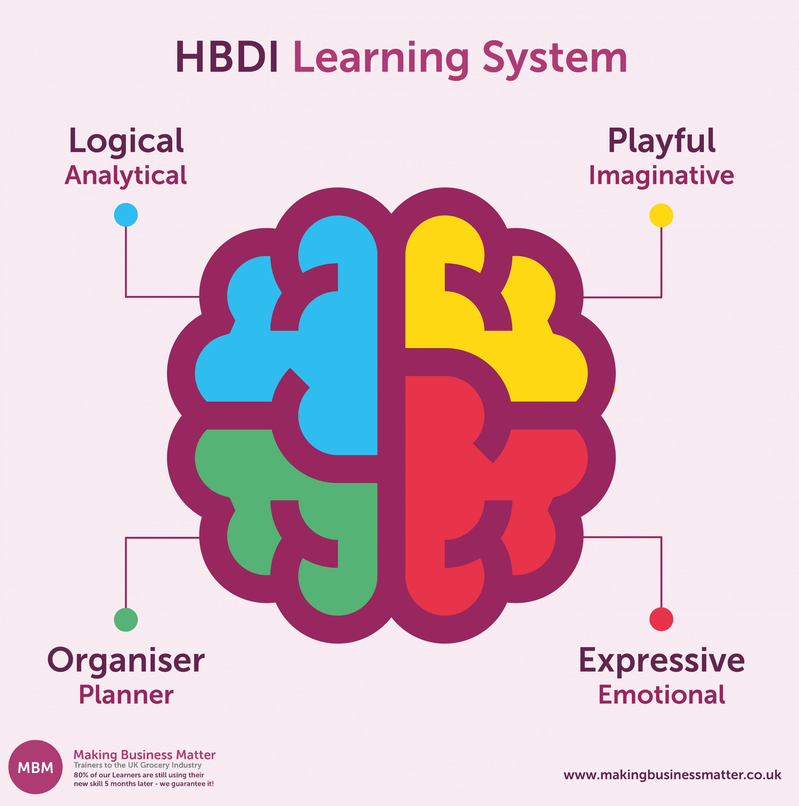
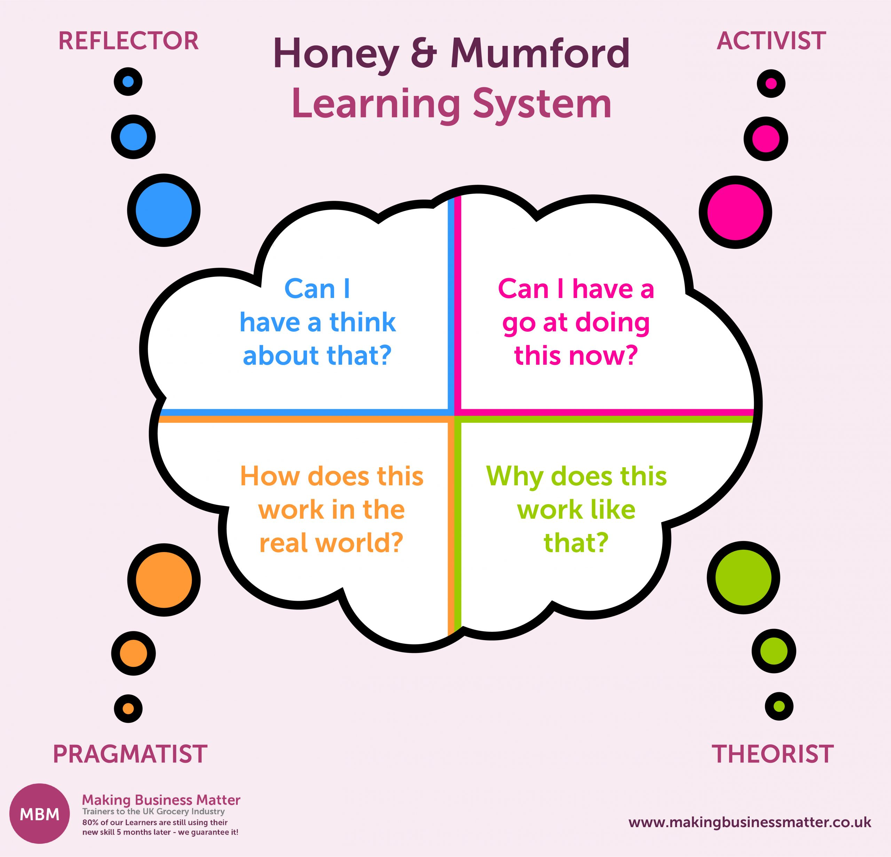
Other Models of Learning Styles
4MAT Model
Gregorc Model
Kolb Model
Honey-Mumford Model
Herrmann Brain Dominance
To Design, Develop, and Evaluate Quality Blended Learning

Slide 49
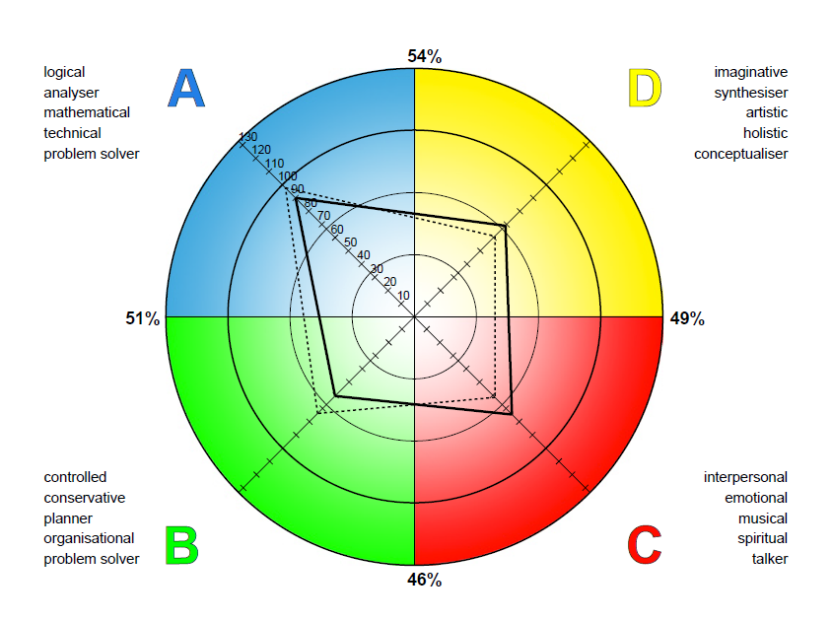
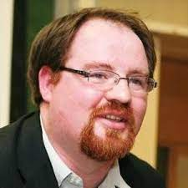
Other Models of Learning Styles
The Nexus Metamodel:
Developed by Damian Gordon
Analytical
Students
Emotional
Students
Practical
Students
Creative
Students
To Design, Develop, and Evaluate Quality Blended Learning

Slide 50
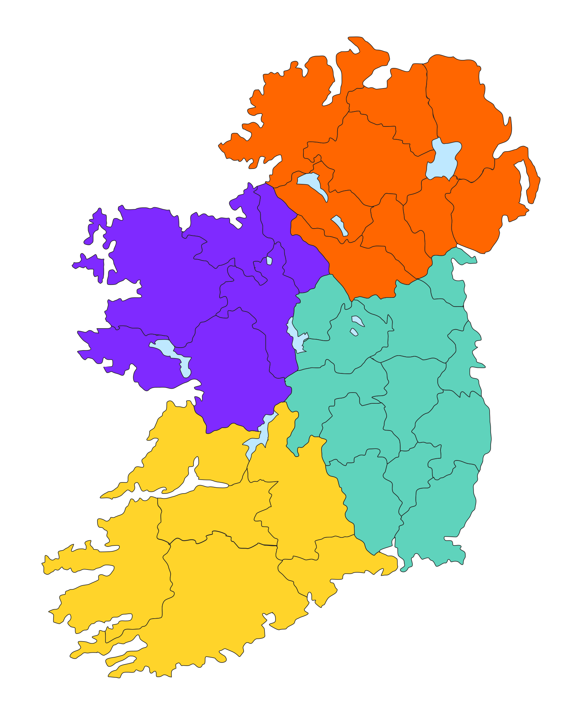
Connacht in the west is the kingdom of learning, the seat of the greatest and wisest druids and magicians; the men of Connacht are famed for their eloquence, their handsomeness and their ability to pronounce true judgement.
Ulster in the north is the seat of battle valour, of haughtiness, strife, boasting; the men of Ulster are the fiercest warriors of all Ireland, and the queens and goddesses of Ulster are associated with battle and death
Munster in the south is the kingdom of music and the arts, of harpers, of skilled ficheall players and of skilled horsemen. The fairs of Munster were the greatest in all Ireland.
Leinster, the eastern kingdom, is the seat of prosperity, hospitality, the importing of rich foreign wares like silk or wine; the men of Leinster are noble in speech and their women are exceptionally beautiful.

Slide 51



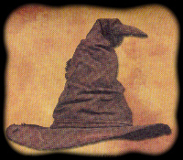

"You might belong in Gryffindor,
Where dwell the brave at heart,
There daring, nerve, and chivalry
Set Gryffindors apart”
"You belong in Hufflepuff,
Where they are just and loyal,
Those patient Hufflepuffs are true
And unafraid to toil"
"Here in wise old Ravenclaw,
If you've a ready mind,
Those of wit and learning,
Will always find their kind."
"Here you are in Slytherin,
Where you'll make your real friends,
Those cunning folk use any means
To achieve their ends."

Slide 52
Learning Styles
BOTTOM LINE:
Vary your mode of delivery (visual, auditory, text, practical, groupwork, individual work, emotional, logical, puzzle, problems, games).
To Design, Develop, and Evaluate Quality Blended Learning

Slide 53
Multiple Intelligences
Damian Gordon
To Design, Develop, and Evaluate Quality Blended Learning

Slide 54

Howard Gardner
Born July 11, 1943
Died Sept 13, 1999
An American developmental psychologist
He is best known for his theory of multiple intelligences, as outlined in his 1983 book Frames of Mind: The Theory of Multiple Intelligences.
To Design, Develop, and Evaluate Quality Blended Learning

Slide 55
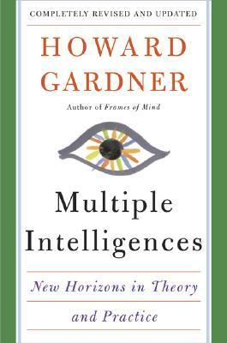
Multiple Intelligences
Multiple Intelligences is a theory proposed by psychologist Howard Gardner in 1983. It suggests that intelligence is not a single general ability, but rather a set of different kinds of intelligences that people may possess in varying degrees. According to this theory, everyone has a unique mix of these intelligences.
To Design, Develop, and Evaluate Quality Blended Learning

Slide 56
Multiple Intelligences
Multiple Intelligences is a theory proposed by psychologist Howard Gardner in 1983. It suggests that intelligence is not a single general ability, but rather a set of different kinds of intelligences that people may possess in varying degrees. According to this theory, everyone has a unique mix of these intelligences.
To Design, Develop, and Evaluate Quality Blended Learning

Slide 57
Multiple Intelligences
Unlike IQ tests, which only measure three dimensions:
  Linguistic Intelligence
  Logical-Mathematical Intelligence
  Spatial Intelligence
To Design, Develop, and Evaluate Quality Blended Learning

Slide 58
Multiple Intelligences
Multiple Intelligences measures eight:
  Linguistic Intelligence
  Logical-Mathematical Intelligence
  Musical Intelligence
  Bodily-Kinesthetic Intelligence
  Spatial Intelligence
  Interpersonal Intelligence
  Intrapersonal Intelligence
  Naturalistic Intelligence
To Design, Develop, and Evaluate Quality Blended Learning

Slide 59
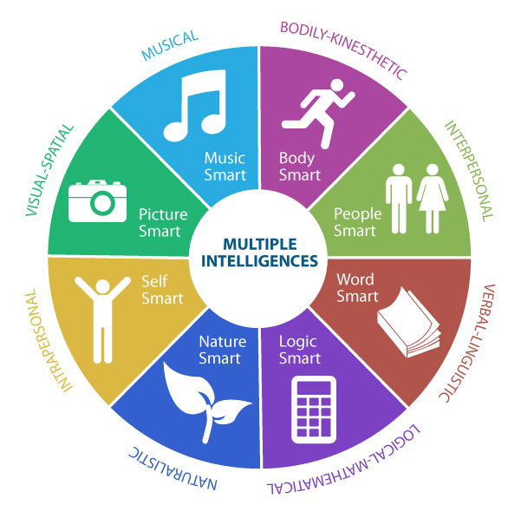
IQ
Tests

Slide 61
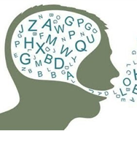
Multiple Intelligences
Linguistic Intelligence – sensitivity to spoken and written language; good at reading, writing, storytelling (e.g., writers, poets, journalists).
To Design, Develop, and Evaluate Quality Blended Learning

Slide 62
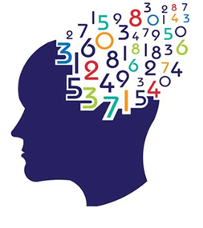
Multiple Intelligences
Logical-Mathematical Intelligence – ability to analyze problems logically, perform mathematical operations, and investigate issues scientifically (e.g., scientists, mathematicians).
To Design, Develop, and Evaluate Quality Blended Learning

Slide 63
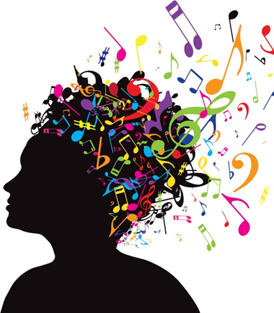
Multiple Intelligences
Musical Intelligence – skill in performance, composition, and appreciation of musical patterns (e.g., musicians, composers).
To Design, Develop, and Evaluate Quality Blended Learning

Slide 64
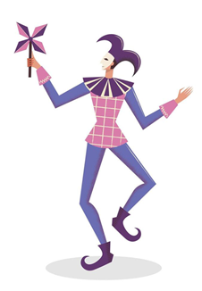
Multiple Intelligences
Bodily-Kinesthetic Intelligence – using one’s whole body or parts of the body to solve problems or create products (e.g., dancers, athletes, surgeons).
To Design, Develop, and Evaluate Quality Blended Learning

Slide 65
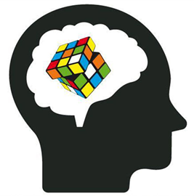
Multiple Intelligences
Spatial Intelligence – ability to think in three dimensions (e.g., architects, artists, engineers).
To Design, Develop, and Evaluate Quality Blended Learning

Slide 66
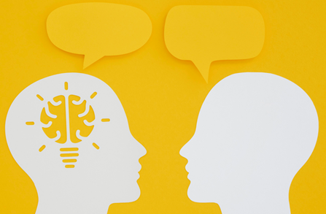
Multiple Intelligences
Interpersonal Intelligence – capacity to understand and interact effectively with others (e.g., teachers, social workers, leaders).
To Design, Develop, and Evaluate Quality Blended Learning

Slide 67

Multiple Intelligences
Intrapersonal Intelligence – capacity to understand oneself, one’s feelings, and motivations (e.g., philosophers, psychologists).
To Design, Develop, and Evaluate Quality Blended Learning

Slide 68

Multiple Intelligences
Naturalistic Intelligence – ability to recognize and categorize plants, animals, and other aspects of nature (e.g., botanists, farmers, biologists).
To Design, Develop, and Evaluate Quality Blended Learning

Slide 69
Differentiated Instruction
Damian Gordon
To Design, Develop, and Evaluate Quality Blended Learning

Slide 70
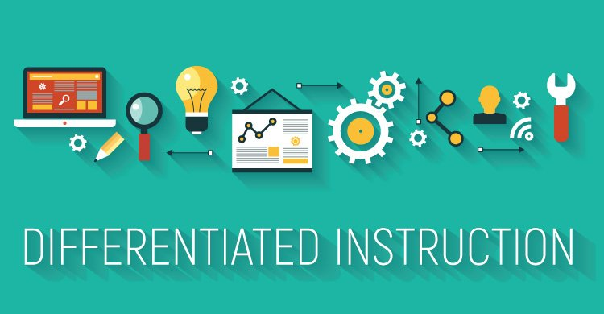
To Design, Develop, and Evaluate Quality Blended Learning

Slide 71
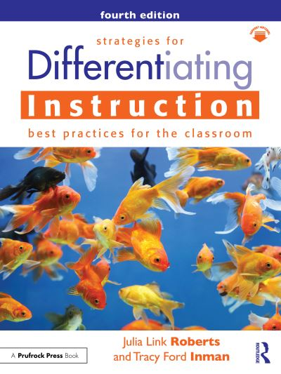
Differentiated Instruction
No two students are alike.
No two students learn in the identical way.
An enriched environment for one student is not necessarily enriched for another.
In the classroom we should teach students to think for themselves.
To Design, Develop, and Evaluate Quality Blended Learning

Slide 72
Differentiated Instruction
Although essential curricula goals may be similar for all students, methodologies employed in a classroom must be varied to suit to the individual needs of all students
Learning must be differentiated to be effective.
To Design, Develop, and Evaluate Quality Blended Learning

Slide 73
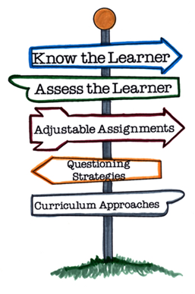
Differentiated Instruction
Differentiating instruction means creating multiple paths so that students of different abilities, interest or learning needs experience equally appropriate ways to absorb, use, develop and present concepts as a part of the daily learning process.
To Design, Develop, and Evaluate Quality Blended Learning

Slide 74
Differentiated Instruction
It allows students to take greater responsibility and ownership for their own learning, and provides opportunities for peer teaching and cooperative learning.
To Design, Develop, and Evaluate Quality Blended Learning

Slide 75
Differentiated Instruction: 3 Characteristics
1. Several elements and materials are used to support instructional content.
2. Align tasks and objectives to learning goals.
3. Instruction is concept-focused and principle-driven.

Slide 76
Differentiated Instruction: 3 Characteristics
1. Several elements and materials are used to support instructional content.
  These include acts, concepts, generalizations or principles, attitudes, and skills. The variation seen in a differentiated classroom is most frequently in the manner in which students gain access to important learning. Access to the content is key.
To Design, Develop, and Evaluate Quality Blended Learning

Slide 77
Differentiated Instruction: 3 Characteristics
2. Align tasks and objectives to learning goals.
  Designers of differentiated instruction view the alignment of tasks with instructional goals and objectives as essential. Goals are most frequently assessed by many state-level, high-stakes tests and frequently administered standardized measures. Objectives are frequently written in incremental steps resulting in a continuum of skills-building tasks. An objectives-driven menu makes it easier to find the next instructional step for learners entering at varying levels.
To Design, Develop, and Evaluate Quality Blended Learning

Slide 78
Differentiated Instruction: 3 Characteristics
3. Instruction is concept-focused and principle-driven.
  The instructional concepts should be broad-based, not focused on minute details or unlimited facts. Teachers must focus on the concepts, principles and skills that students should learn. The content of instruction should address the same concepts with all students, but the degree of complexity should be adjusted to suit diverse learners.
To Design, Develop, and Evaluate Quality Blended Learning

Slide 79
Differentiated Instruction: 4 Approaches
1.
Content
2.
Process
3.
Product
4. Environment
To Design, Develop, and Evaluate Quality Blended Learning

Slide 80
Differentiated Instruction: 4 Approaches
1. Differentiating the Content
Differentiating content (or topic) requires that students are pre-tested so the teacher can identify the students who do not require direct instruction.
Students demonstrating understanding of the concept can skip the instruction step and proceed to apply the concepts to the task of solving a problem.
To Design, Develop, and Evaluate Quality Blended Learning

Slide 81
Differentiated Instruction: 4 Approaches
2. Differentiating the Process
Differentiating the processes (or activities) means varying learning activities or strategies to provide appropriate methods for students to explore the concepts.
It is important to give students alternative paths to manipulate the ideas embedded within the concept.
To Design, Develop, and Evaluate Quality Blended Learning

Slide 82
Differentiated Instruction: 4 Approaches
2. Differentiating the Process
Learners are expected to interact and work in groups. Teachers may have whole-class introductory discussions followed by work in groups.
These groups must change members as for different evaluations and projects.
To Design, Develop, and Evaluate Quality Blended Learning

Slide 83
Differentiated Instruction: 4 Approaches
3. Differentiating the Product
Differentiating the product means varying the complexity of the product. Students do assignments to demonstrate mastery of the concepts.
Weaker students may have reduced performance expectations, while advanced students may be asked to produce work that requires more complex or more advanced thinking.
To Design, Develop, and Evaluate Quality Blended Learning

Slide 84
Differentiated Instruction: 4 Approaches
3. Differentiating the Product
Items to which students respond may be differentiated so that different students can demonstrate or express their knowledge and understanding in different ways.
A well-designed student product allows varied means of expression and alternative procedures and offers varying degrees of difficulty, types of evaluation, and scoring.
To Design, Develop, and Evaluate Quality Blended Learning

Slide 85
Differentiated Instruction: 4 Approaches
4. Differentiating the Environment
Through Accommodating Individual Learning Preferences.
There has been a great deal of work on learning styles over the last 2 decades.
To Design, Develop, and Evaluate Quality Blended Learning

Slide 86


