Slide 1
Accommodations for Diverse Students
Damian Gordon

Slide 2
Visual Cue/ Graphic Organiser
Accommodations for Diverse Students
Specific Learning Difficulties
Dyslexia
Dyspraxia
ASD
ADHD
Dyscalculia
Dysgraphia
Final Thoughts

Slide 3
Specific Learning Difficulties

Slide 4
Specific Learning Difficulties
Also known as Specific Developmental Disorder.
Specific learning difficulties include:
Dyslexia | Challenges with reading and spelling
Dyspraxia | Challenges with fine and/or gross motor skills
ASD | Challenges with social and communication skills
Attention Deficit Hyperactive Disorder (ADHD) | Challenges with attention and concentration

Slide 5
Dyslexia

Slide 6
Dyslexia
http://www.dyslexia.ie
A specific learning difficulty which makes it harder for some people to learn, to read, write and spell.

Slide 7
Dyslexia
What’s it like?

Slide 8
Dyslexia
What’s it like?
It’s different for different people.
U
A
B

Slide 9
Dyslexia
What’s it like?

Slide 10
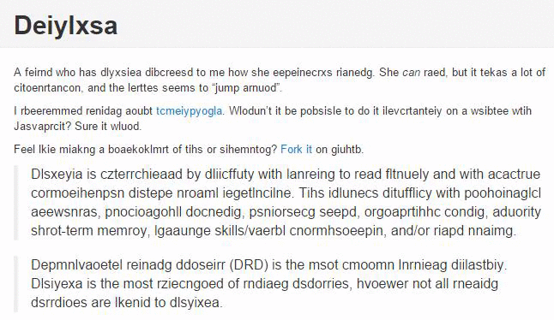

Slide 12
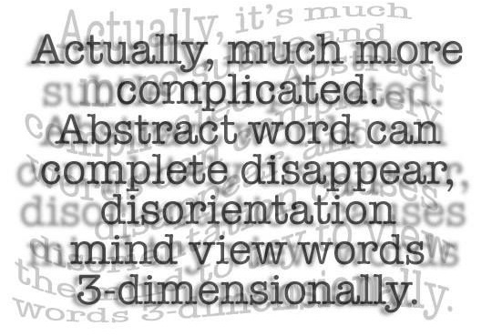

Slide 14
Dyslexia
The Dyslexia Association of Ireland (DAI) recommends the use of san serif fonts such as Arial, Comic Sans, Verdana or Sassoon.
Arial
Comic Sans
Verdana
Sassoon

Slide 15
Dyslexia
The Dyslexia Association of Ireland (DAI) recommends the use of san serif fonts such as Arial, Comic Sans, Verdana or Sassoon.
Arial
Comic Sans
Verdana
Sassoon

Slide 16
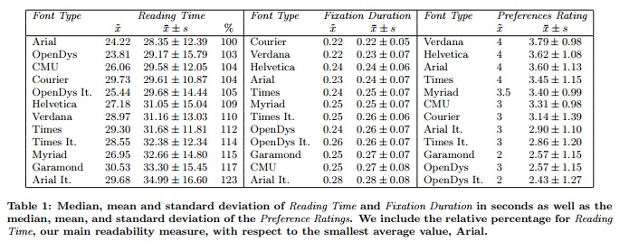
Dyslexia
Rello, L., Baeza-Yates, R. (2013) “Good Fonts for Dyslexia”, In Proceedings of the 15th International ACM SIGACCESS Conference on Computers and Accessibility (p. 14). ACM.

Slide 17
Help the Student to Prepare for Class by:
Giving them your notes a few days before class.
Giving them labs a few days before the lab (if possible).
Explaining the key words first before they are used when discussing that topic in class.

Slide 18
Help the Student in the Class by:
Using images and diagrams where possible (and help learners devise their own pictures and diagrams).
Breaking a longer sentence into a few shorter ones (sometimes students are so focused on understanding each word, they can miss the meaning of the sentence).
Providing model answers where possible.
Providing sentence starters to show how to begin a written response.

Slide 19
Help the Student in Tests and Assignments by:
Arranging tests and assignments to work from easiest to hardest problems.
Not penalizing them for spelling errors.
Breaking down tests and assignments into small parts (using new paragraphs and bullet points to break things up).
Providing them with extended time for testing.

Slide 20
Dyslexia
Open Dyslexic Font:
https://opendyslexic.org
Dyslexie Font:
https://www.dyslexiefont.com/en/typeface/

Slide 21
An aside…
Save my slides as file type “Outline/RTF” under “Other Formats”:
And you’ll find a Word document that you can manipulate:

Slide 22
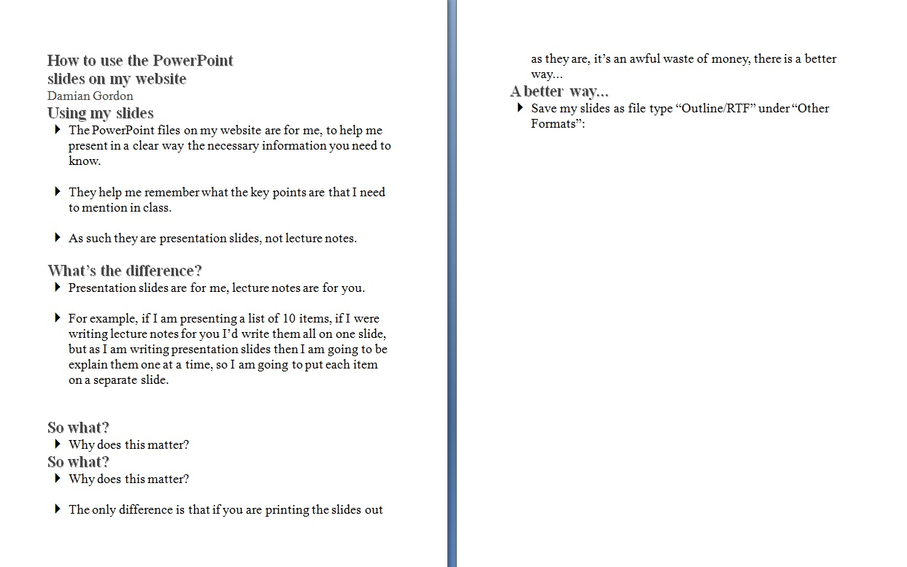
An aside…
You’ll find the text is too big:
So you should reduce the text size and CHANGE THE FONT:

Slide 23
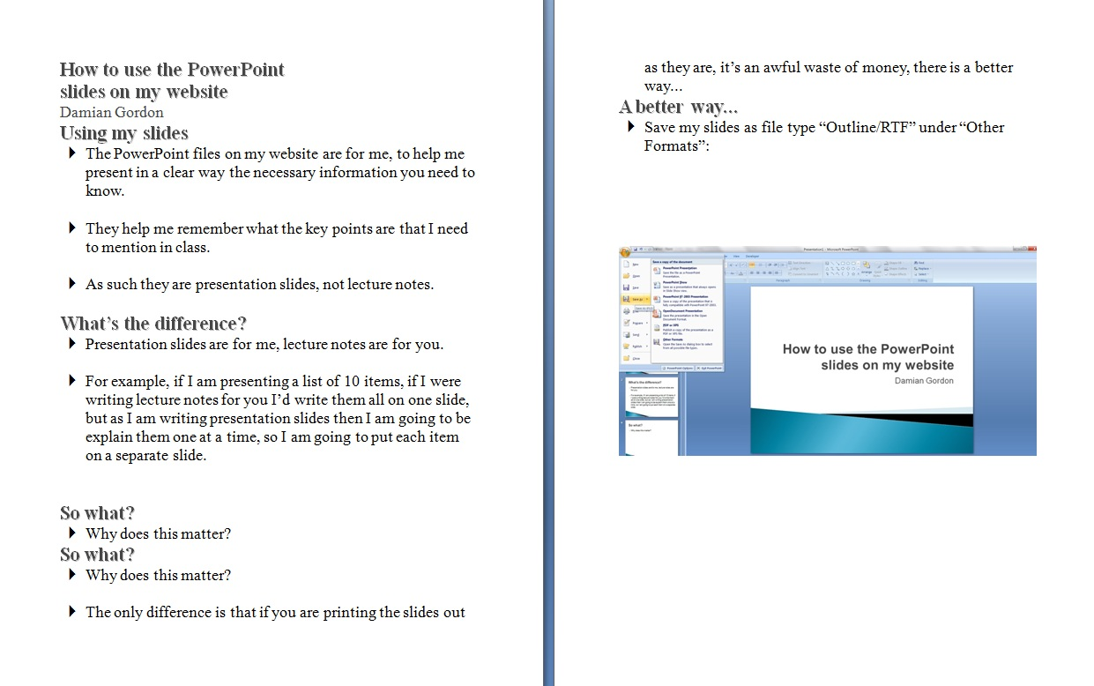
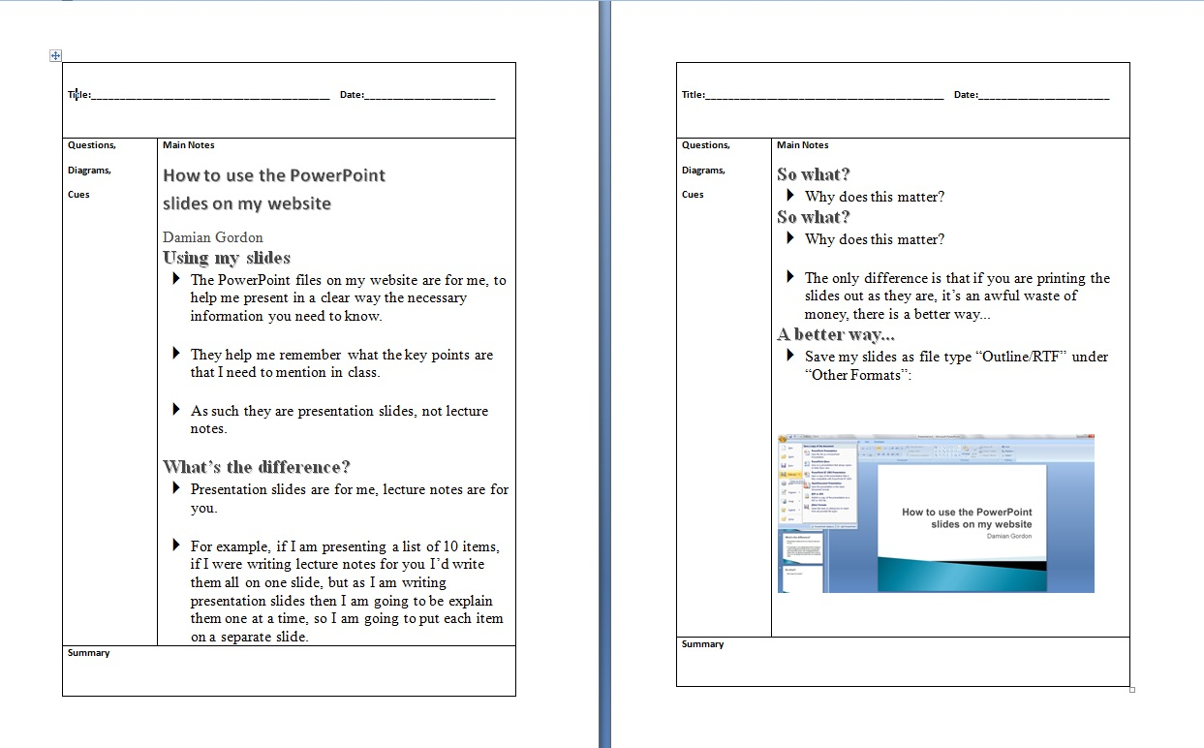
An aside…
Add in any diagrams from the PowerPoint (a lot of the images in my slides are just for “setting the mood” so there’s no need to include them):
And put the notes in the Cornell Note format (you’ll find a template on the same page as this presentation):

Slide 24
An aside…
DARTs: Directed Activities for Reading Texts, activities involving highlighting, cutting-and-pasting and moving around enlarged text.
So it’s better if your documents are available are DOC or PPT, and not PDF.

Slide 25
An aside…
And it’s best to avoid examples that use single letter pairs, such as:
p,q
p,d
b,d
b,q

Slide 26
Dyslexia

Slide 27
Dyscalculia

Slide 28
Dyscalculia
http://www.dyscalculia.org
Dyscalculia is a specific learning disability affecting numbers and maths (it’s really about an inability to conceptualise numbers)

Slide 29
Dyscalculia
Other names:
Disorder in Mathematics (SLD-Math)
Math Learning Disability (MLD)
Developmental Dyscalculia (DD)
Acalculia
Gerstmann's Syndrome
Math Dyslexia
Math Anxiety
Numerical Impairment
Number Agnosia
Nonverbal Learning Disorder / Disability (NLD)

Slide 30
Dyscalculia
What’s it like?

Slide 31
Dyscalculia
What’s it like?
It’s different for different people.
U
A
B

Slide 33
Dyscalculia
Has issues with counting.
Has issues with using counting strategies for addition.
Has difficulties in memorizing arithmetic facts.
Has struggles to apply math concepts to money.
Has a hard time grasping information shown on graphs or charts.
Has trouble finding different approaches to the same math problem.

Slide 34
Help the Student to Prepare for Class by:
Giving them your notes a few days before class.
Giving them labs a few days before the lab (if possible).
Explaining the key words first before they are used when discussing that topic in class.

Slide 35
Help the Student in the Class by:
Using images and diagrams where possible (and help learners devise their own pictures and diagrams).
Breaking a longer sentence into a few shorter ones.
Using concrete objects to illustrate mathematical concepts.
Using computer programs that are useful to help consolidate learning.

Slide 36
Help the Student in Tests and Assignments by:
Arranging tests and assignments to work from easiest to hardest problems.
Considering allowing the student to use a calculator or software.
Breaking down tests and assignments into small parts (using new paragraphs and bullet points to break things up).
Providing them with extended time for testing.

Slide 37
vCalc has a library of free online calculators pre-built with specific formulas for specific tasks. Just search for your task. Use for conversions, research, math, algebra, calculus, engineering, work or school. There are specific calculators for tasks in nursing, physics, chemistry, engineering, business, education, construction, finance, science, calendars, and ancient and foreign measures.

Slide 38
Dyspraxia

Slide 39
Dyspraxia
http://www.dyspraxia.ie
It is a developmental co-ordination disorder, affecting fine and/or gross motor coordination in children and adults.

Slide 40
Dyspraxia
What’s it like?

Slide 41
Dyspraxia
What’s it like?
It’s different for different people.
U
A
B

Slide 42
Dyspraxia
Poor balance
Poor fine and/or gross motor co-ordination
Poor posture
Confused about which hand to use
Difficulty with reading, writing
Speech problems - slow to learn to speak and speech may be incoherent
Phobias or obsessive behaviour and impatient

Slide 43
Help the Student to Prepare for Class by:
Giving them your notes a few days before class.
Giving them labs a few days before the lab (if possible).
Explaining the key words first before they are used when discussing that topic in class.

Slide 44
Help the Student in the Class by:
Using images and diagrams where possible (and help learners devise their own pictures and diagrams).
Breaking a longer sentence into a few shorter ones (and using a larger font where possible).
Making sure they are seated near the front (if they need help), and are away from windows, doors and other distractions.
Providing breaks in the schedule (to give the students a chance to stretch and catch up).

Slide 45
Help the Student in Tests and Assignments by:
Arranging tests and assignments to work from easiest to hardest problems.
Considering allowing the student to use speech-to-text software.
Breaking down tests and assignments into small parts (using new paragraphs and bullet points to break things up).
Providing them with extended time for testing.

Slide 46
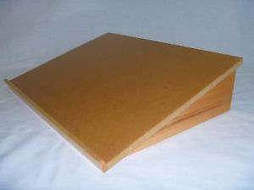

Slide 47
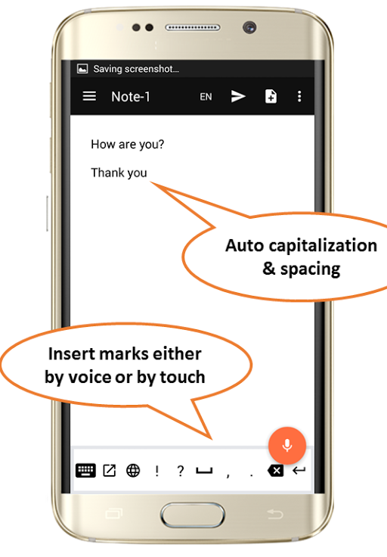
Free Speech-to-Text Online Notepad
https://speechnotes.co

Slide 48
Dysgraphia

Slide 49
Dysgraphia
https://www.sess.ie/categories/specific-learning-disabilities/dysgraphia
Dysgraphia is a disorder of handwriting primarily that causes a student’s handwriting to be almost illegible, and makes it very difficult to learn to spell. It can be often associated with a very high verbal IQ.

Slide 50
Dysgraphia
Dysgraphia often co-occurs with other learning disabilities like:
Speech Impairment
Attention Deficit Hyperactive Disorder
Developmental Coordination Disorder

Slide 51
Dysgraphia
What’s it like?

Slide 52
Dysgraphia
What’s it like?
It’s different for different people.
U
A
B

Slide 53
Dysgraphia

Slide 54
Help the Student to Prepare for Class by:
Giving them your notes a few days before class.
Giving them labs a few days before the lab (if possible).
Explaining the key words first before they are used when discussing that topic in class.

Slide 55
Help the Student in the Class by:
Using images and diagrams where possible (and help learners devise their own pictures and diagrams).
Breaking a longer sentence into a few shorter ones.
Providing a lesson outline for helping take notes.
Providing breaks in the schedule (to give the students a chance to stretch and catch up).

Slide 56
Help the Student in Tests and Assignments by:
Arranging tests and assignments to work from easiest to hardest problems.
Considering allowing the student to use speech-to-text software.
Breaking down tests and assignments into small parts (using new paragraphs and bullet points to break things up).
Providing them with extended time for testing.

Slide 59
Free Speech-to-Text Online Notepad
https://speechnotes.co

Slide 60
Autism Spectrum Disorder (ASD)

Slide 61
Autism Spectrum Disorder
https://autismireland.ie
It generally results in having difficulty with social interactions and exhibiting a restricted range of interests and/or repetitive behaviours.

Slide 62
Autism Spectrum Disorder
What’s it like?

Slide 63
Autism Spectrum Disorder
What’s it like?
It’s different for different people.
U
A
B

Slide 64
Autism Spectrum Disorder
What’s it like?

Slide 65
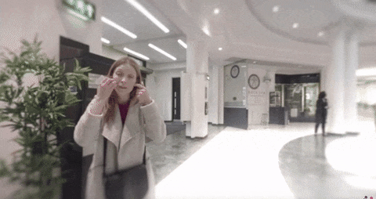
http://www.autism.org.uk/VR

Slide 66
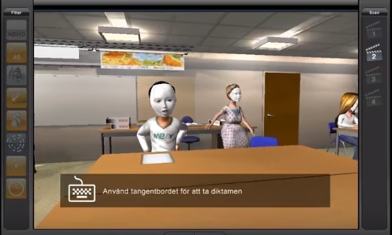
https://www.youtube.com/watch?v=_3R0a64UW3g

Slide 67
Autism Spectrum Disorder
Students with Autism Spectrum Disorder may:
Yawn in class, or laugh or giggle (inappropriately).
Echo words or phrases said by you or others.
Insist on sameness.
Use gestures instead of words to indicate their needs.
Not like to be asked a lot of questions in class.
Not like hugs or cuddles.

Slide 68
Help the Student to Prepare for Class by:
Giving them your notes a few days before class.
Giving them labs a few days before the lab (if possible).
Explaining the key words first before they are used when discussing that topic in class.

Slide 69
Help the Student in the Class by:
Using images and diagrams where possible.
Repeating and rephrasing key points throughout the class.
Clearly indicate when you are transitioning away from the topic, e.g. if you are telling an anecdote.
Try to avoid slang or idiomatic speech (and avoid sarcasm, it may inadvertently reinforce inappropriate learning)

Slide 70
Help the Student in Tests and Assignments by:
Not penalizing them for spelling errors.
Understanding that many students with ASD have handwriting deficits, so allowing extra time for handwritten work and explore the use of word processors.
Breaking down tests and assignments into small parts (using new paragraphs and bullet points to break things up).
Do not expect skills learned in one setting to generalize to another setting. Teach the skill and rehearse it in a variety of settings.

Slide 71
A visual schedule or visual diary.

Slide 72
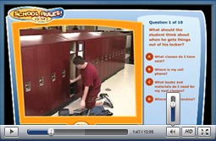
http://www.socialskillbuilder.com

Slide 73
ADHD

Slide 74
ADHD
http://www.hadd.ie
ADHD is Attention Deficit Hyperactivity Disorder, which is a broad term, and the condition can vary from person to person. It is generally understood to describe students who have trouble focusing.

Slide 75
ADHD
It supersedes the previous (outdated) term Attention Deficit Disorder (ADD).

Slide 76
ADHD
There are three types of ADHD:
Inattentive ADHD is when a person shows enough symptoms of inattention, or distractibility, but isn’t hyperactive or impulsive.
Hyperactive/impulsive ADHD is when a person has symptoms of hyperactivity and impulsivity but not inattention.
Combined ADHD is when a person has symptoms of inattention, hyperactivity, and impulsivity.

Slide 77
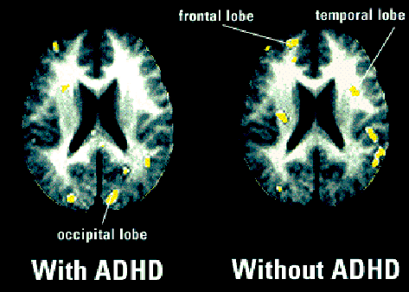

Slide 78
Help the Student to Prepare for Class by:
Giving them your notes a few days before class.
Giving them labs a few days before the lab (if possible).
Explaining the key words first before they are used when discussing that topic in class.

Slide 79
Help the Student in the Class by:
Using images and diagrams where possible (and help learners devise their own pictures and diagrams).
Use a visual signal (e.g. something shiny) to get their attention.
Making sure they are seated near the front (if they need help), and are away from windows, doors and other distractions.
Providing breaks in the schedule (to give the students a chance to take a break).

Slide 80
Help the Student in Tests and Assignments by:
Arranging tests and assignments to work from easiest to hardest problems.
Considering allowing the student to use a word processor.
Breaking down tests and assignments into small parts (using new paragraphs and bullet points to break things up).
Providing them with extended time for testing.

Slide 82
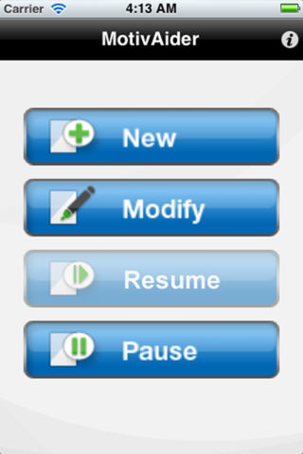
http://habitchange.com/iphone_app.php

Slide 83
Final Thoughts

Slide 84
Final thoughts:
We have seen that most of the accommodations are the same for a wide range of conditions.
Instead of trying to consider a diverse range, maybe just aim for the common ones (this ties into a broader principle of Universal Design for Learning):

Slide 85
Help the Student to Prepare for Class by:
Giving them your notes a few days before class.
Giving them labs a few days before the lab (if possible).
Explaining the key words first before they are used when discussing that topic in class.
Putting documents in DOC or PPT, but not PDF.

Slide 86
Help the Student in the Class by:
Using images and diagrams where possible.
Repeating and rephrasing key points throughout the class.
Speaking clearly and using gestures to emphasise key points.
Providing model answers where possible.

Slide 87
Help the Student in Tests and Assignments by:
Making sure they are working in a quiet area.
Not penalizing them for spelling errors.
Breaking down tests and assignments into small parts (using new paragraphs and bullet points to break things up).
Providing them with extended time for testing.

Slide 88
Final thoughts:
Encourage all of the students in the class to share their notes with each other.
Give students a chance to show their many strengths in class (if possible).

Slide 89
Thanks !!! Please contact me if you have any comments or suggestions: Damian.X.Gordon@TUDublin.ie

