Slide 1
Universal Design for Learning: Multiple Means of Expression
Damian Gordon

Slide 2
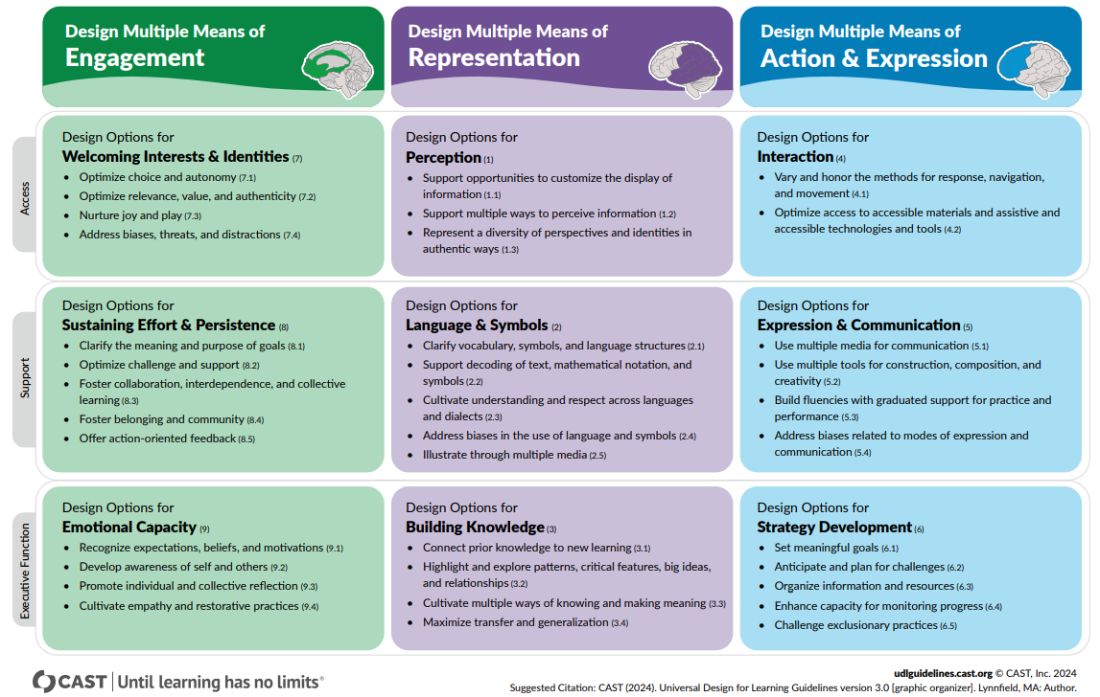
UDL 3.0

Slide 3
UDL 3.0
Multiple means of Expression
Guideline 4: Design Options for Interaction
Guideline 5: Design Options for Expression & Communication
Guideline 6: Design Options for Strategy Development

Slide 4
UDL 3.0
EXPRESSION
Interaction
Expression & Communication
Strategy Development
The
“HOW”

Slide 5
UDL 3.0
Multiple means of Expression
Guideline 4: Design Options for Interaction

Slide 6
UDL 3.0
4. Design Options for Interaction
Vary and honor the methods for response, navigation, and movement
Optimize access to accessible materials and assistive and accessible technologies and tools

Slide 7
UDL 3.0
e.g. provide alternative ways of accessing content, in terms of rate, timing, and motor action.
e.g. provide alternative keystrokes for mouse actions, and access to alternative keyboards
4. Design Options for Interaction
Vary and honor the methods for response, navigation, and movement
Optimize access to accessible materials and assistive and accessible technologies and tools
e.g. only use software that works with a range of assistive technologies.
e.g. explore the use of switch and scanning access for your content.

Slide 8
UDL 3.0
Multiple means of Expression
Guideline 5: Design Options for Expression & Communication

Slide 9
UDL 3.0
5. Design Options for Expression & Communication
Use multiple media for communication
Use multiple tools for construction, composition, and creativity
Build fluencies with graduated support for practice and performance
Address biases related to modes of expression and communication

Slide 10
UDL 3.0
e.g. consider using text, speech, drawing, film, music, dance, visual art, sculpture.
e.g. use social media, interactive web tools, simulations, chats, animations.
5. Design Options for Expression & Communication
Use multiple media for communication
Use multiple tools for construction, composition, and creativity
Build fluencies with graduated support for practice and performance
Address biases related to modes of expression and communication
e.g. provide sample sentences, and sentence starters. Use concept mapping tools.
e.g. provide multiple model solutions to real problems, and differentiated feedback.

Slide 11
UDL 3.0
Multiple means of Expression
Guideline 6: Design Options for Strategy Development

Slide 12
UDL 3.0
6. Design Options for Strategy Development
Set meaningful goals
Anticipate and plan for challenges
Organize information and resources
Enhance capacity for monitoring progress
Challenge exclusionary practices

Slide 13
UDL 3.0
6. Design Options for Strategy Development
Set meaningful goals
Anticipate and plan for challenges
Organize information and resources
Enhance capacity for monitoring progress
Challenge exclusionary practices
e.g. create guides and checksheets to identify milestones, and to help estimate effort.
e.g. create guides and checksheets to embed points to reflect at, and point to show your work.
e.g. create guides and checksheets for notetaking, and categorizing.
e.g. create guides and checksheets for self-assessment, and sample rubrics.

