Slide 1
UDL – Week2 Recap
Damian Gordon

Slide 2
Module Contents
On Brightspace
Also here:
  www.damiantgordon.com

Slide 3
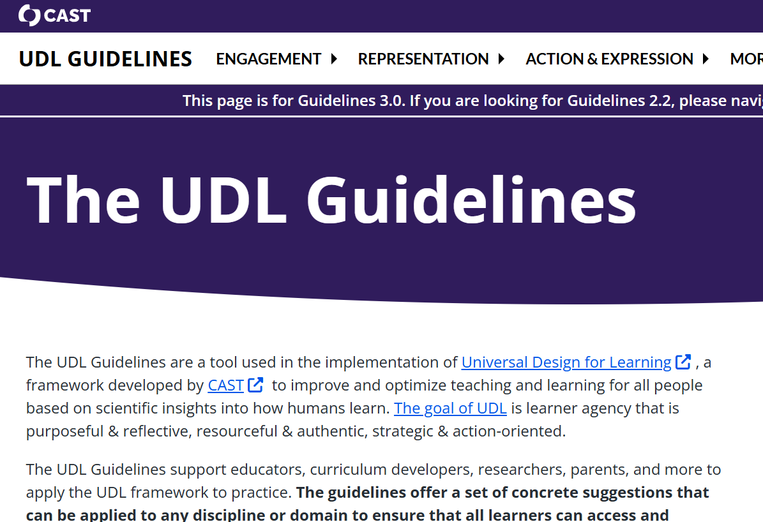
UDL 3.0
CAST maintain the UDL guidelines at the following website: https://udlguidelines.cast.org/

Slide 4
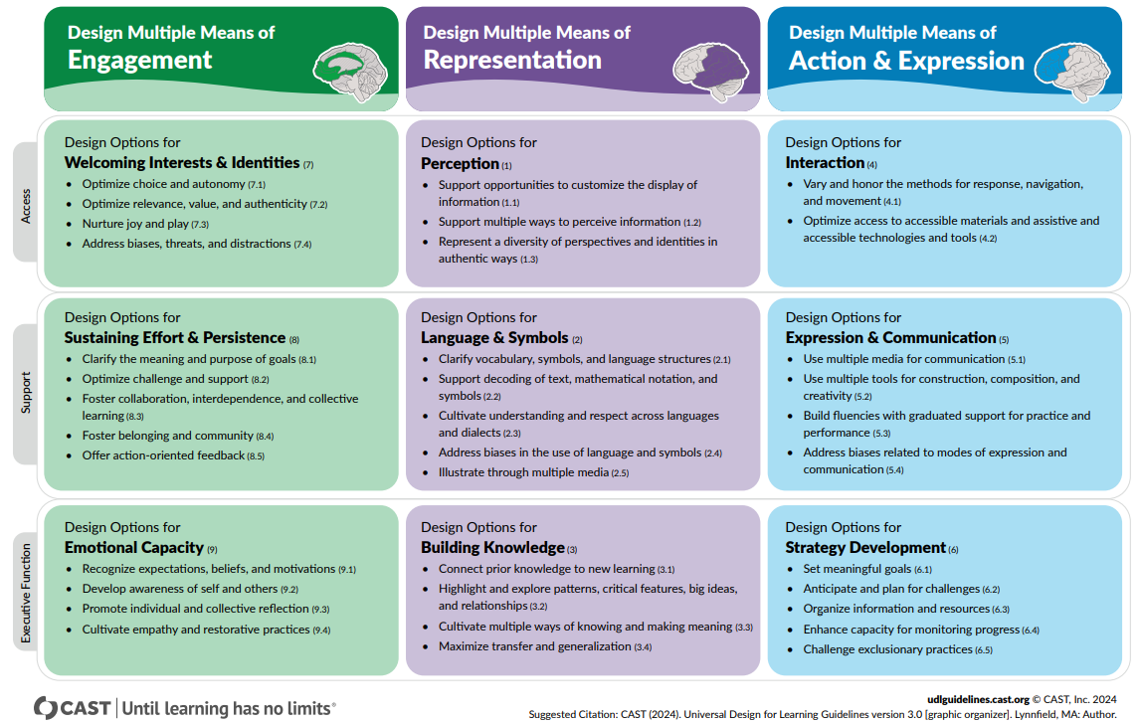
UDL 3.0

Slide 5
UDL 3.0
REPRESENTATION
Perception
Language & Symbols
Building Knowledge
The
“WHAT”

Slide 6
UDL 3.0
EXPRESSION
Interaction
Expression & Communication
Strategy Development
The
“HOW”

Slide 7
UDL 3.0
ENGAGEMENT
Welcoming Interests & Identities
Sustaining Effort & Persistence
Emotional Capacity
The
“WHY”

Slide 8






Focus

Slide 9
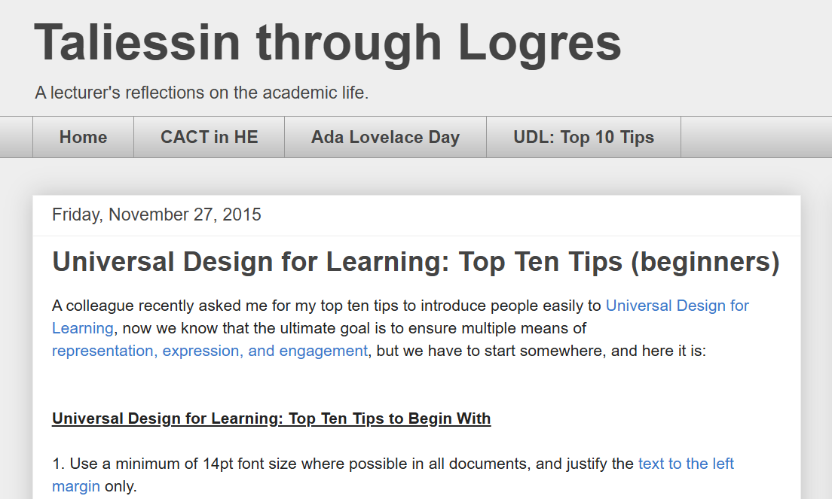

Slide 10
Bloom’s Taxonomy
Evaluation
Synthesis
Analysis
Application
Comprehension
Knowledge
Higher Order
Thinking

Slide 11
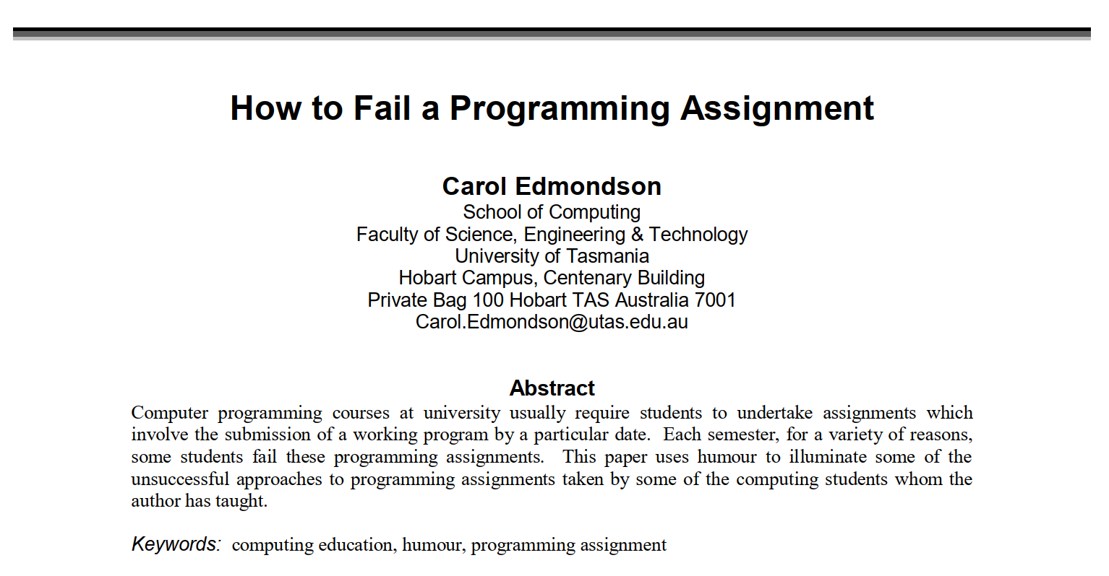

Slide 12
Learning Activity
Redesign some aspect of an educational activity you are currently delivering in line with the principles of Universal Design for Learning
https://www.damiantgordon.com/Courses/UniversalDesignforLearning/Assessment.html

