Slide 1
Storyboards
Damian Gordon

Slide 2
Storyboarding
“Storyboards are visual organizers, typically a series of illustrations displayed in sequence for the purpose of pre-visualizing a video, web-based training, or interactive media sequence.”
http://www.instructionaldesign.org/storyboarding.html

Slide 3
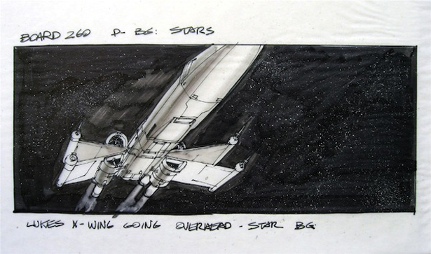
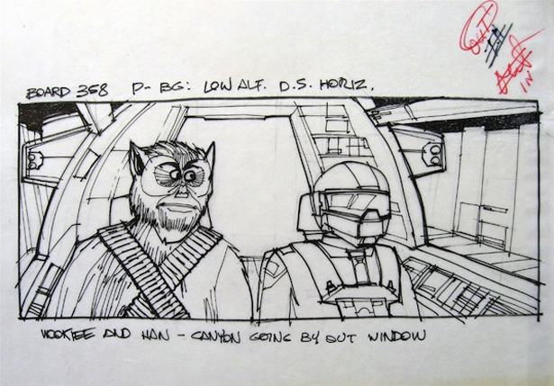
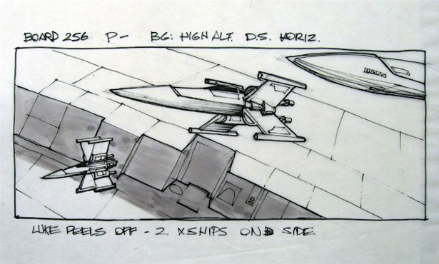
Star Wars

Slide 4
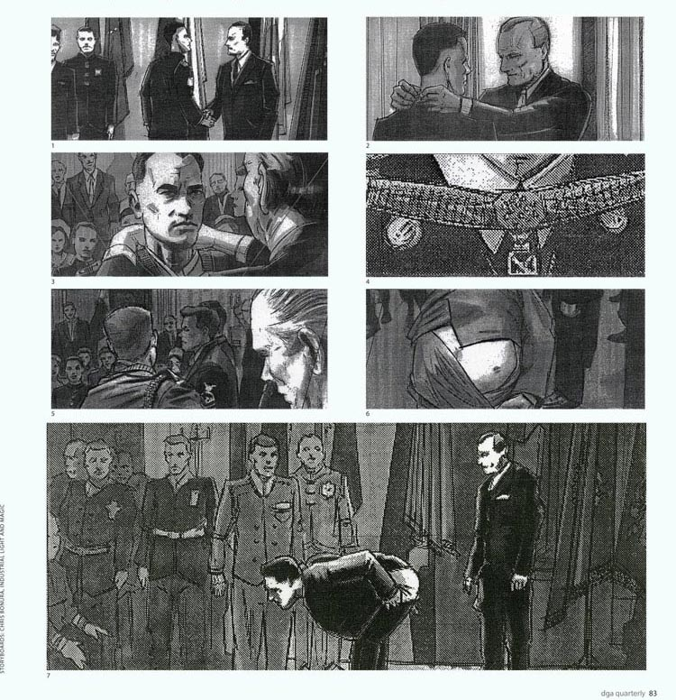
Forrest Gump

Slide 5
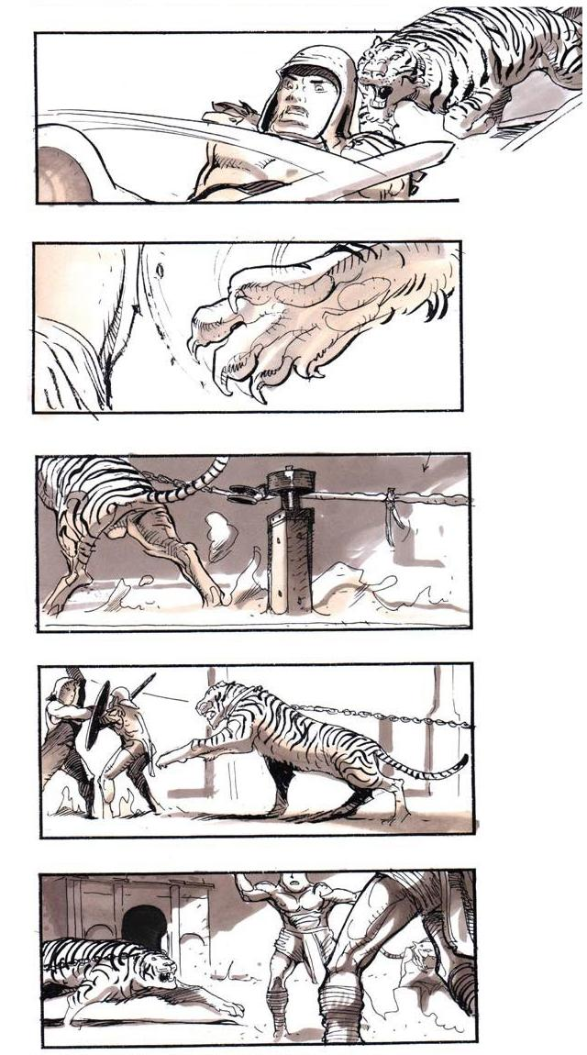
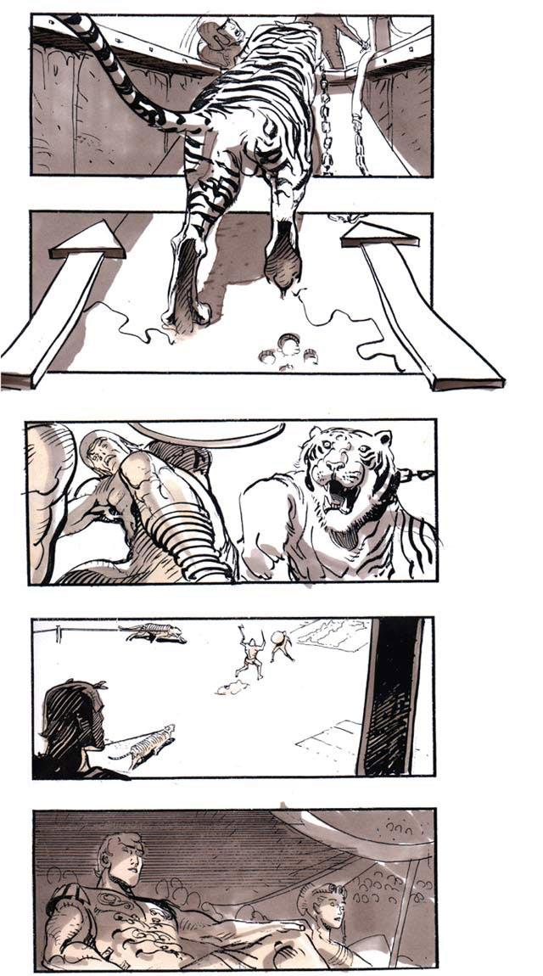
Gladiator

Slide 6
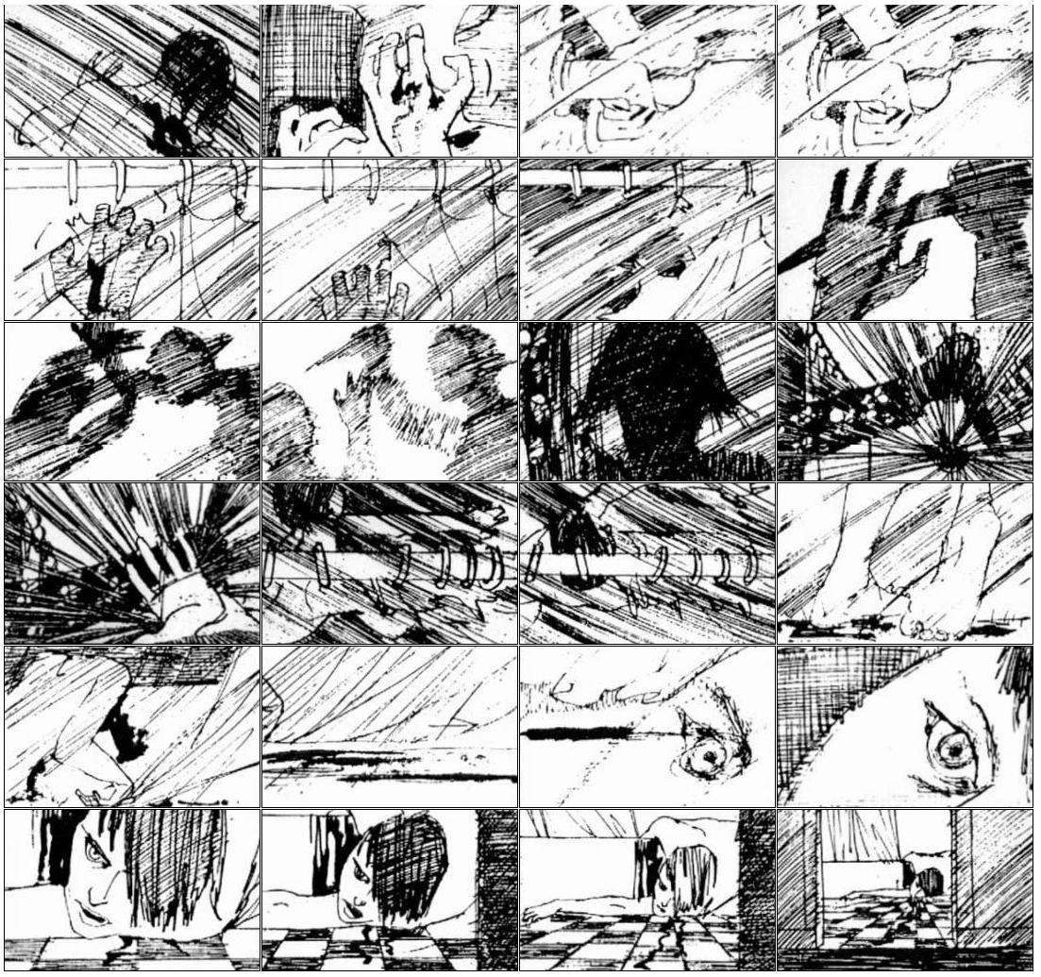
Psycho

Slide 7
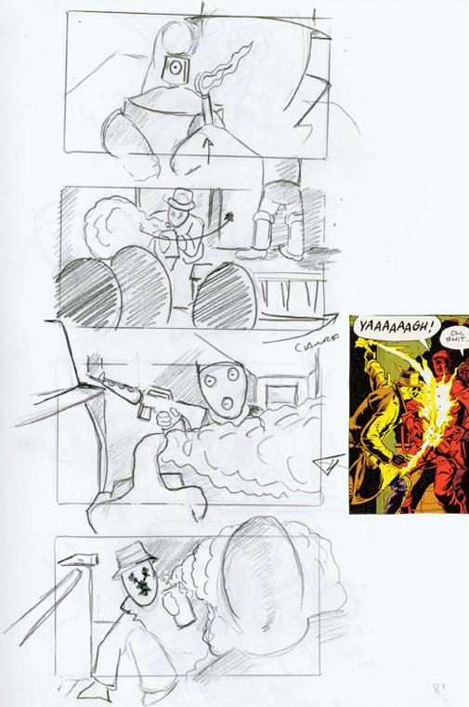
Watchmen

Slide 8
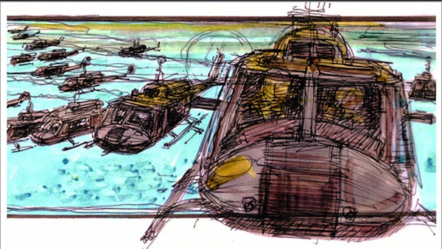
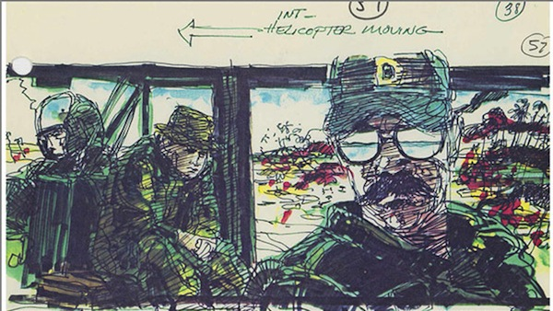
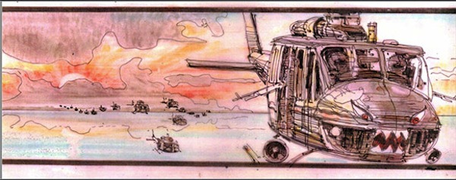
Apocalypse Now

Slide 9
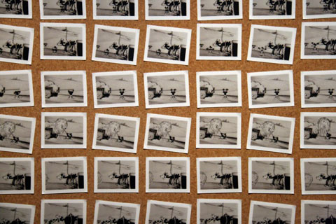
Storyboarding: History
Developed by Disney Studios in 1930s.

Slide 10
Storyboarding: Purpose
The goal of storyboarding is to get ideas down on paper and communicate effectively to all members of the team (and end-users?)
They provide a tangible baseline focus for discussion, and alteration.
They are
Inexpensive
Easy to understand for anyone
Easy to make
Good at giving you an early picture of the system

Slide 11
Storyboarding: Types
Passive
Sketches, pictures, screenshots
PowerPoint or example outputs
Active
Slideshows, simple animations
“Demo mode” of typical behaviour of system
Interactive
Interactive tools
Requires user participation

Slide 12
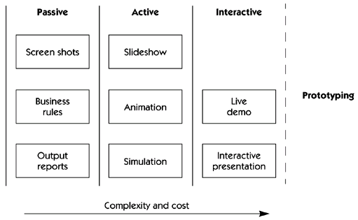
Storyboarding: Types

Slide 13
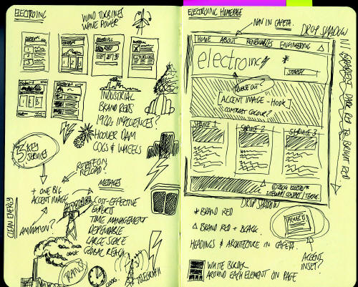
Storyboarding: Features

Slide 14
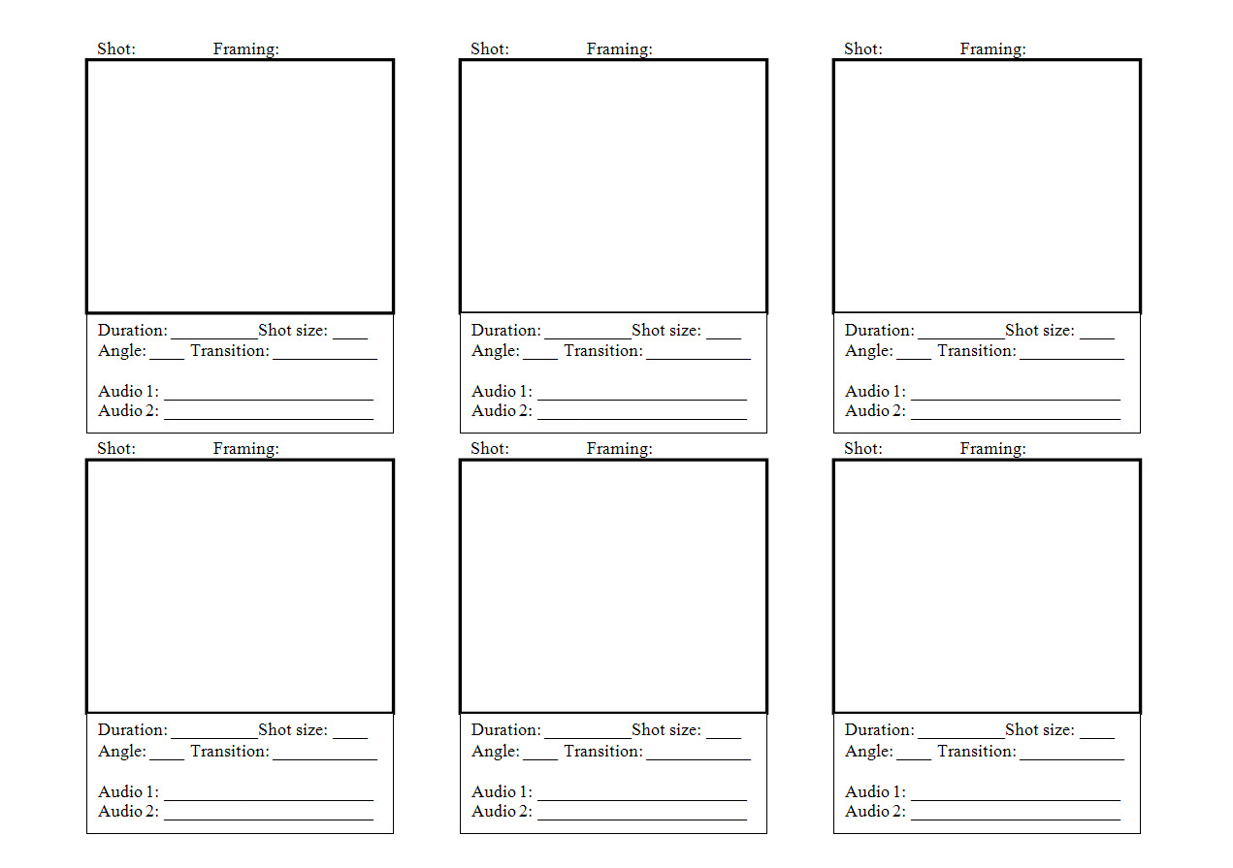
Storyboarding: Features

Slide 15
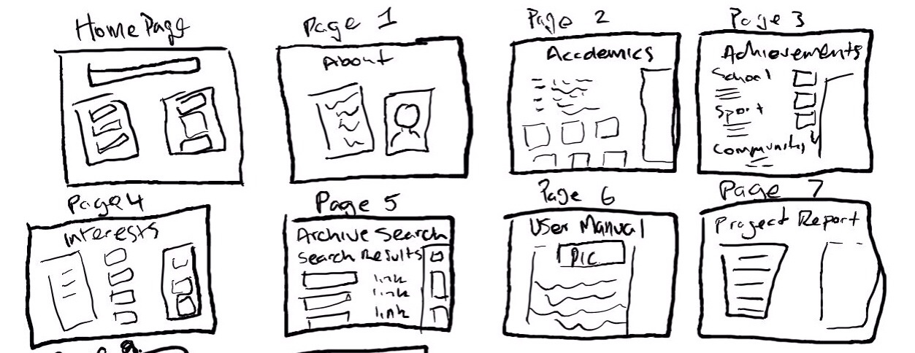
Storyboarding: Features

Slide 16
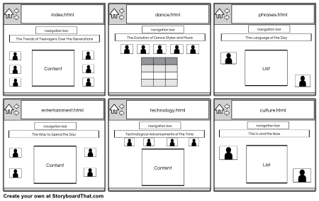
Storyboarding: Features

Slide 17
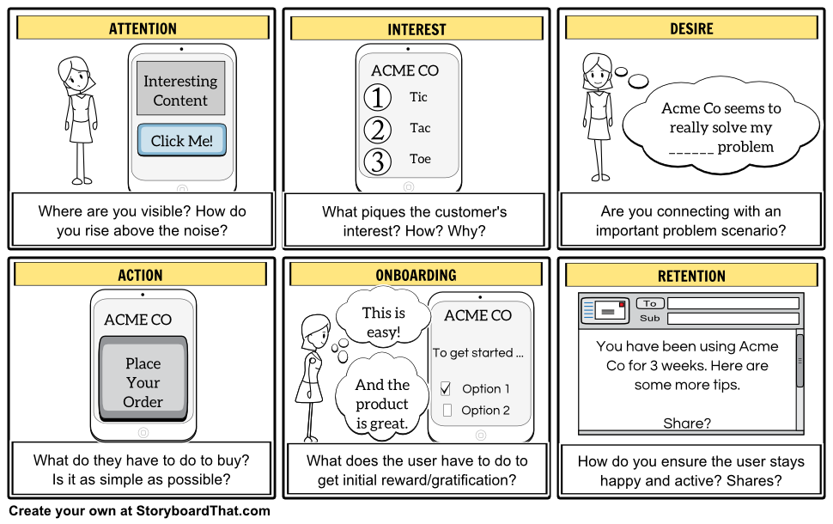
Storyboarding: Features

Slide 18
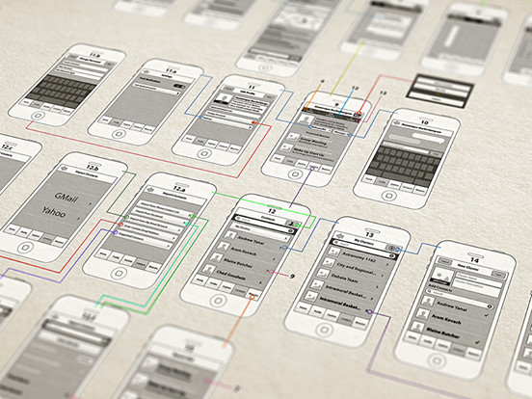
Storyboarding: Features

Slide 19
Storyboarding: Tools
Celtx
http://www.celtx.com
Lectora Snap
http://lectora.com/
Articulate 360
https://www.articulate.com/360/
Adobe Captivate
http://www.adobe.com/products/captivate.html

Slide 20
Storyboarding: Tools
Figma
https://www.figma.com/
Invision
https://crozdesk.com/software/invision/
Vectr
https://crozdesk.com/software/vectr/
Justinmind
https://crozdesk.com/software/justinmind/

Slide 21
Related Ideas

Slide 22
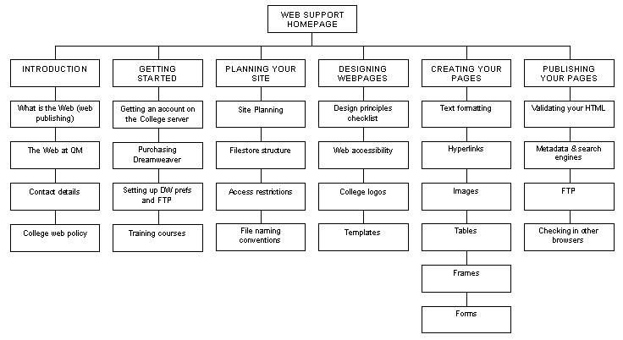
Site Map

Slide 23
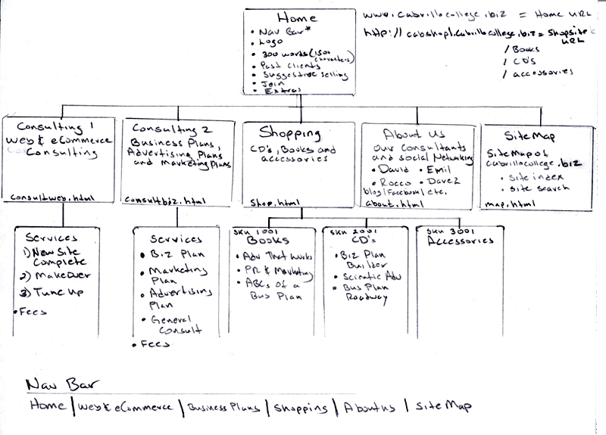
Site Map

Slide 24
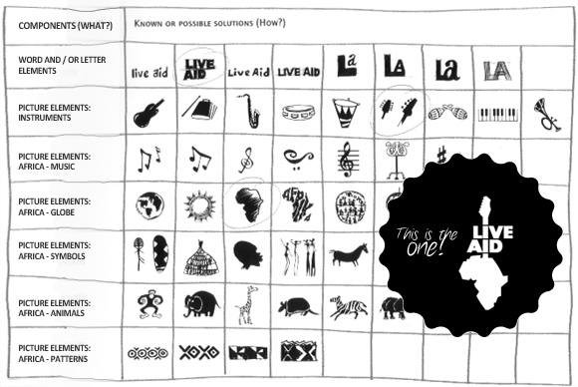
Morphological Matrix

Slide 25
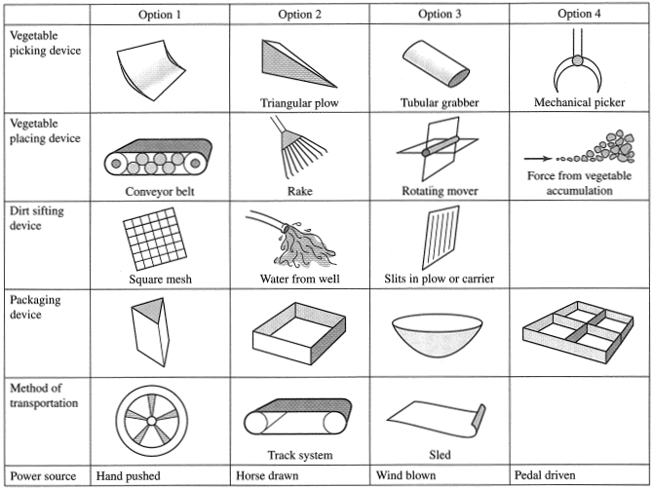
Morphological Matrix

Slide 26
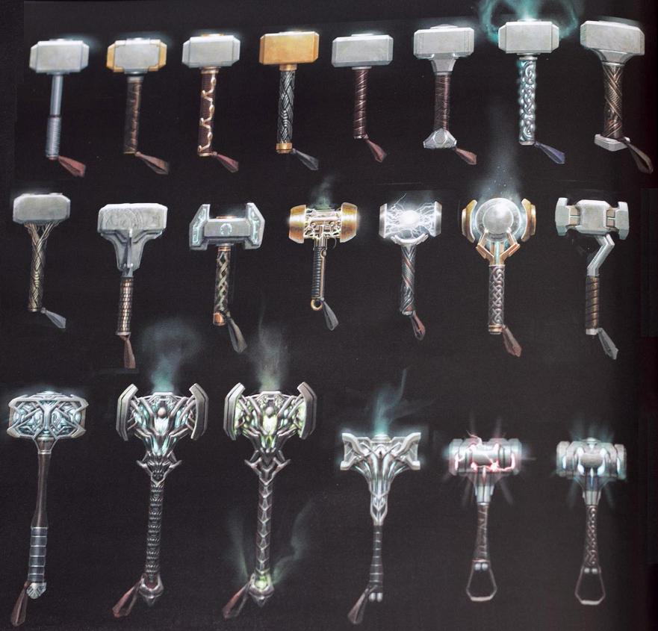
Design Options

