Slide 1
Universal Design for Learning: Multiple Means of Engagement
Damian Gordon

Slide 2
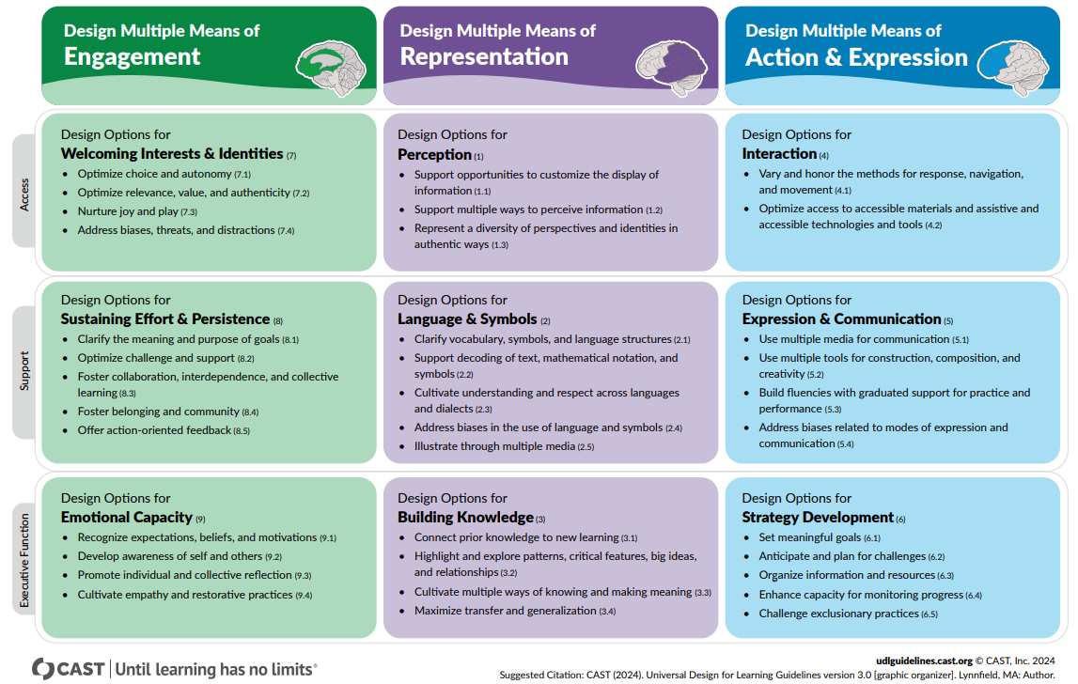
UDL 3.0

Slide 3
UDL 3.0
Multiple means of Engagement
Guideline 7: Design Options for Welcoming Interests & Identities
Guideline 8: Design Options for Sustaining Effort & Persistence
Guideline 9: Design Options for Emotional Capacity

Slide 4
UDL 3.0
ENGAGEMENT
Welcoming Interests & Identities
Sustaining Effort & Persistence
Emotional Capacity
The
“WHY”

Slide 5
UDL 3.0
Multiple means of Engagement
Guideline 7: Design Options for Welcoming Interests & Identities

Slide 6
UDL 3.0
7. Design Options for Welcoming Interests & Identities
Optimize choice and autonomy
Optimize relevance, value, and authenticity
Nurture joy and play
Address biases, threats, and distractions

Slide 7
UDL 3.0
e.g. provide students with choice in terms of challenge, rewards, timing of sub-tasks.
7. Design Options for Welcoming Interests & Identities
Optimize choice and autonomy
Optimize relevance, value, and authenticity
Nurture joy and play
Address biases, threats, and distractions
e.g. create activities that are personalized, relevant (culturally and socially), and ability appropriate.
e.g. create activities that foster problem solving, and encourage the use of imagination.
e.g. create a supportive and accepting classroom environment.

Slide 8
UDL 3.0
Multiple means of Engagement
Guideline 8: Design Options for Sustaining Effort & Persistence

Slide 9
UDL 3.0
8. Design Options for Sustaining Effort & Persistence
Clarify the meaning and purpose of goals
Optimize challenge and support
Foster collaboration, interdependence, and collective learning
Foster belonging and community
Offer action-oriented feedback (consideration8.5)

Slide 10
UDL 3.0
e.g. encourage students to define and focus on goals; and explore what excellence means.
8. Design Options for Sustaining Effort & Persistence
Clarify the meaning and purpose of goals
Optimize challenge and support
Foster collaboration, interdependence, and collective learning
Foster belonging and community
Offer action-oriented feedback (consideration8.5)
e.g. focus less on external evaluation, and focus on effort and improvement in meeting standards.
e.g. use peer-review and peer-tutoring. Create rubrics and guides for groupwork.
e.g. provide feedback that is frequent, timely, and relevant. Also that emphasises effort and improvement.

Slide 11
UDL 3.0
Multiple means of Engagement
Guideline 9: Design Options for Emotional Capacity

Slide 12
UDL 3.0
9. Design Options for Emotional Capacity
Recognize expectations, beliefs, and motivations
Develop awareness of self and others
Promote individual and collective reflection
Cultivate empathy and restorative practices

Slide 13
UDL 3.0
9. Design Options for Emotional Capacity
Recognize expectations, beliefs, and motivations
Develop awareness of self and others
Promote individual and collective reflection
Cultivate empathy and restorative practices
e.g. create guides and checksheets to reduce frustration, and to keep on-task in spite of distractions.
e.g. use real life examples or simulations to demonstrate coping skills.
e.g. assist students in overcoming specific topics that they have phobias about.
e.g. assist the students in identifying their personal goals, and their own strengths and weaknesses.

