Slide 1
EMPATHY MAPPING
Edel Gallagher

Slide 2
TODAY’S Session
Overview of Empathy Maps
Examples in a local context
Group Activity

Slide 3
EMPATHY MAPPING – KEY FEATURES
Visual tool
Developed by Dave Gray (Xplane)
Updated in 2017
Generally used in early stages of design
Purpose: to understand end users / learners

Slide 4
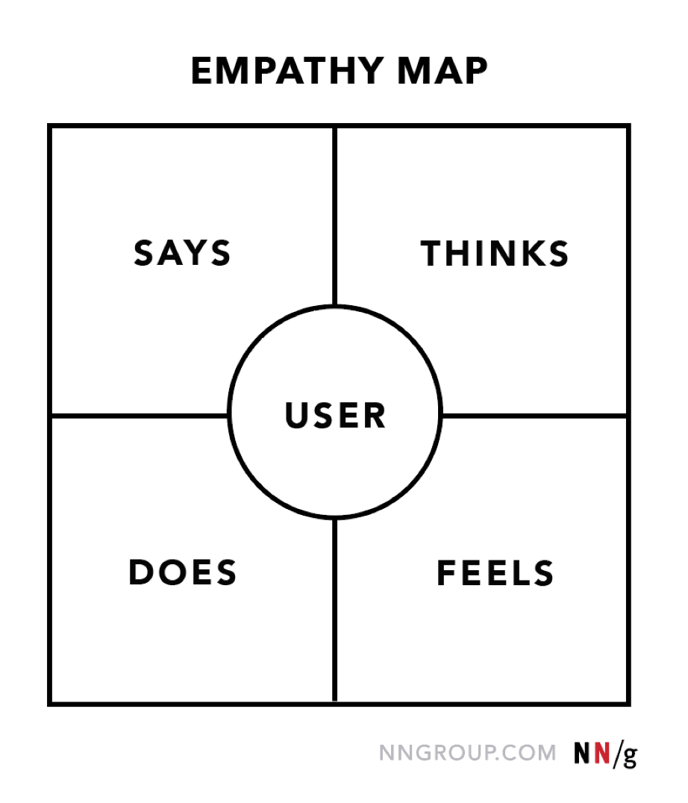
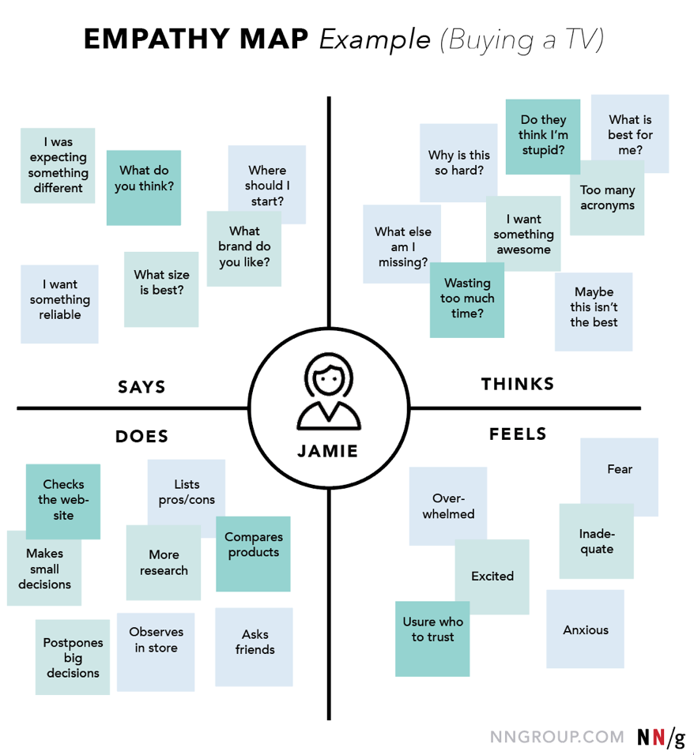
EMPATHY MAPPING
Notes:
Summary: Visualising user attitudes and behaviours in an empathy map helps UX teams align on a deep understanding of end users.
Says: Direct or paraphrased representative quotes from users
Thinks: Users’ thoughts, motivations, and needs framed in first-person statements
Does: Typical or observed user behaviours and actions
Feels: Users’ emotional states during the process

Slide 5
EMPATHY MAPPING - Process
HOW TO CONDUCT AN EMPATHY MAPPING SESSION
Define scope and goals (user and why you are mapping)
Gather materials (whiteboard, sticky notes etc;)
Collect research
Generate sticky notes for each quadrant
Synthesize ideas (in each quadrant)
Polish and Plan
https://www.nngroup.com/articles/empathy-mapping/

Slide 6
Updated VERSION
Dave Gray

Slide 7
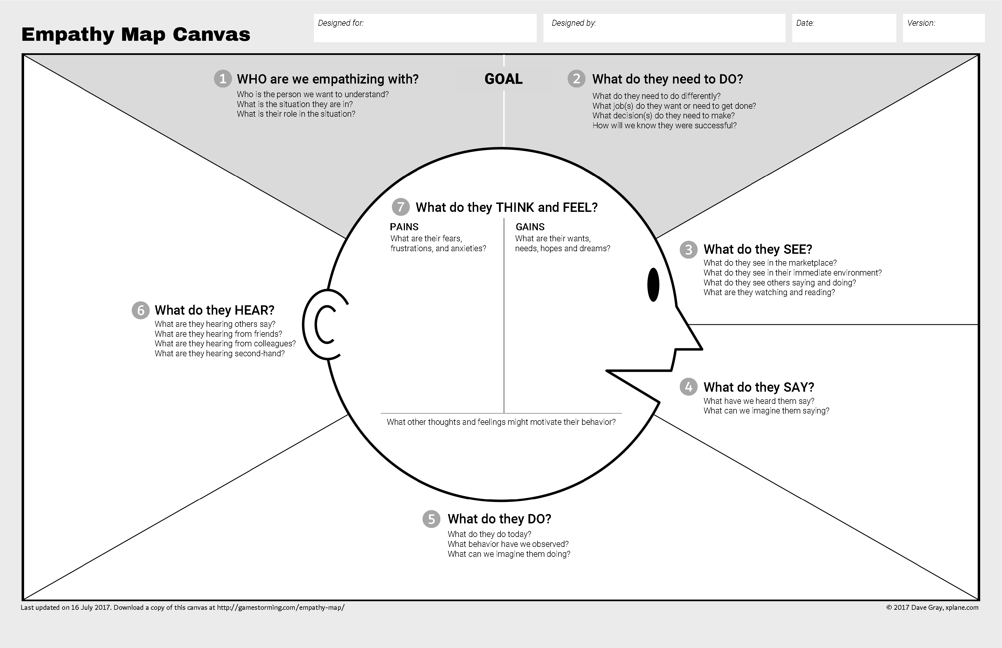
Empathy Map Canvas (Gray, 2017)
Notes:
Ordered
Personal reflection – Similar to Osterwalder Business Model Canvas
https://gamestorming.com/empathy-map-canvas-006/

Slide 8
Empathy map for learners
Niels Floor

Slide 9
EMPATHY MAPPING FOR LEARNERS (2020)
Developed by Niels Floor

Slide 10
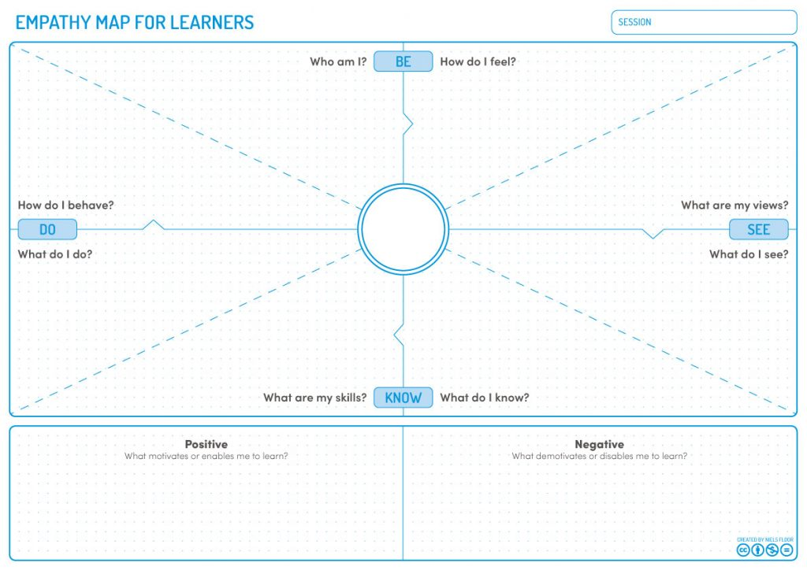
Empathy map for learners (floor, 2020)
Notes:
https://lxd.org/news/empathy-map-for-learners-and-learning-experience-design/

Slide 11
EMPATHY MAPPING for Learners
HOW TO CONDUCT AN EMPATHY MAP FOR LEARNERS SESSION
Write date and name of session
Start by asking the question ‘Who am I?’
Answer rest of question on clockwise order
After answering these, think about positive and negative aspects (motivate/enable learners to be successful)
Add a picture of learner to the centre of empathy map (makes it easier to remember)
https://lxd.org/news/empathy-map-for-learners-and-learning-experience-design/

Slide 12
EMPATHY MAPPING IN A LOCAL CONTEXT
Vaugh, T. et al. (2018) Designing the Transition to Higher Education for Students from Under-Represented Groups, Universal Design & Higher Education in Transformation Congress, 30th October -2nd November 2018, Dublin Castle.
https://arrow.tudublin.ie/unides18pap/20/
Claudia Fernandez-Rivera, Sarah Boland, Eamon Aswad, John Gilligan, Dympna O’Sullivan, and Emma Murphy. AccessDesign: An inclusive co-design toolkit for the creation of accessible digital tools. Proceedings of ICCHP – AAATE 2022: 13th joint Conference on Digital Inclusion, Assistive Technology & Accessibility, Lecco, Italy, July 11-15, 2022. DOI: 10.35011/icchp-aaate22-p1-32
https://arrow.tudublin.ie/creaart/118/

Slide 13
EMPATHY MAPPING IN A LOCAL CONTEXT
Vaugh, T. et al. (2018) Designing the Transition to Higher Education for Students from Under-Represented Groups, Universal Design & Higher Education in Transformation Congress, 30th October -2nd November 2018, Dublin Castle.
https://arrow.tudublin.ie/unides18pap/20/
Maynooth University
Describes an Empathy Mapping Process that was used in a co-design workshop setting
(Empathy Mapping Workshop and Experience Mapping Workshop – 50 students each)
Needs identified during the sessions, lead to the creation of ‘problem narratives’

Slide 14
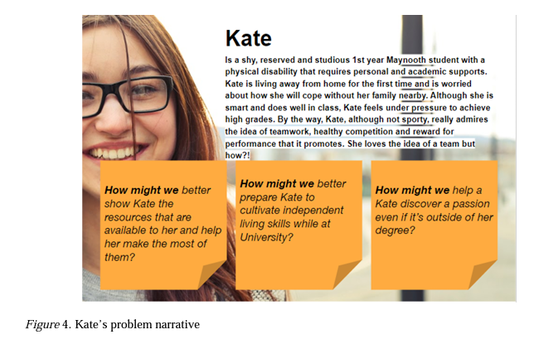
Sample Problem Narrative

Slide 15
EMPATHY MAPPING IN A LOCAL CONTEXT
Claudia Fernandez-Rivera, Sarah Boland, Eamon Aswad, John Gilligan, Dympna O’Sullivan, and Emma Murphy. AccessDesign: An inclusive co-design toolkit for the creation of accessible digital tools. Proceedings of ICCHP – AAATE 2022: 13th joint Conference on Digital Inclusion, Assistive Technology & Accessibility, Lecco, Italy, July 11-15, 2022. DOI: 10.35011/icchp-aaate22-p1-32
https://arrow.tudublin.ie/creaart/118/
TU Dublin, School of Computer Science, 3rd Year Students, St John of God Liffey Services
Describes how Empathy Maps were used in the initial stages of a co-design process

Slide 16
USEFUL LINKS
https://www.nngroup.com/articles/empathy-mapping/
https://lxd.org/news/empathy-map-for-learners-and-learning-experience-design/
https://gamestorming.com/empathy-mapping/

Slide 17
ACTIVITY
Part 1 – 10 mins
In your group:
Introductions / context
Decide:
Template to use – Empathy Map Canvas or Empathy Map for Learning
Your learner/user - Answer ‘Who Am I?’ (Note: you may use an existing persona)
3 Key characteristics of this learner
The learning situation / What learner is to do
Assign the role of note-taker and a reporter
Part 2 – 20 mins
In your group:
Work through the template, answering questions in a clockwise direction, take notes
You may decide to role play, or collaboratively decide on responses

