Slide 1
Universally Designed
Learning Spaces
Damian Gordon

Slide 2

Learning Spaces
Some Reading:
Creating Inclusive Learning Opportunities in Higher Education: A Universal Design Toolkit
By Sheryl Burgstahler

Slide 3
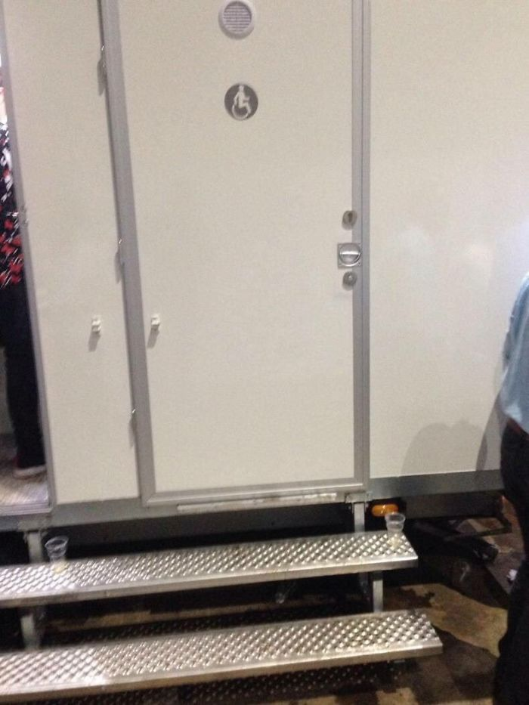

Slide 4
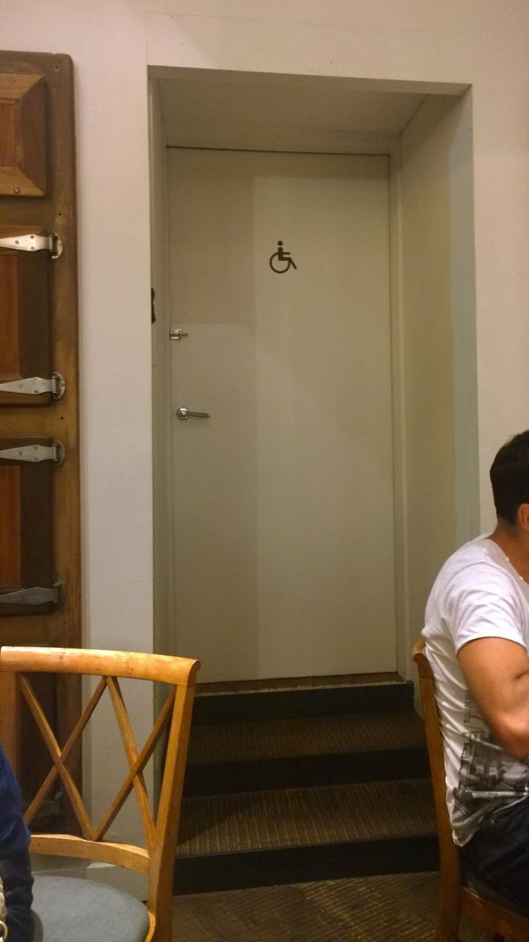

Slide 5
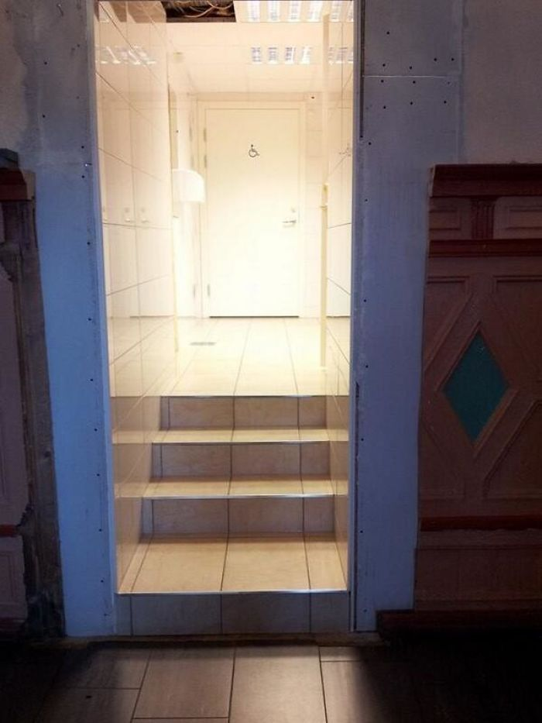

Slide 6
The Basics:
Principles

Slide 7
UDLS Model
UD
Principles
UDL
Principles
UD
Learning
Spaces
WCAG
2.0

Slide 8
Room Types
Lecture rooms
Seminar rooms
Theatres
Laboratories
Computer spaces
Corridors
Computer labs
Makerspaces
Libraries
Services offices
Canteen
Storage

Slide 9
Learning Spaces
UD Higher Education (UDHE) process:
  Identify best practices in the field for this space (for each room type)
  Consider the diverse characteristics of potential users
  Merge best practices with UDLS model
  Plan for accommodations (have processes to request and address)
  Evaluate (get feedback from a range of individuals, and modify as needed)

Slide 10
Learning Spaces
Reasons for reluctance
  People think it might reduce visual appeal
  An all-or-nothing attitude

Slide 11
Learning Spaces
Entrances without steps
Flush thresholds
Wide doorways
Non-slip surfaces
Level door handles
Grab bars
Accessible bathrooms
Large print controls
Kitchen controls that can be used seated
Good lighting
Etc.

Slide 12
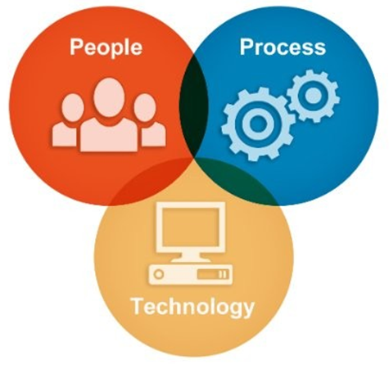
Knowledge Management

Slide 13
Knowledge Management
% = effort required
70%
20%
10%

Slide 14
Knowledge Management
% = effort required
70%
20%
Attitudes, Sharing,
Innovation, Skills,
Teamwork, Motivation,
Vision, Objectives
Systems,
Integration,
Policy, Workflows,
Best Practices.
Data Storage,
Networks/Internet,
Automation,
Standards
10%

Slide 15
Who do we need to think about?

Slide 16
Everyone

Slide 17
A range of abilities
in the areas of:
Vision
Speech
Hearing
Mobility/dexterity
Everyone

Slide 18
A range of abilities
in the areas of:
Vision
Speech
Hearing
Mobility/dexterity
Everyone
Short and Tall

Slide 19
A range of abilities
in the areas of:
Vision
Speech
Hearing
Mobility/dexterity
Everyone
Short and Tall
Left-handed, right-handed and ambidextrous

Slide 20
A range of abilities
in the areas of:
Vision
Speech
Hearing
Mobility/dexterity
Everyone
Short and Tall
Different cultures
Left-handed, right-handed and ambidextrous

Slide 21
Different gender identities
A range of abilities
in the areas of:
Vision
Speech
Hearing
Mobility/dexterity
Everyone
Short and Tall
Different cultures
Left-handed, right-handed and ambidextrous

Slide 22
Range of English
Language skill
levels
Different gender identities
A range of abilities
in the areas of:
Vision
Speech
Hearing
Mobility/dexterity
Everyone
Short and Tall
Different cultures
Left-handed, right-handed and ambidextrous

Slide 23
What do we need to think about?

Slide 24
The Basics:
Ramps

Slide 25
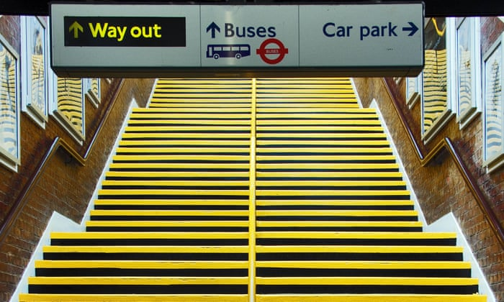
Learning Spaces
We need them, otherwise it’s too many steps:

Slide 26
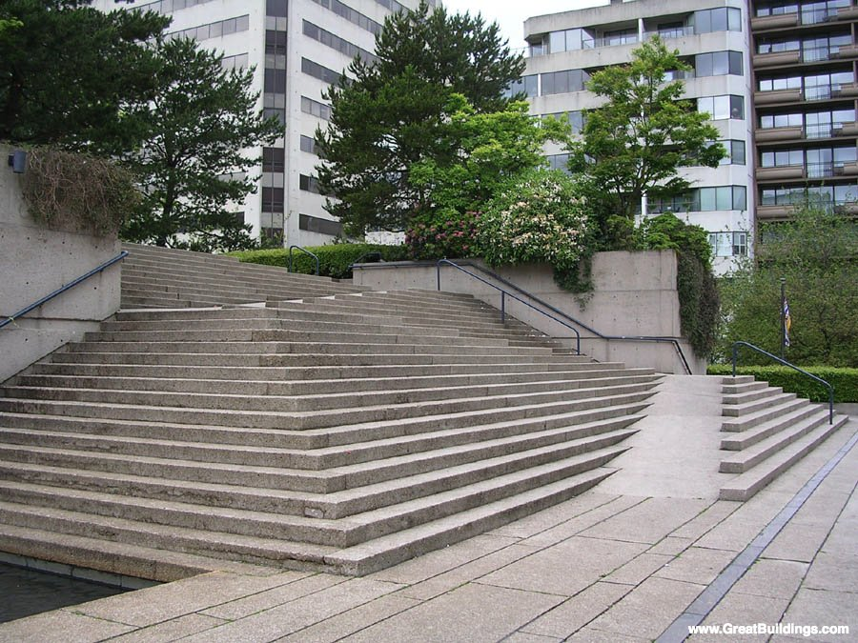
Learning Spaces
Robson Square, Vancouver, Canada

Slide 27
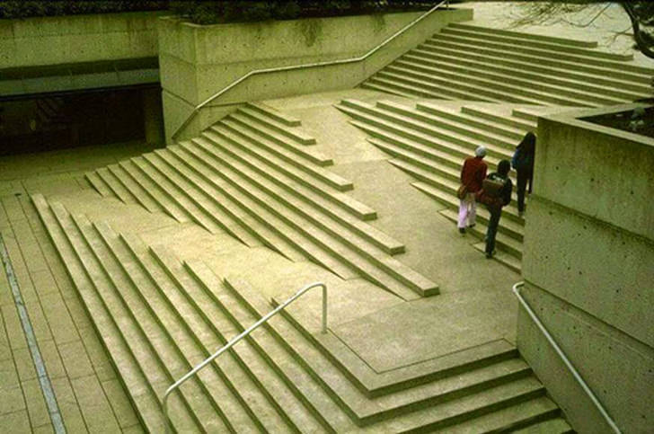
Learning Spaces
Robson Square, Vancouver, Canada
Photograph by Howard Davis

Slide 28
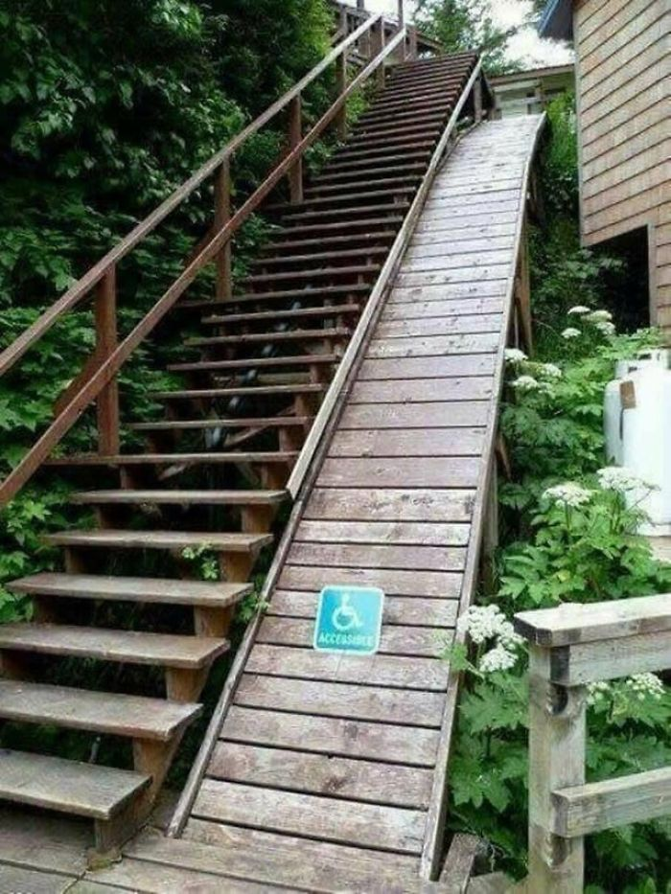
Learning Spaces
Source:
https://www.demilked.com/wheelchair-ramp-design-fails/

Slide 29
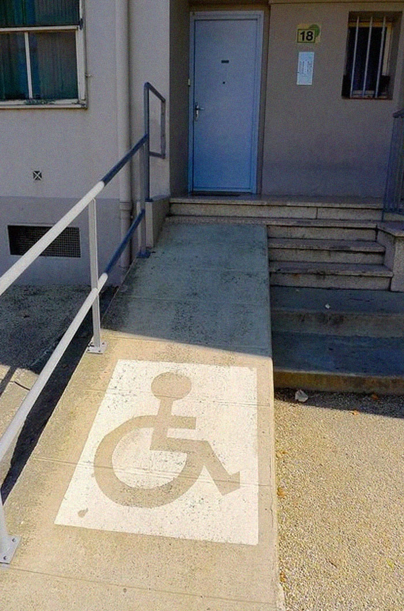
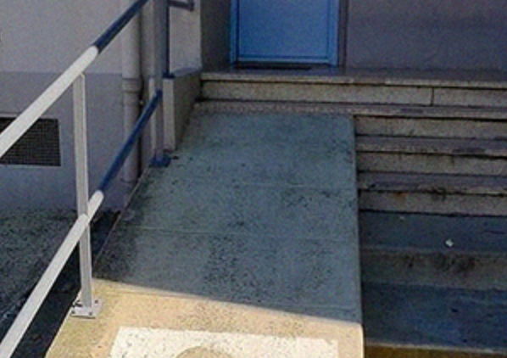
Learning Spaces
Source:
https://www.demilked.com/wheelchair-ramp-design-fails/

Slide 30
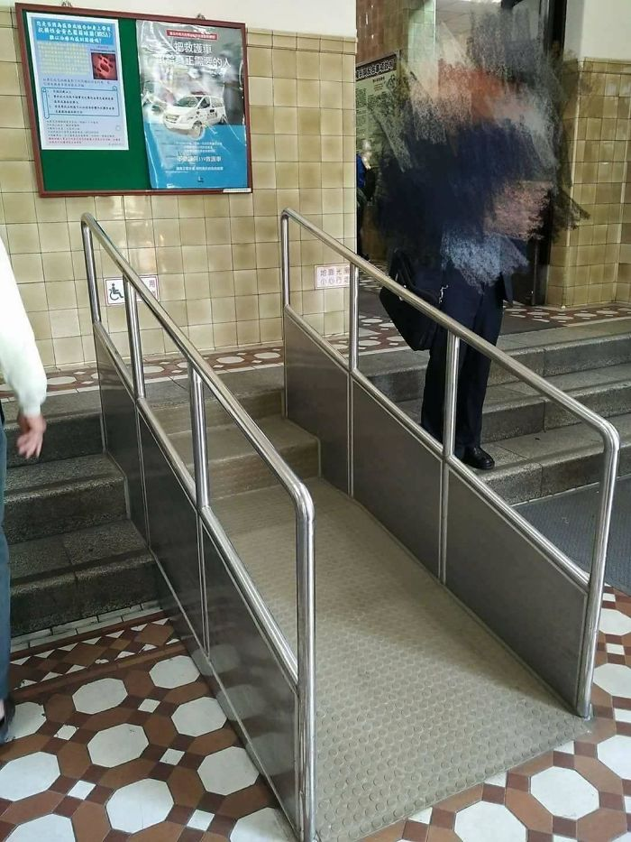
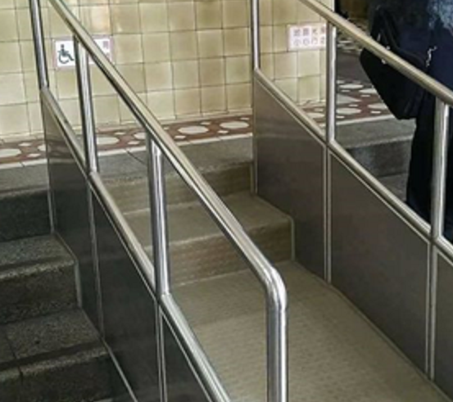
Learning Spaces
Source: Juju1990

Slide 31
The Basics:
Campus Considerations

Slide 32

Surfaces
They can help or hinder:

Slide 33
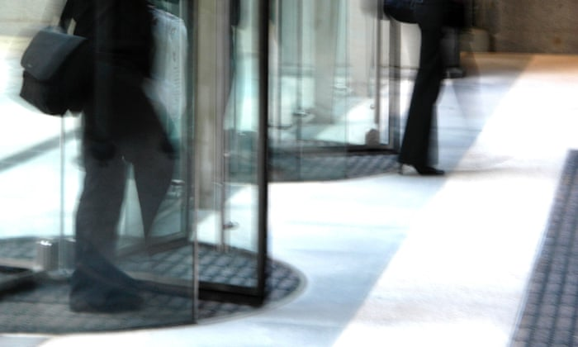
Doorways
Are rotating doors a good idea?

Slide 34
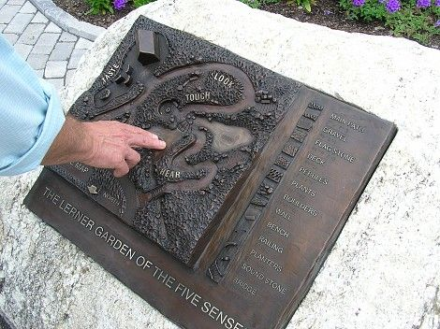
Signs
“Accessible signage plays an important role in making buildings usable and accessible”
“Wayfinding refers to the techniques used by all users of the environment as they move from place to place independently and safely.”
http://www.accessconsultancy.ie/accessible_wayfinding

Slide 35
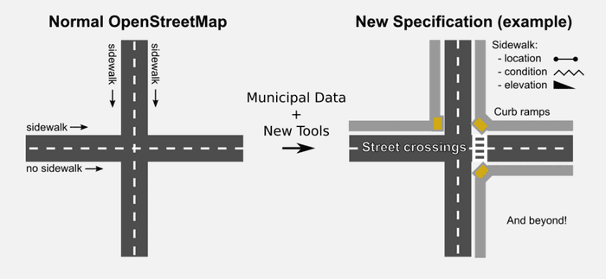
Signs
Source: https://www.theguardian.com/cities/2018/feb/14/what-disability-accessible-city-look-like

Slide 36
Signs
Some thoughts:
  Good pre visitor information.
  Building cues - i.e. using the architectural features of the building, e.g. locating directional signs at or before every major intersection, at major destinations.
  Changes in flooring material to indicate that the individual is moving from one area into another.
  Changes in colour to identify major destinations.

Slide 37
Signs
Some thoughts:
  Good signage which is designed with accessibility in mind, e.g., signs should be as clear, short and concise as practicable;
  Text on signs should not be set entirely in capital letters.
  Visual signs should be designed with due consideration given to the height of sign, layout of sign, font size, font type, use of symbols and visual contrast with background, etc.

Slide 38
Signs
Some thoughts:
  Hand held maps and directory boards.
  “You are here” maps.
  Staff and volunteers. For example a number of hospitals in Ireland have volunteers on hand to provide assistance and support to patients and visitors.

Slide 39

Signs
Wait a minute !!!

Slide 40
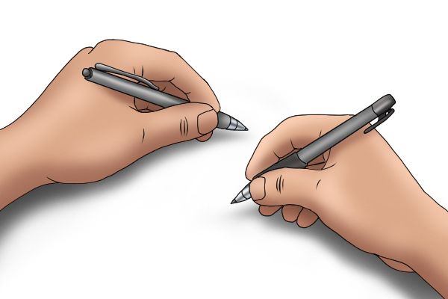
Handedness

Slide 41
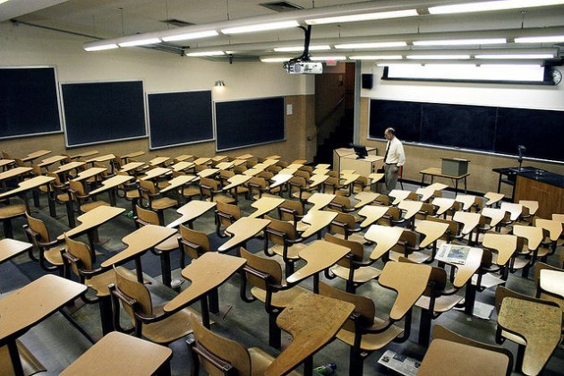
Handedness
Excluding the lefties:

Slide 42

Handedness
Excluding the lefties:

Slide 43

Handedness
Excluding the lefties:

Slide 44

Handedness
We need this:

Slide 45
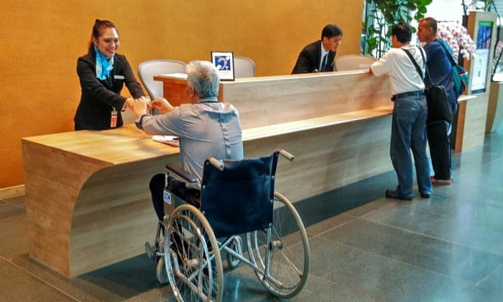
Reception Desks
Flexible design:

Slide 46
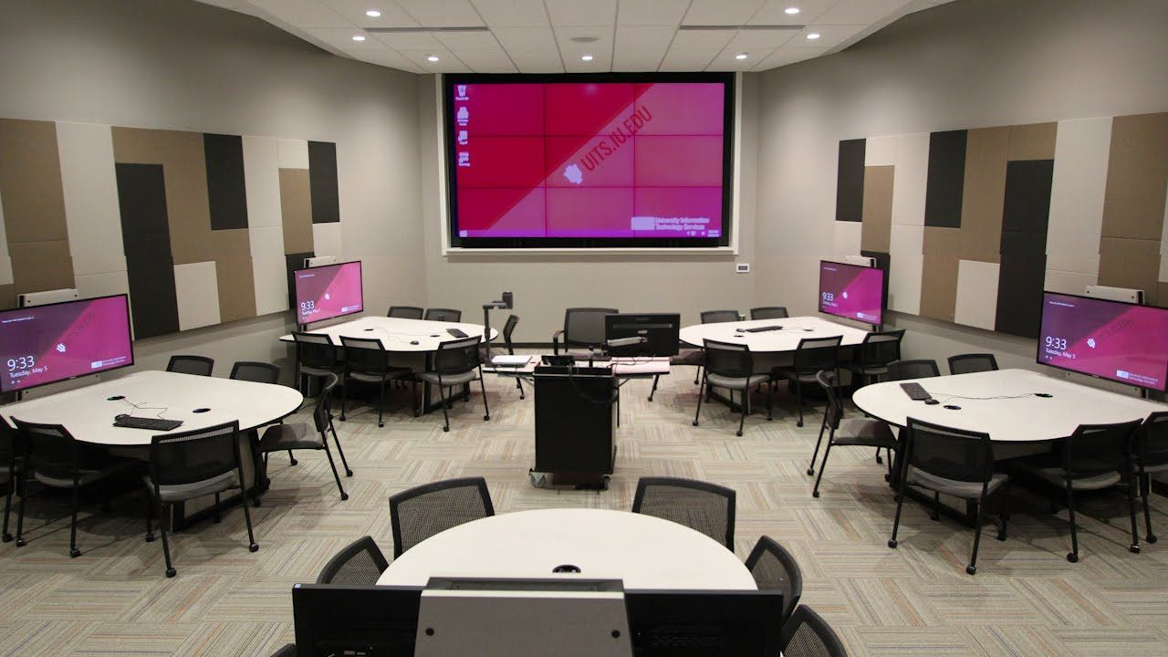
Seating
Flexible Seating:

Slide 47

Walls
Acoustic tiles:

Slide 48
Equipment
There is so much equipment available that is really accessible, it just takes someone to have a look for it, it’s out there:
  Large print measuring devices and other equipment
  Talking measuring scales and others
  Remote control microscopes
  Breakers with handles
  Etc.

Slide 49
Equipment
There is so much equipment available that is really accessible, it just takes someone to have a look for it, it’s out there:
  Large print measuring devices and other equipment
  Talking measuring scales and others
  Remote control microscopes
  Breakers with handles
  Etc.
With COVID-19 and online teaching, where students might have to look at a lecturer demonstrating this equipment on a small video screen, large print and speaking features are a massive advantage.

Slide 50
Good practice in UD
An excellent checklist is available here to look at good UD Practices in HD in Physical Spaces:
https://www.washington.edu/doit/sites/default/files/atoms/files/EA_Physical_Spaces.pdf

Slide 51
When two people install different things at different times and make a mess!

Slide 52
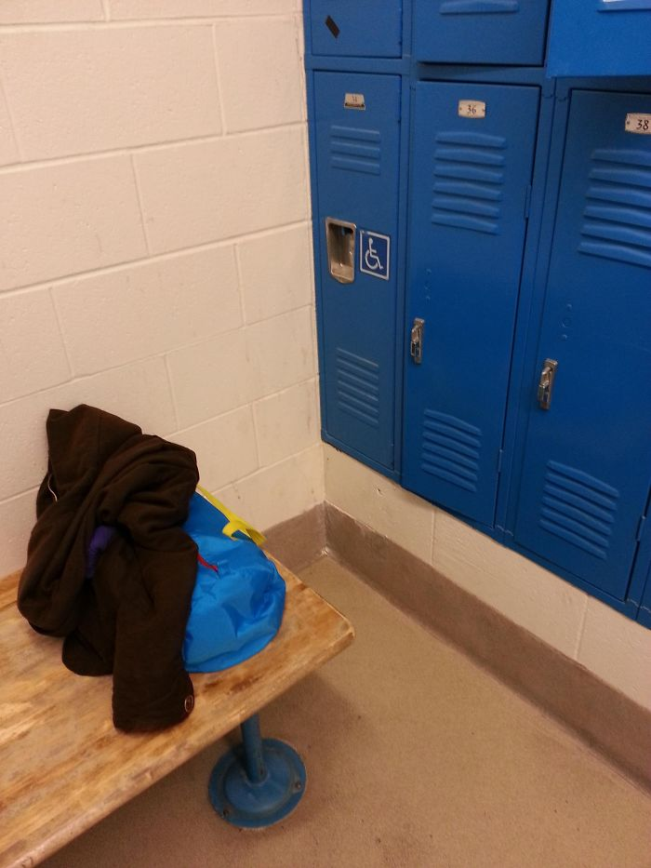
Storage

Slide 53
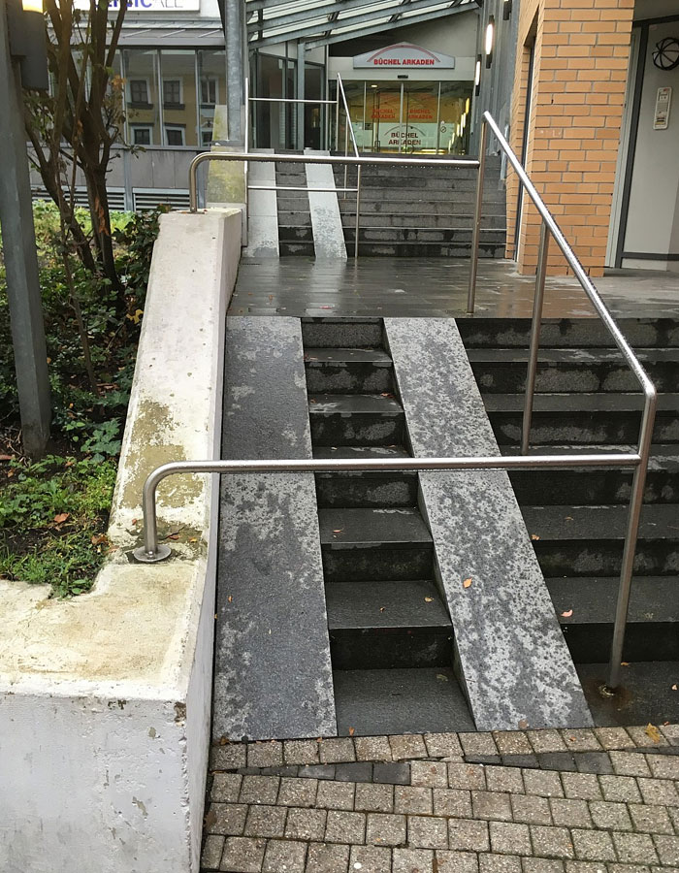
Ramps

Slide 54
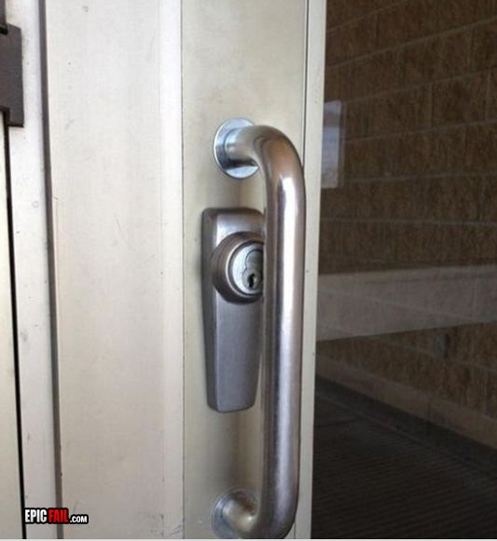
Doors

Slide 55
My Fav is coming up!
The Projector and Fan
There are sooooo many examples of these…

Slide 56
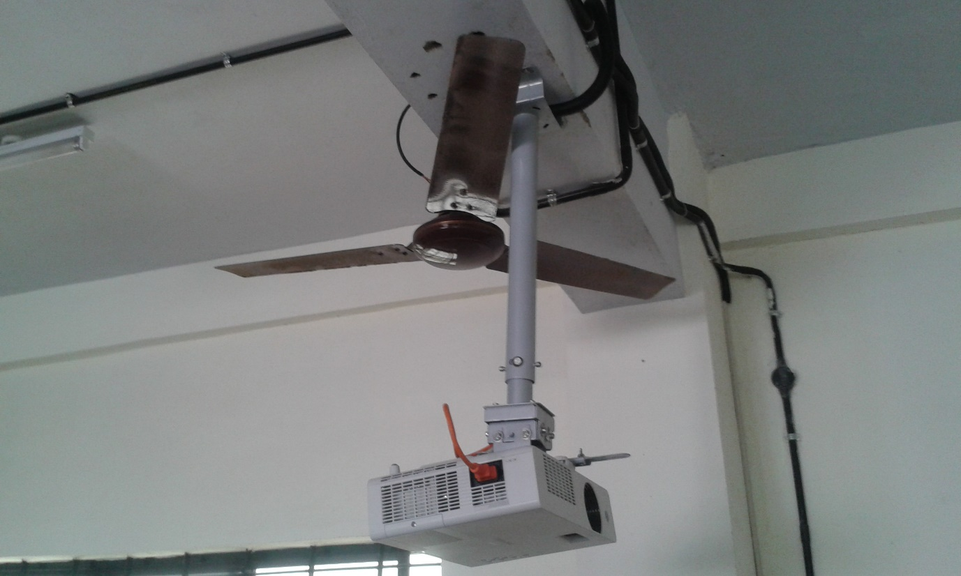
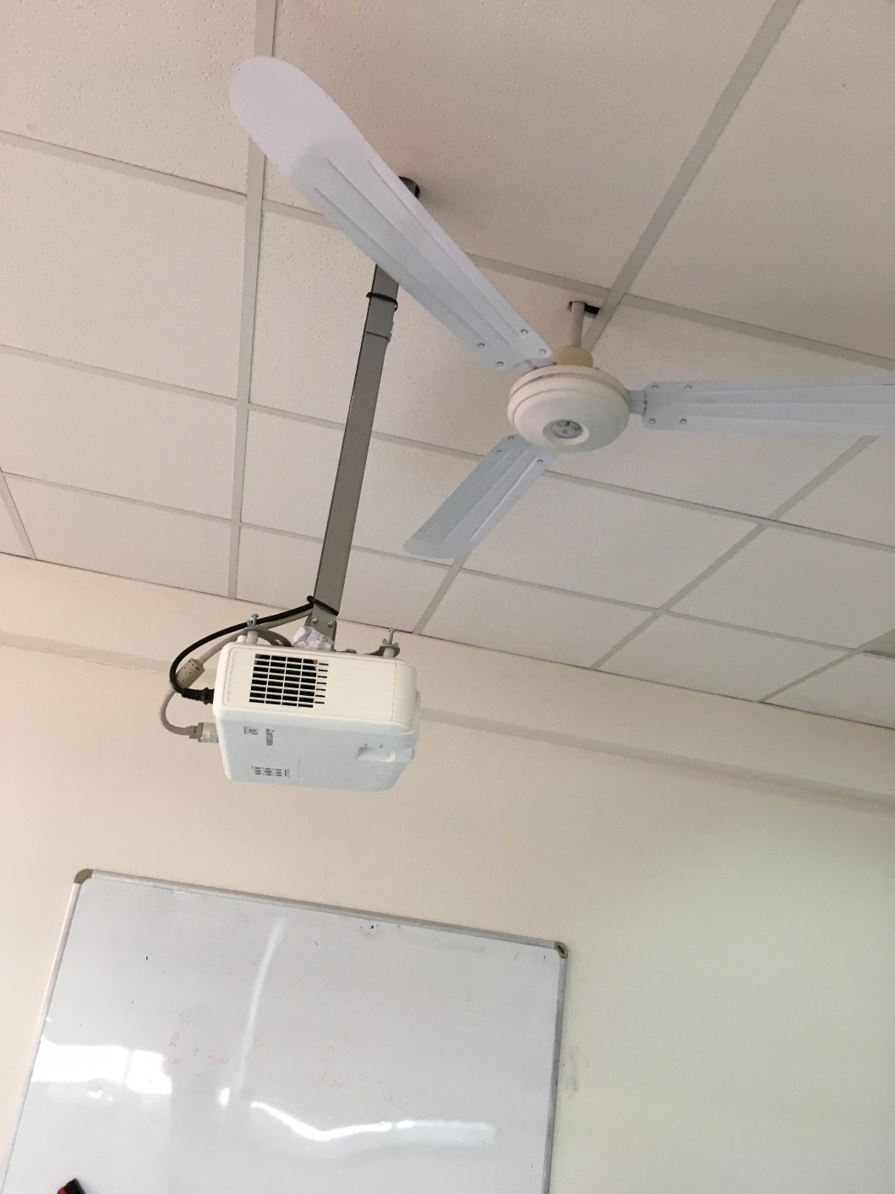
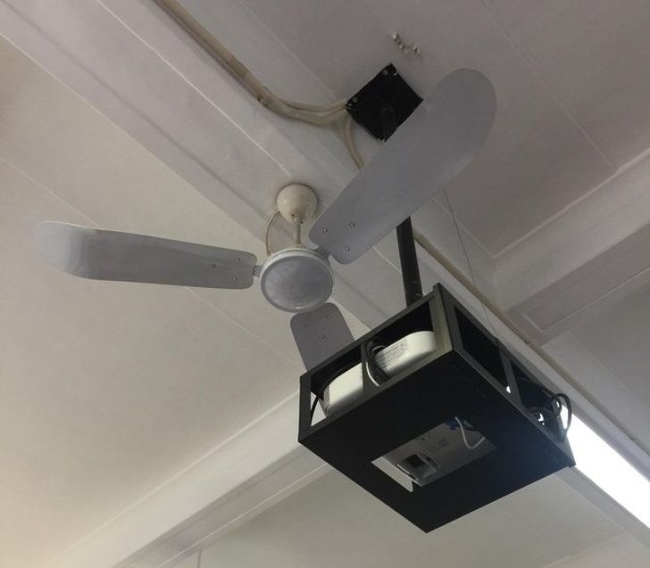
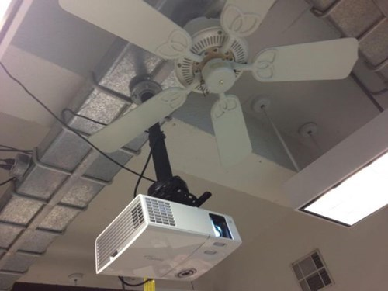

Slide 57
Doors

Slide 58
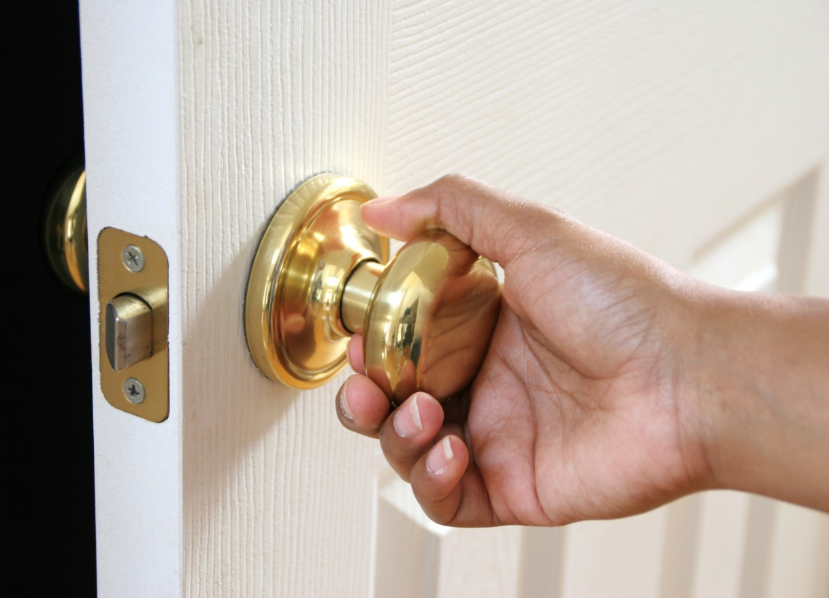
Doors
Doorknobs are a disaster for people who don’t have strength in their grips.

Slide 59
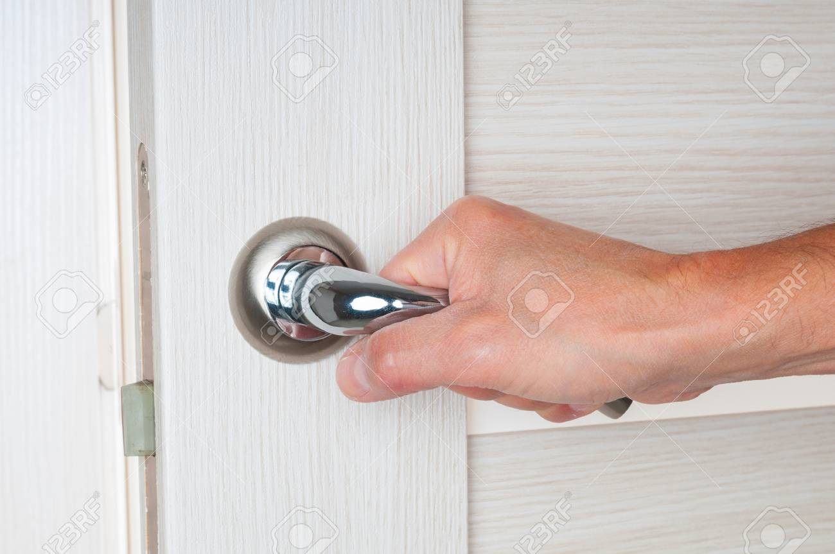
Doors
Doorhandles are a lot better, but can still be a challenge for those who don’t have strength in their grips.

Slide 60
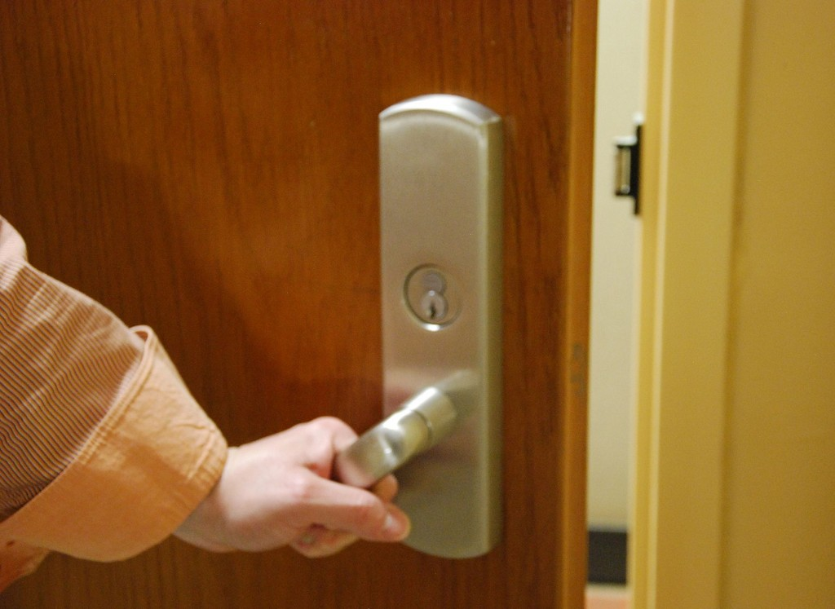
Doors
An accessibly Doorhandle is better, they have a reduced operable force

Slide 61

Doors
A disability access door button is even better, but the logo sometimes confuses people

Slide 62
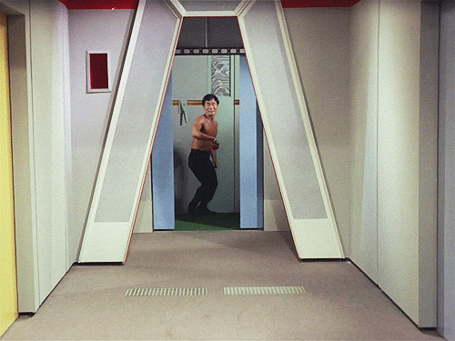
Doors
Star Trek doors are the best:

Slide 63
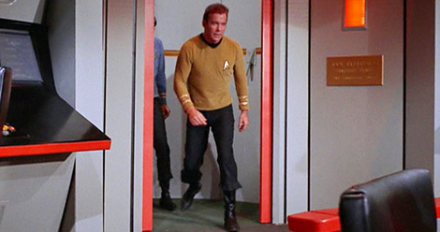
Doors

Slide 64
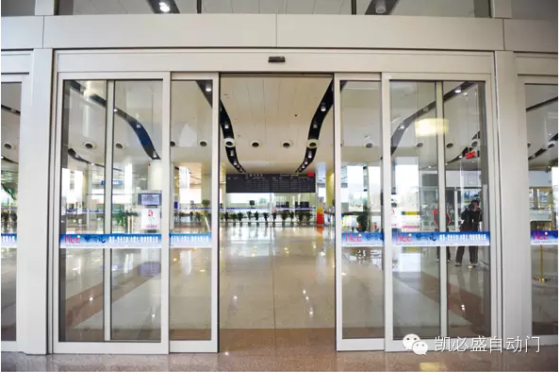
Doors

Slide 65
Measures

Slide 66
Process Measures (1/2)
What processes are present to allow both students and others to report accessibility challenges that they are experiencing?
  Do they have to do it in person, by email, on a website, etc.?
  Can it be anonymous or not?
Who is the person responsible for reading these reports?
  What powers do they have to effect change?
  Is this a full-time or part-time job?

Slide 67
Process Measures (2/2)
How is the accessibility challenge going to be addressed?
How is the change going to be evaluated?
Will the reporter and other be asked for feedback?
How will the issue by considered closed?

Slide 68
Attitude Measures
Do we accept that changes are going to be happening to improve service?
Is there budget for changes in physical space as well as technology and online services?
Is there budget for staff to work on this?
Do lecturers and other staff have the training and attitudes to deal with accessibility challenges, e.g. do they look forward to learning how their modules will change as new students with a range of needs enroll?

Slide 69
Good practice in UD
An excellent checklist is available here to look at good examining how inclusive a campus is:
https://www.washington.edu/doit/sites/default/files/atoms/files/Self_Exam_Inclusive_Campus_tagged.pdf

Slide 70


