Slide 1
Universal Design for Learning

Slide 2
Universal Design for Learning
CAST members, Anne Meyer and David Rose developed the principles of UDL in the late 1990s as a framework to improve and optimize teaching and learning for all people based on scientific insights into how humans learn.

Slide 3
Universal Design for Learning
The UDL Guidelines can be used by educators, curriculum developers, researchers, parents, and anyone else who wants to implement the UDL framework in a learning environment. These guidelines offer a set of concrete suggestions that can be applied to any discipline or domain to ensure that all learners can access and participate in meaningful, challenging learning opportunities.

Slide 4
Universal Design for Learning
The UDL Guidelines suggests:
Multiple means of Representation: To give learners various ways of acquiring information and knowledge,
Multiple means of Expression: to provide learners alternatives for demonstrating what they know
Multiple means of Engagement: to tap into learners' interests, offer appropriate challenges, and increase motivation.

Slide 5
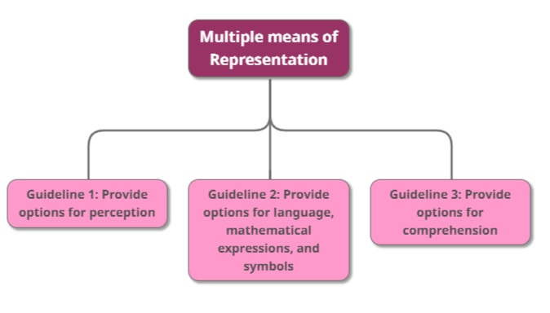
Universal Design for Learning
The
“WHAT”

Slide 6
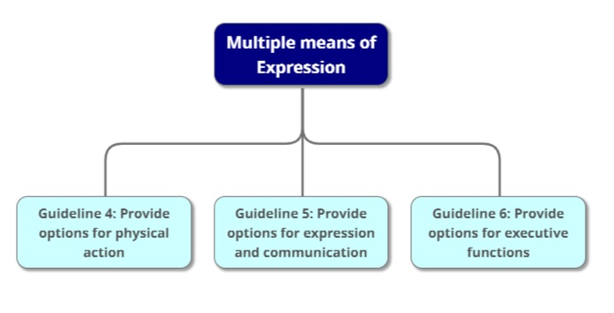
Universal Design for Learning
The
“HOW”

Slide 7
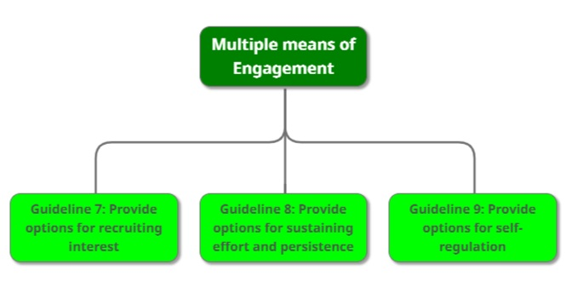
Universal Design for Learning
The
“WHY”

Slide 8
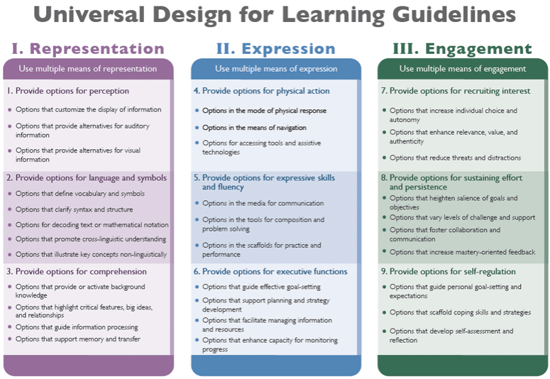

Slide 9
Universal Design for Learning
Multiple means of Representation
Guideline 1: Provide options for perception
Guideline 2: Provide options for language, mathematical expressions, and symbols
Guideline 3: Provide options for comprehension

Slide 10
Universal Design for Learning
Multiple means of Representation
Guideline 1: Provide options for perception
Checkpoint 1.1 – Offer ways of customizing the display of information
Checkpoint 1.2 - Offer alternatives for auditory information
Checkpoint 1.3 - Offer alternatives for visual information

Slide 11
Universal Design for Learning
Multiple means of Representation
Guideline 1: Provide options for perception
Checkpoint 1.1 – Offer ways of customizing the display of information
Checkpoint 1.2 - Offer alternatives for auditory information
Checkpoint 1.3 - Offer alternatives for visual information
e.g. change the font size, type, and colour. Also change the background
e.g. change the speed of a video or an audio file
e.g. create captions, and allow text-to-speech. Consider tactile interfaces
e.g. follow accessibility standards (DAISY, NIMAS, etc.)

Slide 12
Universal Design for Learning
Multiple means of Representation
Guideline 2: Provide options for language, mathematical expressions, and symbols
Checkpoint 2.1 - Clarify vocabulary and symbols
Checkpoint 2.2 - Clarify syntax and structure
Checkpoint 2.3 - Support decoding of text, mathematical notation, and symbols
Checkpoint 2.4 - Promote understanding across languages
Checkpoint 2.5 - Illustrate through multiple media

Slide 13
Universal Design for Learning
Multiple means of Representation
Guideline 2: Provide options for language, mathematical expressions, and symbols
Checkpoint 2.1 - Clarify vocabulary and symbols
Checkpoint 2.2 - Clarify syntax and structure
Checkpoint 2.3 - Support decoding of text, mathematical notation, and symbols
Checkpoint 2.4 - Promote understanding across languages
Checkpoint 2.5 - Illustrate through multiple media
e.g. pre-teach vocabulary and symbols, so that it connects to the students
e.g. make explicit links between parts of the teaching content
e.g. provide access to alternative representations of mathematical notations.
e.g. provide links to online translation tools and multilingual glossaries.

Slide 14
Universal Design for Learning
Multiple means of Representation
Guideline 3: Provide options for comprehension
Checkpoint 3.1 - Activate or supply background knowledge
Checkpoint 3.2 - Highlight patterns, critical features, big ideas, and relationships
Checkpoint 3.3 - Guide information processing, visualization, and manipulation
Checkpoint 3.4 - Maximize transfer and generalization

Slide 15
Universal Design for Learning
Multiple means of Representation
Guideline 3: Provide options for comprehension
Checkpoint 3.1 - Activate or supply background knowledge
Checkpoint 3.2 - Highlight patterns, critical features, big ideas, and relationships
Checkpoint 3.3 - Guide information processing, visualization, and manipulation
Checkpoint 3.4 - Maximize transfer and generalization
e.g. link topics to student’s previous knowledge and cross-curricular topics
e.g. to emphasise critical content, use multiple examples, and non-examples
e.g. “chunk” information into smaller elements, and memory mnemonics and tools
e.g. provide a visual organiser to show a sequence of topics, but give the students the choice of “entry-point”

Slide 16
Universal Design for Learning
Multiple means of Expression
Guideline 4: Provide options for physical action
Guideline 5: Provide options for expression and communication
Guideline 6: Provide options for executive functions

Slide 17
Universal Design for Learning
Multiple means of Expression
Guideline 4: Provide options for physical action
Checkpoint 4.1 - Vary the methods for response and navigation
Checkpoint 4.2 - Optimize access to tools and assistive technologies

Slide 18
Universal Design for Learning
Multiple means of Expression
Guideline 4: Provide options for physical action
Checkpoint 4.1 - Vary the methods for response and navigation
Checkpoint 4.2 - Optimize access to tools and assistive technologies
e.g. provide alternative ways of accessing content, in terms of rate, timing, and motor action.
e.g. provide alternative keystrokes for mouse actions, and access to alternative keyboards
e.g. only use software that works with a range of assistive technologies.
e.g. explore the use of switch and scanning access for your content.

Slide 19
Universal Design for Learning
Multiple means of Expression
Guideline 5: Provide options for expression and communication
Checkpoint 5.1 - Use multiple media for communication
Checkpoint 5.2 - Use multiple tools for construction and composition
Checkpoint 5.3 - Build fluencies with graduated levels of support for practice and performance

Slide 20
Universal Design for Learning
Multiple means of Expression
Guideline 5: Provide options for expression and communication
Checkpoint 5.1 - Use multiple media for communication
Checkpoint 5.2 - Use multiple tools for construction and composition
Checkpoint 5.3 - Build fluencies with graduated levels of support for practice and performance
e.g. consider using text, speech, drawing, film, music, dance, visual art, sculpture.
e.g. use social media, interactive web tools, simulations, chats, animations.
e.g. provide sample sentences, and sentence starters. Use concept mapping tools.
e.g. provide multiple model solutions to real problems, and differentiated feedback.

Slide 21
Universal Design for Learning
Multiple means of Expression
Guideline 6: Provide options for executive functions
Checkpoint 6.1 - Guide appropriate goal-setting
Checkpoint 6.2 - Support planning and strategy development
Checkpoint 6.3 - Facilitate managing information and resources
Checkpoint 6.4 - Enhance capacity for monitoring progress

Slide 22
Universal Design for Learning
Multiple means of Expression
Guideline 6: Provide options for executive functions
Checkpoint 6.1 - Guide appropriate goal-setting
Checkpoint 6.2 - Support planning and strategy development
Checkpoint 6.3 - Facilitate managing information and resources
Checkpoint 6.4 - Enhance capacity for monitoring progress
e.g. create guides and checksheets to identify milestones, and to help estimate effort.
e.g. create guides and checksheets to embed points to reflect at, and point to show your work.
e.g. create guides and checksheets for notetaking, and categorizing.
e.g. create guides and checksheets for self-assessment, and sample rubrics.

Slide 23
Universal Design for Learning
Multiple means of Engagement
Guideline 7: Provide options for recruiting interest
Guideline 8: Provide options for sustaining effort and persistence
Guideline 9: Provide options for self-regulation

Slide 24
Universal Design for Learning
Multiple means of Engagement
Guideline 7: Provide options for recruiting interest
Checkpoint 7.1 - Optimize individual choice and autonomy
Checkpoint 7.2 - Optimize relevance, value, and authenticity
Checkpoint 7.3 - Minimize threats and distractions

Slide 25
Universal Design for Learning
Multiple means of Engagement
Guideline 7: Provide options for recruiting interest
Checkpoint 7.1 - Optimize individual choice and autonomy
Checkpoint 7.2 - Optimize relevance, value, and authenticity
Checkpoint 7.3 - Minimize threats and distractions
e.g. provide students with choice in terms of challenge, rewards, timing of sub-tasks.
e.g. create activities that are personalized, relevant (culturally and socially), and ability appropriate.
e.g. create activities that foster problem solving, and encourage the use of imagination.
e.g. create a supportive and accepting classroom environment.

Slide 26
Universal Design for Learning
Multiple means of Engagement
Guideline 8: Provide options for sustaining effort and persistence
Checkpoint 8.1 - Heighten salience of goals and objectives
Checkpoint 8.2 - Vary demands and resources to optimize challenge
Checkpoint 8.3 - Foster collaboration and community
Checkpoint 8.4 - Increase mastery-oriented feedback

Slide 27
Universal Design for Learning
Multiple means of Engagement
Guideline 8: Provide options for sustaining effort and persistence
Checkpoint 8.1 - Heighten salience of goals and objectives
Checkpoint 8.2 - Vary demands and resources to optimize challenge
Checkpoint 8.3 - Foster collaboration and community
Checkpoint 8.4 - Increase mastery-oriented feedback
e.g. encourage students to define and focus on goals; and explore what excellence means.
e.g. focus less on external evaluation, and focus on effort and improvement in meeting standards.
e.g. use peer-review and peer-tutoring. Create rubrics and guides for groupwork.
e.g. provide feedback that is frequent, timely, and relevant. Also that emphasises effort and improvement.

Slide 28
Universal Design for Learning
Multiple means of Engagement
Guideline 9: Provide options for self-regulation
Checkpoint 9.1 - Promote expectations and beliefs that optimize motivation
Checkpoint 9.2 - Facilitate personal coping skills and strategies
Checkpoint 9.3 - Develop self-assessment and reflection

Slide 29
Universal Design for Learning
Multiple means of Engagement
Guideline 9: Provide options for self-regulation
Checkpoint 9.1 - Promote expectations and beliefs that optimize motivation
Checkpoint 9.2 - Facilitate personal coping skills and strategies
Checkpoint 9.3 - Develop self-assessment and reflection
e.g. create guides and checksheets to reduce frustration, and to keep on-task in spite of distractions.
e.g. use real life examples or simulations to demonstrate coping skills.
e.g. assist students in overcoming specific topics that they have phobias about.
e.g. assist the students in identifying their personal goals, and their own strengths and weaknesses.

