Slide 1
Universal Design for Learning: Multiple Means of Representation

Slide 2
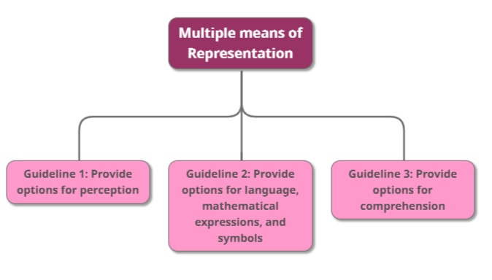
Universal Design for Learning
The
“WHAT”

Slide 3
Universal Design for Learning
Multiple means of Representation
Guideline 1: Provide options for perception
Guideline 2: Provide options for language, mathematical expressions, and symbols
Guideline 3: Provide options for comprehension

Slide 4
Universal Design for Learning
Multiple means of Representation
Guideline 1: Provide options for perception
Checkpoint 1.1 – Offer ways of customizing the display of information
Checkpoint 1.2 - Offer alternatives for auditory information
Checkpoint 1.3 - Offer alternatives for visual information

Slide 5
Universal Design for Learning
Multiple means of Representation
Guideline 1: Provide options for perception
Checkpoint 1.1 – Offer ways of customizing the display of information
Checkpoint 1.2 - Offer alternatives for auditory information
Checkpoint 1.3 - Offer alternatives for visual information
e.g. change the font size, type, and colour. Also change the background
e.g. change the speed of a video or an audio file
e.g. create captions, and allow text-to-speech. Consider tactile interfaces
e.g. follow accessibility standards (DAISY, NIMAS, etc.)

Slide 6
Universal Design for Learning
Multiple means of Representation
Guideline 2: Provide options for language, mathematical expressions, and symbols
Checkpoint 2.1 - Clarify vocabulary and symbols
Checkpoint 2.2 - Clarify syntax and structure
Checkpoint 2.3 - Support decoding of text, mathematical notation, and symbols
Checkpoint 2.4 - Promote understanding across languages
Checkpoint 2.5 - Illustrate through multiple media

Slide 7
Universal Design for Learning
Multiple means of Representation
Guideline 2: Provide options for language, mathematical expressions, and symbols
Checkpoint 2.1 - Clarify vocabulary and symbols
Checkpoint 2.2 - Clarify syntax and structure
Checkpoint 2.3 - Support decoding of text, mathematical notation, and symbols
Checkpoint 2.4 - Promote understanding across languages
Checkpoint 2.5 - Illustrate through multiple media
e.g. pre-teach vocabulary and symbols, so that it connects to the students
e.g. make explicit links between parts of the teaching content
e.g. provide access to alternative representations of mathematical notations.
e.g. provide links to online translation tools and multilingual glossaries.

Slide 8
Universal Design for Learning
Multiple means of Representation
Guideline 3: Provide options for comprehension
Checkpoint 3.1 - Activate or supply background knowledge
Checkpoint 3.2 - Highlight patterns, critical features, big ideas, and relationships
Checkpoint 3.3 - Guide information processing, visualization, and manipulation
Checkpoint 3.4 - Maximize transfer and generalization

Slide 9
Universal Design for Learning
Multiple means of Representation
Guideline 3: Provide options for comprehension
Checkpoint 3.1 - Activate or supply background knowledge
Checkpoint 3.2 - Highlight patterns, critical features, big ideas, and relationships
Checkpoint 3.3 - Guide information processing, visualization, and manipulation
Checkpoint 3.4 - Maximize transfer and generalization
e.g. link topics to student’s previous knowledge and cross-curricular topics
e.g. to emphasise critical content, use multiple examples, and non-examples
e.g. “chunk” information into smaller elements, and memory mnemonics and tools
e.g. provide a visual organiser to show a sequence of topics, but give the students the choice of “entry-point”

