Slide 1
Universal Design for Learning

Slide 2
Universal Design for Learning
CAST members, Anne Meyer and David Rose developed the principles of UDL in the late 1990s as a framework to improve and optimize teaching and learning for all people based on scientific insights into how humans learn.

Slide 3
Universal Design for Learning
The UDL Guidelines can be used by educators, curriculum developers, researchers, parents, and anyone else who wants to implement the UDL framework in a learning environment. These guidelines offer a set of concrete suggestions that can be applied to any discipline or domain to ensure that all learners can access and participate in meaningful, challenging learning opportunities.

Slide 4
Universal Design for Learning
The UDL Guidelines suggests:
Multiple means of Representation: To give learners various ways of acquiring information and knowledge,
Multiple means of Expression: to provide learners alternatives for demonstrating what they know
Multiple means of Engagement: to tap into learners' interests, offer appropriate challenges, and increase motivation.

Slide 5
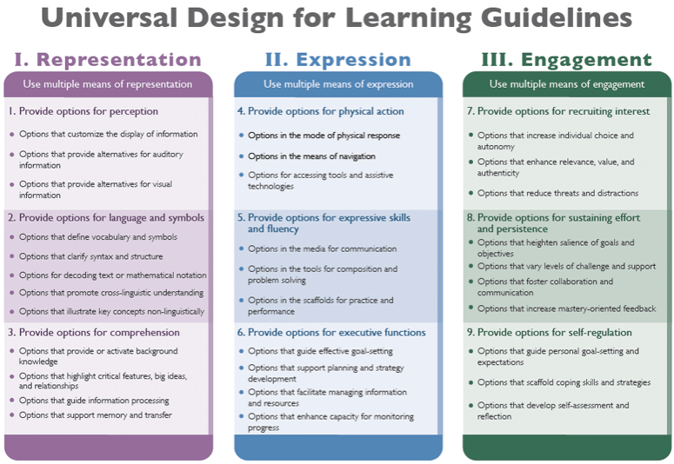

Slide 6
Universal Design for Learning
Multiple means of Representation
Guideline 1: Provide options for perception
Guideline 2: Provide options for language, mathematical expressions, and symbols
Guideline 3: Provide options for comprehension

Slide 7
Universal Design for Learning
Multiple means of Expression
Guideline 4: Provide options for physical action
Guideline 5: Provide options for expression and communication
Guideline 6: Provide options for executive functions

Slide 8
Universal Design for Learning
Multiple means of Engagement
Guideline 7: Provide options for recruiting interest
Guideline 8: Provide options for sustaining effort and persistence
Guideline 9: Provide options for self-regulation

Slide 9
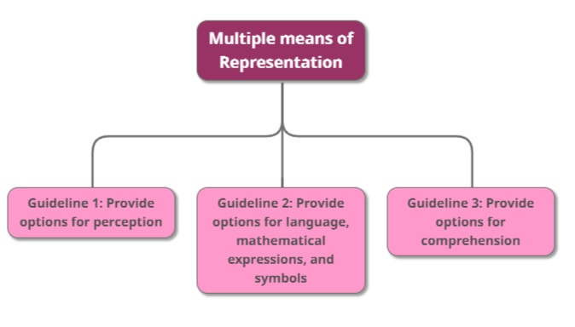
Universal Design for Learning
The
“WHAT”

Slide 10
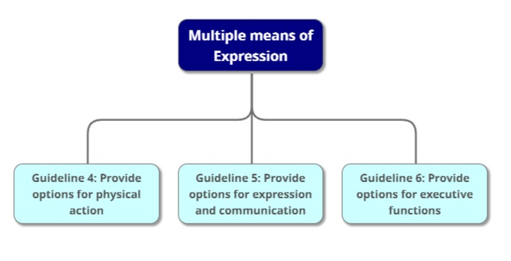
Universal Design for Learning
The
“HOW”

Slide 11
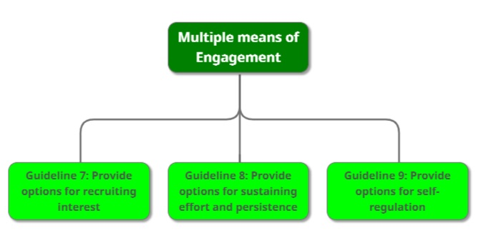
Universal Design for Learning
The
“WHY”

