Slide 1
Writing Learning Outcomes
Damian Gordon

Slide 2
Learning Outcomes
We’ve seen some of these already:

Slide 3
Learning Outcomes
On successful completion of this module the learner will be able to:
Demonstrate a clear understanding of the philosophy and principles of Universal Design for Learning and how they relate to a variety of educational standards, regulations and guidelines.
Critically assess designs for existing educational content according to the principles and philosophy of Universal Design for Learning.

Slide 4
Learning Outcomes
How to write Learning outcomes:
We typically write 3-7 learning outcomes
We begin with a verb (one of Bloom’s)
Limit the length of each learning outcome to about 400 characters
Exclude special characters (e.g., accents, umlats, ampersands, etc.)
Exclude special formatting (e.g., dashes, numbering, etc.)

Slide 5
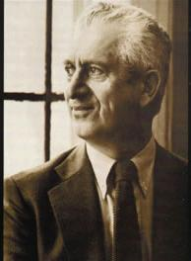
Benjamin S. Bloom
Born: Feb 21, 1913
Died: Sept 13, 1999
Born in Lansford, Pennsylvania.
Educational psychologist
Editor of “Taxonomy of Educational Objectives, Handbook 1: Cognitive Domain” (1956)

Slide 6
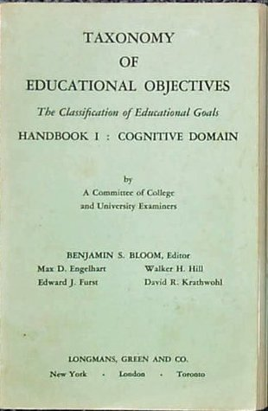
Bloom’s Taxonomy
In 1956 Bloom helped developed a taxonomy of cognitive objectives in “Taxonomy of Educational Objectives, Handbook 1”
As a means of expressing qualitatively different kinds of thinking

Slide 7
Bloom’s Taxonomy
It’s been adapted for classroom use as a planning tool and is one of the most universally applied models Provides a way of organizing thinking skills into six levels, from basic to the more complex levels of thinking

Slide 8
Bloom’s Taxonomy
Evaluation
Synthesis
Analysis
Application
Comprehension
Knowledge
Higher Order
Thinking

Slide 9
Bloom’s Taxonomy
Evaluation: compare and discriminate between ideas, assess value of theories, presentations make choices based on reasoned argument, verify value of evidence, recognize subjectivity

Slide 10
Bloom’s Taxonomy
Synthesis: use old ideas to create new ones, generalize from given facts, relate knowledge from several areas, predict, draw conclusions

Slide 11
Bloom’s Taxonomy
Analysis: seeing patterns, organization of parts, recognition of hidden meanings, identification of components

Slide 12
Bloom’s Taxonomy
Application: use information use methods, concepts, theories in new situations, solve problems using required skills or knowledge

Slide 13
Bloom’s Taxonomy
Comprehension: understanding information, grasp meaning, translate knowledge into new context

Slide 14
Bloom’s Taxonomy
Knowledge: observation and recall of information, knowledge of dates, events, places knowledge of major ideas

Slide 15
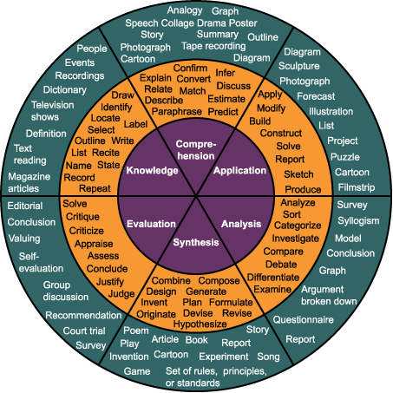
Bloom’s Taxonomy

Slide 16
Bloom’s Taxonomy
Evaluation: appraise, argue, assess, attach, choose, compare, defend estimate, judge, predict, rate, score, select, support, value

Slide 17
Bloom’s Taxonomy
Synthesis: arrange, assemble, collect, compose, construct, create, design, develop, formulate, manage, organize, plan, prepare

Slide 18
Bloom’s Taxonomy
Analysis: analyze, appraise, calculate, categorize, compare, contrast, criticize, differentiate, discriminate, distinguish, examine

Slide 19
Bloom’s Taxonomy
Application: apply, choose, demonstrate, dramatize, employ, illustrate, interpret, operate, practice, schedule, sketch, solve, use

Slide 20
Bloom’s Taxonomy
Comprehension: classify, describe, discuss, explain, express, identify, indicate, locate, recognize, report, restate, review

Slide 21
Bloom’s Taxonomy
Knowledge: arrange, define, duplicate, label, list, memorize, name, order, recognize, relate, recall, repeat, reproduce, state

Slide 22
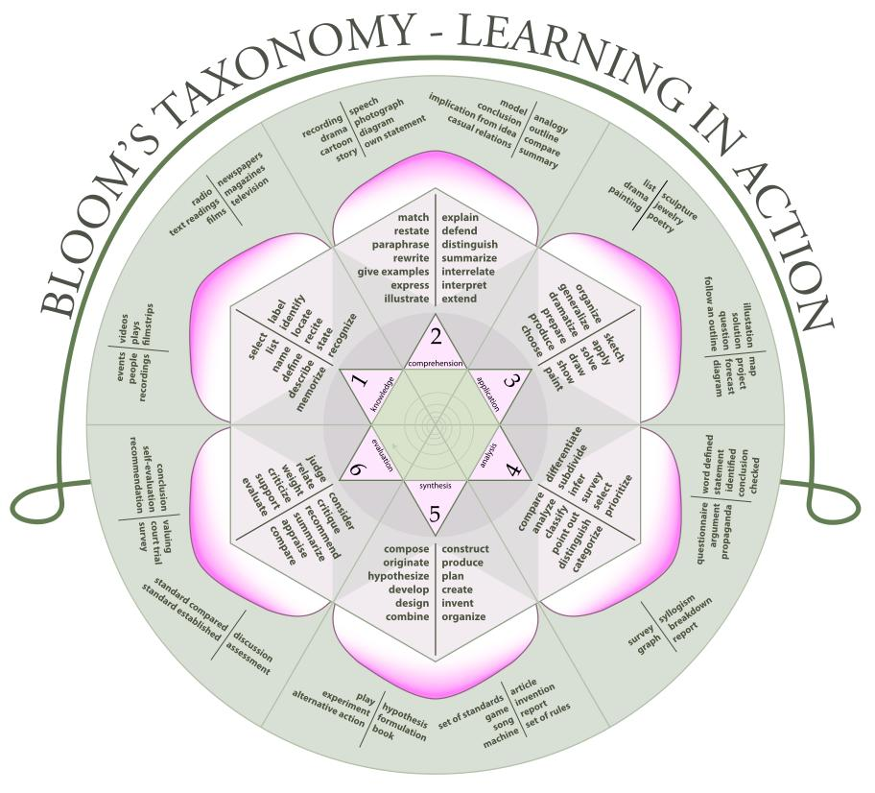

Slide 23
Evaluation
Synthesis
Analysis
Application
Comprehension
Knowledge

Slide 24
Evaluation
Analysis
Synthesis
Application
Comprehension
Knowledge

