Slide 1
Equitable Use

Slide 2
Equitable Use
The design is useful and marketable to people with diverse abilities.

Slide 3
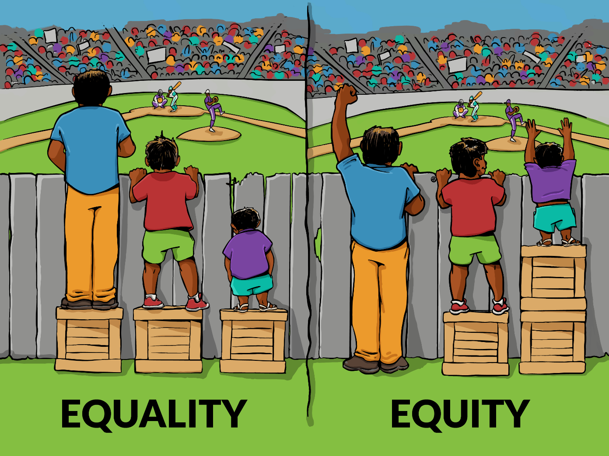
Equitable Use

Slide 4
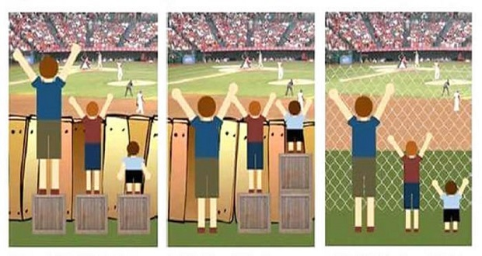
Equitable Use

Slide 5
Equitable Use

Slide 6
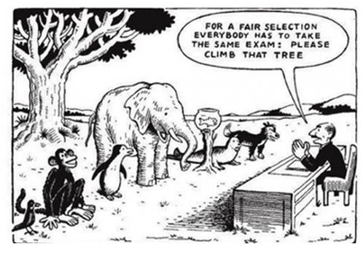
Equitable Use

Slide 7
Equitable Use
Provide the same means of use for all users: identical whenever possible; equivalent when not.
Avoid segregating or stigmatising any users.
Provisions for privacy, security, and safety should be equally available to all users.
Make the design appealing to all users.

Slide 8
Evaluate these designs
Identify
Positive aspects
Negative aspects
Opportunities to apply positive aspects of this design to other designs

Slide 9
Evaluate these designs
Do they:
Provide the same means of use for all users: identical whenever possible; equivalent when not?

Slide 10
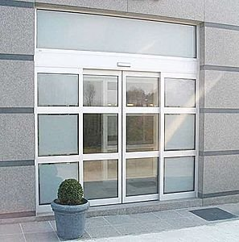
Provide the same means of use for all users: identical whenever possible; equivalent when not.
Principle 1: Equitable Use
Notes:
Automatic doors which allows people to easily enter and exit a building.

Slide 11
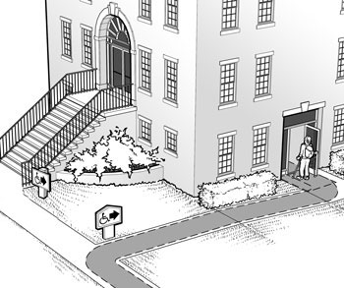
Provide the same means of use for all users: identical whenever possible; equivalent when not.
Principle 1: Equitable Use
Notes:
Step free entrance around the back, forcing someone who cannot use steps to enter through a delivery entrance.

Slide 12
Evaluate these designs
Do they:
Avoid segregating or stigmatizing any users?

Slide 13
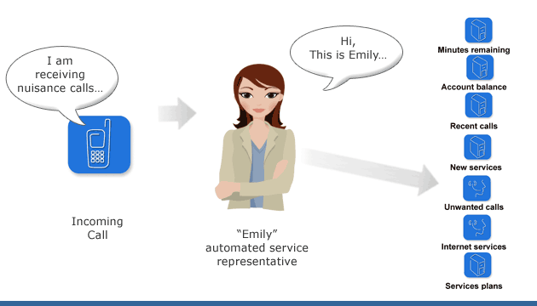
Avoid segregating or stigmatising any users.
Principle 1: Equitable Use
Notes:
A choice of a number of different communication options available to customers

Slide 14
Avoid segregating or stigmatising any users.
Principle 1: Equitable Use
Notes:
A discount only available to users who are online.

Slide 15
Avoid segregating or stigmatising any users.
Principle 1: Equitable Use
= €€€
Notes:
Having to pay extra for specialised features, for example the high cost of screen reader software for PC users.

Slide 16
Evaluate these designs
Do they:
Make provisions for privacy, security, and safety to be equally available to all users?

Slide 17
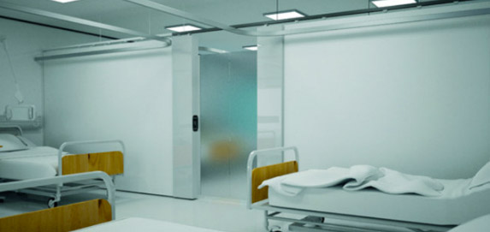
Make provisions for privacy, security, and safety to be equally available to all users
Principle 1: Equitable Use
Notes:
In day surgeries, where the relative numbers of male and female patients are constantly changing, it’s hard to maintain privacy for all patients. This screen provides flexibility for hospital staff to change the layouts of wards at short notice while maintaining privacy.

Slide 18
Make provisions for privacy, security, and safety to be equally available to all users
Principle 1: Equitable Use
Notes:
The security feature called a CAPTCHA prevents forms from being automatically filled in, the nature of CAPTCHA (keeping unauthorised people out) means that sometimes the form is rendered inaccessible to genuine users with low vision or no vision. Some sites offer alternative options ranging from a new image to audio authorisation.

Slide 19
Evaluate these designs
Do they:
Make the design appealing to all users?

Slide 20
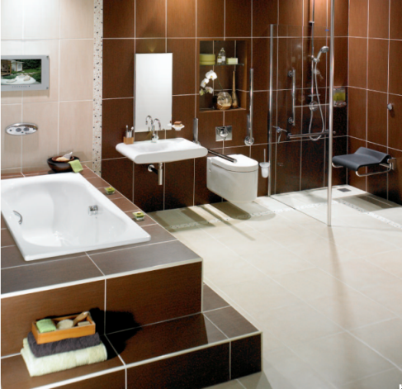
Make the design appealing to all users
Principle 1: Equitable Use
Notes:
Fixtures and fittings in a bathroom which are attractive but also act as grabrails.

Slide 21
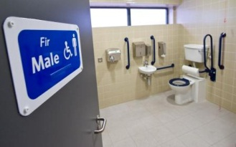
Make the design appealing to all users
Principle 1: Equitable Use
Notes:
Medical looking grabrails installed in accessible houses.

Slide 22
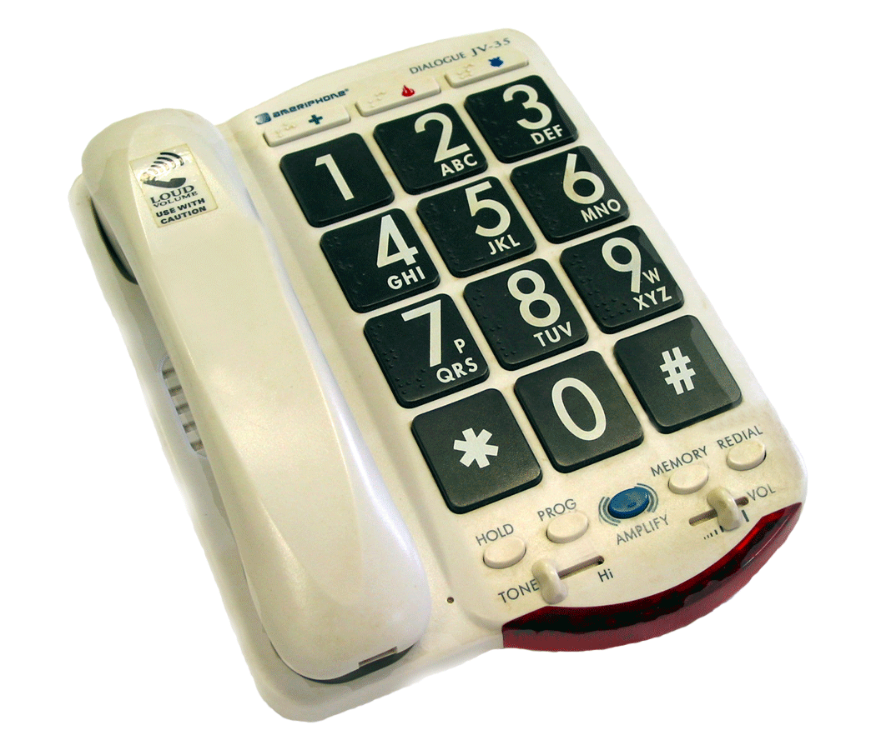
Make the design appealing to all users
Principle 1: Equitable Use
Notes:
A phone designed specifically for people with low vision, which looks like a "special phone".

Slide 23
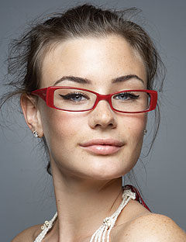
Make the design appealing to all users
Principle 1: Equitable Use
Notes:
Attractive glasses

Slide 24
Discussion
What should we look for in better designs?
What should we avoid in better designs?
Notes:
Conduct an in-class discussion on the aspects of design we should look for.
This can be used to build an ongoing catalogue of evaluations.

Slide 25
A good design is…
As usable for me as it is for anyone else.
One which doesn’t make me feel segregated or stigmatised.
One which gives me needed privacy, security, and safety.
One which appeals to me.
Notes:
Class discussion

