Slide 1
Personas
Damian Gordon

Slide 2
Personas
A persona is a fictional character that can be used to represent a collection of some of the kinds of people who could potentially be using a particular design.

Slide 3
Personas
Typically in user-centred design the designers will use several personas to test the viability of a design. The personas allow the designers to consider the range of stakeholders that might be using their designs, and allows the designer to look at their designs from these stakeholders’ perspectives.

Slide 4
Personas
The need for personas was initially identified in the mid-1990s in the marketing sector, followed quickly by the software sector, and then quickly spreading to a range of design disciplines.

Slide 5
Personas
Benefits that have been suggested for personas include a suggestion that for designers working in groups, they are given a common, consistent understanding of the dimensions of diversity and can communicate and brainstorm more effectively about diversity to each other. It also allows the designers to focus on the users of their design and encourages the designers to learn more about those users and understand how they will use the design.

Slide 6
Personas
Some researchers have criticised the use of personas by indicating that for evaluating a design, the use of real customers who will be using the design is more realistic and preferable to the use of personas which are fictional characters. There is no doubt that using a wide range of real customers is one of the strongest forms of evaluation, but there are many cases where this is not possible, and personas are an effective alternative.

Slide 7
Personas
Some scientific studies (e.g. Frank Long, 2009, “Real or Imaginary: The effectiveness of using personas in product design”) on the use of personas have shown that personas can result in more usable designs, more user-centred discussions, and more effective communication in design teams.

Slide 8
Meet the Normals
Damian Gordon

Slide 9
Universal Design
The design of products, environments, programmes and services to be usable by all people, to the greatest extent possible, without the need for adaptation or specialised design.

Slide 10
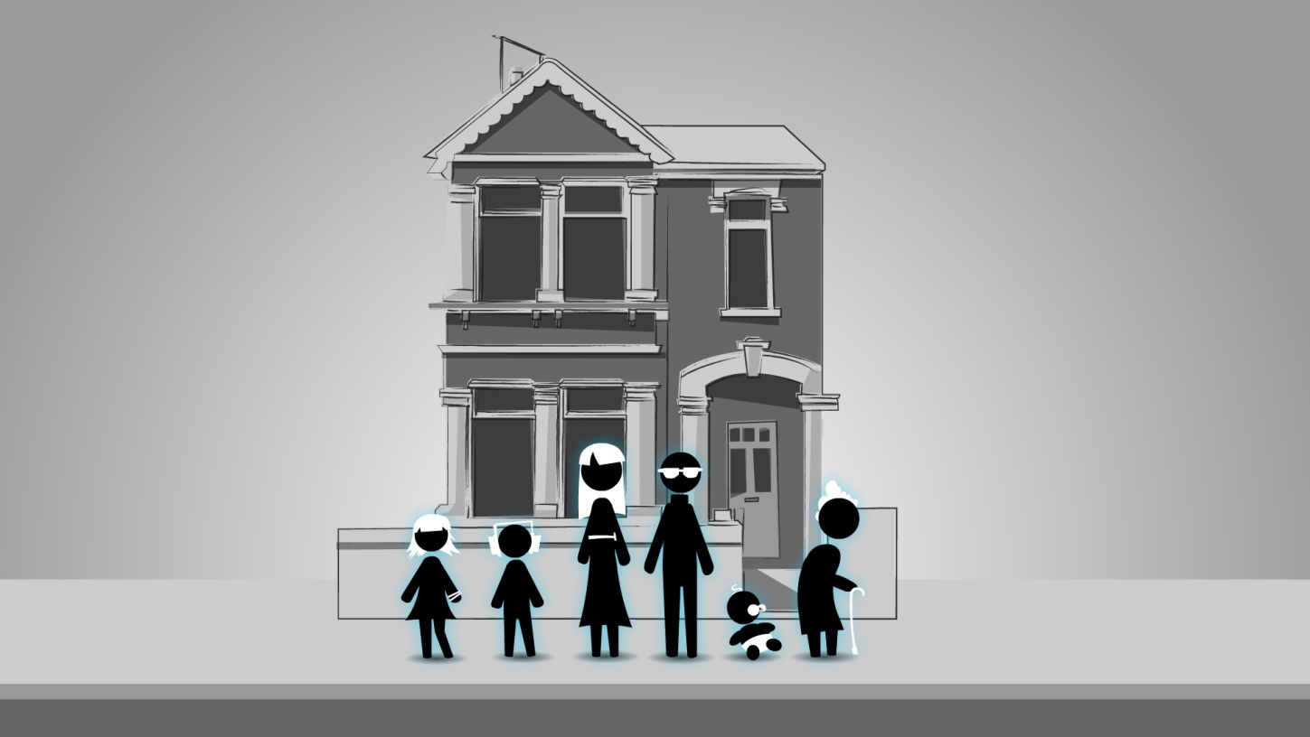
“by all people, to the greatest extent possible”
The Normals

Slide 11
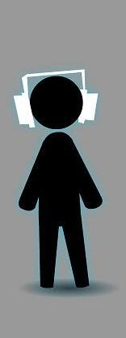
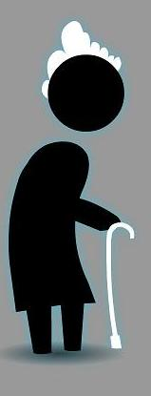
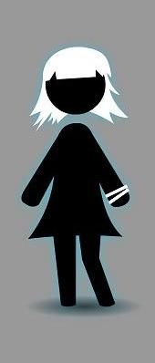
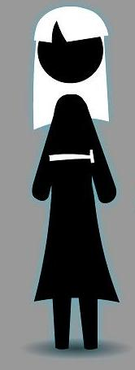
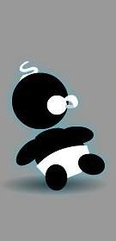
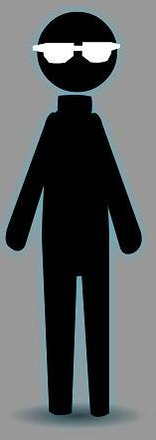
Focus

Slide 12
Betty Normal
Name: Elizabeth “Betty” Normal
Age: 69 years old
Size: 5’6”

Slide 13
Betty Normal
Betty is the grandparent of the family; she is Harry's mother. She is somewhat slow moving and sometimes uses a walker or a cane, but is very active. She is an exceptionally intelligent person, with an incredible memory for events that occurred decades ago, and has a natural affinity for mathematics that she passed onto her son. Think of her as being like Jessica Fletcher from “Murder, She Wrote”.

Slide 14
Betty Normal
She lives in the Normal family home in her own “granny annex” where she keeps her small astronomical telescope; one of her many hobbies is amateur astronomy. She is beginning to experience mild hearing impairment, but it isn’t letting it impact her significantly, and has developed mild arthritis in her left knee, hence the need for a walker or cane.

Slide 15
Betty Normal
Nonetheless she likes to play the Wii regularly with her grandchildren, and has recently taken up painting based on Mary’s encouragement, Betty has been painting some of her favourite starscapes, which she does with Mary and Johnny’s help.

Slide 16
Mary Normal
Name: Mary Normal
Age: 34 years old
Size: 6’2”

Slide 17
Mary Normal
Mary is the mother of the family; she works as a manager in the local supermarket, and works Tuesday to Saturday. She enjoys her job a great deal and has a natural authority about her that makes her a natural leader, and constantly supports and enthuses her staff in doing their jobs.

Slide 18
Mary Normal
She is left-handed, which makes using office scissors and winding her wrist watch awkward. She is also the tallest member of the family. She has recently discovered that she has a mild gluten allergy, and keeps an eye on what she eats.

Slide 19
Mary Normal
She is an avid painter and has been most of her life; her enthusiasm has spread to Betty and Johnny, and now the three of them have regular sessions where they all paint together.

Slide 20
Mary Normal
She has a degree in Business and is constantly reminding her children of the importance of education for their future. She is the stricter of the two parents but is never unfair or overly hard, but she occasionally switches into her “manager” personality at home dealing with the children.

Slide 21
Harry Normal
Name: Harold “Harry” Normal
Age: 36 years old
Size: 6’0”

Slide 22
Harry Normal
Harry is the father of the family, he is a stay-at-home dad who looks after the children and takes care of the house. He really enjoys being able to spend time with his children and is a wonderful father who loves his children dearly.

Slide 23
Harry Normal
He also loves cooking and likes trying out new recipes on the family which are usually very successful. Although his mother, Betty, has her own cooking facilities in her “granny annex” Harry insists that the whole family have dinner together each night, which Betty loves.

Slide 24
Harry Normal
He is a qualified maths teacher and taught for five years, but he is finding his home life more preferable, personally and financially for the family. He keeps up to date on mathematics research and is writing a book focussing on Riemannian geometry. He also loves watching quiz shows on television, and is colour blind.

Slide 25
Susie Normal
Name: Susan “Susie” Normal
Age: 18 years old
Size: 5’8”

Slide 26
Susie Normal
Susie just turned 18 years old last week, and is in first year in college where she is doing a degree in Universal Design. She is actively involved in the Students’ Union and is a member of several of the college societies.

Slide 27
Susie Normal
She has just moved from home into a flat (which is 35 miles away from her home) with two flatmates who were friends of hers in secondary school. She is finding the changes going on in her life a significant adjustment but is getting on with it.

Slide 28
Susie Normal
Susie wears glasses to read, and loves music so she is rarely seen without her iPod and guitar. She also loves going to bingo with her father and grandmother every Tuesday evening, which is something that she is convinced would ruin her “street credit” in college if anyone ever found out.

Slide 29
Johnny Normal
Name: Jonathan “Johnny” Normal
Age: 10 years old
Size: 5’4”

Slide 30
Johnny Normal
Johnny is 10 years old, and he is going to primary school where his favourite subjects are Art, Music and History. He has a natural talent for art and loves painting alongside his mother Mary and his grandmother Betty.

Slide 31
Johnny Normal
Whereas Betty’s paintings are always very realistic, and Mary’s are often abstract in style (Cubist), Johnny can easily turn his hand to any style of painting, but he mostly loves creating paintings and drawings of superheroes fighting monsters based on the comics he reads. He has a similar passion for music and listens to his iPod all the time just like his older sister.

Slide 32
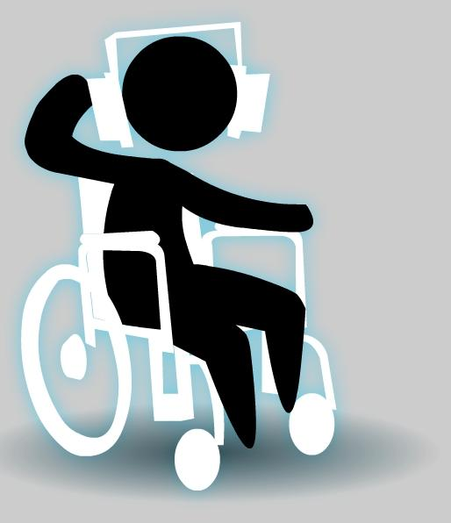
Johnny Normal
He has a few close friends that he likes to hang around with, and gets up to the usual things with them: discussing comics and music, wondering what the big deal about girls is, and telling jokes. Johnny does not have the use of his legs, and uses a manual wheelchair for mobility.

Slide 33
P.J. Normal
Name: Patrick Joseph “P.J.” Normal
Age: 1 year old
Size: 1’6”

Slide 34
P.J. Normal
P.J. is the baby of the family, he is 1 year old. He is a surprisingly calm baby and often his facial expressions suggest that he understands a lot more of what is going on in the world around him than you would expect for a baby. He is also absorbed by the world around him; the sights, the sounds, and the smells are all new to him and each new discovery is fascinating to him.

Slide 35
P.J. Normal
If there is one thing you will never see P.J. without, it is his blue blanket, he loves it very much and finds a myriad of uses for it: the simplest of which is keeping him warm, he also likes to bundle it up and pretend that it is a teddy bear, and he loves to put it on his head when he needs to hide from people.

Slide 36
P.J. Normal
As P.J. has only taken his first steps a few weeks ago, and finds the whole “walking” thing a big drag, he is usually pushed around in a pram.

Slide 37
Discussion
Which of the Normals are:
Normal?
Average?
Whose fault is it is a member of the Normal family can’t use a design?
Notes:
Key point – diversity is the norm – designing for the average is a flawed approach and will exclude others.

