Slide 1
Universal Design
Damian Gordon

Slide 2
Design
What makes a design bad?
Notes:
Again, this should lead to discussion, leading to points such as:
Usability
Utility
Attractiveness
Interesting to start discussion on points such as:
Cost
Simplicity

Slide 3

Bad Designs
"Photograph courtesy of Baddesigns.Com"
Darnell, M. J. (2006). Bad Human Factors Designs. Baddesigns.Com
Notes:
Here is another example of manufacturers packaging different stuff in nearly identical bottles. The example shows two bottles containing different doses of insulin for treating diabetes. In this case, the consequences of choosing the wrong bottle are much more serious. You could end up in the hospital. The bottle on the left contains Insulin R (for Regular Insulin). Regular Insulin acts relatively fast (over a 4 to 6 hour period) and is generally meant to be taken before a meal. The bottle on the right contains Insulin N (for NPH Insulin). NPH Insulin acts over a broader span of time and more slowly (e.g., a 12 to 18 hour period) and is meant to be taken generally once or twice during a 24 hour period to keep a diabetics' blood glucose from rising significantly.
Many diabetics use R (regular) insulin in conjunction with N or some other long-acting insulin. The consequences of accidently taking Insulin R instead of Insulin N at bedtime would be serious because you could end up having a hypoglycemic reaction during the middle of the night (i.e., extremely low blood glucose levels). Thus, choosing the wrong insulin could be a very serious and possibly deadly mistake.

Slide 4
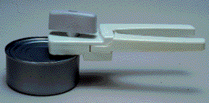
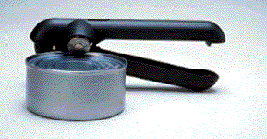
Bad Designs
"Photograph courtesy of Baddesigns.Com"
Darnell, M. J. (2006). Bad Human Factors Designs. Baddesigns.Com
Notes:
One's experience with common everyday objects creates expectations about how other similar devices work. There are dozens of can openers on the market and most work in exactly the same way: they cut around the inside rim of the lid leaving the rim intact with the can and a sharp-edged lid upon opening.
Another less common type of can opener cuts sideways into the can just below the rim. When a can is opened, the sharp edge is on the can itself while the rim remains with the lid. One advantage of the the latter is that the lid doesn't fall into the contents of the can. On the other hand, because the lid doesn't fall within the can, it isn't as convenient for draining away any undesired liquid.

Slide 5
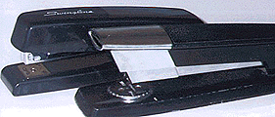
Bad Designs
"Photograph courtesy of Baddesigns.Com"
Darnell, M. J. (2006). Bad Human Factors Designs. Baddesigns.Com
Notes:
One of these staplers is more difficult to use than the other. The nearer one is harder to line up from above because the handle blocks your view of where the staples come out. As a result, when you use the stapler you sometimes miss the paper.

Slide 6
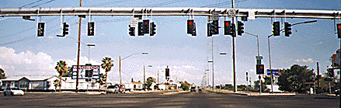
Bad Designs
"Photograph courtesy of Baddesigns.Com"
Darnell, M. J. (2006). Bad Human Factors Designs. Baddesigns.Com
Notes:
I saw this group of stop lights during a long drive from Los Angeles to Houston. The city that the stop lights are in was in the middle of a wide-open desert (like many things between LA and Houston.) The contrast between the empty desert and the stimulus-rich intersection was a little overwhelming; I was a little stunned and confused as to where I should be looking.
It looks as if the people designing the stop lights were counting on the fact that a driver can only see the "business end" of one set of lights at time. Although this is true, having extra sets of stop light housings forces the driver to sort out a lot of visual noise.

Slide 7
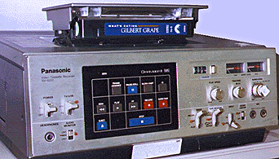
Bad Designs
"Photograph courtesy of Baddesigns.Com"
Darnell, M. J. (2006). Bad Human Factors Designs. Baddesigns.Com
Notes:
This picture shows a top-loading VCR (video cassette recorder). You don't see this style of VCR much anymore. I don't think it's a very good design because you can't put anything on top of the VCR. Like a TV. You also can't put it in a shelf very easily because there has to be room above it to load tapes. This design is not suited to where people want to put their VCRs. It needs to be able to be put into a small space or to have something placed on top of it.

Slide 8
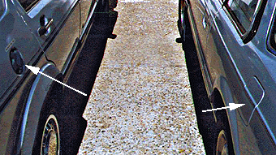
Bad Designs
"Photograph courtesy of Baddesigns.Com"
Darnell, M. J. (2006). Bad Human Factors Designs. Baddesigns.Com
Notes:
Every time we go to the gas station we have to remember which side of the car the gas cap is on so we know which side of the gas pump to pull up to. This seems to be more difficult than necessary to remember. This picture shows why. The gas cap is on the right side of one of our cars and on the left side of the other. No wonder it is hard to remember!

Slide 9
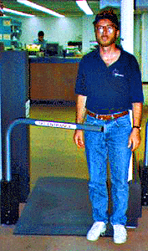
Bad Designs
"Photograph courtesy of Baddesigns.Com"
Darnell, M. J. (2006). Bad Human Factors Designs. Baddesigns.Com
Notes:
There is a gate at this library consisting of a metal bar. It is to keep you from leaving with books you haven't checked out. I get real nervous when I walk through the gate; I think it's the height of the metal bar. If you tried to walk out with an unchecked book, the gate would lock closed. Can you imagine walking into the locked gate with the bar at this height?

Slide 10
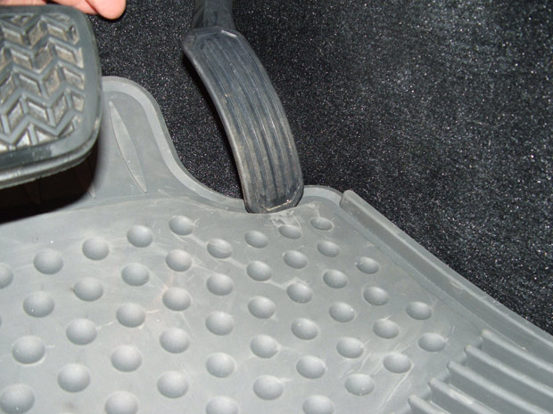
Cost of Bad Designs
In 2009 Toyota had to recall about 3.8 million cars and trucks to reshape and/or replace the accelerator pedals. The design of the accelerator pedal in combination with loose floormats may have resulted in the accelerator pedal getting stuck.

Slide 11
Cost of Bad Designs
In 2011 they had to recall a further 2.2 million cars and trucks because of the same issue.

Slide 12
Universal Design

Slide 13
Universal Design
Universal Design is the design and composition of an environment so that it can be accessed, understood and used to the greatest extent possible by all people regardless of their age, size or disability
  Irish Disability Act, 2005

Slide 14
Universal Design
Universal Design means…
  Design Once
  Include All
It is not (just) about disability
It is about usability for all

Slide 15
Universal Design
Inclusive Design
Design for All
User Needs Design
User-Centred Design
Human-Centred Design
Barrier-Free Design
Accessible Design
Adaptable Design
Transgenerational design
Design for a Broader Average

Slide 16
Universal Design
Universal design is an approach to design that honours human diversity. It addresses the right for everyone – from childhood into their oldest years – to use all spaces, products and information, in an independent, inclusive and equal way. It is a process that invites designers to go beyond compliance with access codes, to create excellent, people centred design.
  Elaine Ostroff

Slide 17
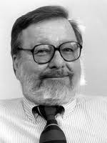
Universal Design
Ron Mace (1941-1998), an architect who helped create the first building code for accessibility in the US in 1973 that first became mandatory in North Carolina, and quickly spread to all other states.

Slide 18
Universal Design
His work on accessibility lead him in the mid-1980s to conceive of a new approach to design that he called “Universal Design” which he said was “The design of products and environments to be usable by all people, to the greatest extent possible, without the need for adaptation or specialized design.” In 1989, Ron established the federally-funded Center for Accessible Housing, currently known as The Center for Universal Design, at the School of Design at North Carolina State University in Raleigh.

Slide 19
Universal Design for Learning
In parallel, five clinicians from North Shore Children’s Hospital in Salem, MA—Anne Meyer, David Rose, Grace Meo, Skip Stahl and Linda Mensing—met at a local pizza parlor and conceived of the Center for Applied Special Technology (CAST).
With an anonymous grant of $15,000, CAST is founded at North Shore Children’s Hospital. The focus: How can computer technology enhance learning for students with learning disabilities?

Slide 20
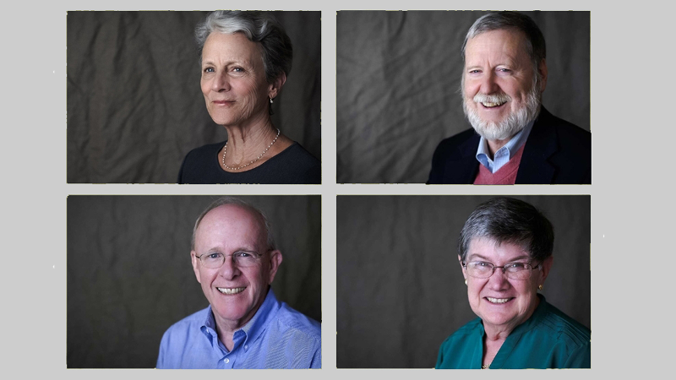
Universal Design for Learning
Anne Meyer, David Rose, Skip Stahl, Grace Meo

Slide 21
Universal Design for Learning
In1988 CAST develops the Equal Access program with the goal of equalizing access to the curriculum through technology. This new focus on “fixing” the curriculum rather than addressing individual student needs sows the seeds for Universal Design for Learning.
By 1995 CAST begins to articulate the concept of Universal Design for Learning in talks and presentations.

Slide 22
The Principles of Universal Design
Equitable Use
Flexibility in Use
Simple and Intuitive
Perceptible Information
Tolerance for Error
Low Physical Effort
Size and Space for Approach and Use

Slide 23
Equitable Use

Slide 24
1: Equitable Use
Provide the same means of use for all users: identical whenever possible; equivalent when not
Avoid segregating or stigmatising any users
Provisions for privacy, security and safety should be equally available to all users
Make the design appealing to all users
Notes:
Principle 1: Equitable Use – The design is useful and marketable to any group of users
Provide the same means of use for all users: identical whenever possible; equivalent when not
Avoid segregating or stigmatising any users
Provisions for privacy, security and safety should be equally available to all users
Make the design appealing to all users

Slide 25
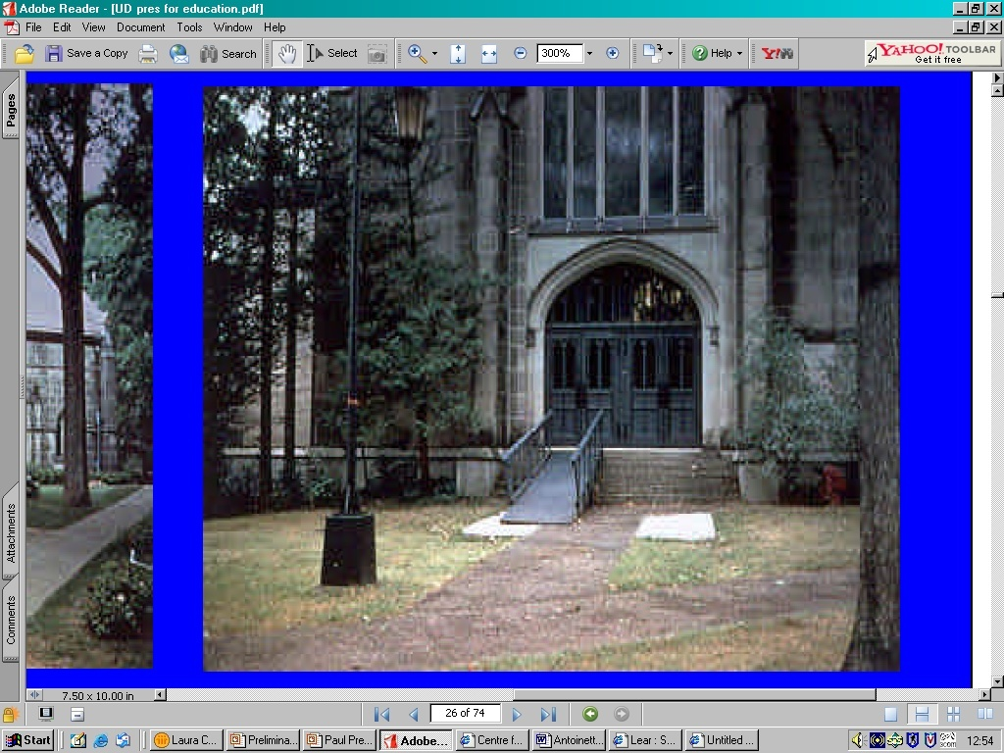
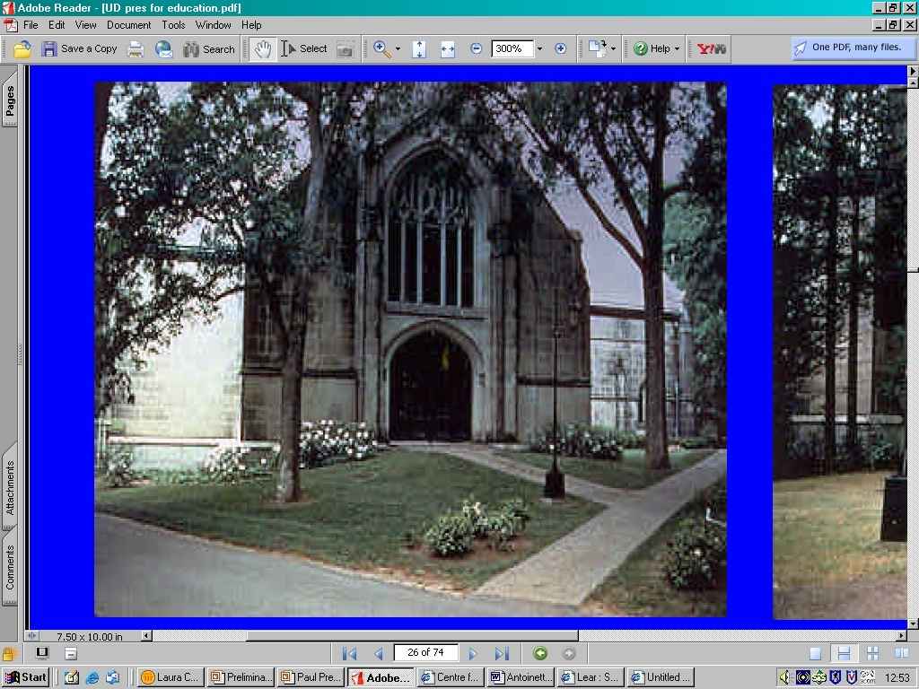
1: Equitable Use
Notes:
Principle1: Equitable Use: The design is useful and marketable to people with diverse abilities:
Can everyone use the same entrance?
The image on the left shows the entrance to a college library. There is a metal, stigmatising ramp laid over the front steps – not a very attractive or welcoming entry.
The image on the right shows the renovated entrance. This is a good example of Universal Design. The area surrounding the entrance has been landscaped, eliminating the need for the steps and creating a gentle grade that everyone can use.

Slide 26
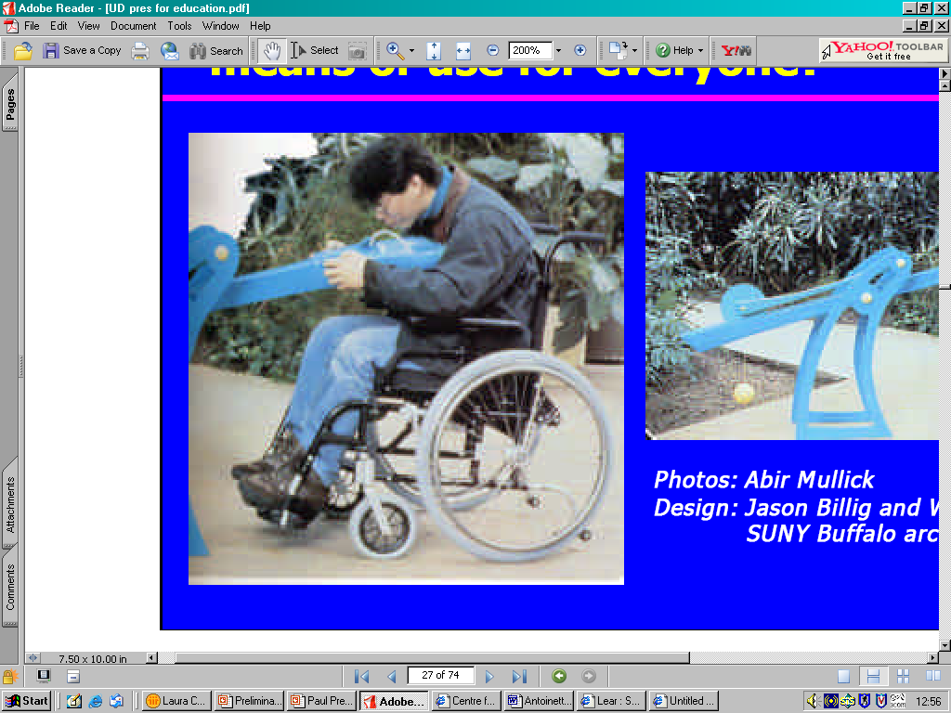
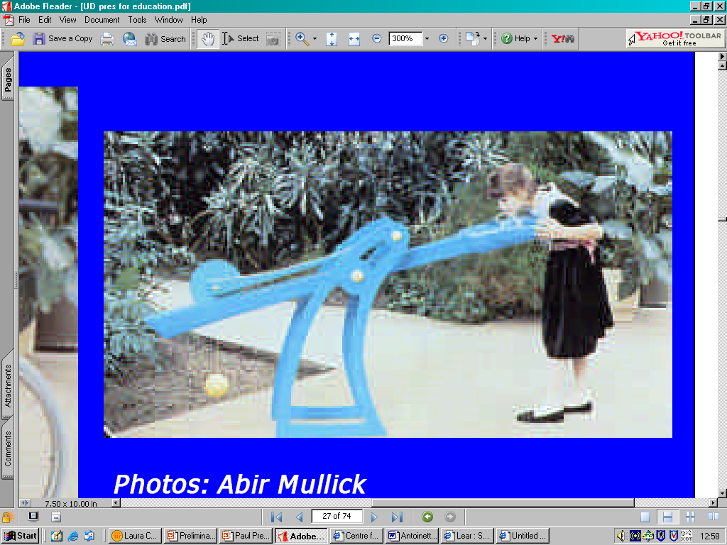
1: Equitable Use
Notes:
Principle1: Equitable Use: The design is useful and marketable to people with diverse abilities:
Does the design provide the same means of use for everyone?
The height adjustable drinking fountain offers choice for children, adults, wheelchair users and people of very tall and short stature to individualise the drinking height and become part of the larger public.
Unlike ‘accessible’ solutions that segregate users by providing two fountains side by side – one for standing users and one for seated users – this universally designed democratic solution offers the same opportunity to all people

Slide 27
Flexibility in Use

Slide 28
2: Flexibility in Use
Provide choice in method of use
Accommodate right-handed or left-handed access and use
Facilitate the user’s accuracy and precision
Provide adaptability to the user’s pace
Notes:
Principle 2: Flexibility in Use – The design accommodates a range of individual preferences and abilities.
Provide choice in method of use
Accommodate right-handed or left-handed access and use
Facilitate the user’s accuracy and precision
Provide adaptability to the user’s pace

Slide 29
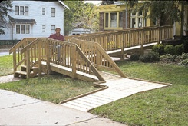
2: Flexibility in Use
Notes:
Principle 2: Flexibility in Use – The design accommodates a range of individual preferences and abilities.
This photo illustrates a building entrance that offers a ramp and stairs, providing equitable use and a choice of entry method.
While essential for a wheelchair or stroller user, a long ramp may be too fatiguing for an ambulatory older person and stairs may also be the choice of someone in a hurry who can walk.

Slide 30
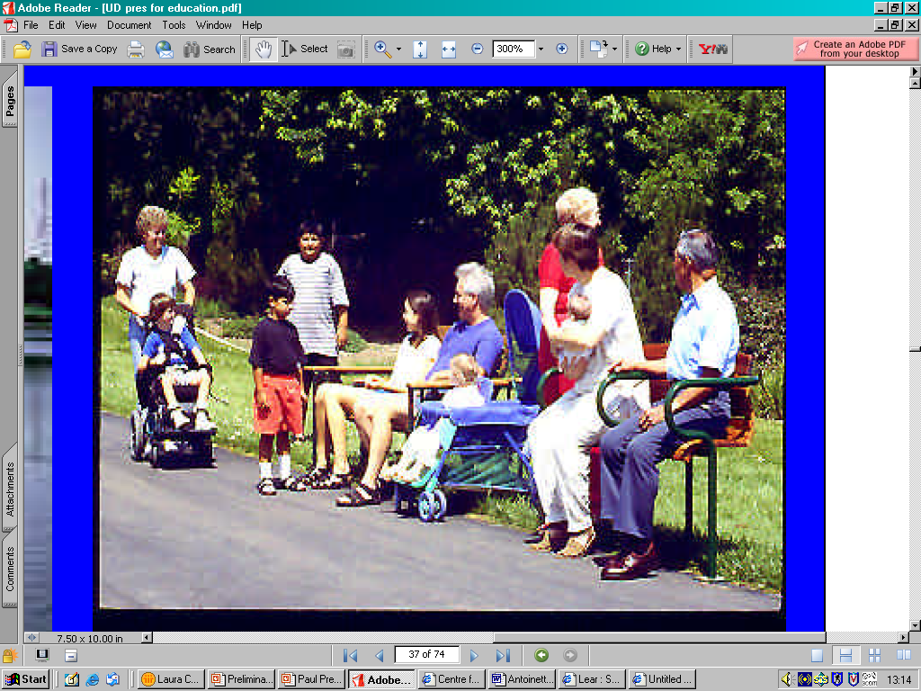
2: Flexibility in Use
Notes:
Principle 2: Flexibility in Use – The design accommodates a range of individual preferences and abilities.
Does the park seating accommodate individual preferences?
On the right, a child using a wheelchair joins a group of seated people on a wooden park bench.
There’s a mother with a baby in a pram, and an elderly person and a mother with a baby in her arms using a very high bench with arms to support sitting and standing.

Slide 31
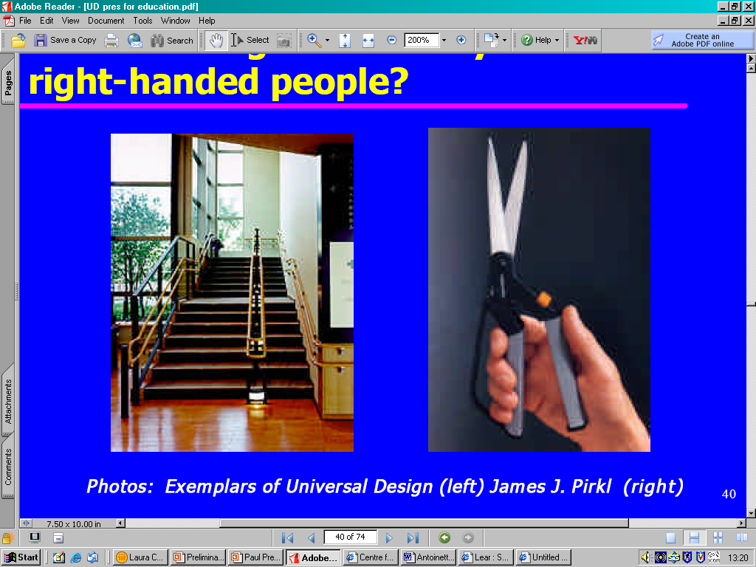

2: Flexibility in Use
Notes:
Principle 2: Flexibility in Use – The design accommodates a range of individual preferences and abilities.
Can the design be used by left and right-handed people?
The OXO Good Grips Swivel Scissors are used by grasping the non-slip rubber grip handles and by pulling back the spring loaded switch. They can be easily be used by right or left handed people and individuals who have low hand strength or arthritis. They have a swivel handle that absorbs a lot of the pressure from the users hands, which ensures that the scissors are comfortable even when cutting tougher materials.
In the image on the left, the standard stairway has a third handrail installed approximately 75cm away from the outer one., meaning the users can steady themselves by using either their right or left hand, or both hands. Lights have also been installed at foot level for safety and visibility. The level landing halfway up the flight of stairs gives people the opportunity to rest before proceeding, and there is seating installed on the top landing.

Slide 32
Simple and Intuitive

Slide 33
Simple and Intuitive
Eliminate unnecessary complexity
Be consistent with user expectations and intuition
Accommodate a wide range of literacy and language skills
Arrange information consistent with its importance
Provide effective prompting and feedback during and after task completion

Slide 34
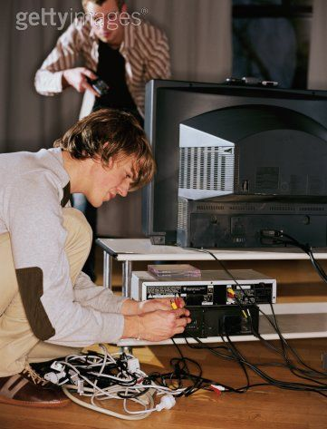
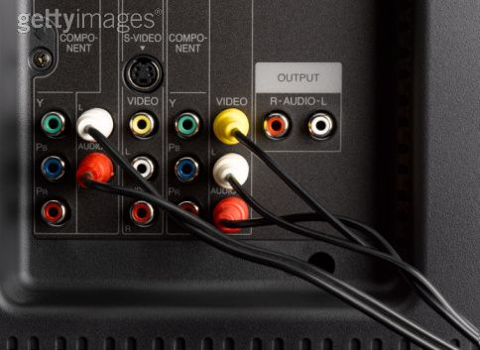
Simple and Intuitive
Notes:
Principle 3: Simple and Intuitive
Is it easy to understand? Can you make it work?
The photo on the right illustrates the back of a television with colour-coded plugs and receptacles that simplify installation.

Slide 35
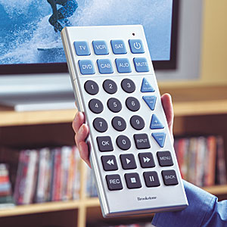
Simple and Intuitive
Notes:
Principle 3: Simple and Intuitive
Is it simple to use by most people?
With giant buttons, this extra-large remote is easy to use and impossible to lose. It is simple to program, and controls TV, VCR, DVD player, satellite, cable and auxiliary A/V device. The buttons are large and high-contrast, and glow in the dark, and are therefore useable by people with visual impairments and differently sized hands.

Slide 36
Perceptible Information

Slide 37
4: Perceptible Information
Use different modes (pictorial, verbal, tactile) for redundant presentation of essential info
Provide adequate contrast between essential information and its surroundings
Maximize ‘legibility’ of essential information and its surroundings
Differentiate elements in ways that can be described (i.e. make it easy to give instructions or directions)
Provide compatibility with a variety of techniques or devices used by people with sensory limitations

Slide 38
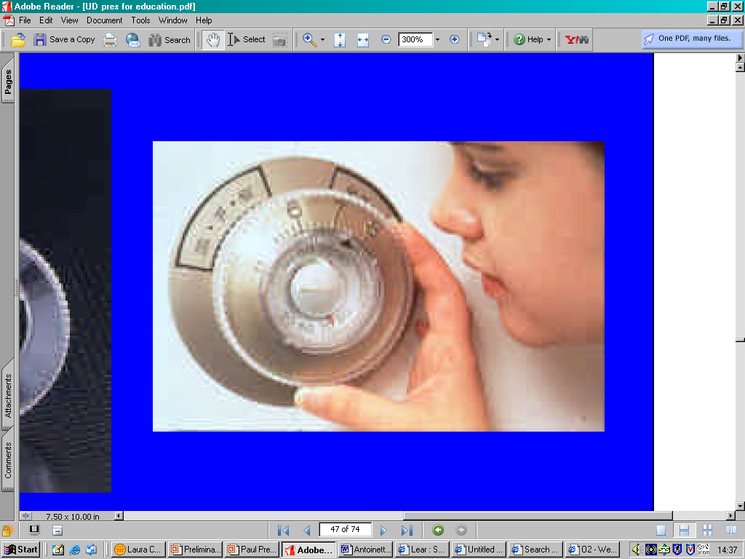
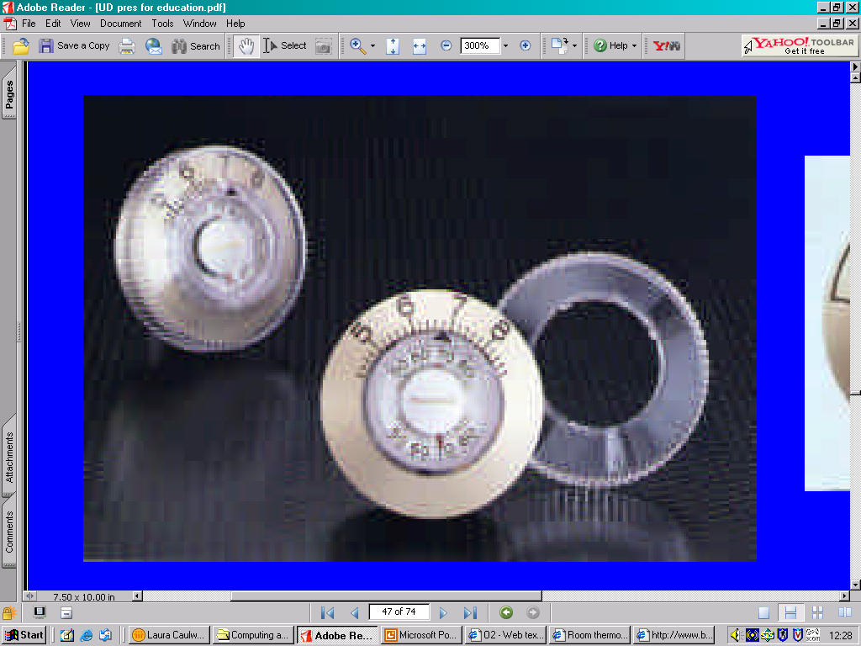
4: Perceptible Information
Notes:
Principle 4: Perceptible Information
Does the design use different modes for presentation?
The Honeywell thermostat in these two images provides tactile, visual and audible cues and instructions.
The numerals and arrow pointer are oversized and high contrast.
The clear outer ring cover has 3 dimensional indices that allow tactile feedback for users who may be blind and who rely on counting the degree increments to set the temperature.
The knob is course-knurled for secure gripping, and the thermostat can be positioned on the wall at any height for standing and seated users.

Slide 39
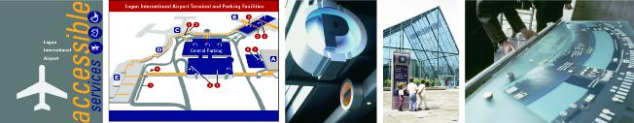
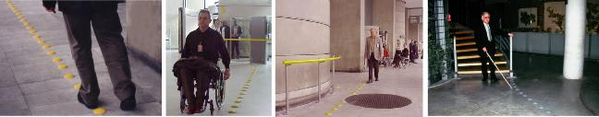
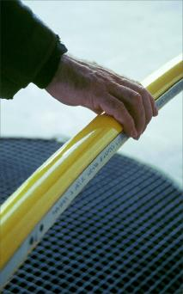
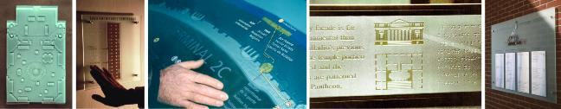
4: Perceptible Information
Notes:
Principle 4: Perceptible Information
Does the environment help you find your way?
Designer Coco Raynes created a wayfinding system in the Charles de Gaulle Airport in Paris, France.
It is intrinsically functional and multi-sensory but also compellingly attractive in design and stunningly executed.
Upon entering the terminal, the yellow raised floor markings can be followed visually, by foot or wheelchair, and make a sound when tapped.
The terminal is introduced with a simplified, tactile floor plan, on an information table angled to permit wheelchair access.
Raynes Rail is also installed, a braille and audio handrail system that makes public buildings, parks, transportation facilities and museums accessible to everyone. It contains multilingual audio units which are activated by photo sensors that do not require any physical strength or motor control. The Braille and audio messages provide directions, describe open areas, traffic patterns, and warn of ramps, stairs and turns. In museums, the audio provides cultural information.
Even though they’re attention grabbing in bright yellow, the handrails have no handicapped stigma.
All travellers benefit from this quality of attention to the critical role of orientation in public transit hubs.

Slide 40
Tolerance for Error

Slide 41
5: Tolerance for Error
Arrange elements to minimise hazards and errors: most used elements, most accessible; hazardous elements eliminated, isolated or shielded
Provide warnings of hazards and errors
Provide fail safe features
Discourage unconscious action in tasks that require vigilance

Slide 42
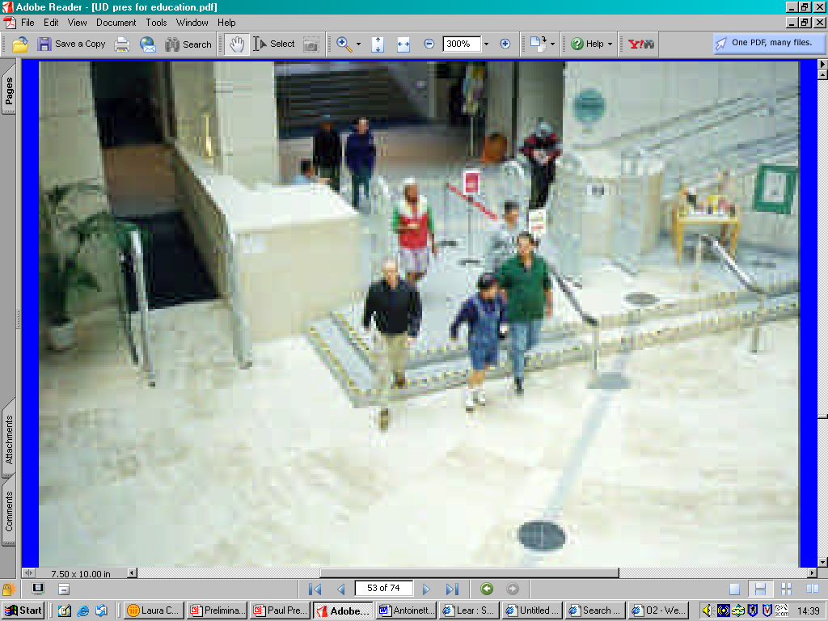
5: Tolerance for Error
Notes:
Principle 5: Tolerance for Error
Are there unexpected level changes?
This photo is of the entrance to a library.
There is a large and attractive skylight in the roof, which draws people’s attention.
People look up, and therefore don’t notice the 2 steps down in front of them, and stumble on the steps.
This problem has been tackled by putting stripy tape on the edges of the steps to draw attention to them.

Slide 43
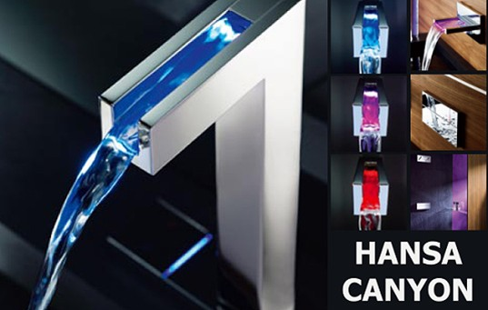
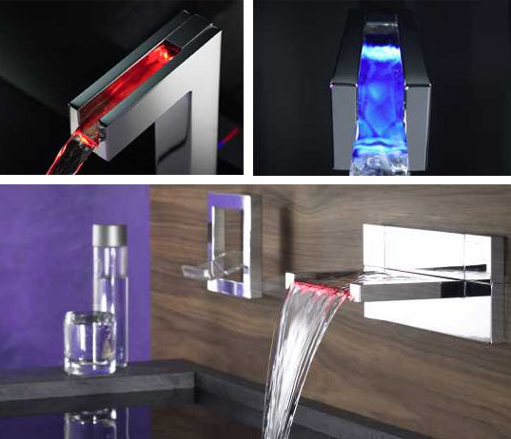
5: Tolerance for Error
Notes:
Principle 5: Tolerance for Error
How can you tell when the water is hot?
Hansa Canyon have designed these sleek faucets with water ‘canyons’.
These canyons are lined with LEDs that are temperature sensitive, and change colour accordingly.
They are blue for cold, pink for warm and red for hot.
It’s a very functional feature, and also a safety measure.
The colours can help prevent you from scalding yourself white washing your hands or stepping into a really cold bath.

Slide 44
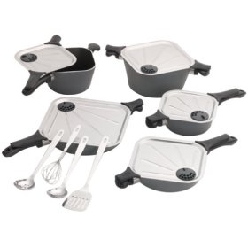
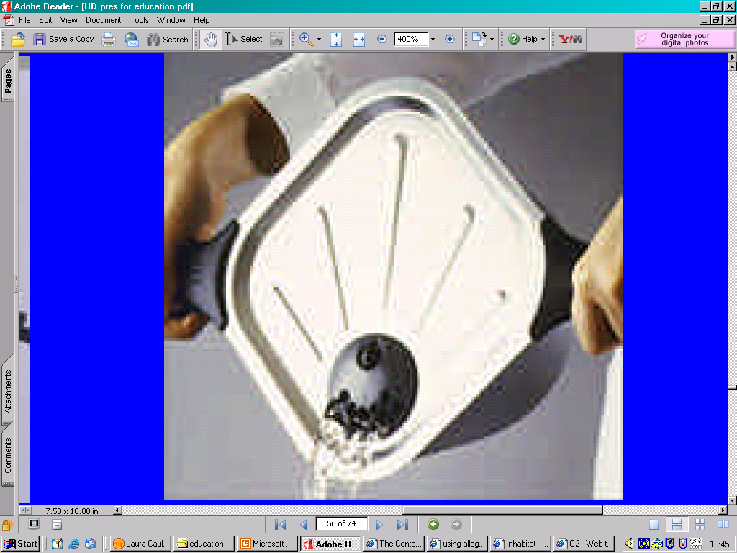
5: Tolerance for Error
Notes:
Principle 5: Tolerance for Error
Is it safe to handle?
Allegro cookware has a round base, to suit standard round heated sources.
However, the tops and lids have four corners, creating two natural poring spouts.
Handles located at the other two corners of the pot, align and lock with the lid handles, providing safe and balanced handling and pouring.
The flat lids contain steam vents, designed to prevent boiling over, and injuries caused by steam.
They also allow for easier and safer draining and straining while cooking.

Slide 45
Low Physical Effort

Slide 46
6: Low Physical Effort
Allow user to maintain a neutral body position
Use reasonable operating forces
Minimise repetitive actions
Minimise sustained physical effort

Slide 47
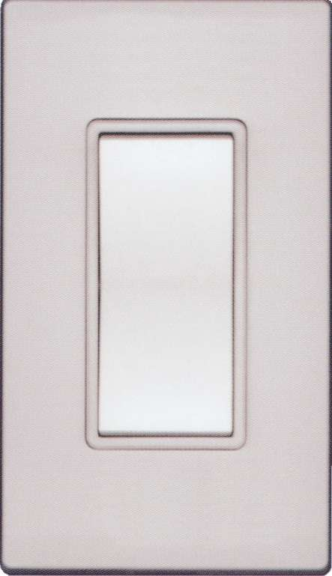
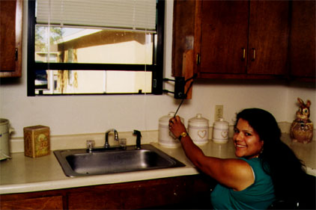
6: Low Physical Effort
Notes:
Principle 6: Low Physical Effort
Does the design help minimise the effort needed?
Leviton rocker switches on the left are much easier to use than toggle switches.
Lever door handles are much easier to use than round door knobs.
Windowease, seen in the image on the right, is a retrofit product that can be installed on any window.
It has been designed so that the operating crank is low, and in reach of most users, sitting or standing, and requires minimal force to turn.
Because of its intuitive design, children as young as 3 can use it, and it can be used with little or no instruction.

Slide 48
Size and Space for
Approach and Use

Slide 49
7: Size and Space for Approach and Use
Provide a clear line of sight to important elements for any seated or standing user
Make reach to all components comfortable for any seated or standing user
Accommodate variations in hand and grip size
Provide adequate space for the use of assistive devices or personal assistance

Slide 50
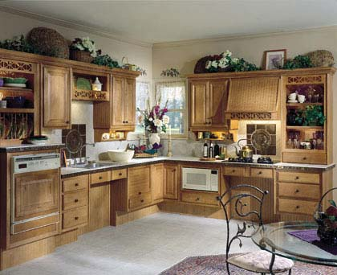
7: Size and Space for Approach and Use
Notes:
Principle 7: Size and Space for Approach and Use
Is there room to maneuver?
This kitchen offers work spaces, appliances and traffic lanes that are appropriate for all ages and capabilities.
This kitchen has clear floor spaces and knee spaces that offer ease of movement and maneuverability for people in wheelchairs or scooters, and room for several people to share in meal preparation.

Slide 51
Conclusions
Diversity is the norm
Universal design celebrates human differences
Universal design markets usability, not disability
Ageing consumers have great economic power
Universal design offers a blueprint for designing a world fit for all people
Universal design recognises the interdependence of humanity, the natural world, and the products of human design

