Slide 1
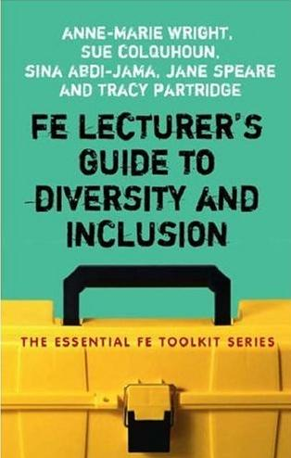
Universal Design for Learning:
Diverse Learners

Slide 2
Learners
Speakers of Other Languages
Gender
Emotions
Age
Neurodiversity
Dyslexia

Slide 3
Speakers of Other Languages
People for whom English is their second language
  ESOL – English for Speakers of Other Languages
  ESL – English as a Second Language
  EAL – English as an Additional Language
  ESP – English for Special Purposes
  EAP – English for Academic Purposes

Slide 4
Teaching English

Slide 5

Teaching English

Slide 6
History of Language Learning
Early theories of language learning suggested that there is only a limited capacity in the brain for language learning, and the more of a second language you learn, the more you forget your first language!
Although a body of research shows that this is not at all the case, nonetheless some people still see this as “commonsense”
It fact the contrary is true, the better you speak one language, the easier you will find it to learn another
Baker, C. (2002) Foundations of Bilingual Education and Bilingualism. Third Edition. Clevedon

Slide 7
Valuing Multilingualism
Multilingualism can be a real asset in the classroom and teachers need to find the benefits of it for all students in the classroom
Draw on the cultures, languages, experiences of all students in the classroom

Slide 8
Some Suggestions
Use short sentences
Avoid Idioms, colloquialisms, and figurative language,
  E.g. “raining cats and dogs”, “chalk and cheese”, “turning your nose up”
Consider the use of technical terms that have an alternative common meaning
  E.g. “Mouse” (computer, rodent), Weight (Mass, Force), Artefacts (distortions on video, stuff)

Slide 9
Some Suggestions
Identify anecdotes and digressions
  Students may not be able to distinguish
When speaking try to avoid words with similar sounds
  “Cheap” and “Chic”
  “Thirteen” and “Thirty”
  “Fridge” and “Fringe”

Slide 10
Gender Issues
Differences that are socially constructed and often taken for granted in society
And may vary from culture to culture
How does gender influence the roles people take and what can educators do to challenge these assumptions?

Slide 11
Gender Issues
How does gender operate within different specialisms?

Slide 12
Gender Issues
How does gender operate within different specialisms?
Computer Science

Slide 13
Gender Issues
How does gender operate within different specialisms?
Computer Science
Ambient belonging: How stereotypical cues impact gender participation in computer science. Sapna Cheryan, Victoria C. Plaut, Paul G. Davies, Claude M. Steele. Journal of Personality and Social Psychology 2009; 97(6): 1045-1060.

Slide 14
Gender Issues
Things to consider (1/2)
  How well balanced is the distribution of gender in your:
    Group
    Teaching team
    Labour market
  Where is the course advertised?
  What kind of language is employed?

Slide 15
Gender Issues
Things to consider (2/2)
  Is there childcare available?
  Are staff trained in gender equality?
  Is there contacts with those working in a labour market?

Slide 16
Emotions
Emotional state effects learning
It would be wonderful to imagine that learning is purely an intellectual pursuit, but your emotions have a very significant impact on your learning

Slide 17
Emotions
The behaviouristic view would have it that emotions are merely forms of behaviour and have no inherent rationale.
From a humanistic perspective (Carl Rogers) new ideas can sometimes be threatening to students therefore it is important for the teacher to form a relationship with the students.

Slide 18
Emotions
Teachers must try to take account the “emotional climate” of the class
  What is the morale like?
  How is conflict and dissent handled?
  What are the beginnings and ends of class like?
Always respect feelings no matter how inappropriate they may appear.
Don’t be afraid to include students emotions in the classroom, “How do you feel about…?”

Slide 19
Age
Consider the potential diversity of age range in your classroom, are there any younger or older than typically expected ranges in the classroom ?
How does it affect your “duty-of-care”?
And contractual responsibilities ?

Slide 20
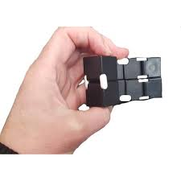
Neurodiversity
Multi-Sensory Teaching Approaches
  Use visual aids (diagrams, color coding, mind maps).
  Incorporate audio (recorded lectures, text-to-speech tools).
  Provide kinesthetic activities (hands-on learning, movement breaks).
  Allow for tactile learning (manipulatives, textured materials).

Slide 21
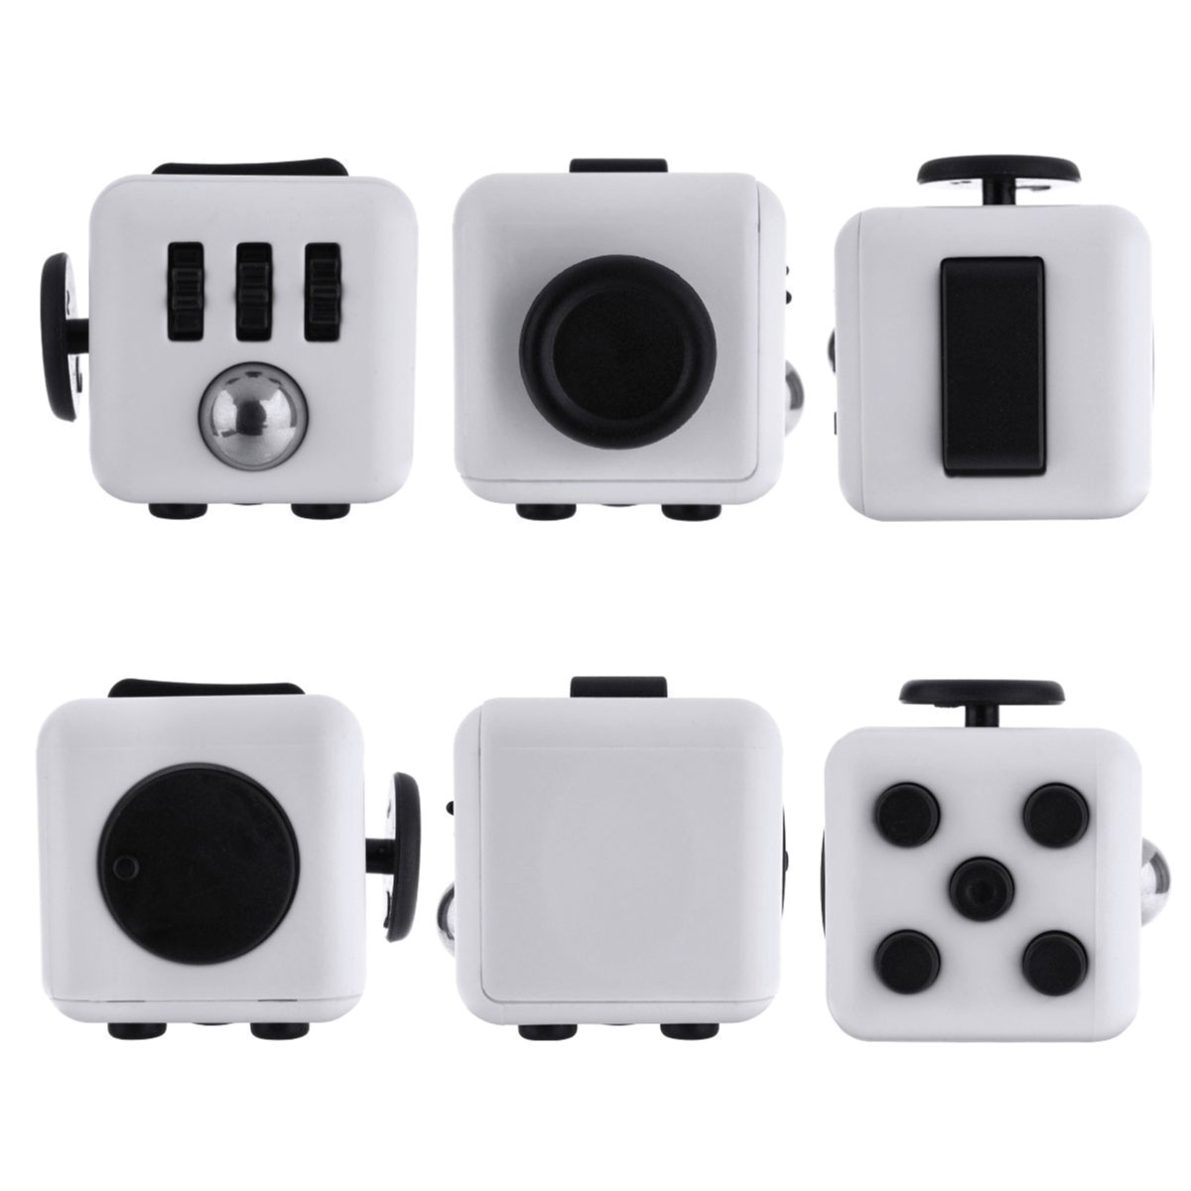

Slide 22
Neurodiversity
Clear, Structured Instruction
  Break content into small, manageable steps.
  Provide clear, concise instructions (both verbal and written).
  Use checklists and schedules to help students stay on track.
  Set consistent routines to reduce anxiety.

Slide 23
Neurodiversity
Flexible Assessments & Assignments
  Offer multiple ways to demonstrate understanding (oral presentations, projects, written assignments).
  Allow extra time for processing and task completion.
  Use alternative grading methods, such as pass/fail or weighted assignments.

Slide 24
Dyslexia
Very misunderstood
Many theories
Inner-ear issues ?
May have issues with
  Spelling
  Reading
  Writing

Slide 25
Dyslexia
READING
  If you are using new or complex terminology, make sure you explain it, or it is clear from the context of the sentence around it.
  Sometimes students are so focused on understanding each work, they can miss the meaning of the sentence or skip a line in the middle of the sentences
    Keep sentences short !

Slide 26
Dyslexia
SPELLING
  DARTs: Directed Activities for Reading Texts, activities involving highlighting, cutting-and-pasting and moving around enlarged text
  Where possible use visual information as well as text
  Help learners devise their own pictures and diagrams

Slide 27
Dyslexia
WRITING
  LSCWC: Look, Say, Cover, Write, Check
  Use word processing, and spell-check
  Use dragon dictate

Slide 28
Robin Brewer
University of Michigan
An Intersectional Approach to Designing for Disability
February 10, 2023

Slide 29
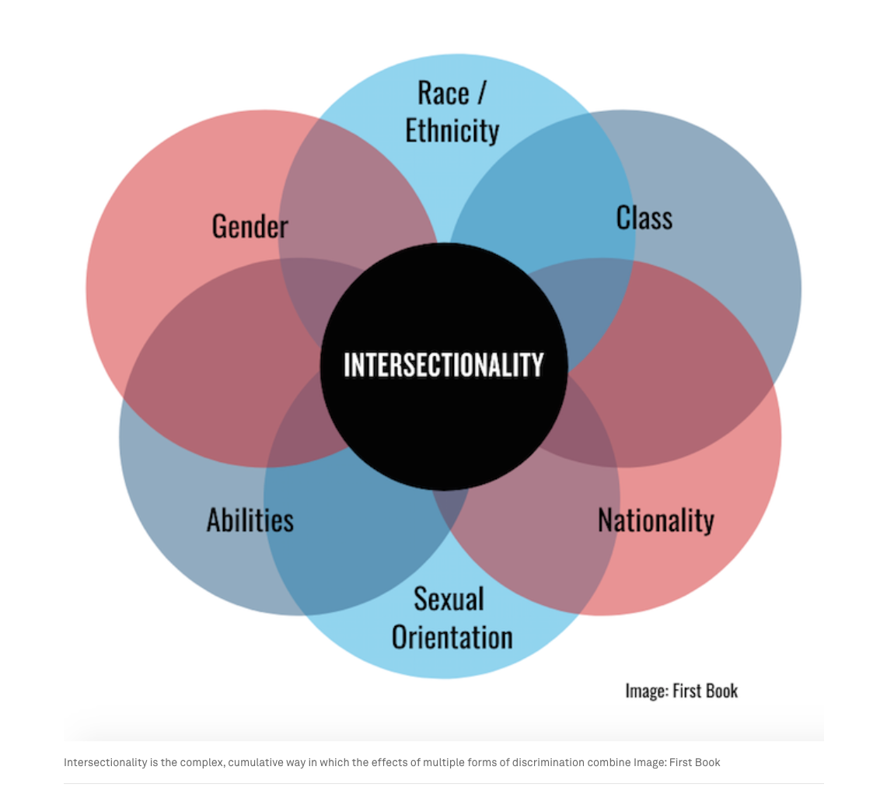

Slide 30
Irish Equal Status Act 2000

Slide 31
Equal Status Act 2000
Gender
Marital
status
Family
status
Age
Disability
Sexual orientation
Race
Religion
Membership of the Traveller community

