Slide 1
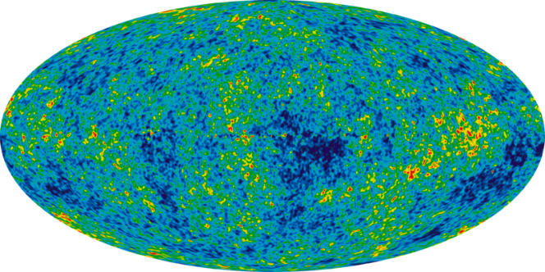
An Introduction to Universal Design for Learning
Damian Gordon

Slide 2
Module Overview
Universal design is a philosophy which guides designers to consider all users when designing any product or service, and to provide all users with identical use whenever possible, or at the very least equal use. The philosophy is made concrete through the Principles of Universal Design, compiled by researchers at North Carolina State University.

Slide 3
Module Overview
Though initially linked closely to the fields of architecture, built environment, ergonomics and product design, the philosophy of Universal Design has now gained relevance across a much broader set of domains, in many cases supplementing an already rich understanding of accessibility, and user-centred design, but in other cases it has been responsible for developing ab initio an interest in diversity and universality in design.

Slide 4
Module Overview
In the education domain Universal Design for Learning (also known as Universal Design for Education) focuses on the design and development of learning materials and learning activities in such a way that there are:
Multiple means of representation that give learners various ways of acquiring information and knowledge
Multiple means of expression that provide learners alternatives for demonstrating what they know
Multiple means of engagement that tap into learners' interests, challenge them appropriately, and motivate them to learn.

Slide 5
Module Overview
The history of education has seen technologies (from low-tech, to medium-tech, to hi-tech) that provide a steadily increasing number of learners with new opportunities for understanding and innovating. Online technologies and smartphones are blurring the cultural, political and social barriers that have existed heretofore, allowing people to understand issues from a global perspective and are at the same time redefining knowledge as an increasingly relativistic concept.

Slide 6
Module Aims
The aims of this module are to:
Motivate students to examine designs from the perspective of the user at the extremes of human ability, rather than designing for the average user.
Provide students with the knowledge and skills to produce universal design and development of educational content.
Critically assess designs, regulations, legislation and standards for their adherence to the principles and philosophy of universal design.

Slide 7
Learning Outcomes
On successful completion of this module the learner will be able to:

Slide 8
Learning Outcomes (1of 6)
Demonstrate a clear understanding of the philosophy and principles of Universal Design for Learning and how they relate to a variety of educational standards, regulations and guidelines.

Slide 9
Learning Outcomes (2 of 6)
Critically assess designs for existing educational content according to the principles and philosophy of Universal Design for Learning.

Slide 10
Learning Outcomes (3 of 6)
Critically review relevant literature, including legislation, policy, directives, academic journals and industry standards to direct the development of guidelines and assessment of designs.

Slide 11
Learning Outcomes (4 of 6)
Identify the connections between gender, age, internationalisation and affective state and the study of Universal Design for Learning.

Slide 12
Learning Outcomes (5 of 6)
Select and employ appropriate teaching and learning methods for specific Universal Design contexts.

Slide 13
Learning Outcomes (6 of 6)
Select and employ appropriate technologies (including potentially adaptive or augmentative devices) for a defined Universal Design for Learning scenario.

Slide 14
Universal Design for Learning
Damian Gordon

Slide 15
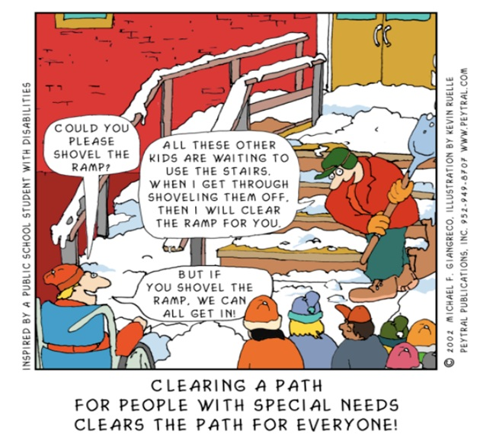
Universal Design

Slide 16
Universal Design for Learning
In the past we would plan our lessons based on the average student's needs...

Slide 17
Universal Design for Learning
We often taught as though all students had the same needs...

Slide 18
The reality is that all children are unique and teachers are now expected to meet the needs of diverse learners within their classrooms. We cannot continue to teach in the same ways we did in the past and expect to meet the diverse needs of our learners.

Slide 19
What is Universal Design for Learning?
Universal Design for Learning (UDL) is a research-based framework for designing curricula—that is, educational goals, methods, materials, and assessments—that enable all individuals to gain knowledge, skills, and enthusiasm for learning.
This is accomplished by simultaneously providing rich supports for learning and reducing barriers to the curriculum, while maintaining high achievement standards for all students.

Slide 20
UDL Guidelines

Slide 21
UDL Guidelines
UDL Guidelines suggests:
Multiple means of Representation: To give learners various ways of acquiring information and knowledge,
Multiple means of Expression: to provide learners alternatives for demonstrating what they know
Multiple means of Engagement: to tap into learners' interests, offer appropriate challenges, and increase motivation.

Slide 22
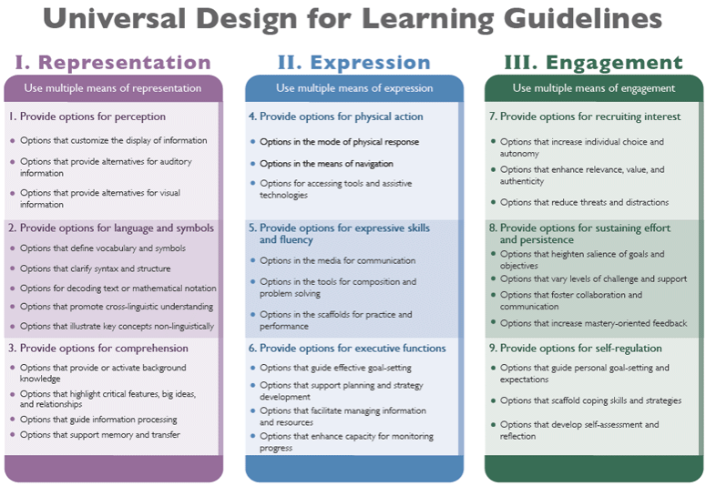

Slide 23
People in Design
Damian Gordon

Slide 24
People in Design
What is a system view?

Slide 25
People in Design
What is a system view?
The System is a box...
System

Slide 26
People in Design
What is a system view?
The System has inputs...
System
Inputs

Slide 27
People in Design
What is a system view?
The System has outputs...
System
Inputs
Outputs

Slide 28
People in Design
What is a system view?
and a number of interacting processing, that convert inputs into outputs.
Inputs
Process 1
Process 4
Outputs
Process 2
Process 5
Process 3

Slide 29
People in Design
So how do this work for a person?

Slide 30
People in Design
So how do this work for a person?

Slide 31
People in Design
Exactly the same way

Slide 32
People in Design
Exactly the same way
Inputs

Slide 33
People in Design
Exactly the same way
Inputs
Perception

Slide 34
People in Design
Exactly the same way
Sight
Hearing
Taste
Smell
Touch
Inputs
Perception

Slide 35
People in Design
Exactly the same way
Sight
Hearing
Taste
Smell
Touch
Inputs
Perception
Outputs

Slide 36
People in Design
Exactly the same way
Sight
Hearing
Taste
Smell
Touch
Inputs
Perception
Outputs
Action

Slide 37
People in Design
Exactly the same way
Sight
Hearing
Taste
Dexterity
Locomotion
Reach
Smell
Touch
Inputs
Perception
Outputs
Action

Slide 38
People in Design
Exactly the same way
Sight
Hearing
Taste
Dexterity
Locomotion
Reach
Smell
Touch
Inputs
Perception
Interacting Processes
Outputs
Action

Slide 39
People in Design
Exactly the same way
Sight
Hearing
Taste
Dexterity
Locomotion
Reach
Smell
Touch
Inputs
Perception
Interacting Processes Cognition
Outputs
Action

Slide 40
People in Design
Exactly the same way
Sight
Hearing
Taste
Dexterity
Locomotion
Reach
Smell
Touch
Inputs
Perception
Interacting Processes Cognition
Outputs
Action
Attention
Memory
Language

Slide 41
People in Design
Exactly the same way
Sight
Hearing
Taste
Dexterity
Locomotion
Reach
Smell
Touch
Inputs
Perception
Interacting Processes Cognition
Outputs
Action
The WHAT of learning:
REPRESENTATION
Attention
Memory
Language

Slide 42
People in Design
Exactly the same way
Sight
Hearing
Taste
Dexterity
Locomotion
Reach
Smell
Touch
Inputs
Perception
Interacting Processes Cognition
Outputs
Action
The WHAT of learning:
REPRESENTATION
The HOW of learning:
ENGAGEMENT
Attention
Memory
Language

Slide 43
People in Design
Exactly the same way
Sight
Hearing
Taste
Dexterity
Locomotion
Reach
Smell
Touch
Inputs
Perception
Interacting Processes Cognition
Outputs
Action
The WHAT of learning:
REPRESENTATION
The HOW of learning:
ENGAGEMENT
The WHY of learning:
ACTION/EXPRESSION
Attention
Memory
Language

