Slide 1
Notes:
Notes:
Notes:

Slide 2
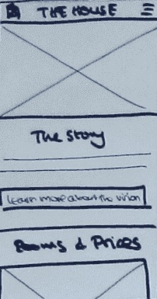
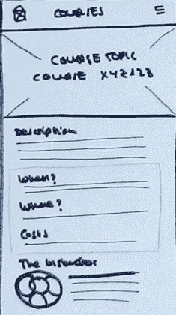
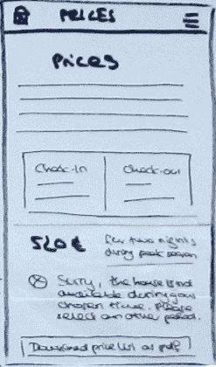
Notes:
Home page
Notes:
Course page
Notes:
Shopping page

